Slide 1
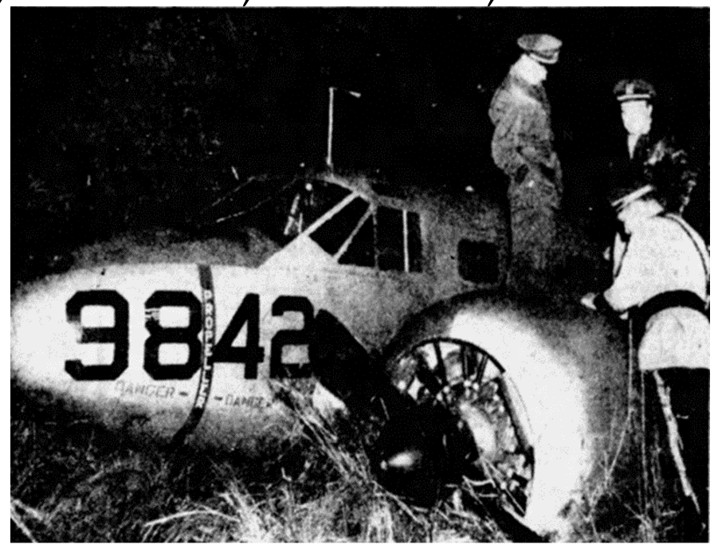
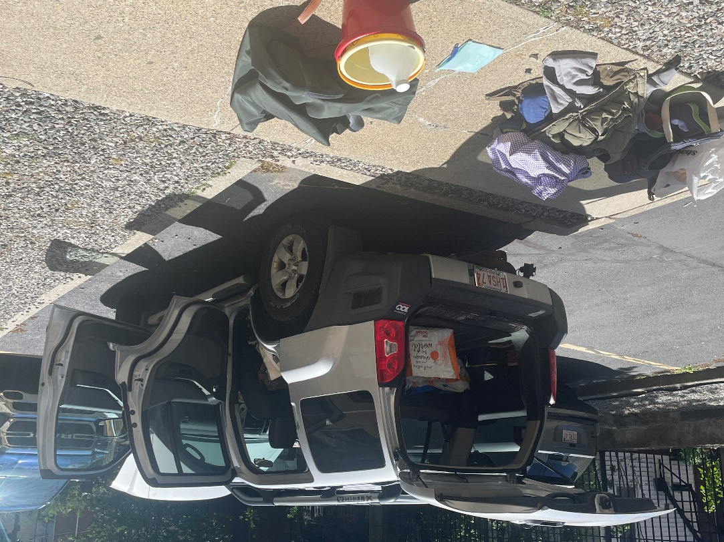
WARPLANES LOST AND FOUND IN wwii RI AREA
Capt. Eric Troels Wiberg, Esq.
United States Naval Sea Cadet Corps, Falcon Division, 1 Narragansett St, Cranston, RI
Sat. Feb. 8, 2025, 2-2.30/2.45pm

Slide 2
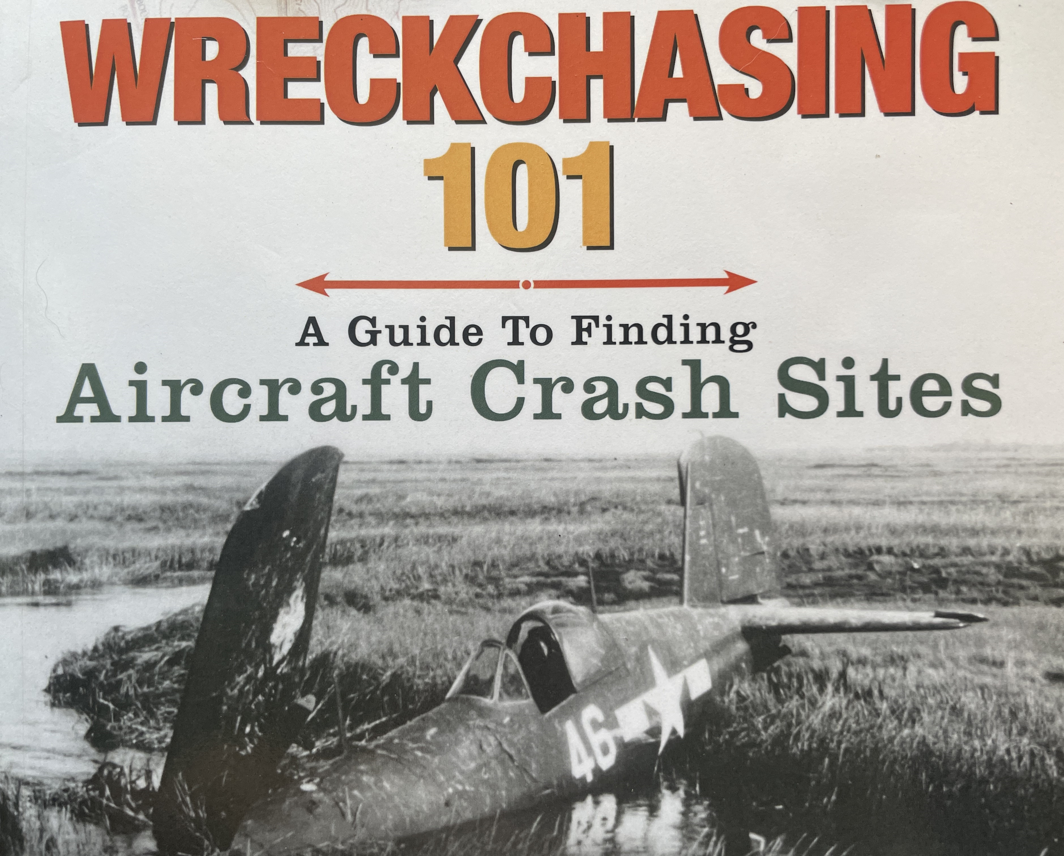

Slide 3
Overview:
Did you realize that in New England there are so many aircraft wrecks, both military and civilian, that on average there is one every 35 miles of land? That is because historians like Jim Ignasher of New England Aviation History.com and Larry Webster in Rhode Island have identified close to 2,000 air accidents, from losing a wheel to total destruction or missing in the oceans.
In Rhode Island there are at least 500 military accidents, starting in World War II, and some 150 civilian wrecks from 1906 to recent times. Minimum.
In Massachusetts there are at least 375 military and 301 civilian airplane mishaps, with over 150 occurring on Cape Cod or surrounding seas and islands. Last year Eric spent many months finding a dozen and documenting nearly 200 other WWII aircraft in Bahamas. Now he shares his focus on women pilots, Cold War warriors, and lone fighter pilots who ditched in the cold Atlantic, or into ponds and marshes and road near us.

Slide 4
Why (and why not) find historic aircraft?
A conundrum: a bit crazy to do this, and a bit crazy not to….
The aircraft are an amalgam of tragedy, honor, mystery, ‘just metal,’ engineering, sleuthing. Finding them provides personal satisfaction, an opportunity to meet folks with local knowledge and hear their stories on instantly-common interests, and a wonderful way to get outside and engage with nature, urban and all other environments, places, wildlife.
On the negative side are bear traps, all bodies of water and mud, trespassing dangers (shotguns, fences, gates, barbed wire), cold, dark, storms, wrong information, loss of batteries, signal, threat of being chased off land or water, many days searching alone with never finding anything, vulnerability, boredom and did I mention bear traps?

Slide 5
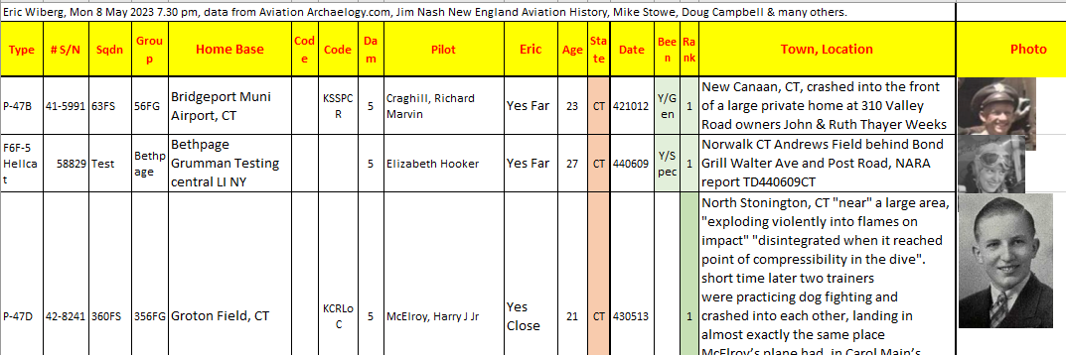
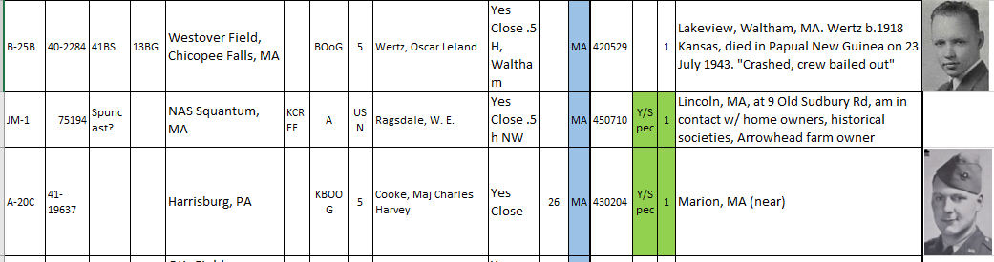
Thanks to Jim Ignasher, New England Aviation History

Slide 6
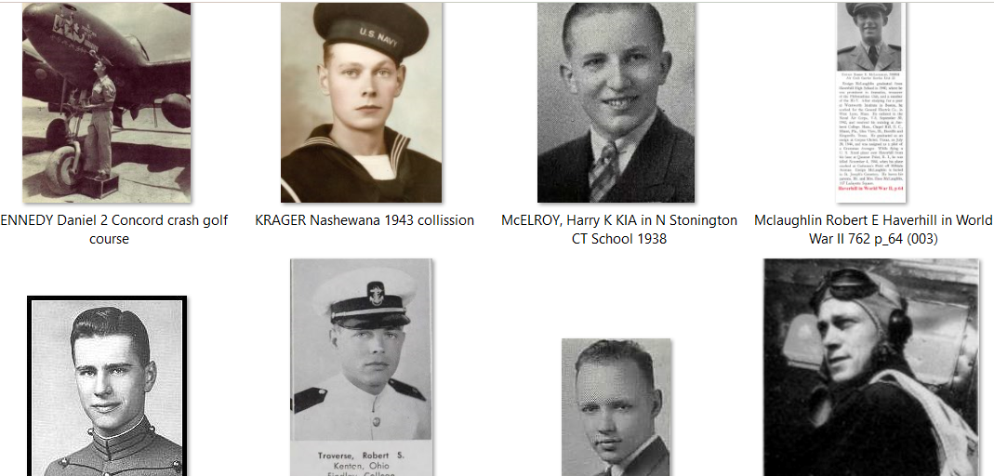
Who Were The Missing?

Slide 7

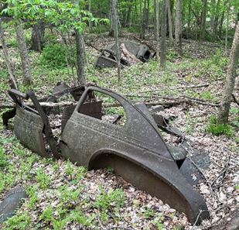

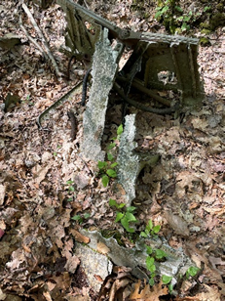

Where and How to Look for Them? Notes:

Slide 8
Young Asplund’s Aircraft into a Nearby Pond
The reason I write with this esoteric historical information is that Davisville Middle School abuts Sawmill Pond and on 22 April 1944 a Navy fighter plane piloted by Oswald Eugene Asplundh landed in the same Sawmill Pond following a training accident and fatal collision. The plane is said to have “crashed and burned to the waterline in Sawmill Pond.” This per my esteemed colleague historian of NewEnglandAviationHistory.com Jim Nash of RI. By way of background, I am an educator, historian, graduate or Roger Williams and URI, now based in Boston.
The reason I write is to ask whether you or any colleagues or students know of any sightings of a plane or plane parts in Sawmill Pond over the years and whether there is any institutional history or memory of same at Davisville Middle School? I was in Providence College archives last week and received the below amplifying information.
The founder of MAR / Marine Aviation Research my niche is finding historic planes on a very small budget – no SCUBA, no boat, no plane, no metal detector. Using just a mask and boots I found a jet in Johns Pond Mashpee MA as you can see at https://www.capenews.net/mashpee/news/chunk-of-1940s-fighter-jet-may-have-been-found-in-johns-pond/article_a27d576d-c36b-578c-a970-b0378edc5cf6.html.
It would seem this plane meets the criteria and thankfully the remains of Ens. Asplundh have been removed and buried long ago. Often just metal frames and parts remain. Do you know of any floating rafts or the depths of the pond or whether anyone uses it or how someone like me (public) might access it? I’ve been going after a plane in the ocean off Jamestown RI and this is not far from there,

Slide 9
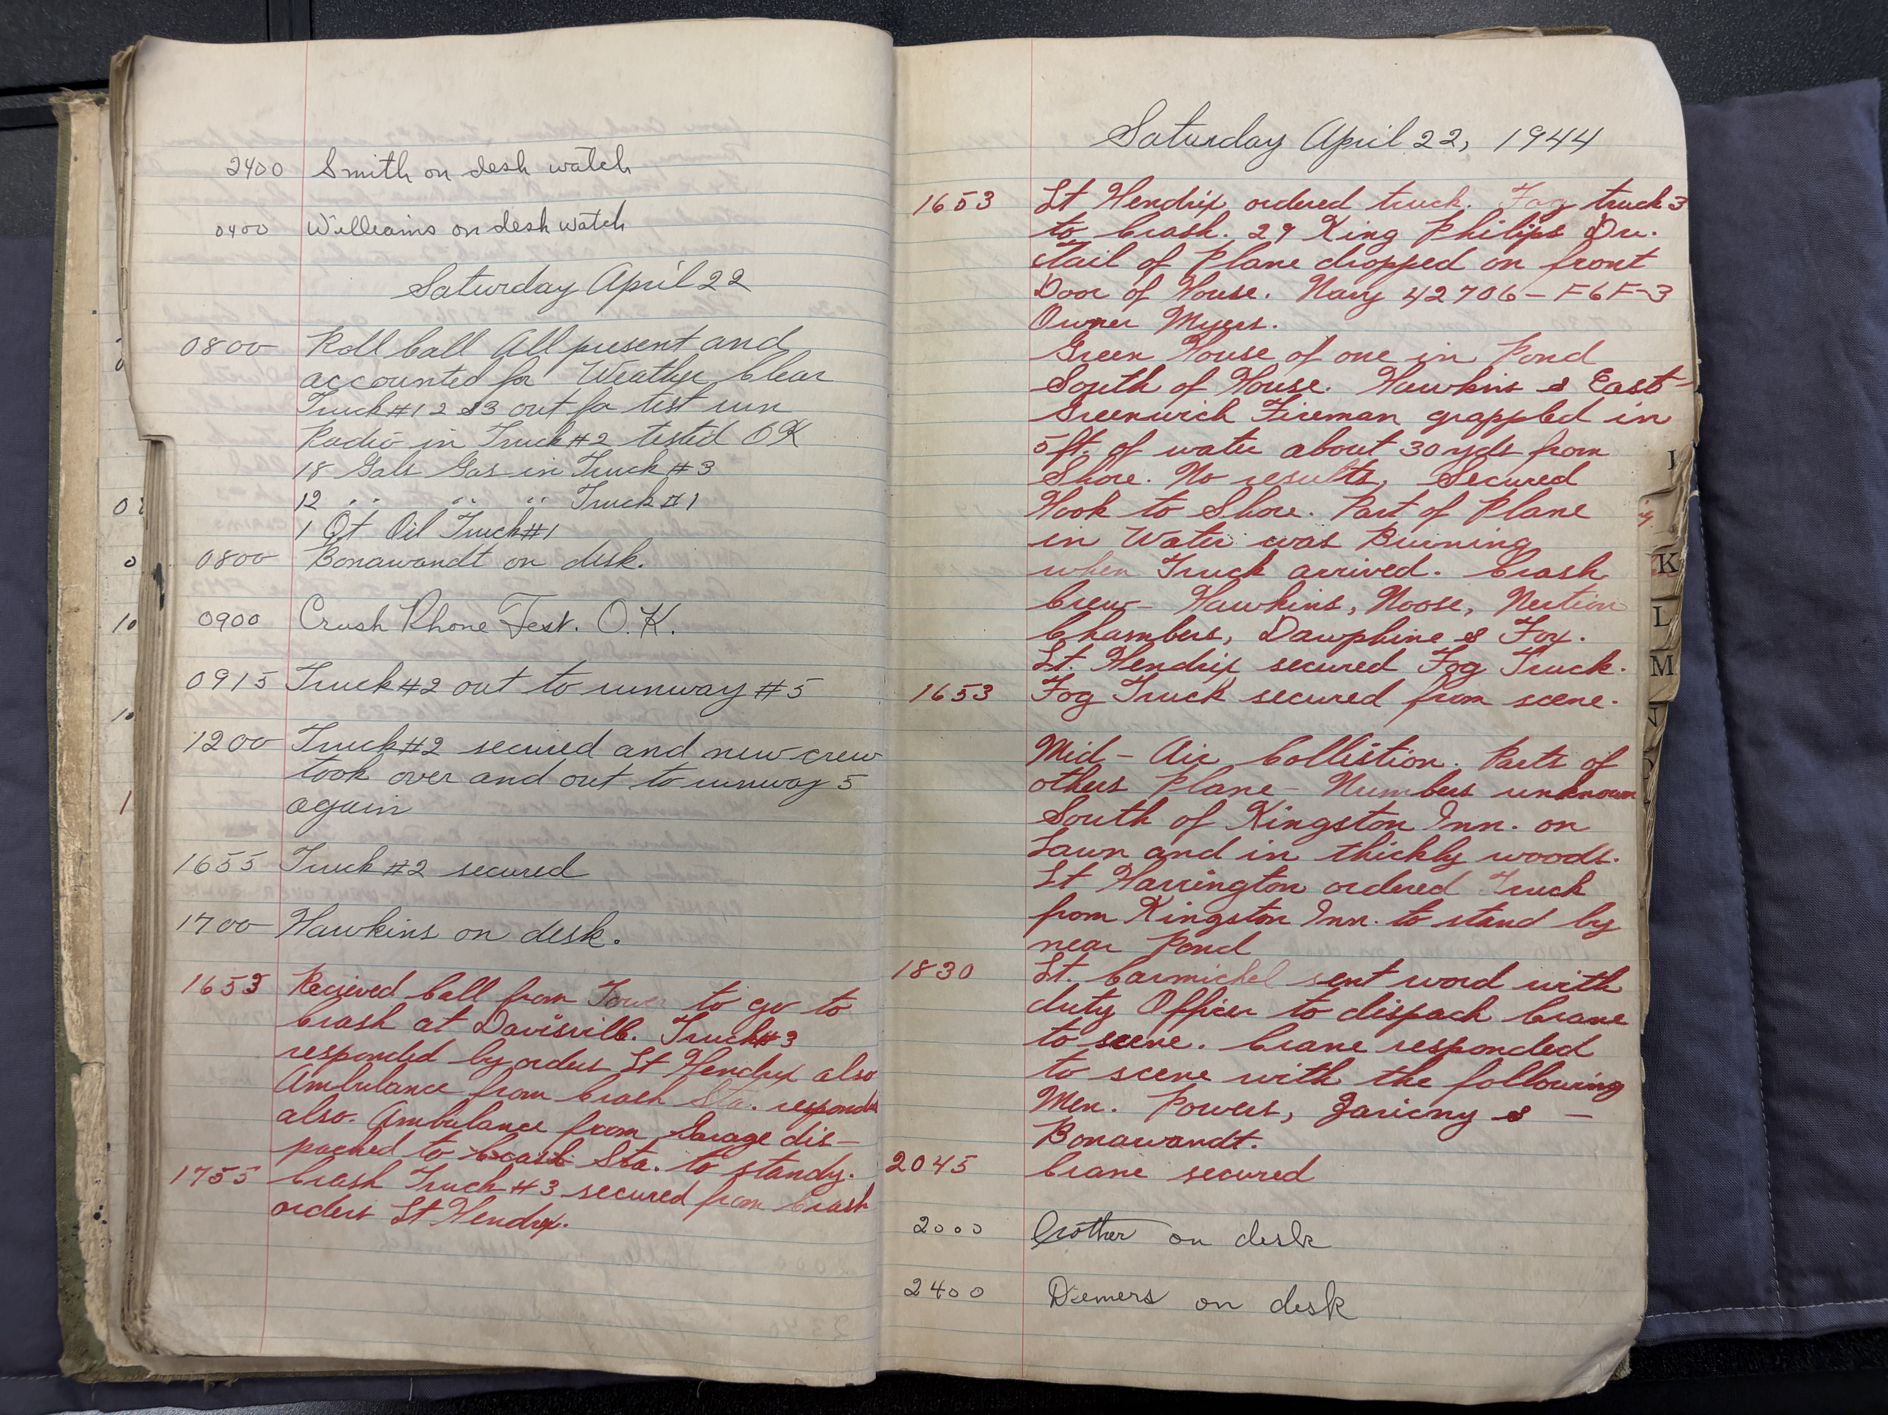
Where planes are “really” often found – in archives first. It requires leg work in libraries as well as in the field/s and streams, and determination – I looked for 45 planes in New England and aside from little traces didn’t find my first parts for a year.

Slide 10
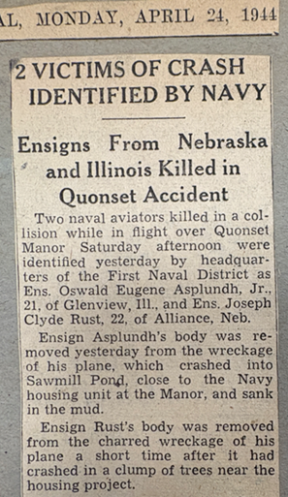
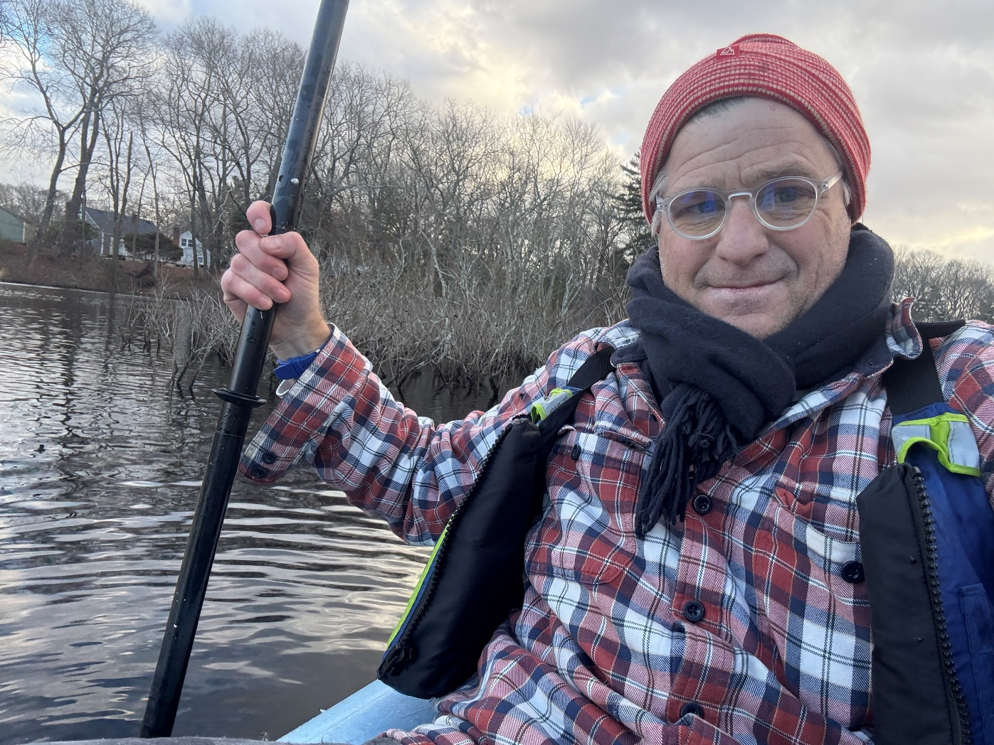

Slide 11
British Royal Navy Aviators’ Graves in Newport Farewell St. near U-boat Germans
Their “base” was a fictional office, not a ship
They crashed and died, from Britain in RI w/ no ship, in Tiverton, Quonset – all over. I visited a graveyard with the Vicar on a tractor
An RAF plane went up on its nose and the USN rescue watched as the pilot without any help pulled its tail down to earth and taxied to hangar
Some of the pilot’s planes wrecked in Mackerel Cove, the propellers are near shore.
On D-Day a PV-1 Ventura with the inventor of the forensic fingerprint crashed off Jamestown killing pilot Sullivan and all 8 on board on a secret to Europe via Nantucket. Took off from Quonset. Records at Providence College

Slide 12
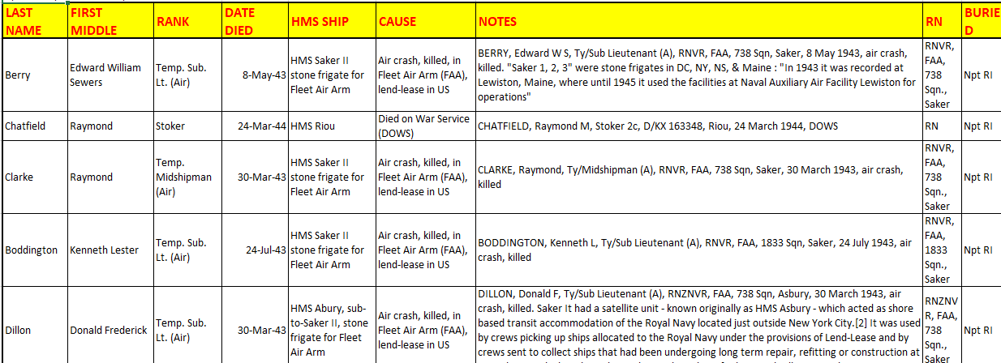
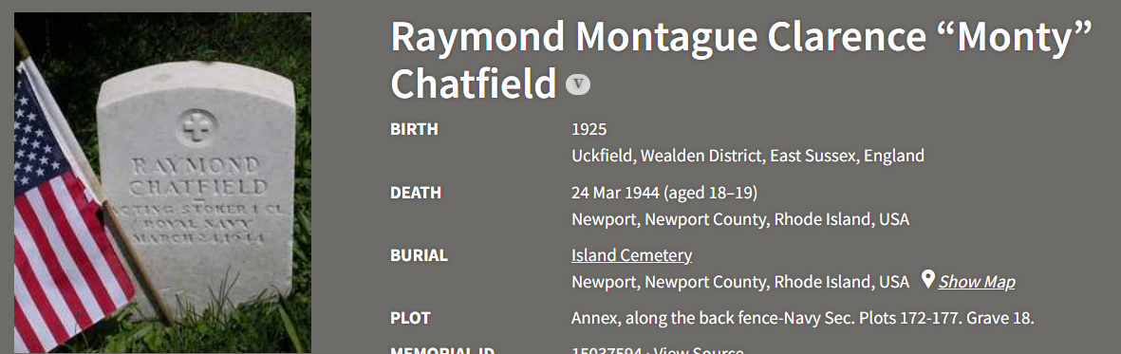

Slide 13
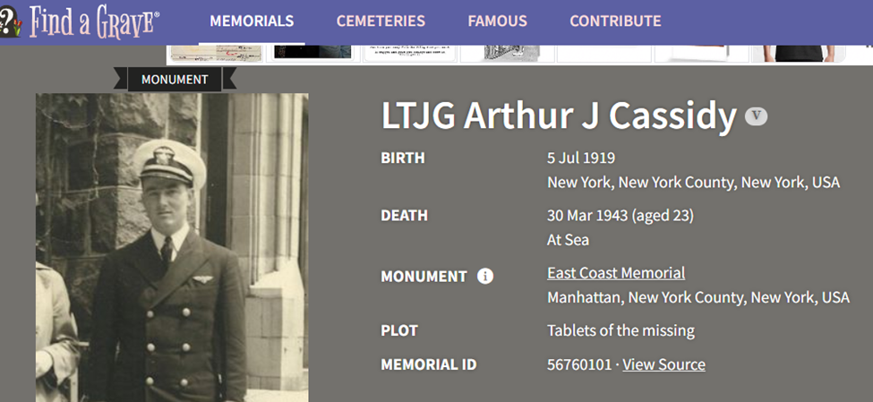
Young Cassidy ordered to fly to land in storm, heard over Providence, never found – can anyone help? For decades he has been searched for…..

Slide 14
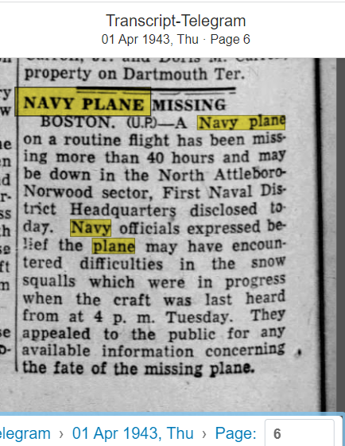
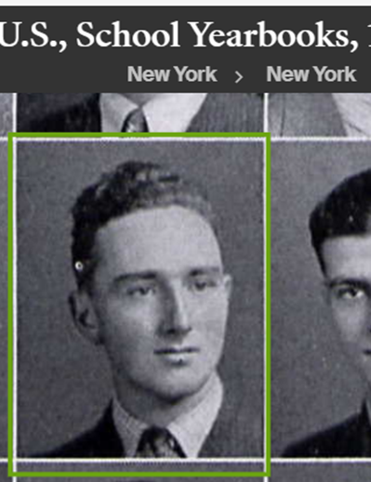
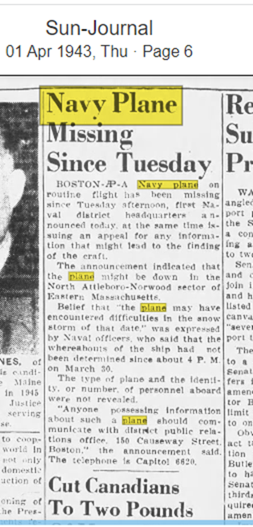
The Case of Cassidy over North Providence

Slide 15
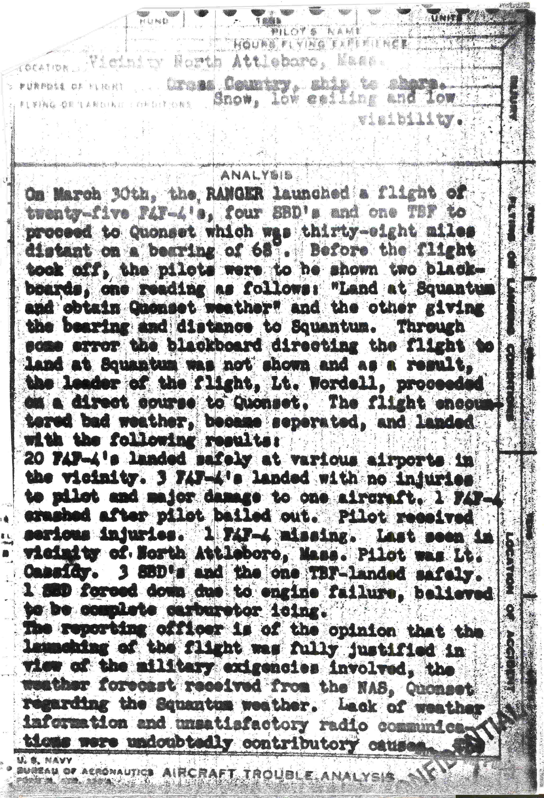
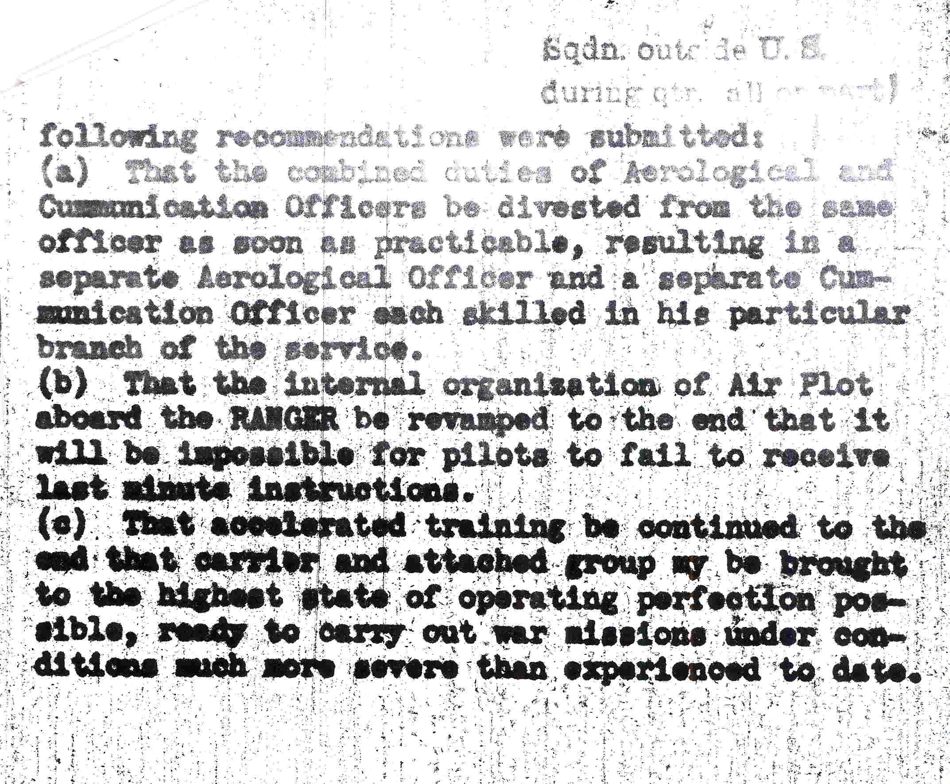
USS Ranger an Aircraft Carrier was at Quonset

Slide 16
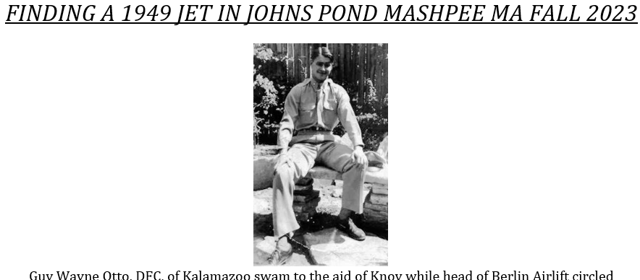

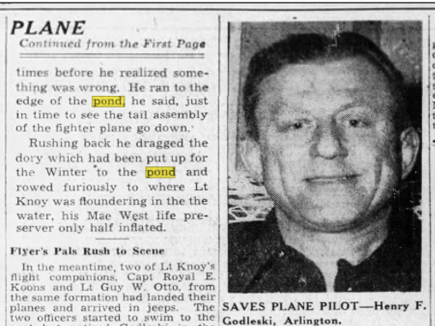

Slide 17
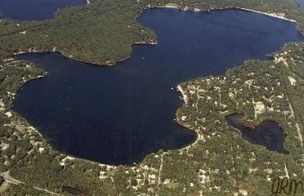
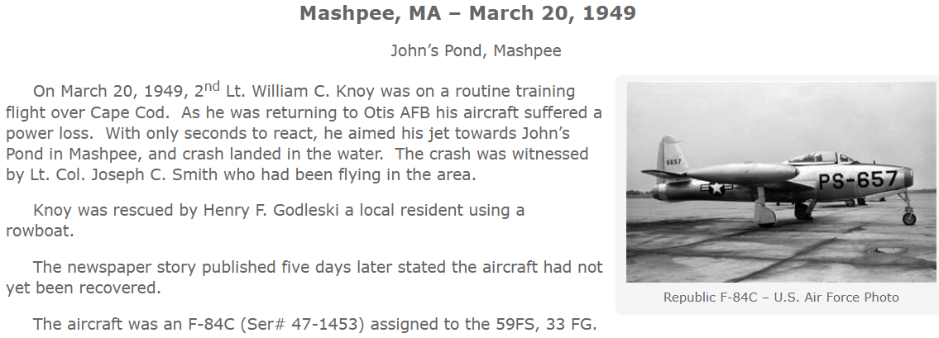
Johns Pond Mashpee Otis AFB, Fall 2023

Slide 18
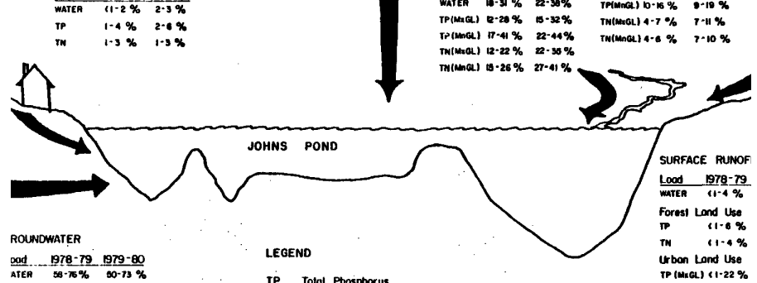
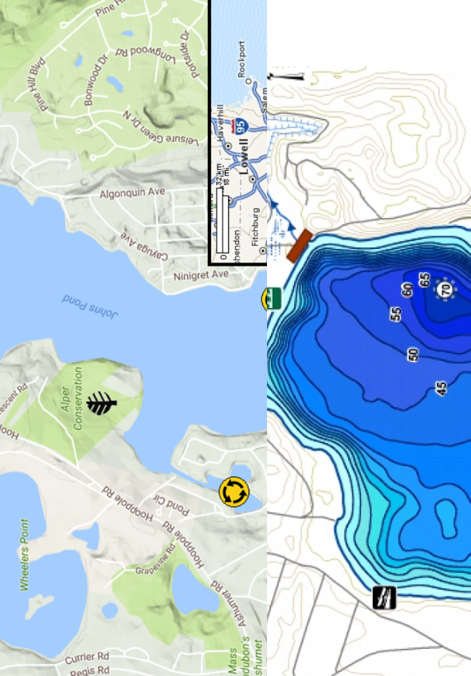
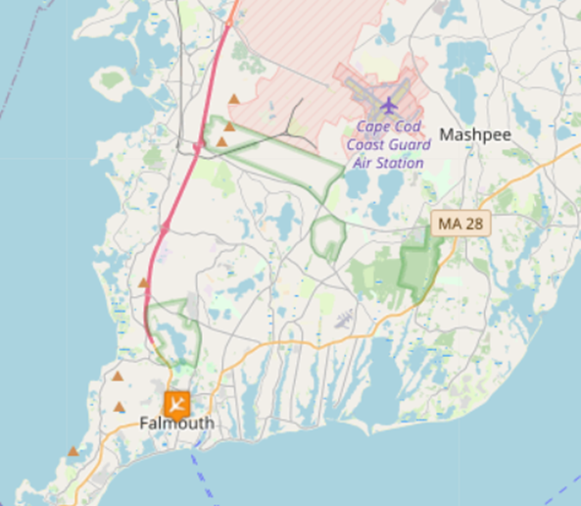
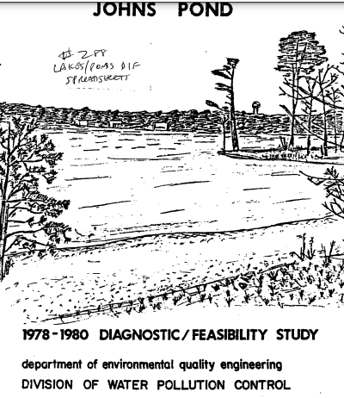

Slide 19
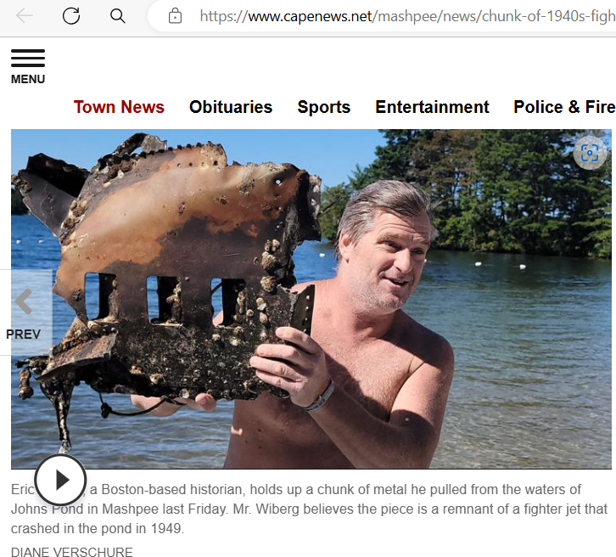

Slide 20
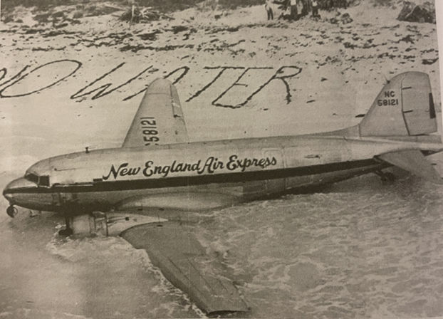
A New England Air Express passenger craft which crashed in the Bahamas, October, 1948.

Slide 21
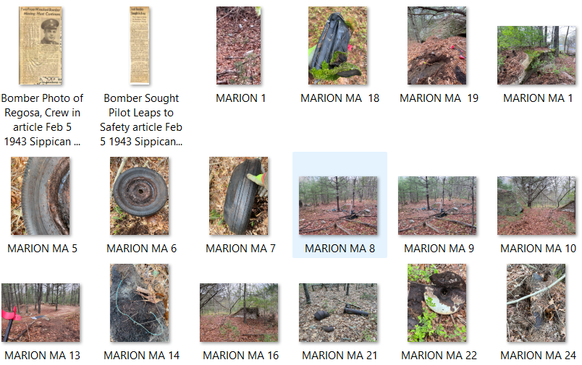
Marion MA Tragic Bomber Wreck, Tabor, Towers

Slide 22
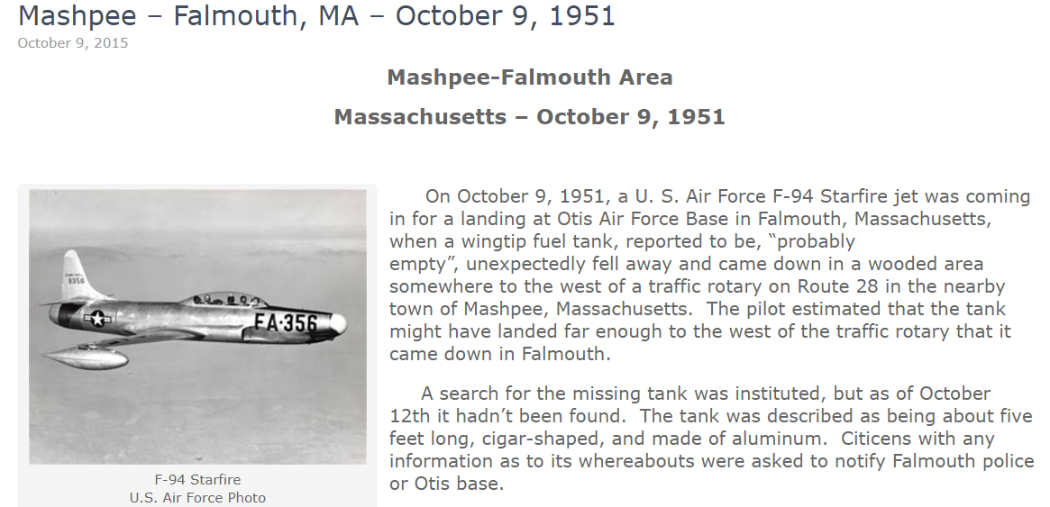

Slide 23
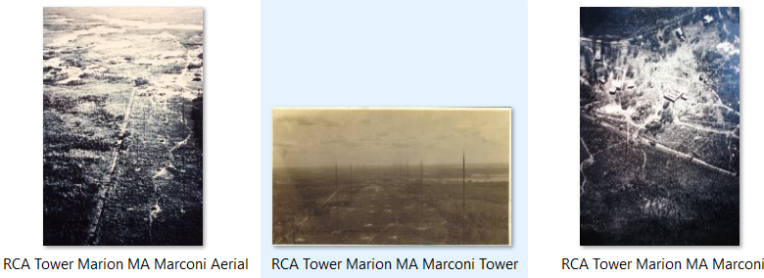
# WHEN WHERE DETAILS
1 5/9/64 North Parsonfield Maine, York Cty skull, bones, shallow grave, dirt road, prob. Not an aviator
2 5/22/75 Burlington, MA, by Merrimack River skeletal in army fatigues, sweater, garison belt, Levi Jeans, not likely a flier, metal necklace w/ Thespian logo, sneakers
3 3/10/77 Atlantic Ocean, Point Judith RI 30 miles off body w bullet in left hip
4 12/23/80 Narragansett, Whale Rock to Narragansett Pier, RI same body parts found 8/18/77 same area
5 9/16/81 Scarborough ME, beach near Rosebrier Motel partial skeletal of right radius (hand?) near hotel Cumberland Cty Maine, on beach at Scarborough ME
6 7/11/82 Brewster, MA, Cape Cod central bones parts, believed male adult died 1978-1980
7 2/5/83 Pine Point Beach, Scarborough, Cumberland Cty, Maine skeletal lower jaw tangled in beach debris at Pine Point Beach, Scarborough ME
8 11/21/83 Potter's Cove, Jamestown RI single specimen found fishermens net
9 8/30/84 Taunton, MA, SW of Boston partial skeletal parts found construction area

Slide 24
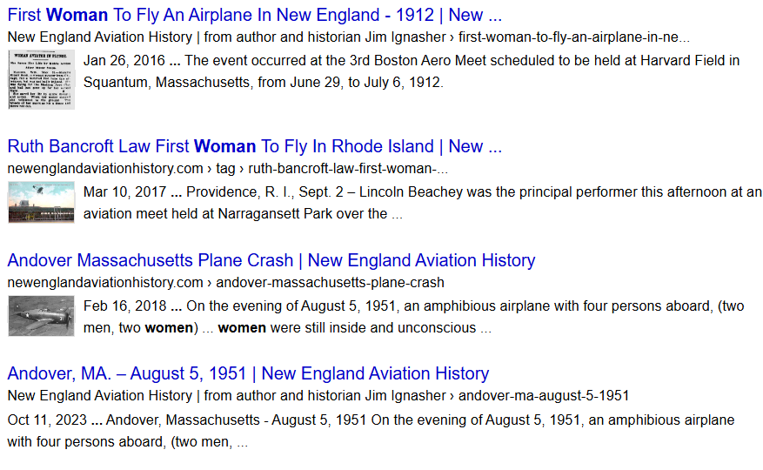
Women Aviators in New England

Slide 25
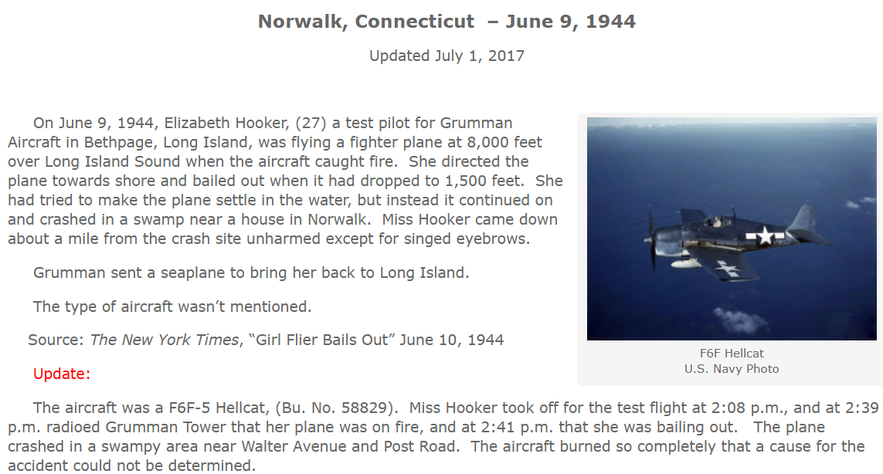
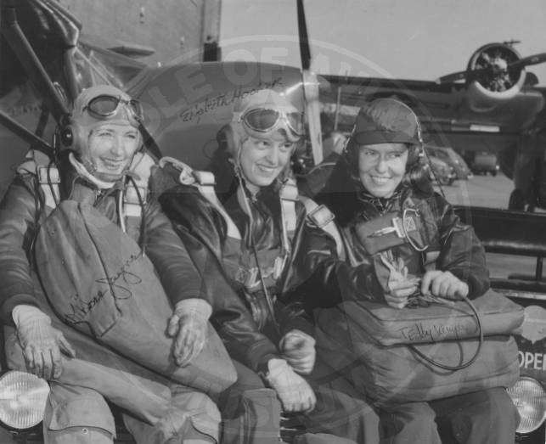
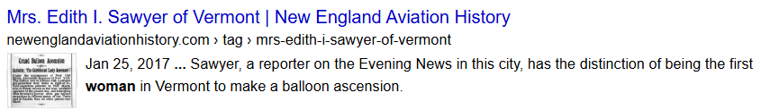

Slide 26
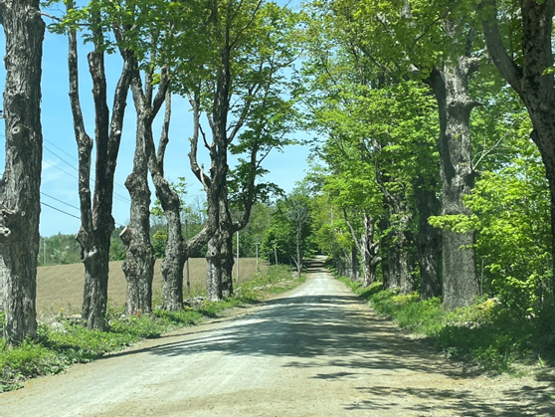
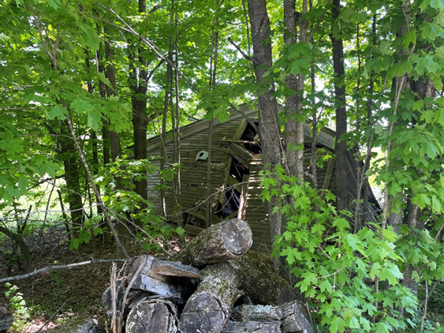
Bucolic barn in Cummington, the author found remnants from a crashed fighter plane.

Slide 27
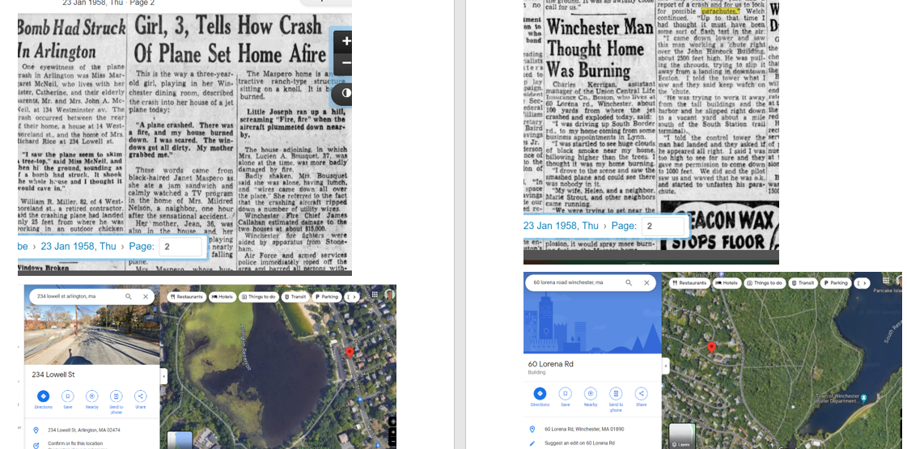
Process, Template: News, Intel, Maps, Photos

Slide 28
T H A N K Y O U ! !
Thanks to Jim Ignasher (Sea Cadet), Douglas E. Campbell ( USN-Ret.) Joe Yukna, Caitlin, Geoff, and Diane Fitzgerald, G. de Ramel, Capt. Paul Aranha, Larry Webster, Wickes & Claire Helmboldt, many volunteers without whom we find very little.
In memory of those whose aircraft are lost along with them, and not yet found. We will keep trying.
Leads welcome at eric@ericwiberg.com

