Slide 1
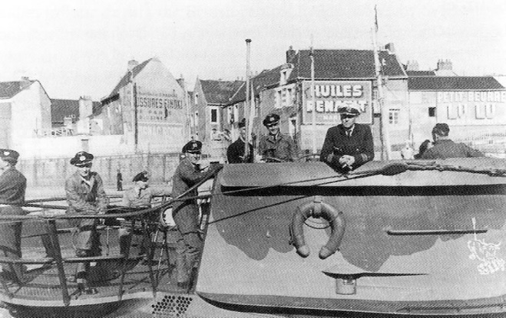
U-BOATS IN NEW ENGLAND
by Capt. Eric T. Wiberg
Steamship Historical Society of America
2500 Post Road, Warwick, Rhode Island
Saturday 13th of February, 2016

Slide 2
Overview:
73 German U-boat patrols for over 600+ patrol days
35 Allied ships sunk or damaged for over 182,000 GRT
428 Allied sailors killed, 1,152 survived, 545 landed in New England
3 German U-boats sunk off New England: RI, Nantucket, Nova Scotia
4 U-boats surrendered in Portsmouth Navy Yard, Kittery, Maine
7 U-boats destroyed by US Submarines post-war off Cape Cod
3 German officers or sailors buried in New England: MA and Newport
3 groups of German saboteurs landed: Maine, Long Island, St. John NB
1 US Navy vessel (USS Eagle) sunk by U-boat, Portland Maine
1 patrol to lay mines off Boston Harbor MA - unsuccessful

Slide 3
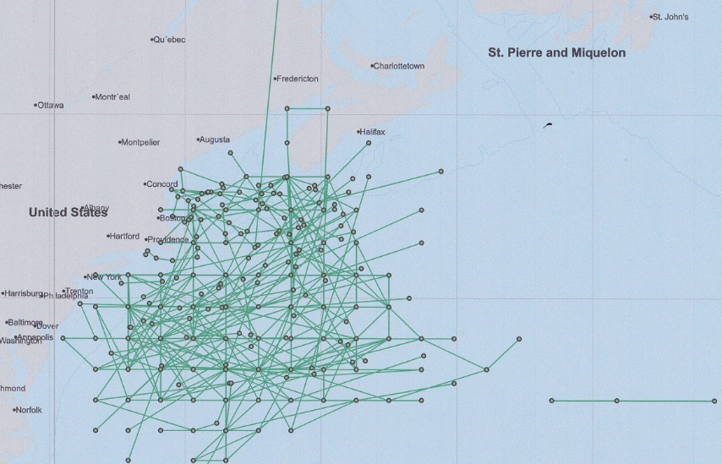

Slide 4
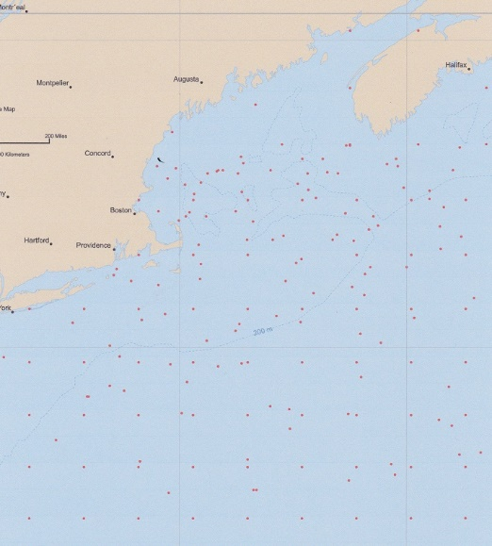

Slide 5
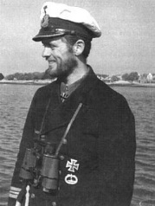

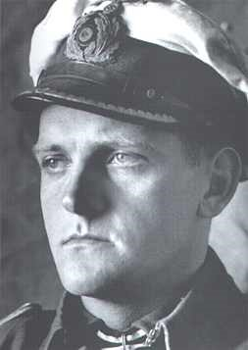
Hardegen in U-123 was first to arrive, Topp an ace
Reinhard Hardegen was the
First of Operation Paukenschlag
to arrive in Jan. 1942. He is
still alive today.
One of the U-boats was en-route to Japan with diagrams for German airplane fighters, as well as material and scientists for an atom bomb.
Another sub had a spy with US$70,000 destined for North America, but it was sunk and he was captured. Two U-boats went to Argentina in 1945.
Erich Topp was one of the greatest U-boat aces of WWII.

Slide 6
NAME | DATE | U-BOAT | CARGO | TYPE | LEFT | DESTINATION | FLAG | TONS | ON | KIA | LIVED | ARR NE | WHERE
Norness | 1/14/1942 | U-123 | 12,222 tons Admiralty fuel oil | Motor tanker | New York | Halifax | Panama | 9,577 | 41 | 2 | 39 | 39 | Newport
Alexandra Hoegh | 1/21/1942 | U-130 | 12,000 tons crude oil | Motor tanker | Caripito, Venezuala | Halifax | Norway | 8,248 | 28 | 0 | 28 |  | Shelbourne NS
Thirlby | 1/23/1942 | U-109 | 7,600 tons maize | Steam ship | New York | Halifax | UK | 4,887 | 45 | 3 | 42 |  | Halifax
Ranja | 3/17/1942 | U-71 | Petroleum | Motor tanker | Houston | Halifax | Norway | 6,355 | 34 | 34 | 0
Thursobank | 3/22/1942 | U-373 | 7,839 tons general cargo | Motor ship | New York | Cape Town | UK | 5,575 | 56 | 30 | 26 |  | Halifax
Hertford | 3/29/1942 | U-571 | 12,013 ton general cargo (meat) | Steam ship | Sydney, Aust. | Halifax | UK | 10,923 | 62 | 4 | 58 |  | Liverpool & Halifax
Nemanja | 4/8/1942 | U-84 | 7,207 tons sugar | Steam ship | San Pedro de Macoris, DR | Halifax | Yugoslavia | 5,226 | 47 | 13 | 34 |  | Halifax
West Imboden | 4/21/1942 | U-752 | 7,357 tons general cargo | Steam ship | Durban | Boston | US | 5,751 | 35 | 0 | 35 | 35 | Portland ME
Taborfjell | 4/30/1942 | U-576 | 2,200 tons sugar in 16,200 sacks, 70 tons chrome ore | Steam ship | New York | Montreal | Norway | 1,339 | 20 | 17 | 3 |  | St. John
Skottland | 5/17/1942 | U-588 | Lumber | Steam ship | New York | Sydney, NS | Norway | 2,117 | 24 | 1 | 23 | 23 | Boston
Fort Qu'Appelle | 5/17/1942 | U-135 | 9,200 tons general cargo, 500 tons acetone | Steam ship | Kingston, Jamaica | Halifax | UK | 7,127 | 47 | 13 | 34 |  | Shelbourne NS

Slide 7
Fort Binger | 5/18/1942 | U-588 | Ballast | Steam ship | Belfast | New York | UK | 5,671 | 61 | 1 | 60 |  | Yarmouth NS
Norland | 5/20/1942 | U-108 | Ballast | Motor tanker | Glasgow | Corpus Christi | Norway | 8,134 | 48 | 0 | 48 | 14 | New Bedford & Nantucket
Plow City | 5/22/1942 | U-588 | 4,971 tons bauxite ore | Steam ship | Trinidad | New York | US | 3,282 | 31 | 1 | 30 | 30 | New London
Margot | 5/23/1942 | U-588 | 5,500 tons general cargo, military stores incl. aircraft parts, tanks, explosives | Steam ship | New York | Cape Town, Egypt via Trinidad | UK | 4,545 | 45 | 1 | 44 |  | New York
Zurichmoor | 5/23/1942 | U-432 | Ballast | Steam ship | Halifax | St. Thomas, USVI | UK | 4,455 | 45 | 45 | 0
Polyphemus | 5/25/1942 | U-578 | 5,936 tons of wheat, 790 tons wool | Motor ship | Sydney, Aust. | Halifax | Dutch | 6,269 | 80 | 15 | 65 | 18 | New Bedford & Nantucket
Liverpool Packet | 5/31/1942 | U-432 | 1,945 tons US Govt. stores | Steam ship | New York | Halifax | Canada | 1,188 | 21 | 2 | 19 |  | Seal I., Cape Sable
Mattawin | 6/2/1942 | U-553 | 7,000 tons military stores | Motor ship | New York | Cape Town | UK | 6,919 | 71 | 0 | 71 | 34 | Cape Cod, MA
Berganger | 6/2/1942 | U-578 | General cargo incl. 48,000 bags coffee, 1,000 bales linters, 1,138 liters sunflower seeds, hides | Motor ship | Santos, Brazil | Boston | Norway | 6,826 | 47 | 4 | 13 | 43 | New Bedford
Ben & Josephine | 6/3/1942 | U-432 | Fish | Fishing vessel | Gloucester | Sea Island, NS | US | 102 | 8 | 0 | 8 | 8 | Mount Desert, ME
Malayan Prince | 6/9/1942 | U-432 | General cargo | Motor ship | New York | Halifax | UK | 8,593 | 40 | 0 | 40 |  | (slightly damaged)

Slide 8
Lark | 6/13/1942 | U-107 | 50 tons fish | Fishing vessel | Le Havre Banks, NS | Boston | US | 148 | 27 | 0 | 27 | 27 | Boston
Port Nicholson | 6/16/1942 | U-87 | 1,600 auto parts, 4,000 tons military stores | Steam ship | Halifax | New York | UK | 8,402 | 91 | 6 | 85 | 85 | Boston
Cherokee | 6/16/1942 | U-87 | Ballast - 350 tons sand | Steam passenger ship | Halifax | Boston | US | 5,896 | 169 | 86 | 83 | 83 | Provincetown & Boston
Moldanger | 6/27/1942 | U-404 | 8,700 tons general cargo, incl. salted hides, tallow, wool, veg. oil | Motor ship | Buenos Aires | New York | Norway | 6,827 | 44 | 14 | 30 |  | Cape May, NJ
Alexander Macomb | 7/3/1942 | U-215 | 9,000 tons military cargo, tanks planse, explosives | Steam ship | New York | Woods Hole MA | US | 7,191 | 66 | 10 | 56 | 31 | Woods Hole MA
Lucille M. | 7/25/1942 | U-89 | Fish | Fishing vessel | Yarmouth | Fishing grounds | Canada | 54 | 11 | 0 | 11 |  | Shelbourne, NS
Angelus | 5/19/1943 | U-161 | Molasses | Schooner | Barbados | Halifax | Canada | 255 | 10 | 8 | 2 | 2 | Portland ME
Pan Pennsylvania | 4/16/1944 | U-550 | 140,000 bbls 80 octane gasoline, aircraft on deck | Turbine tanker | New York | Barry, Wales | US | 11,017 | 81 | 25 | 56 |  | Londonberry, Ireland
Cornwallis | 12/3/1944 | U-1230 | bagged sugar, molasses in barrels | Steam ship | Sandwich, MA | St. John, NB | Canada | 5,458 | 48 | 43 | 5 | 5 | Rockland, ME
Atlantic States | 4/5/1945 | U-879 | Ballast | Turbine tanker | Boston | Las Piedras, Venezuela | US | 8,537 | 57 | 0 | 57 | 52 | Boston
USS Eagle (PE-56) | 4/23/1945 | U-853 | N/A | Patrol craft | Patrol | Patrol | US | 625 | 62 | 49 | 13 | 13 | Maine, TBN
Black Point | 5/5/1945 | U-853 | 7,759 tons coal | Steam ship | Newport News, VA | Weymouth, MA | US | 5,353 | 46 | 12 | 34 | 34 | Point Judith & Newport

Slide 9
New England Ports Survivors Landed In:
MAINE:
Portland, Rockland, Mount Desert Island
MASSACHUSETTS:
New Bedford, Nantucket, Boston, Woods Hole, Provincetown & “Cape Cod” – probably Provincetown ultimately
RHODE ISLAND:
Point Judith, Newport (both Allied sailors & German U-boat survivors)
CONNECTICUT:
New London (site of US Navy submarine base)

Slide 10
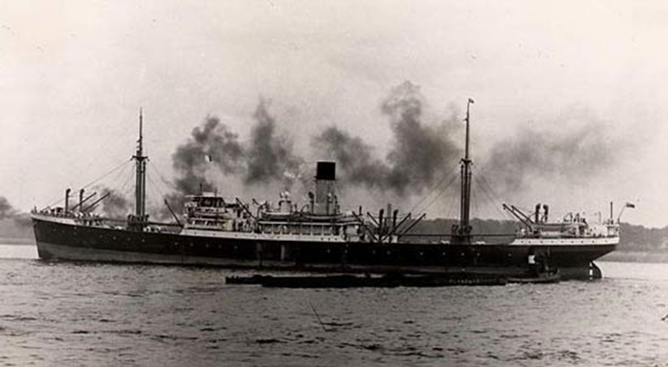
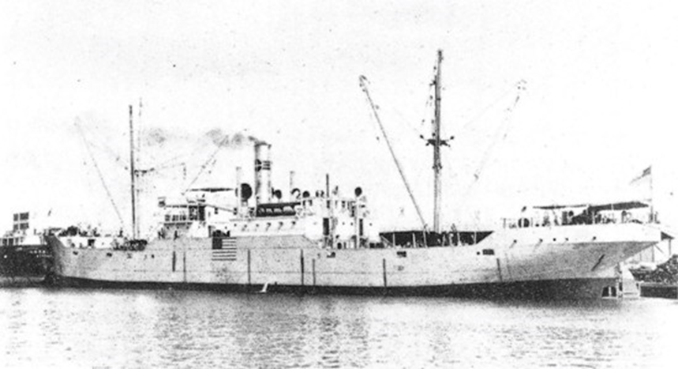
Peisander, whose men survived and were rescued by the USCGC General Greene off Nantucket
SS Plow City, whose captain fled the Peisander lifeboat, thinking it was a U-boat ploy, only to be itself sunk by a U-boat hours later

Slide 11
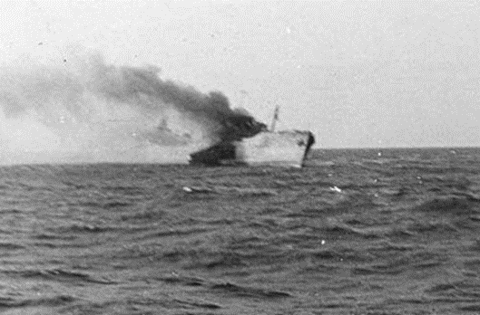
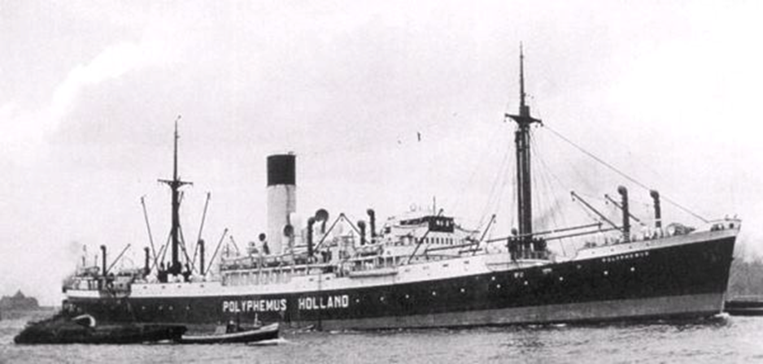
M/T Norland’s extraordinary survival voyages
The Polyphemus which rescued Norland survivors only to be itself sunk the following day
M/T Norland under fire by U-108 in a rare action photo

Slide 12
Norland summary of survivor’s voyages:
The surviving men from both the Polyphemus (51 men) and the Norland (14) then boarded five lifeboats, which together were sighted by three (3) submarines (U-566/Borchert, U-593/Kelbling, and an unidentified boat) and rescued by six (6) vessels. The six vessels which rescued the Norland survivors after they were rescued by the Polyphemus were:
D/S Maria Amelia (to New York),
Torvanger (to the F/V Alpha and Estelle),
the F/V Alpha and Estelle (to New Bedford Massachusetts),
the F/V Hunting-Sanford (to New Bedford),
the D/S Mirandella (to New York), and
the USCGC General Greene (WPC 140) (to Nantucket).

Slide 13
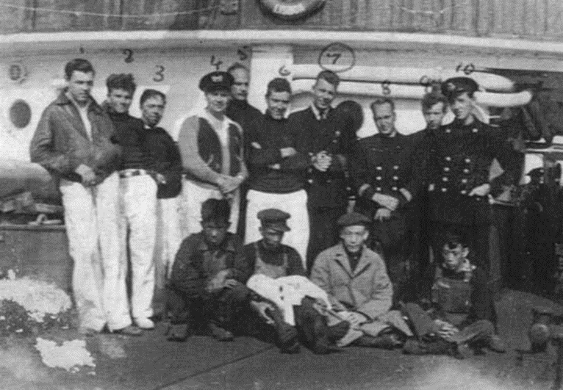
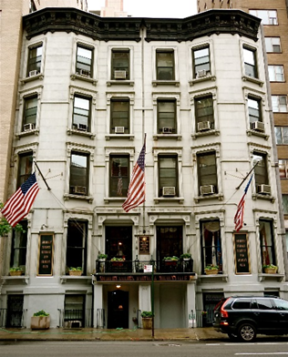
Boat 1: 2 Norland men – rescued by the Hunting-Sanford, landed New Bedford.
Boat 2: 3 Norland men – rescued by USCGC General Greene, landed Nantucket.
Boat 3: 2 Norland men – rescued by Mirandella, landed New York.
Boat 4: 4 Norland men – rescued by Maria Amelia, landed New York.
Boat 5: 3 Norland men, including Second Officer Bjelde navigating (total 14 men) – rescued by Torvanger, Alpha and Estelle, landed New Bedford.
The Soldiers, Sailors,
Marines, Coast Guard
and Airmen’s Club, since
1919, Lexington Avenue,
New York, NY

Slide 14
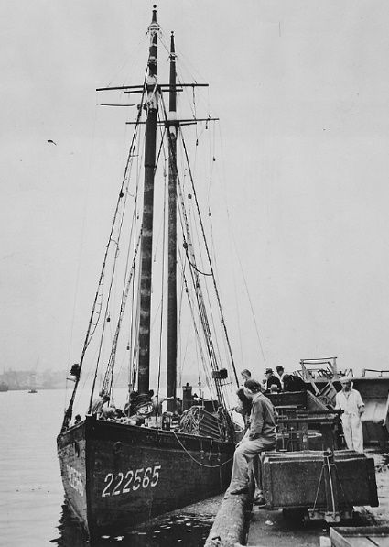
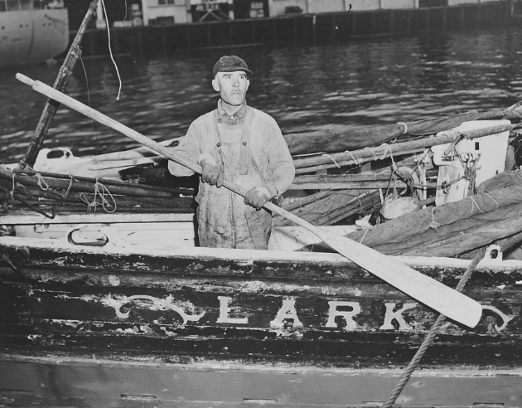
F/V Lark, shelled by sub, made it back to Boston

Slide 15
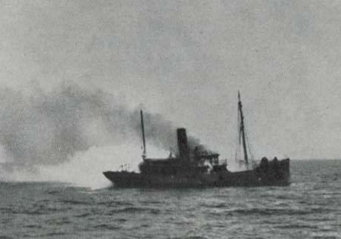
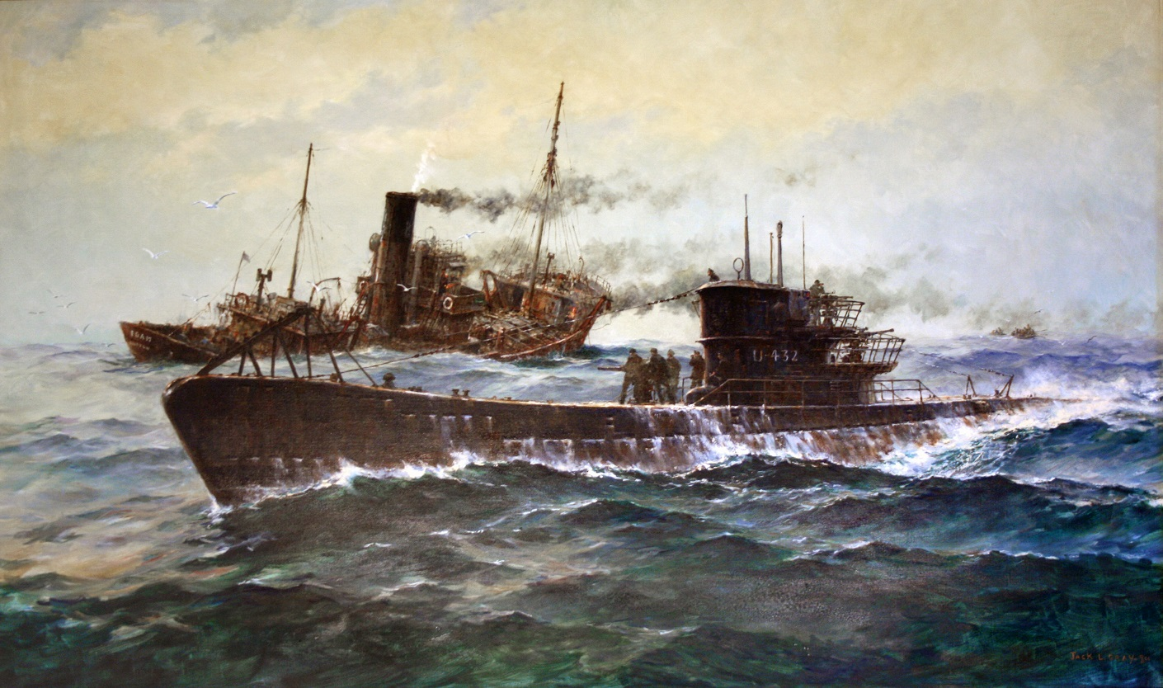
SS Foam sunk by U-432 off Nova Scotia 1942

Slide 16
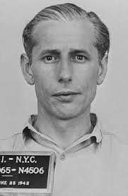
Operation Pastorius
John Dasch, 39, leader of the 4-man team landed at Amagansett Long Island on June 12, 1942 thanks to U-202 under Lindner. He had over $84,000 cash in USD. Five days later Dasch went from NY to DC to surrender. All 7 spies were arrested. Five were electrocuted after military tribunal on 8 August. Dasch and Burger were spared and returned to Germany in 1948.

Slide 17
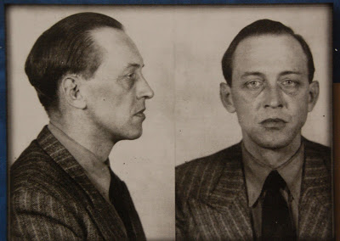
Landing in New Brunswick, Canada
Marius Alfred Langbein, a spy who landed at St. Martin’s village, near St. John New Brunswick in the Bay of Fundy by U-213 under von Varendorff on the 14th of May, 1942. His job was to monitor convoys from Halifax and relay it to Germans. Instead he buried the radio, hitched and took the train to Montreal, was arrested in a brothel, released, and lived as Alfred Haskins, touring night clubs and brothels until the end of 1944, burning through $7,000. Then he ran out of funds and surrendered. He was deported back to German after the war and returned to his wife.

Slide 18
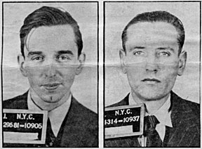
Operation Magpie
William C. Colepaugh of Niantic, CT and educated at MIT (left), and Erich Gimpel were landed at Hancock Point, Frenchman’s Bay, near Bar Harbor Maine by U-1230 under Hilbig on Nov. 27, 1944. They had US$60,000 cash and diamonds and evaded capture on snowy roads and trains to reach New York City. Colepaugh, who had taken a Swedish freighter to Germany to enroll with the Abewehr and was trained by SS Major Otto Skorzeny, spent on lavish living for a month then got cold feet. He confessed to a school friend and turned himself – and Gimpel – into the FBI the day after Christmas. Though sentenced to death, FDR died before they were executed, so the sentence was commuted, and they served sentences in jail. Colepaugh went on to a quiet life in Pennsylvania and Florida, earning accolades as a Rotarian in PA.

Slide 19
Ten U-boats sunk off New England: 3 during WWII
Sub # | Date Sunk | Sunk by what Allied vsl | Region Sunk | Lat / Long Sunk | Date POW | How Surrendered
U-215 | 3-Jul-42 | HMS Le Tigre | East of Boston | 41°48'N / 66°38'W | KIA | never surrendered
U-550 | 16-Apr-44 | USS Gandy, USS Joyce, USS Peterson | 70 nm SE of Nantucket | 40°09'N / 69°44'W | KIA | surrendered in battle
U-853 | 6-May-45 | USS Atherton, USS Moberly | Block Island Sound | 41°13'N / 71°27'W | KIA | never surrendered
U-1228 | 5-Feb-46 | USS Sirago SS 485 | 37 nm NE of Provincetown MA, in Gulf of Maine (see U-234), 600' of water | 42°32′N / 69°37′W (Niestle says 42°30'N / 69°38'W) | 17-May-45 | surrendered Portsmouth NH
U-805 | 8-Feb-46 | USS Sirago SS 485 | off Cape Cod | 42°32'N / 69°27'W | 15-May-45 | surrendered Portsmouth NH

Slide 20
U-977 | 13-Nov-46 | USS Atule SS 403 | off Cape Cod | 42°33'N / 69°43'W | 17-Aug-45 | surrendered Argentina, motored to Boston 13 Nov. 1945
U-530 | 28-Nov-47 | USS Toro SS 422 | 40 nm NE of Cape Cod | 42°39'N / 69°32'W | 10-Jul-45 | was taken to Argentina in 1945, towed to Boston MA
U-234 | 19-Nov-47 | USS Greenfish SS 351 | 40 nm NE Provincetown MA, in Gulf of Maine (see U-1228, U-889, same position), 600' of water | 42°37'N / 69°33'W | 19-May-45 | surrendered Portsmouth NH 19 May 1945
U-889 | 20-Nov-47 | USS Flying Fish SS 229 | off Cape Cod - same position as U-234 | 42°37'N / 69°33'W | 13-May-45 | surrendered Shelburne NS, transferred to NH 10 Jan. 1946
U-858 | 21-Nov-47 | USS Sirago SS 485 | c. 40 nm off Cape Cod | 42°31'N / 69°34'W | 14-May-45 | surrendered Lewes Delaware

Slide 21
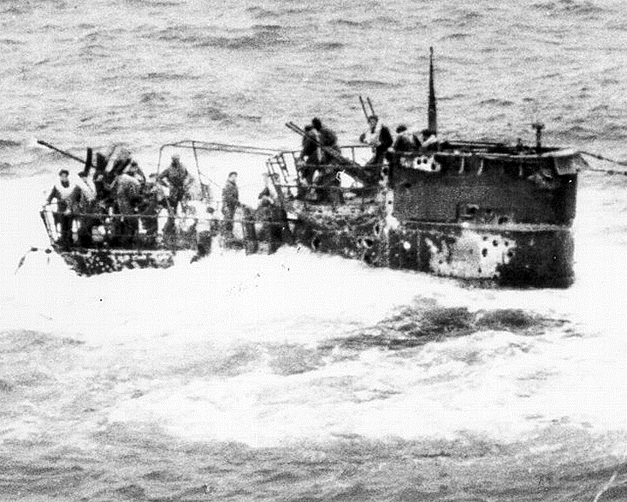
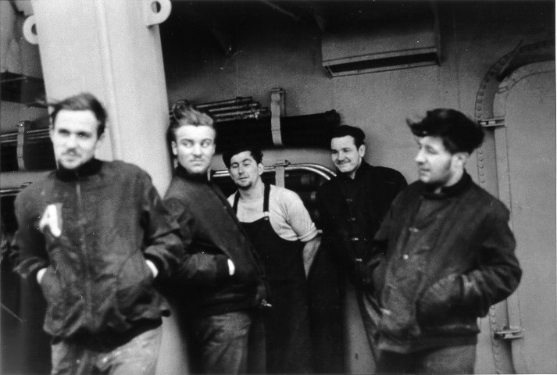
U-550 sunk off Nantucket, survivors taken

Slide 22
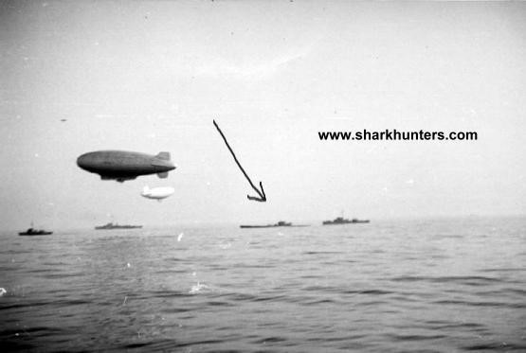
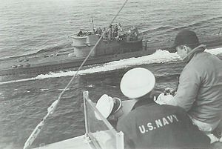
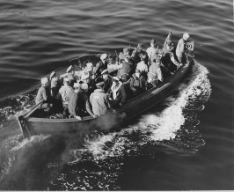
U-boats surrendering at sea

Slide 23
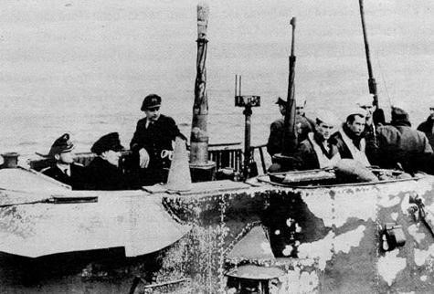
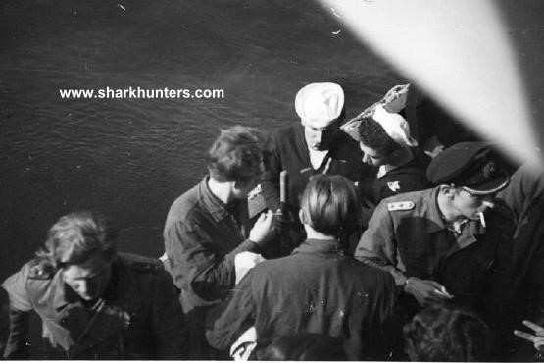
U-boats surrendered in Portsmouth, NH 1945

Slide 24
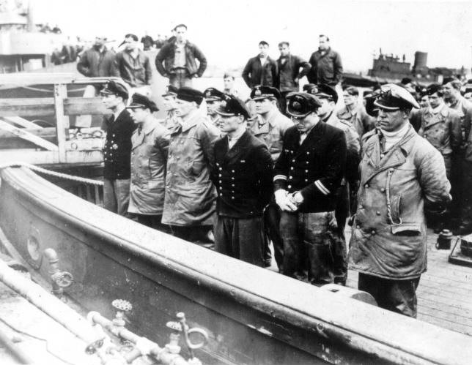
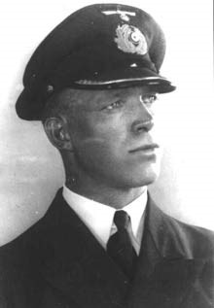
Steinhoff surrender & suicide, Boston jail

Slide 25
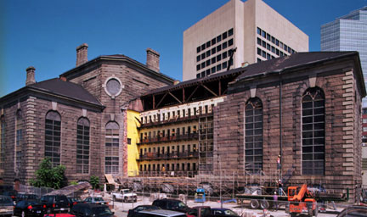
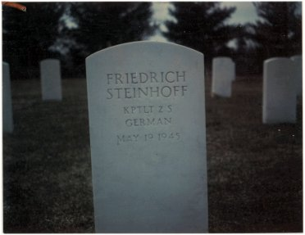
Boston jail, now a modern hotel on the
Charles River near the Zakim Bridge
Steinhoff’s grave at Fort Devens, MA, along with over a dozen Axis POW dead. The Boston Marathon bomber has been imprisoned there.

Slide 26
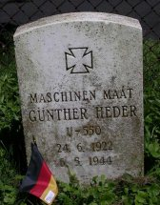
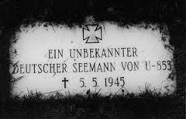
Two U-Boat Sailors Buried in Newport, RI
Can member of the audience help
the author to pinpoint these graves off Farewell Street?

Slide 28
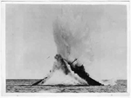
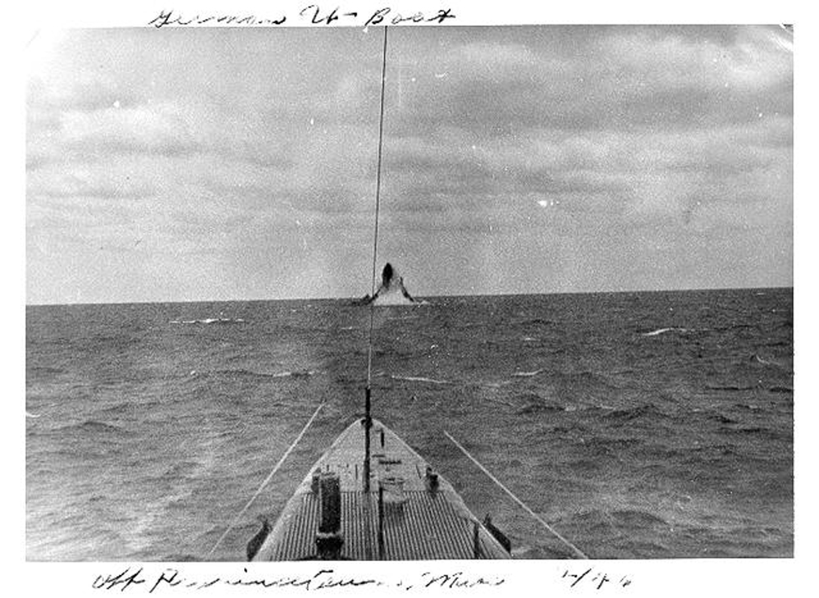
U-977 being sunk by USS Cape Cod 1947
U-1228 being sunk off Cape Cod 1947

Slide 29
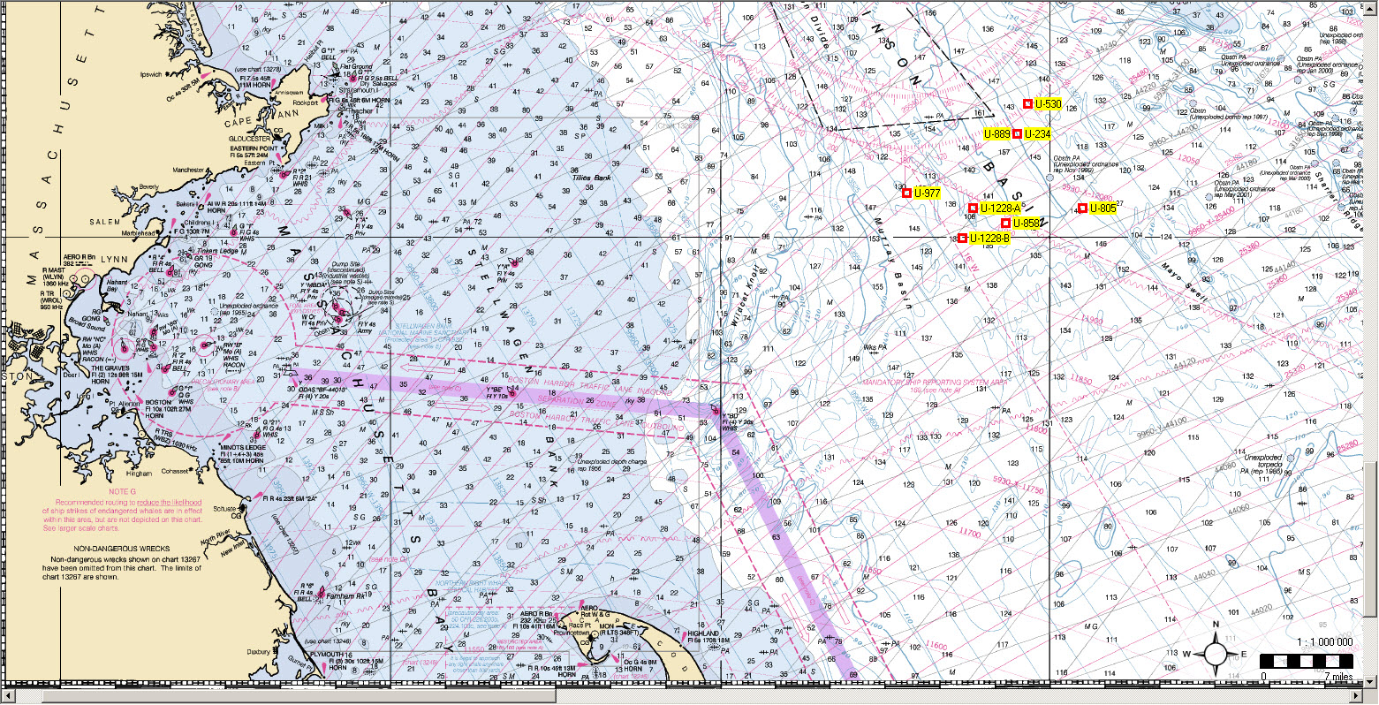
Six U-Boats sunk off Cape Cod MA 1946-1947

Slide 30
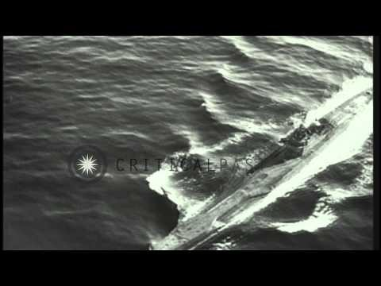
Video of U-858 and U-805 surrendering in NH

Slide 31
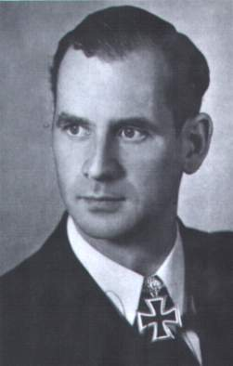
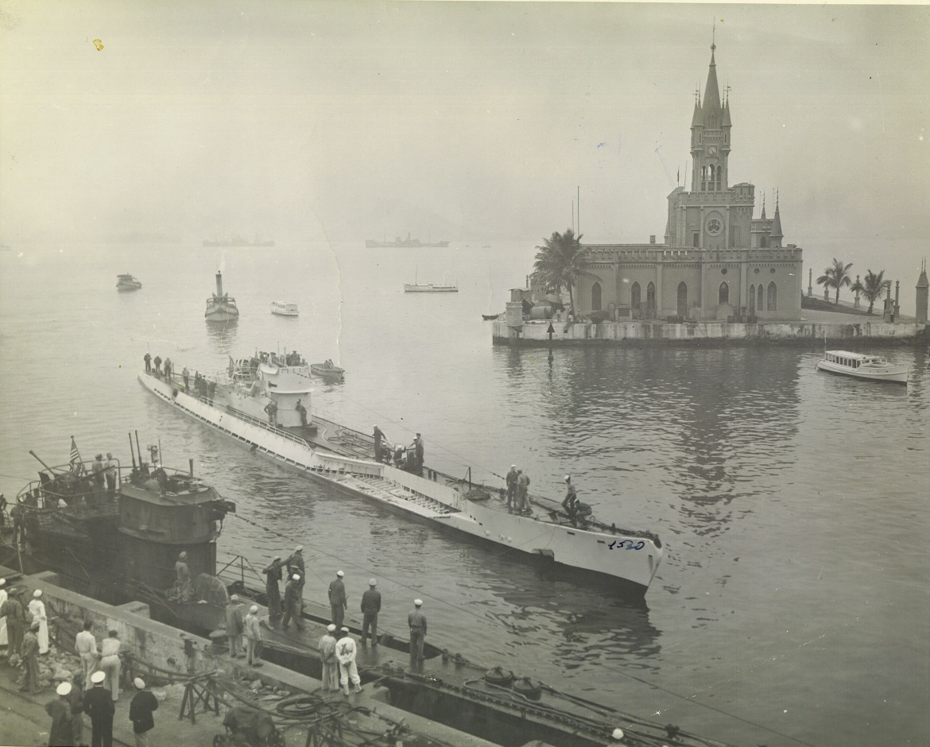
Otto von Bulow, whose descendant was subsequently accused of murdering his wife, Sunny, in Newport RI. The film “Reversal of Fortune” is based on the high-society drama and Rhode Island trial.
U-977 and U-530 in Rio de Janeiro, Brazil Sept. 1945, they
surrendered in Argentina, were brought to New London

Slide 32
www.uboatsnewengland.blogspot.com
The author would appreciate any “on the ground” research by audience members about survivors landed in Newport and other New England ports, their care, the logistics of their medical attention, lodging, repatriation, vessels which carried them, duration of stay, etc. from local press, oral histories, local history books, etc.
During the writing of “U-Boats Bahamas,” but before publication, at least three important witnesses passed away, including two US naval gunners and the daughter of a survivor.
It is imperative to find living witnesses and their descendants to try to record and share their stories before it is too late!
Thank you! www.ericwiberg.com, Westport, CT, eric@ericwiberg.com

