Slide 1
Early Years at Sea: 100 Vessels,
Ten Casualties: Lessons Learned
By: Capt. Eric Troels Wiberg, Esq., McAllister Towing
For: United States Naval Sea Cadets of Rhode Island, Kingstown, RI
Wednesday April 20, 2016, 1:00 PM

Slide 2
1992:
16 various New England winter training voyages, S/Y WHISPER, Wiberg, crew
15 Bahamas; dozens of trips, 18' Boston Whaler MA'WESSEL II, family boat 1989-1992
14 Port Everglades FL-Nassau, 150’ Australian tall ship YOUNG ENDEAVOUR, lliason
1991:
13 Lymington, England - Ireland - Brittany, France, 60’ WAR BABY, Wiberg, crew
12 TRANSAT Antigua-Bermuda-Belgium, 65’ ketch CHEBEC, 1991, Wiberg, mate
1990:
11 Nassau Harbor, Montague Bay, 40' RACER, Peter Christie, Commodore, RNSC
10 Bermuda-Lauderdale via Nassau, 42’ Wauquiez S/Y BON VIVANT, Aug., crew
9 Bermuda-Newport, 50’ Frers sloop RISING STAR, Mike Hall skipper, Wiberg crew
1989:
8 Bermuda-Newport, 39’ Cook sloop TEMPO, July, Wiberg boat-boy
7 Marion-Bermuda Race, 39’ custom Cook sloop TEMPO, June
6 Narragansett Bay, numerous day sails, Beneteau 35' BLACK SHEEP, Crew
1988:
5 Fernandez-Bennett’s, Cat Island, 62’ Abeking Rasmussen GERONIMO, student
4 Bahamas: various short voyages on 20' M/V MA’ WESSEL, family boat, 1985-1989
1987:
3 Lake Sebago, Maine, 21' AQUASPORT waterski boat, Wiberg, operator, camp
2 Boothbay Harbor, Maine and area, 42' sloop LOON-ATIC, Wiberg, young crew
1 Vestervik-Visby-Sandhamn-Stockholm, 32’ S/Y QU’ELLE AMIE, Wiberg, family

Slide 3
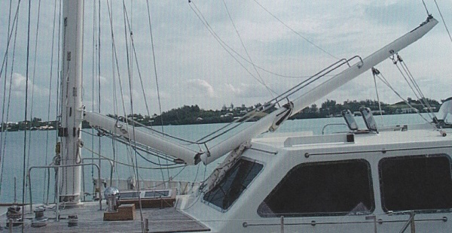
1994:
24 TRANSPAC Galapagos-New Zealand via Marquesas, Tahiti, Cook I., Tonga, STORNOWAY
1993:
24 Panama-Galapagos, 68’ Burma-teak Nicholson ketch STORNOWAY, Dec., Wiberg
23 W. Palm Beach, FL, 117' M/Y JEANETTE, training, THE OTHER WOMAN, Nov.
22 Newport-Lauderdale via Bahamas, 62’ Mason JADEANTE, Sept., Wiberg, crew
21 Camden Maine, Newport RI, Jongert 65' SERENETY OF SEA, daywork, summer
20 Camden, ME-Newport/Portsmouth RI 48' Frers sloop WHISPER, Aug, Wiberg, Mate
19 Camden-Penobscot Bay, Maine, cruises, 28' sloop WHITE WING, Wiberg, Mate
18 Bermuda-Camden, ME - Newport, 48’s Frers sloop WHISPER, Jul., Wiberg WC
17 Marion - Bermuda Race, 48’ aluminum sloop WHISPER, June, Wiberg, WC

Slide 4
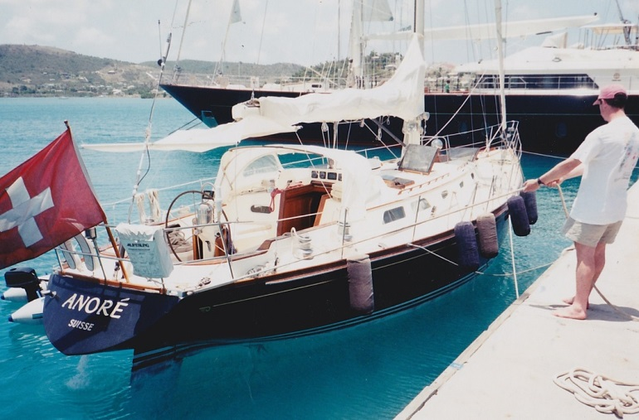
1997:
35 Singapore, races, short deliveries SE Asia, Hunter 42’ ARTEMIS, 1995-1998, Wiberg
34 Jurong to Changi, Singapore, 36' CHEOY LEE sloop, Wiberg, Mate
33 Singapore-Sentosa, numerous day trips, 23' POWER boat, Wiberg, Crew/Operator
1996:
32 Bermuda-Newport, Beneteau 42’, ENDLESS SUMMER, July, Wiberg, Watch Capt.
31 Singapore-Visakhapatnam India-Singapore, 30,000 DWT M/T EDMO, supercargo
1995:
30 Newport-Bra d’Or, NS, Canada, 62’ Little Harbor MOONRACER, Aug., crew
29 Inagua Bahamas-Norfolk-NY, 40,000DWT M/V ATLANTIC ERIE, salt, supercargo
28 Nassau Bahamas-Andros, return, 5,000 DWT water barge MT TITAS, supernumerary
27 Newport-Block Island, 60' sloop NYCE, Capt. Ashton, Wiberg, Crew, Aug
26 Crooked, Acklins Islands, Bahamas, 26' SLOOP, Wiberg, Island Expedition Crew
25 Turks & Caicos-Nassau via southern Bahamas, 65’ sloop CASADORE, Wiberg, crew

Slide 5
1999:
56 Southwest Harbor Maine - Jamestown RI , 44' Mason sloop NIMBUS, Aug.
55 Newport, Jamestown RI, hundreds short trips, 24' Ensign VALENTINE, 1999-2000
54 Cross-Newport Harbor, 32’ sail CAROLINA, June, Wiberg
53 Newport-Tortola, BVI, via Bermuda, Beneteau 43’ ELLEE, Nov.-Dec., Wiberg
52 Newport-Lauderdale via Norfolk, Charleston, 52’ Little Harbor CALICO, Oct.,
51 Newport-Lauderdale via Beaufort, Charleston, 54’ Little Harbor WINDRIVEN, Sept.
50 Newport-Port Canaveral via Annapolis, Charleston, Oyster 53’ SUSIE Q 3, Sep.
49 SW Harbor ME-Newport, 42’ Little Harbor picnic, BOLYA, Sept., Wiberg, mate
48 Newport Cross-Harbor, Oyster 55' AD-VENTURE, Sept, Wiberg
47 Newport Harbor, Narragansett Bay, Oldport Marine launch ECHO, night shift
46 Portsmouth RI, photoshoot, 50 sloop QUINTESSENCE, Wiberg, skipper
45 Jamestown-Block I.-Vineyard-Nantucket, 46' Swan BABE, Charter, Aug., Wiberg
44 Lockeport, Nova Scotia-Newport, RI 40’ Swan XENOPHON, Jul., Wiberg, mate
43 Bermuda - Newport & Pilot’s Point, 62’ S & S sloop WAR BABY, Jul., Wiberg, crew
42 Marion - Bermuda Race, record-holder WAR BABY, Jun, Wiberg, crew
41 Antigua - Newport via Bermuda, 52' Hinckley ANORE, May, Wiberg
1998:
40 Newport Harbor, Narragansett Bay, Oldport Marine launches ECHO, ROUNDER
38 Newport-Bermuda Race, 42’ Benneteau sloop ENDLESS SUMMER, Jun, watch Capt
37 Stratford CT-Portsmouth RI, Swan 46’ sloop BABE, Wiberg, mate
36 Bahamas, various short voyages, 26' Mako SHOAL SHAKER, family boat 1992-2005

Slide 6
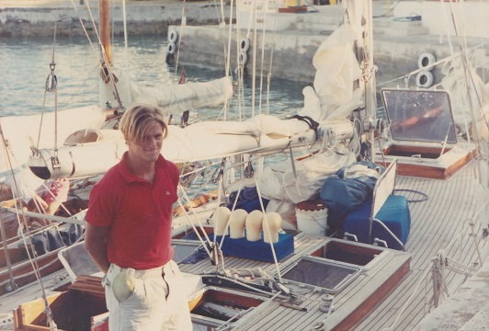
2001:
76 New England charter, Beneteau 44’ S/Y KARKARA, Aug
75 Marion Bermuda Race, 36' Baltic S/Y SHEHARAZADE, Wiberg, Nav. Jun.
74 Portsmouth-Newport RI, Farr 395 S/Y SAOIRSE, Capt. Matt Gerl, crew
73 Newport Harbor, Narragansett Bay, Oldport Marine launches ECHO, ROUNDER
71 Antigua-Bermuda-Block-Black Rock CT, 42' Mariner SHARAZAD, Wiberg
2000:
70 Newport-Bermuda-St. Thomas, USVI 53’ Little Harbor ENVOY, Nov., Wiberg mate
69 Newport-Stamford CT-NY-Rock Hall MD, 48’ Oyster AMAYESING, Sep. Capt.
68 Newport-South Norwalk CT, M/V McKINNA 57, Sep., Wiberg, Phil Holmes
67 Rock Hall -Block I.-Newport-Cuttyhunk-Vineyard-Newport, AMAYESING, Aug.
66 SW Harbor ME-Bristol RI, 50’ Shannon S/Y GAVIA IMMER, Aug., Wiberg
65 Christmas Cove, Maine - Newport, 35’ Hinckley sloop GLORY, Aug., Wiberg mate
64 TRANSAT Bermuda-Azores-Channel I, UK, 46’ Swan MARUTI Jun.-Jul., mate
63 Newport-Bermuda Race, 62’ S&S sloop WAR BABY, Jun., Wiberg, crew
62 Bermuda -Newport, 53’ J-160 sloop CONDOR, May, Wiberg, Joy Baum mate
61 Newport-Tortola, BVI, via Bermuda, Oyster 55’ ADVENTURE, Apr., Wiberg
60 Chaguaramas, Trinidad-Grenada, 12-meter STIARNA (caught fire, sank), Feb.
59 Newport RI, hundreds trips OMS launches HOPE, ECHO, ROUNDER, 1998-2004

Slide 7
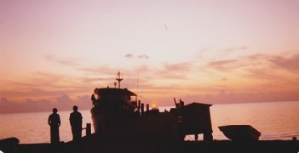
2002:
97 Newport Harbor Christmas Lights, 70' motoryacht ONIWA, Dec, Wiberg, Crew
96 Bermuda-Port Jeff. NY Farr 395 S/Y CARPE DIEM, June, Wiberg, Chad
95 Nantucket-Sag Harbor NY, Beneteau 40’ S/Y SABA, Jul., Wiberg & Mike Hall
94 RI-Block I, Cuttyhunk, Vineyard, Tucket, Juneau 52’ S/Y CARPE DIEM II, Wiberg
93 Padanaram-Vineyard-Tucket-Hadley-Menemsha, Juneau 52’ S/Y CARPE DIEM II
92 Newport-Bristol, Halberg Rassey 42’ S/Y ALCYONE, May, Wiberg
91 Newport - Westport MA, 80' maxi catamaran MAIDEN 2, daycrew, Spring
90 Jamestown RI-Rye NY, Swan 44’ S/Y MANGO May, Wiberg, mate
89 Newport-Bristol-Newport RI Navy charters, QUICK STEP, PATRIOT, Oldport
88 S.Freeport ME-Nahant MA, 40’ Alberg S/Y MINUET Sep., Don Miller, Mate
87 Hull MA-Jamestown RI, 40’ sloop S/Y NIGHT WIND, Sep., Miller, Wiberg, mate
86 Newport-Port Jeff, NY, 42’ sloop S/Y K2 Newport-NY, May, Wiberg
85 Portsmouth-Newport RI, 44’ sloop S/Y GITANA IV, Jun., Wiberg
84 Newport-Portsmouth RI, Swan 46’ S/Y BABE, Aug., Wiberg
83 Barrington-Jamestown RI, Farr 395 S/Y SAOIRSE, Jul., Wiberg, skipper
82 Newport-Narragansett, 14’ SKIFF, via trailer and it’s own hull, May (smallest yet)
81 Newport – Block Island Oldport Launch HOPE, for Oldport Marine, Wiberg
80 Newport – Edgartown Martha’s Vineyard, Oldport launch ROUNDER, Wiberg
79 Portsmouth-Newport, Beneteau 42’ SUMMER WIND, for Bareboat Sailing
78 Fairhaven MA-Newport RI, tow, 40’ S/Y SAIL for Oldport, May, Wiberg, mate
77 Newport, Portsmouth, RI, 45' workboat QUICK STEP, Oldport, mooring/towage

Slide 8
2013: 118 Old Saybrook CT-Norwalk CT, 52' power PELAGIC MAGIC, crew, September
2008: 117 Bermuda-Newport, Bristol 48’ USHUAIA, Wiberg Crew, July
2006: 116 Day racing, Riverside YC, Connecticut, S/Y J-40, Crew, Spring 2006
2005:
115 Shelter Isl. NY-Block Isl.-Wickford RI, 35' Oceanis SEAQUESTERED, Oct.
114 Newport RI-Larchmont NY, 65' Little Harbor PANACEA, Kiragu, Gray, Sep.
113 Newport RI-Wilson's Creek CT, Able 32' sloop LOON, Wiberg, Gray, Aug.
112 Portsmouth RI-Portland, Maine, Swan 48' CYGNE, Wiberg co-skipper, Aug.
111 Newport-Portsmouth RI, 70' Hinckley MISCONDUCT, daysails, Wiberg, crew
110 Bermuda – Marion MA, Beneteau 41’ SLIDERULE, Wiberg Capt., June
2004:
109 Eliot Maine - Portsmouth RI, 33' Tiara twin-power INTREPID Oct, Wiberg/Gray
108 Padanaram MA-Newport RI, 60' Little Harbor SANS TERRE, Oct. Kiragu/Wiberg
107 Islip Long I. NY-Portsmouth RI, 28' Legacy SOUTHPAW, Sept. Wiberg/Johnson
106 Bristol-Newport-Bristol RI, 42' Swan ANTARES, Jul-Sept, Cutler, Wiberg Mate
105 Newport-Hyannis-Nantucket MA, 53' Swan ESCAPE, Capt. S Woolfson, Wiberg
104 Portsmouth-Bristol RI, 42' Swan ANTARES, June, Capt. Zach Cutler, Mate Wiberg
2003:
103 Newport Harbor, Oldport Marine launches ECHO, ROUNDER, boat show
101 Newport, Narragansett Bay, 80' Fife ADVENTURESS, Capt. Casey, Wiberg, crew
100 Marion-Bermuda Race, 42’ Catalina S/Y NORTH STAR II, Wiberg Nav. (3rd Place)
99 St. Martin-Bermuda-Sag Harbor, Bristol 57’ sloop S/Y GALATEA, May-Jun.,
98 Wilmington NC to Beaufort, Hinckley 44’ S/Y MAGIC FLUTE, May, Wiberg

Slide 9
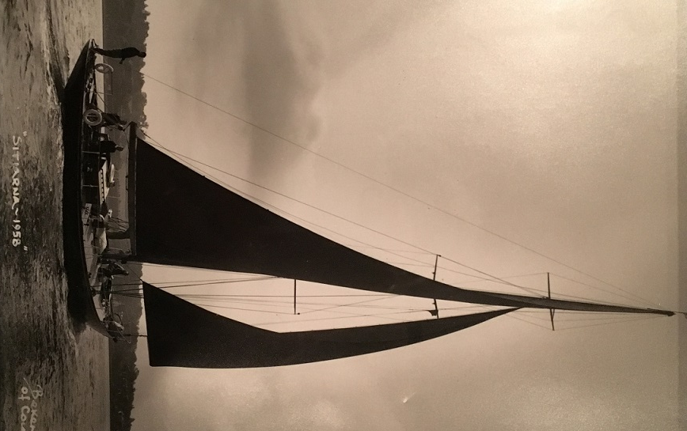
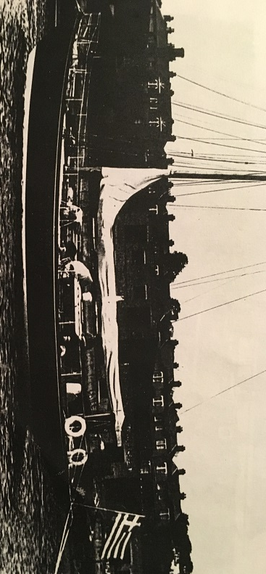
S/Y Stiarna, Built in UK, 1937, classic
Final Crew:
Wiberg (30), Skipper, Owner (60), son (20s), Crew (20s), Carpenter (70)
Time-Line:
Weds. 23 Feb. 06:00 – left Trinidad dock
06:50 – heavy smoke, fire below
06:55 – extinguishers used, fire out of control
07:00 - Mayday VHF, M/V Calypso standing by
07:05 - all crew aboard Calypso
08:00 - T&T CG RIB on-site, rescues gear
08:30 - CG Corozal Point on-site, takes crew
09:30 – all Stiarna crew ashore, Trinidad
Moral: Quick action, decisions,
cooperation, mitigated crew injuries.
Reliance v. Hanover, 2002, Boston:
law.justia.com/cases/federal/district-courts/FSupp2/222/110/2305170/

Slide 10
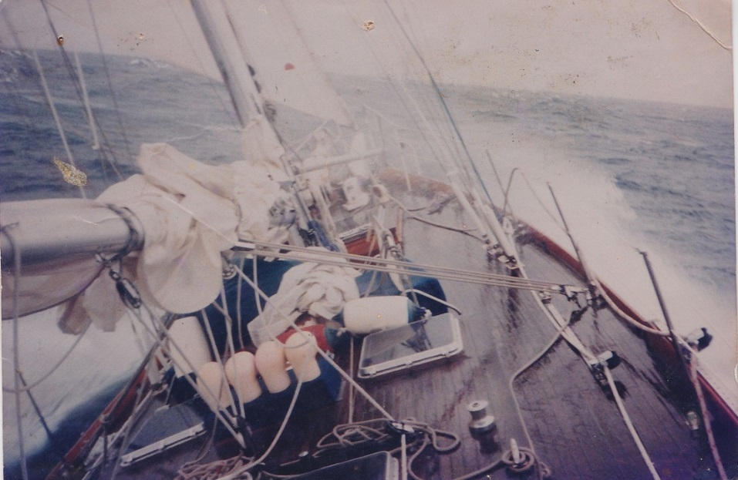
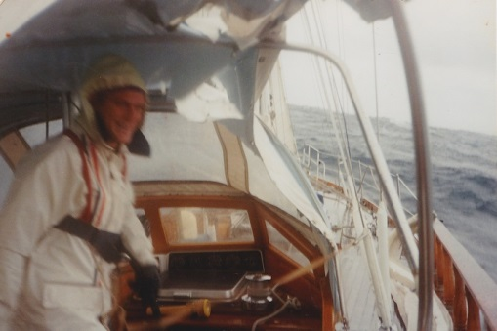
S/Y Chebec, 7-week Trans-At, 1991
Crew: Skipper/Owner (Belgian, 35), Mate (US, 20), Crew (NZ, 20), Crew (Antigua, 30+), Guest (Antigua, 25). Most met the week of sailing.
Route: Antigua, St. Martin, Anguilla, Bermuda, UK coast, English Channel, Belgium
Events: 21-day, 3,000-mile passage, 2-week storm (67+ knots), damage to sails, deck.
Morale: Cold, lack of warm clothes, poor navigation, lack of access to food, knife attack
Take-Aways: Captain a spoilt, self-centered playboy. Crew ill-chosen at last minute. Some experienced drug, alcohol withdrawal. Skipper missed Bermuda, was surprised to make landfall in UK. Refused $500 charter in Bermuda. Insufficient provisions. Passenger. Broken refrigeration. Unpaid crew asked to beautify boat. Skipper hoarded food, failed to enforce discipline, immigration.

Slide 11
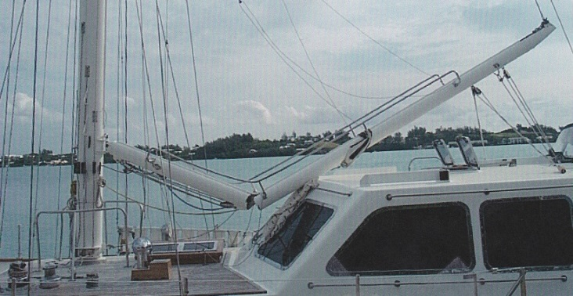
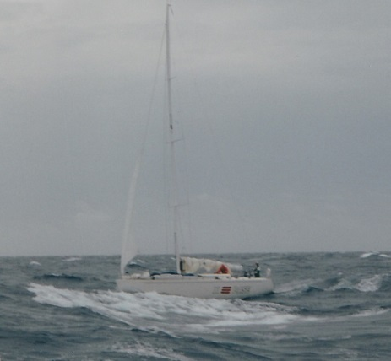
S/Y Bon Vivant, Bermuda-Bahamas
Summary:
18-year old crew only met owners for 30 minutes.
3 of 5 of the original middle-aged crew left boat.
Failed to clear out of Customs/Immo. from Bermuda.
Large age disparity: Skipper 65, Crew 70, Crew 19.
Lack of discipline: no watch roster posted, enforced.
Due to long distance/inexperience, Trans-At called off.
Inability to communicate with shore, return Bermuda.
Take-Aways:
Skipper was an active alcoholic at sea.
Crew (75) was effectively blind at helm at night.
Crew (19) inexperienced, distrustful of others.
Skipper indecisive: Crew (19) nominated port.
14 days meandering in Bermuda Triangle.
Poor lookout kept: steamer approached unseen
Poor squall preparation: near knock-down.
Failure to clear into port properly (“two men”).
Crew punished: left in halyards for hours.

Slide 12
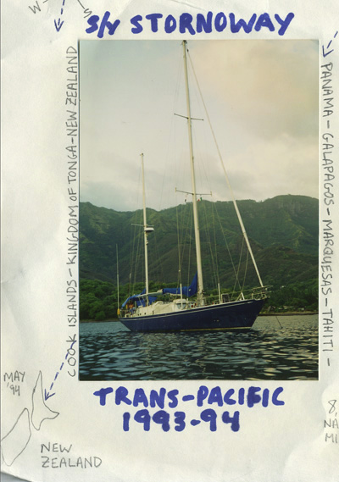
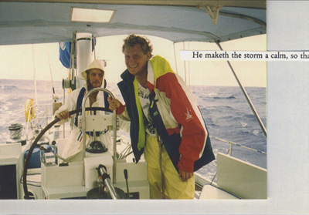
S/Y Stornoway, Panama-NZ 1993-4
Before Panama:
Inexperienced owner/girlfriend hired/fired 6+ people
Captains unrealistic re: motoring, pay, time.
Captain, crew armed with gun/sword, not owners.
Electronic damage (SSB, Radar, Auto-helm) not fixed.
After Galapagos:
All crew that committed remained the balance to NZ.
Though hardly paid, young crew morale was high.
Owner stepped in to guide crew when mandated.

Slide 13
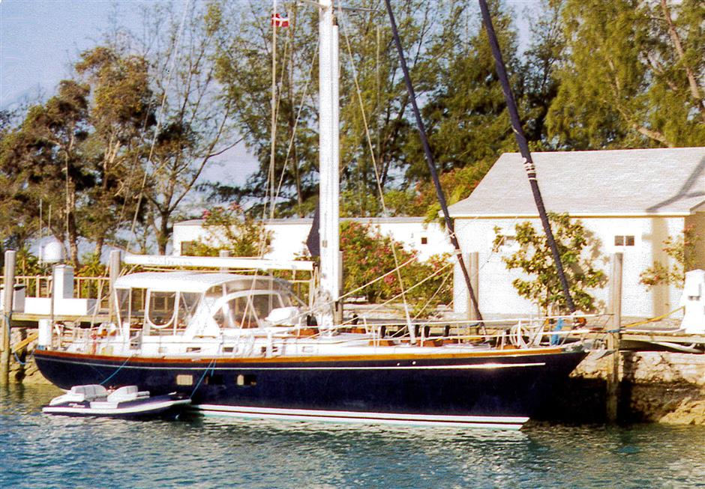
S/Y Windriven, MOB, RI, Oct. 1999
Events: Crew: Wiberg (29), Mate (25), Crew (21) – vessel was 1987-built Little Harbor, 53’
On Oct. 8, 1999, 100 miles southeast of Block Island, en-route RI-VA, the boom parted.
Young, inexperienced, dinghy-sailing crew at wheel. Skipper asleep in underwear.
Loud bang, skipper leaps into cockpit, grabs runaway boom sheet, boom is jerking.
Boom takes skipper over railings, starboard side, boom hits shrouds, flicks him to water.
Man Overboard is sounded, but when mate emerges, fears worst, starts crying.
Crew slaps mate on face, together they throw off a horseshoe life ring, try to douse sail.
It is c.2:30pm, snowy, gale winds, very cold, about 55 degrees in water, no clothes.
To my horror the boat drifts out of earshot and sight. Amazingly, after over 10 minutes they make it back. I order them to start the engine in reverse, the back up, retrieve me.
Take-Aways: 16 minutes in water that cold and I should have died of hypothermia. Extensive swimming experience taught me to keep still and not waste energy.
Know your boat: I could have analyzed flaws better.
Have an experienced Mate – one who knows what to do.
Stay in port if the weather if poor, boat not up to it.
Post Traumatic Stress (PTSD): This cured me of insomnia.
But the youngest crew was almost comatose in bars.
Strip down and snuggle if a teammate is hypothermic!
It’s not worth the money to rush: best preparation first!

Slide 14
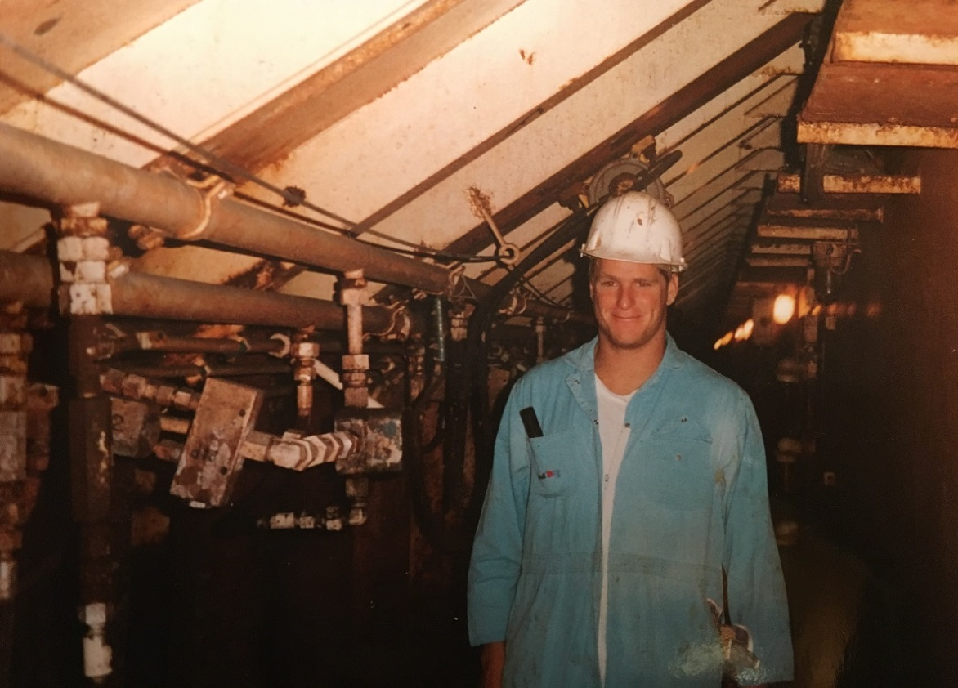
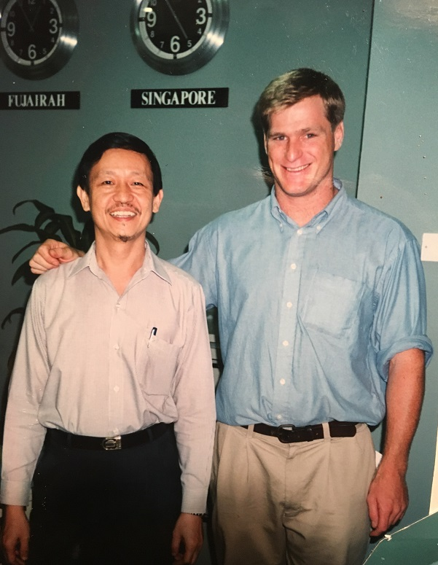
Trainee, Tanker Owner, Singapore, Sept. 1995 – Aug. 1998, Ages 25-27
Aboard a 40,000 DWT bulker carrying salt Bahamas –
VA & NY, Summer, 1995
With HR Manager Mr. Arif Lim, Singapore, 1998

Slide 15
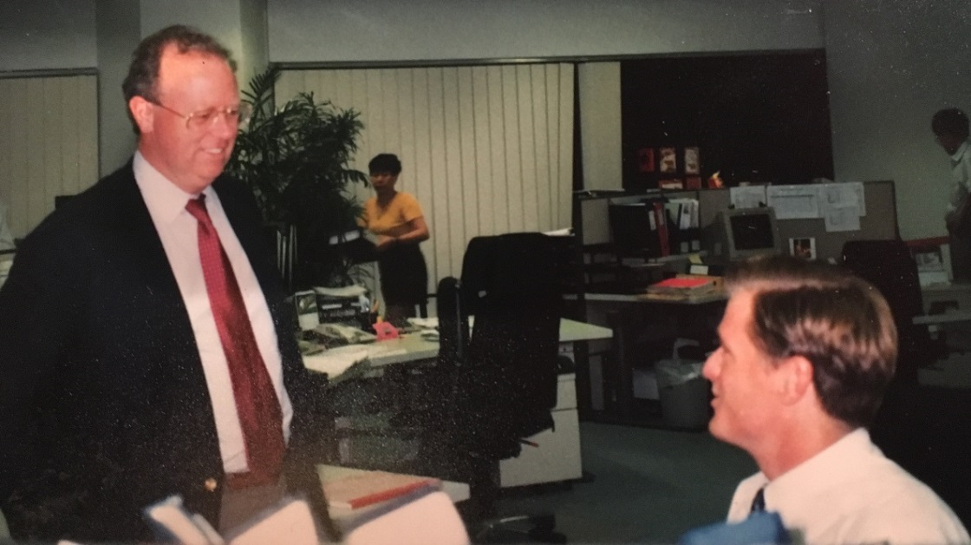
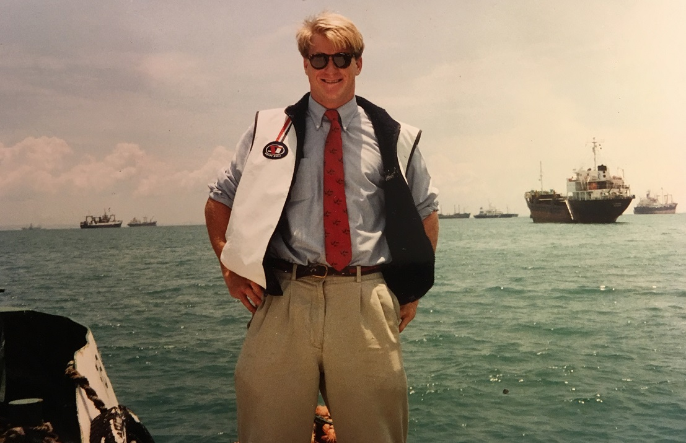
Adapting to a New Environment
Informal – Work hard, party hard. With the owner, Bristol-RI-based Michael Hudner of Bergvall-Hudner (B&H Co./B&H Oceans).
When a friend working at competitor Stolt-Nielsen Chemical Tankers saw this photo, taken during my first week in Singapore, he said that I should have been shot! First trip to the bunker anchorage in a bum-boat. A perk that owners could enjoy any time.

Slide 16
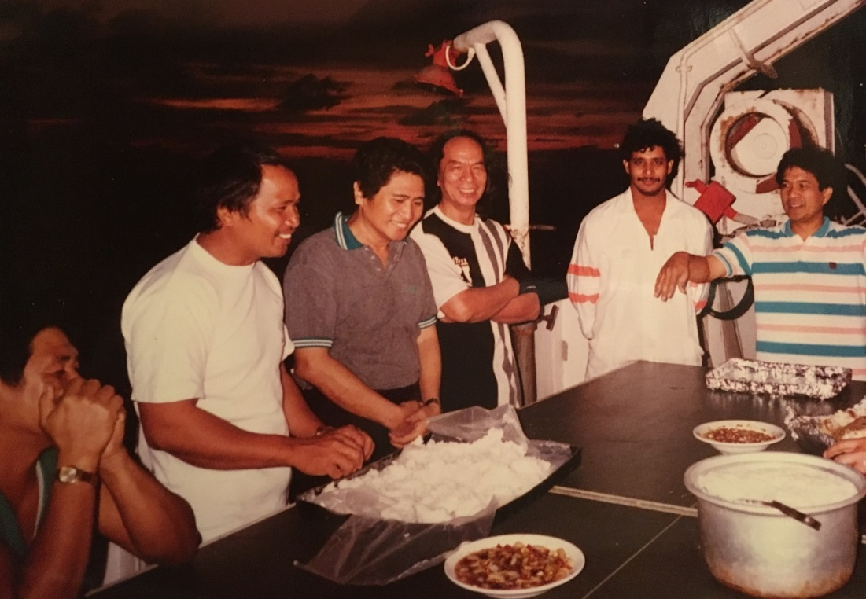
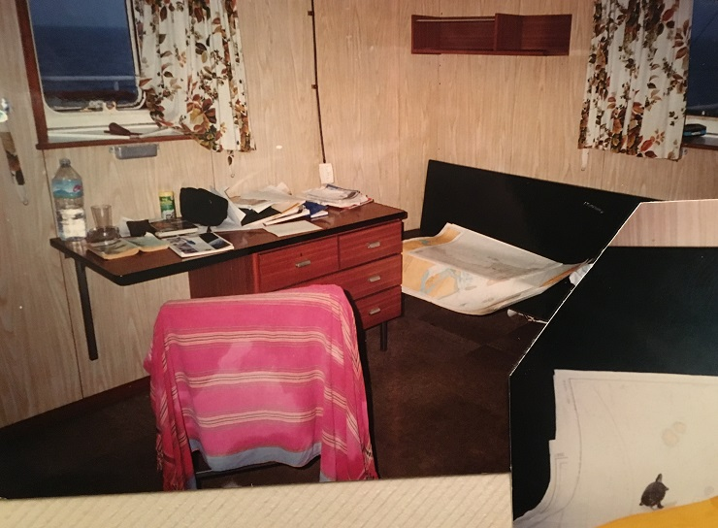
Voyage on M/T Edmo to India, 1995-6
A homogenous crew: All Filipino officers and men. Captain is to far right, waving arms during picnic on deck. To his right is “Dino,” an Indian riding crew working on boilers with Croatians. They welcomed me heartily.
The owner’s cabin: where I stayed for over two weeks, including New Years 1995/1996. Note the charts, several windows, privacy, etc. Also at the lower right corner is one of my two baby turtles, Red and Stripe (red-striped terrapins). I took them along for company. We voyaged from Singapore, the Straits of Malacca, through the Andaman & Nicobar Islands to Visag (Visakhapatnam, Andhra Pradesh), India & back.

Slide 17
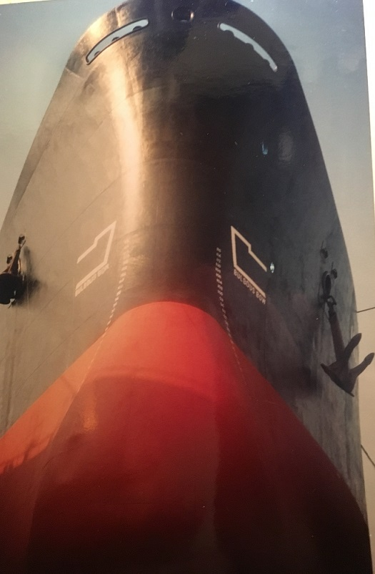
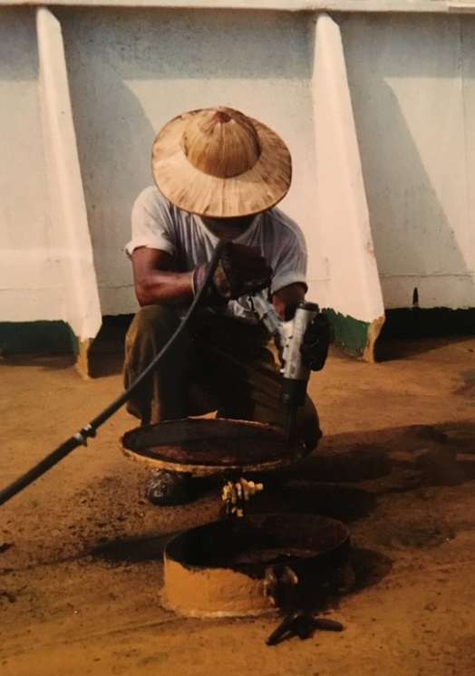
M/T Cury, Explosion off India, 1996
Casualty:
Tanker laden, c. 28,000 tons of gasoline, Arabian Gulf-India.
1996 – Intl. Safety Management/ISM newly implemented
Captain authorized pair of hot workers in slop tank.
Part-gas-filled tank exploded, 1 worker killed, other flung.
Burnt crew moved from deck to tub of cold water.
Indian Navy activated, sent chopper, heli-vacked to Mumbai.
Ship able to make it to Mumbai as well on own steam.
Ships crew’s are bound to follow captain’s orders.
Take-Aways:
Captain said “but I signed the ISM work order.” Paper- work stood in for rather than reinforced common sense.
Helpful Indian Navy, however corrupt shore officials permitted ship to sail within days, before report.

Slide 18
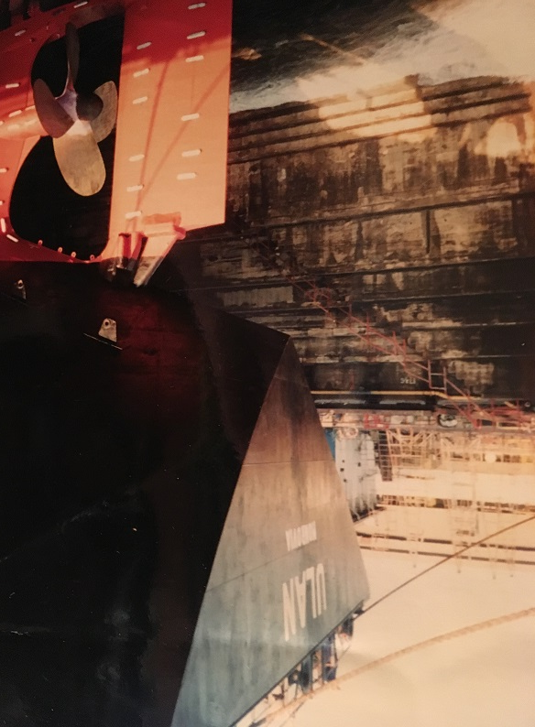
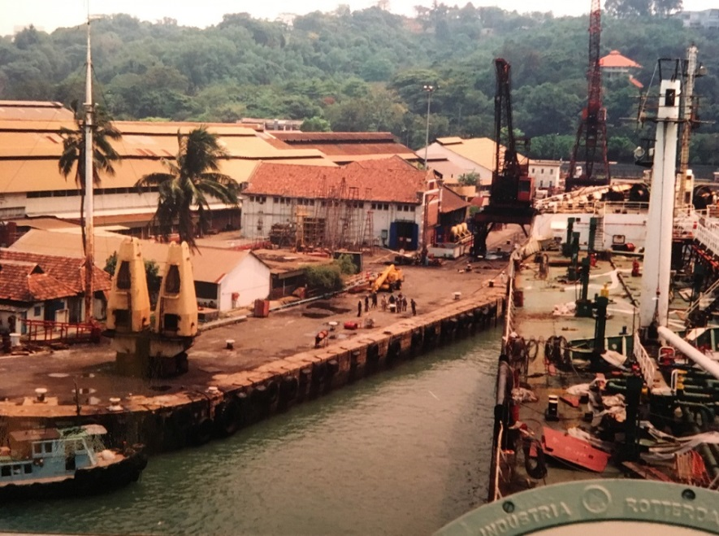
M/T Ulan, 30,000 DWT Product Tanker
M/T Ulan in and being towed out of periodic special survey in Keppel Shipyard opposite Sentosa, Singapore, early 1997. Author spent a few weeks on and off during refit. Ex-Fort Cologne, Canada-Pacific Tankers fleet.

Slide 19
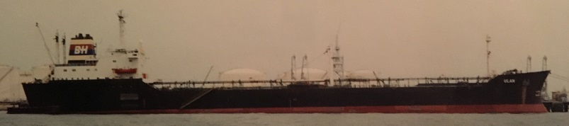
M/T Ulan Cast Ashore, Kandla India
Events:
“On 9th June 1998, a 170 to 200 kmph velocity cyclone struck the coastal regions of Gujarat, near the port of Kandla. Tidal waves as high as 25 feet struck the coastal belt without mercy. When the winds had died down, they left 10,000 people missing, presumed dead, thousands more were left to the mercy of nature. The property damage was estimated at worth more than Rs.25 billion.” That’s $376 million.
YES there were warnings about a cyclone. NO there were no warnings of advance wave
Ulan cast ashore against M/V Clipper Kawa, numerous other ships, far inland.
One crew member ashore climbed a bus, a building, then a boat to return to his ship.
All men safe. General average not declared right away. Tugs scarce. Ship sat for months.
Take-Aways:
Mother nature will dwarf the world’s largest ships. Fortunate no lives lost, oil spilled.
Humanitarian disaster, difficult for owners to communicate with, help crew.
Captain remained on board for months, a lonely, dangerous job. Ultimately towed.

Slide 20
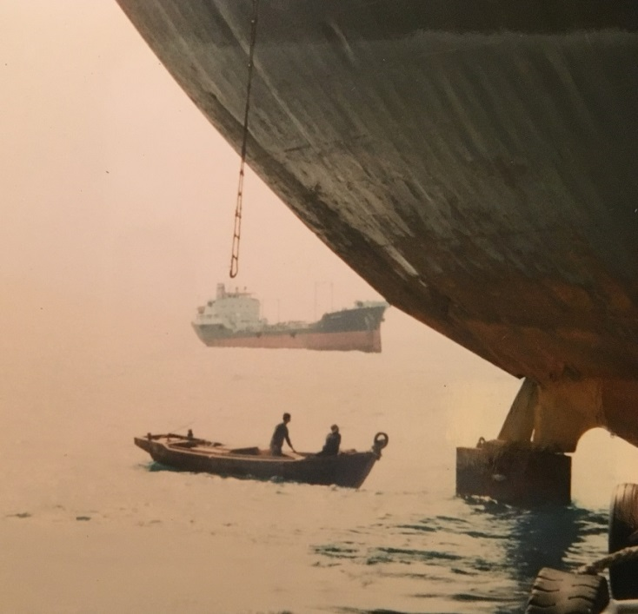
M/T Cury Rocket Attack, Sri Lanka
Footnotes: Before cell phones, you had Telex and Fax, etc. If the Radio Operator and crew are all Filipino, but Captain, etc. are other nationality, crew can use information (sale, redeployment to ice, firing of a popular crew) to mutiny.
Navy: Even some navies are corrupt. Indonesian gunboats fired on our ship when it swung at anchor into their waters. They kidnapped (arrested) the Captain, took vital papers. The Mate took over, we sent new papers, the ship sailed at night far away.
Events: Tamil Tiger terrorists staged a dawn attack with RPG’s from several speedboats.
They targeted a freighter discharging Mirage jets, but machine gun fire hit our ship Cury, and rockets passed overhead. Scared crew called HQ in Singapore. Then a rocket struck our gasoline-laden tanker in a port-side tank, which fortunately carried water.
Take-Aways:
First the Sri Lankan Navy blew the attackers out of the water, ending the attack. Then the UN intervened to restore order. Ship patched up, classed, sailed for repairs in SGP.
Another ship had been attacked in Yemen. Terror attacks on ships are centuries old.

Slide 21
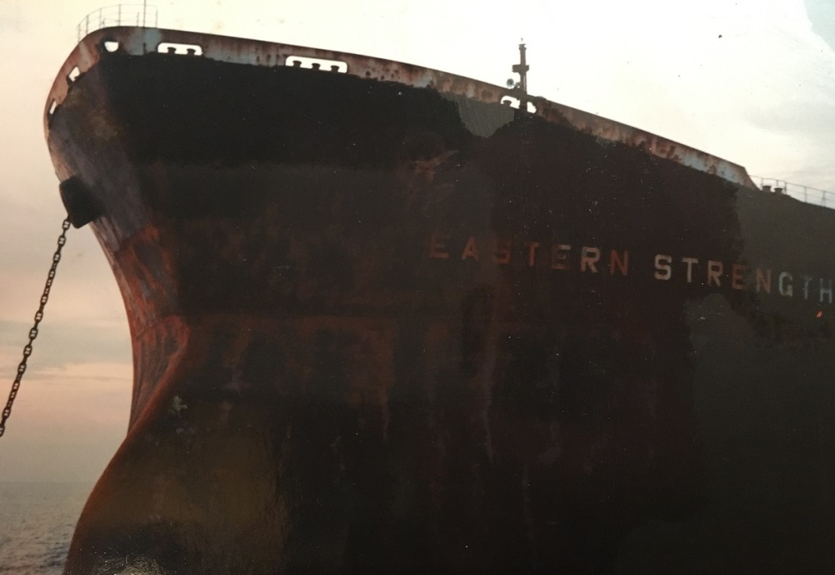
M/T Nafti, Sank Hong Kong, 1998
Events: In spring 1998 M/T Nafti, a crude carrier, berthed at the Mobil Terminal in Hong Kong to discharge about 25,000 metric tons from ship-to-ship, Vietnam.
Suddenly and with no warning, a large valve burst in the engine room, flooding it.
Despite valiant efforts by divers, salvage crews, etc., Nafti sank, resting on bottom.
For many weeks – over a month – the highly valuable berth infrastructure was rendered useless as the ship was patched, salvaged, then sold and towed up river.
Take-Aways: Try as we might, it is extremely difficult to monitor, gauge and class old
machinery such as valves. It might be repeatedly painted and look healthy, but inside be all corroded, or a weld have given way. Only extensive ultrasonic sounding can tell.

Slide 22
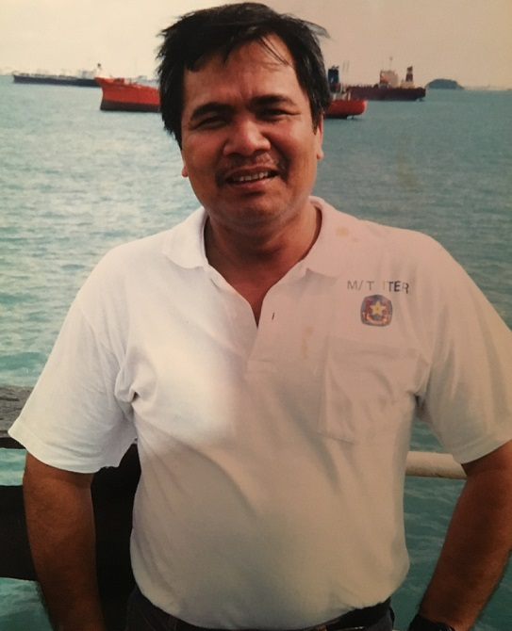
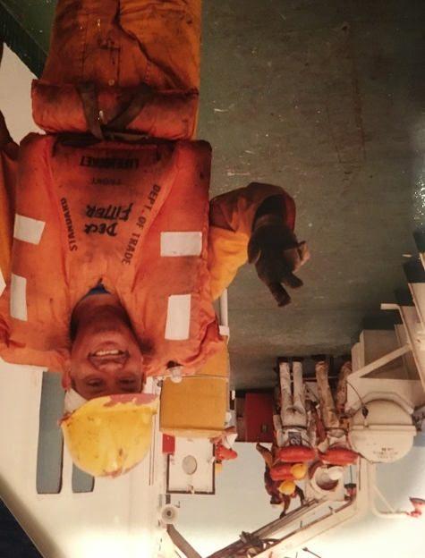
The Human Toll: 4 Deaths, 3 Years
Life at sea is dangerous:
Suicide: ‘Dear John’ letter in Arabia. Unable to land. Given an escort. Ditched escort, hanged himself in the laundry room. Taken Durban.
Heart Attack: Off Mozambique. Same ship, same freezer used for the men’s food.
Murder: Young men in a fight, one stabbed.
Explosion: M/T Cury slop tank explosion.

Slide 23
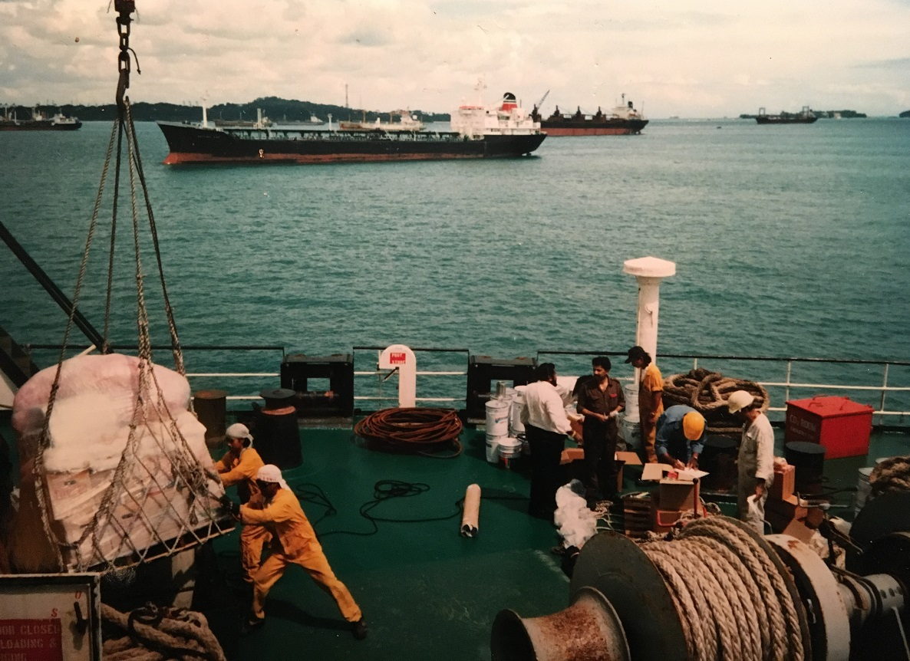
Exciting Global Industry, still! (& safer)
How it works: Global cooperation; folks of many nations and tongues conduct business: owners order the supplies for engine room, ship and galley. Officers sign for it. Crew stow it. Ships of all types lie at anchor ready to deliver or carry cargoes of all descriptions to all corners of the planet. Somehow, the pieces all fit together.

Slide 24
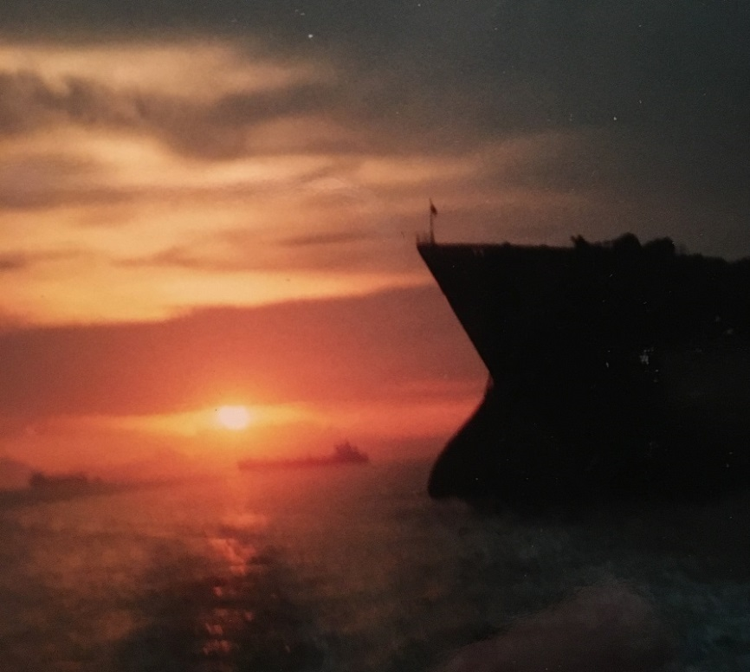
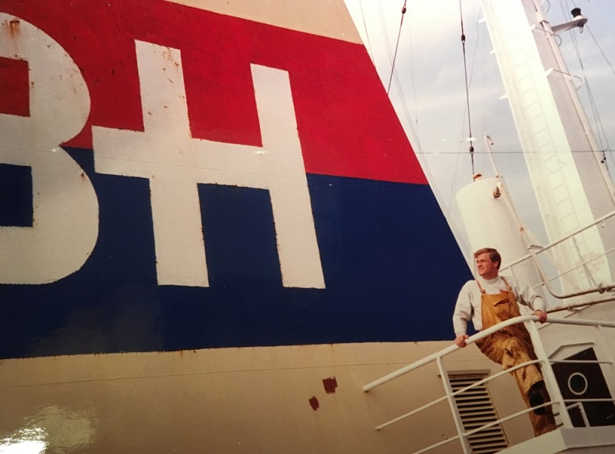
Questions?
Thank You!
www.ericwiberg.com
www.yachtvoyages.blogspot.com
www.wrongseason.net
eric@ericwiberg.com
Westport, CT

