Slide 1
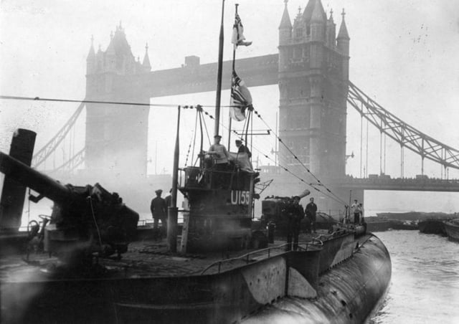
long island sound in War infanta, Spanish-American war,
U-Boats in wwi, WWII
Capt. Eric Troels Wiberg, Esq.
Retired Men’s Association, Greenwich CT
Luncheon, Weds. 25 March, 2026

Slide 2
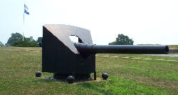
Spanish American War Trophy Groton CT
The cruiser Infanta Maria Teresa fought in the 1898 Battle of Santiago displayed at Fort Griswold Battlefield State Park in Groton
The 140mm cannon from the Spanish flagship Infanta Maria Teresa.

Slide 3
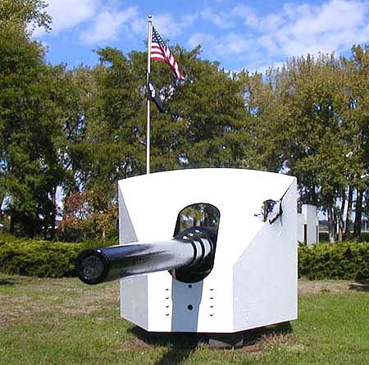
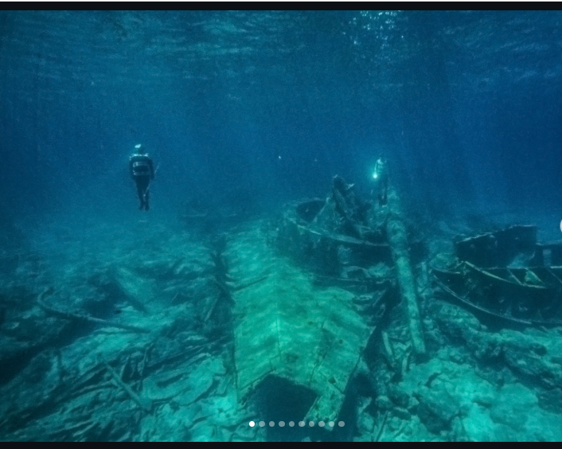
Infanta’s Other Guns: Ottumwa Iowa & Bahamas

Slide 4
German u-boat Deutschland & long island sound World War I

Slide 5
Privately-funded German cargo submarines Deutschland and Bremen traded in Baltimore and New London.
Hapag-Lloyd and Deutsche Bank funded the expeditions, to bypass the blockade
Deutschland carried a mixed cargo valued at $17.5 million, or several times the cost
she called at New London with $.25 billion worth of gems, securities, and medicines
Sank US tug-boat T. A. Scott, Jr., killing all five officers and men, on Nov. 16, 1916
U-53 visited the US Navy base in Newport on 7 Oct. 1916
Left, sank 4 Allied ships off Nantucket, causing Canadian & British navy to race there
only ending when the British ship Stephano was stopped and searched and “….the gathering American destroyers took off its crew and passengers,” enabling the Germans to then sink her.
Deutschland was repaired in New London, and returned to Germany with at least six-and-a-half tons of silver bullion
Deutschland joined Imperial German Navy as SM U-155 sank 42 Allied ships
survived the war, cut telegraph cables at St. John’s, patrolled Nantucket in Sept. 1918.

Slide 6
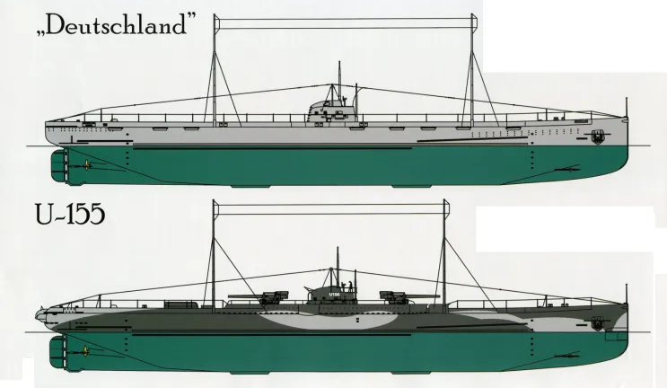
U-155 Deutschland

Slide 7
U-Boat Deutschland Overview
Deutschland was the only successful unarmed sub
U-155, armed with 6 torpedo tubes, fore/aft, 2 guns on deck.
Often U-boats only submerged for stealth and speed
U-155 raided June 1917 to Oct. 1918, sinking 120,434 gross registered tons of shipping and damaging 9,080 more.
Overall in WWI it is estimated that the German navy attacked or sank c.5,500 Allied ships of 30% of the world fleet at c.12 million tons plus 100 Allied warships in WWI.

Slide 8
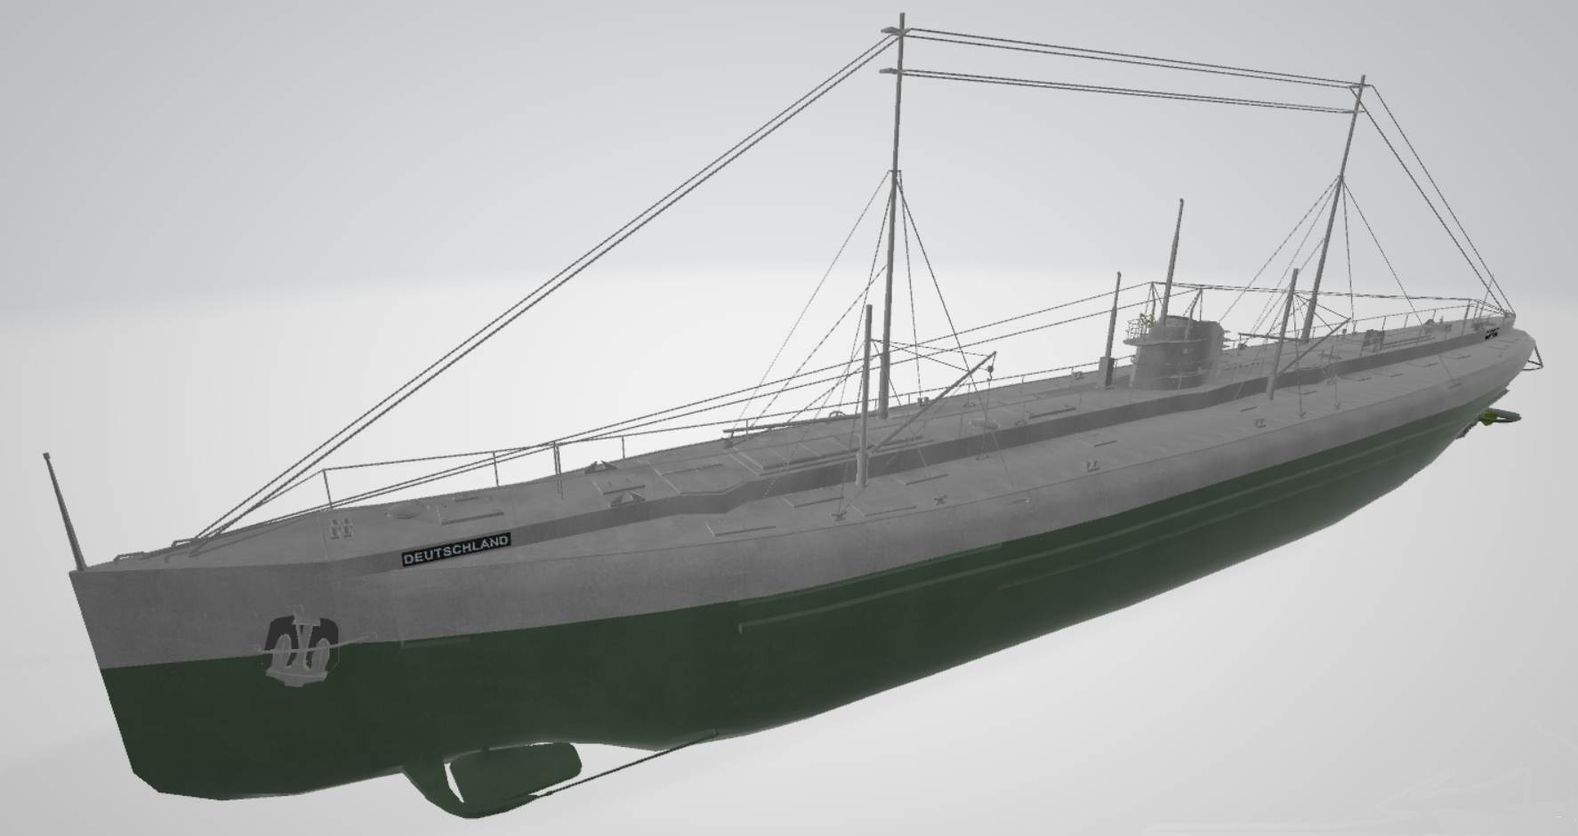
Collision with Tug in CT Waters
On 17 Nov. 1916 Deutschland accidentally rammed tug T. A. Scott, Jr.
T. A. Scott, Jr., sank immediately with the loss of her entire crew of five.
Deutschland's bow was damaged, returned to New London for repairs, delayed a week: cargo that included 6.5 tons of silver bullion.
Capt. Paul König wrote Voyage of the Deutschland, the First Merchant Submarine, intended to sway public opinion in both Germany and the US.
3d voyage, planned for Jan. 1917, was aborted.

Slide 9
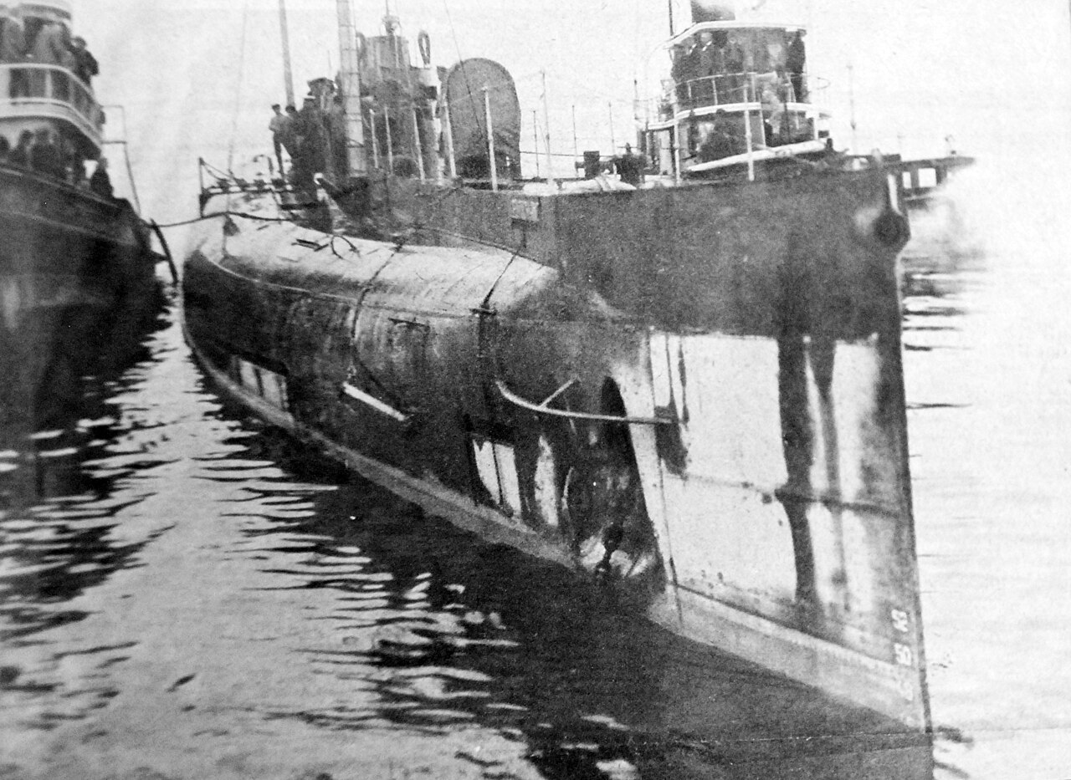
Deutschland in Baltimore Harbor

Slide 10
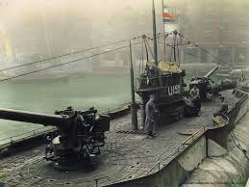
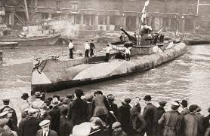
Overview
74 U-boats attacked New England;
7 surrendered or were brought there post-war
13 Italian, French submarines were moved along the region’s coast: 94

Slide 11
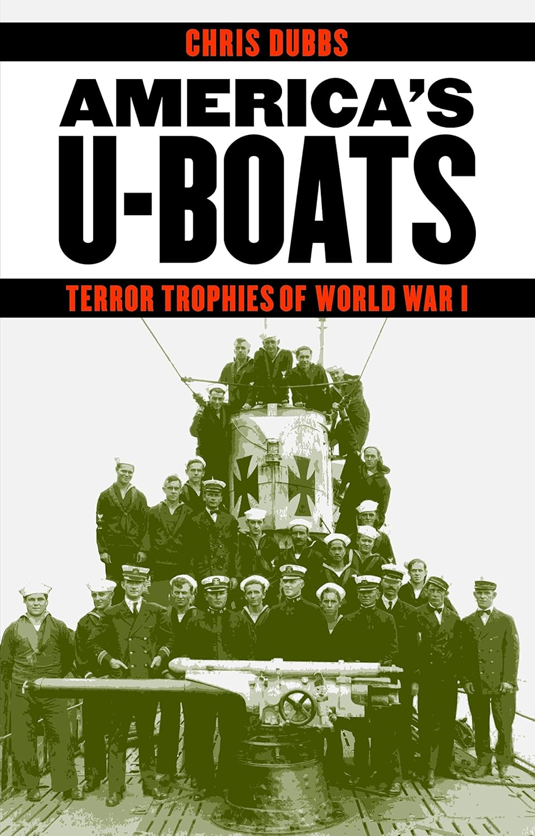
US Navy Manned 6 Captured U-Boats to 1921
Submarines were one of the most revolutionary weapons of World War I
After U-boats sank the Lusitania and began daring attacks on shipping off US East Coast. American press dubbed them “Hun Devil Boats,” “Sea Thugs,” and “Baby Killers.”
U.S. Navy acquired 6 U-boats to study until their destruction under armistice in 1921, these as USN ships, manned by American crews.
They toured 80 US cities to promote the sale of victory bonds and recruit sailors.

Slide 12
The T.A. Scott Company of New London, incorporated 1903.
In 1922 it was merged with the Merritt & Chapman Derrick & Wrecking Company to form the Merritt-Chapman & Scott/
Thomas Albertson Scott (1877-1961) became president.
Built the Connecticut State Pier in New London.
In 1915 it added a warehouse to the pier to handle cargo brought in by German commercial submarines.
Scott was commissioned Lt Commander in U.S. Navy in charge of all government salvage in American, Europe.
He served on the United States Shipping Board.

Slide 13
The Deutschland sailed at night contrary to assurance
tug T.A. Scott, Jr. was ahead of Deutschland, reached Race, Scott was caught by current and swung broadside
unable to stop, sub crashed into tug, sank it immediately.
only survivor was Capt. Frederick Hinsch, manager of German Overseas Navigation Company, sub’s owner.
He could not swim and was wearing a heavy topcoat.
Extra edition of the paper headlined: “FIVE MEN LOST WHEN DEUTSCHLAND SINKS TUG T.A. SCOTT, Jr.”

Slide 14
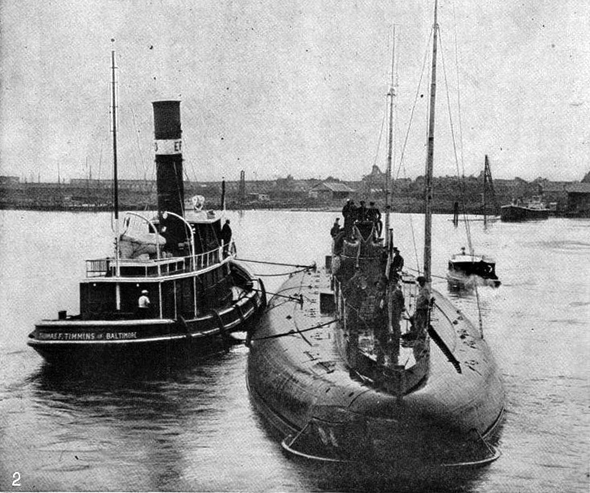
U-Deutschland at Port of Baltimore, 10 July 1916

Slide 15
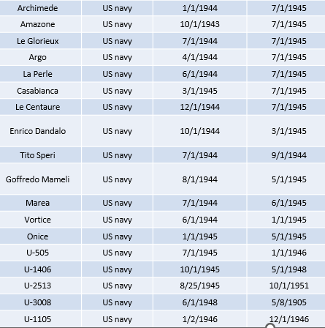
Italian & French Submarines in CT in WWII

Slide 16
Mattawin, Transit Long Island Sound WWII
12 prep-school and Ivy-League-educated volunteers in the American Field Service were passengers on their way to operate ambulances in the Middle East and beyond. included Richard Edwards, Princeton in 1939, Nicholas Madeira Jr., Harvard ’43, Edward Fenton, Amherst ’37, James Morrisey, Edward LeBoutillier, Ronald Gubelman, MIT ’22, Coffin Wilson III, Pennsylvania Museum School of Industrial Art, Harry Blackwell, Charles Fagan, Robert Nelson, William Shoemaker, and Marshall Phelps, Yale ’35
7 AFS volunteers’ sunk aboard the Swedish steamer Agra by U-654 under Forster between New England and Bermuda on 20 April 1942.
Mattawin left New York on 29 May at 8 p.m. anchored off City Island, Bronx
they headed east through the sheltered waters of Long Island Sound
compelled to stop just 3 hours later due to engine trouble. Torpedoed soon.

Slide 17
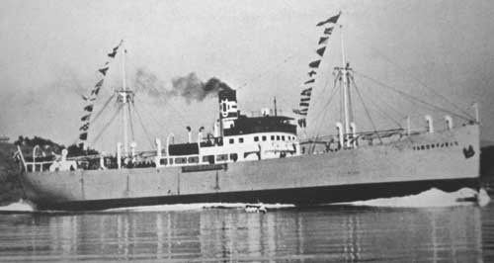
Other Ships Using LI Sound to WWII Fates:
Alexander Macomb 66 men; eight merchant officers, 33 merchant sailors, and 25 naval gunners. Crew set off from New York on 1 July. On the way from City Island, Long Island Sound, to Halifax, she stopped in Woods Hole. Sunk Canada.
Taborfjell in NY 28 April, left the following day on its final voyage. Proceeded via Long Island Sound through Cape Cod Canal, for Montreal.

Slide 18
Skottland headed up the East River, through Hell Gate and Long Island Sound, sailed through the Cape Cod Canal noting “nothing of Naval interest”
Liverpool Packet The cargo included “bales of blankets, a large quantity of potatoes, flour, copper pipe, two big dynamos, each weighing about eight or nine tons, and car tires. On deck were 8 cars and 6 trucks, copper plating, jugs of acid,” with one crew adding “canned milk, prunes, onions, five thousand cases of American beer, steel plates for ships, barrels of oil, Packards, Pontiacs and Studebakers, and two Mack trucks – the Lord only knows what else.”

Slide 19
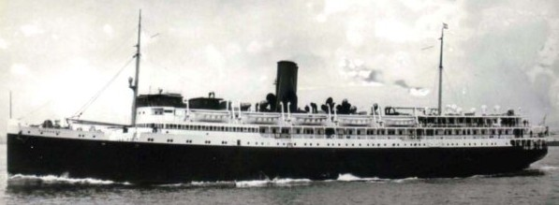
Mallory of Mystic Owned SS Cherokee, Soviets
Cherokee’s “interior was still pretty much as she was in normal operation, and she had not yet been converted for troops.”
Embarked troops to Iceland, where the US Navy and US Air Force maintained bases. Left NY for Providence 29 April, arrived the following day, loaded cargo and boarded passengers and sailed 4 May for Boston via the Cape Cod Canal.

Slide 20
Soviet Capt. Affanasi Melechov, master of a Russian ice-breaker passenger on Cherokee, washed ashore in the bucolic boat-building town of Southwest Harbor, Maine July 25, 45 days after
Konstantin Volokov of the Soviet Consul-General in New York was sent to Maine and recovered the corpse, as well as Captain Melechov’s Soviet passport and a letter of credit which he carried. The Soviet embassy assumed overall responsibility for the case: unknown where Melechov was buried. 2 Soviet Navy officers on Cherokee: Anatoly Bolkov and Eugin Kohliacov.
A possible factor in the high mortality rates is that “one of the destroyers screening the rescue dropped depth-charges.”
mines which Berger had laid at the approaches to Boston

Slide 21
Black Point from Long Island Sound May ‘45
May 1945 Black Point set off from Newport News, Virginia for an unescorted voyage to Weymouth, south of Boston. ..rounding Point Judith to port and heading east along southern shore RI
4 miles from Point Judith and making eight knots, not zig zagging two other freighters, a tanker, and a tug towing two barges visible to the lookouts… tug Chaplain was completed just weeks before
deck-hand Louis Alfred Coley, Jr., 19-year-old waterman whose mother, Catherine Madden, was born and raised on a barge in Boston. Coley said that “the sub was right under, and along their tug, and used it as cover, travelling in their shadow. They didn't realize this until it was too late, and the ship had been hit.” watched as “…the ship was being circled by the U-boat” – left.

Slide 22
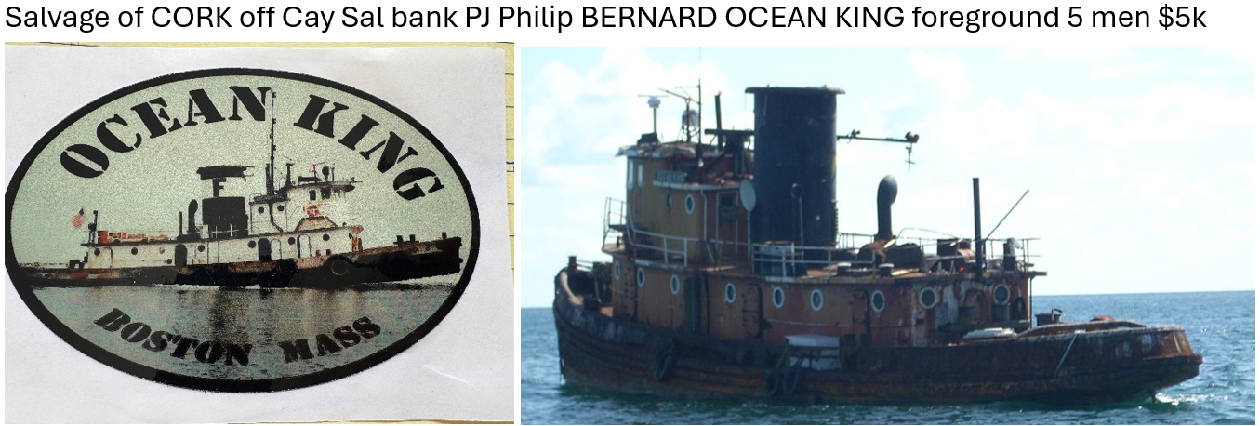
Many lives of tug: was acquired by Foss Maritime or McAllister Towing. Sadly, she seems to have been little-used as her last US-owner referred to her as the “old girl,” and said her nickname was Pond Prince. The historic workhorse is believed to be either in the sand-mining sector or laid up in the Bahamas under the name Carina

Slide 23
Carina rediscovered this year (2026) Bahamas
In 1946 Chaplain joined the fleet of another Bushey affiliate, Sheridan Towing Company and sailed as Margaret Sheridan. From 1951 to 2004 her named remained the Ocean King, under the ownership of Red Star Towing
Amerada-Hess Corporation, in 1977, then Farrell Ocean Services, then McKeil Marine Company, Russell Tripp, Bay State Towing Company, Constellation Tug Co. of Boston.
Carina seems to have been little-used as her last US-owner referred to her as the “old girl,” and said her nickname was Pond Prince.. Then in the sand-mining sector or laid up in the Bahamas under the name Carina.

Slide 24
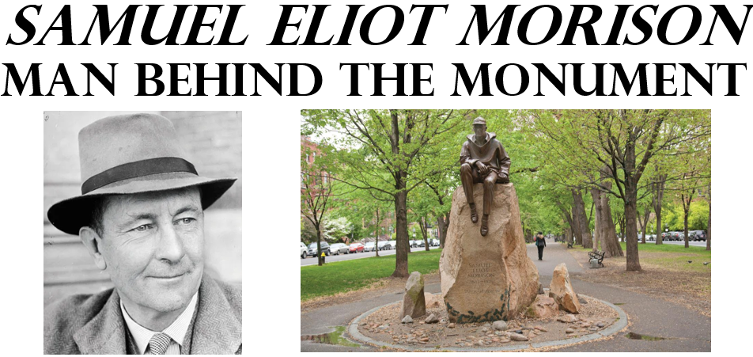
Tribute to Mentor: Admiral & Professor
Like Admiral Samuel Eliot Morison, never give up. Persist. “Dream dreams, then write them – aye but live them first!”

Slide 25
T H A N K Y O U ! !
Questions?
Thanks Troy Johnson, Uncle Ralph McDermid, The de Ramel Foundation, MERS
www.ericwiberg.com
18,000 pages of history
Leads & sponsorhips welcome at
eric@ericwiberg.com

