Slide 1
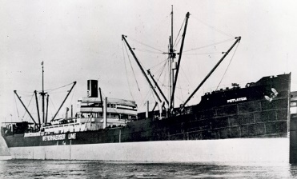
S.S. POTLATCH: Sunk by U-153 on 27 June, 1942, 48 men drifted for 32 days, 46 survivors rescued in Bahamas, taken to Nassau by oil heiress & greeted by the Duchess of Windsor August 1, 1942.
Presentation to the Propeller Club of New York & New Jersey
By Capt. Eric T. Wiberg, JD
Thurs. 6th November 2014

Slide 2
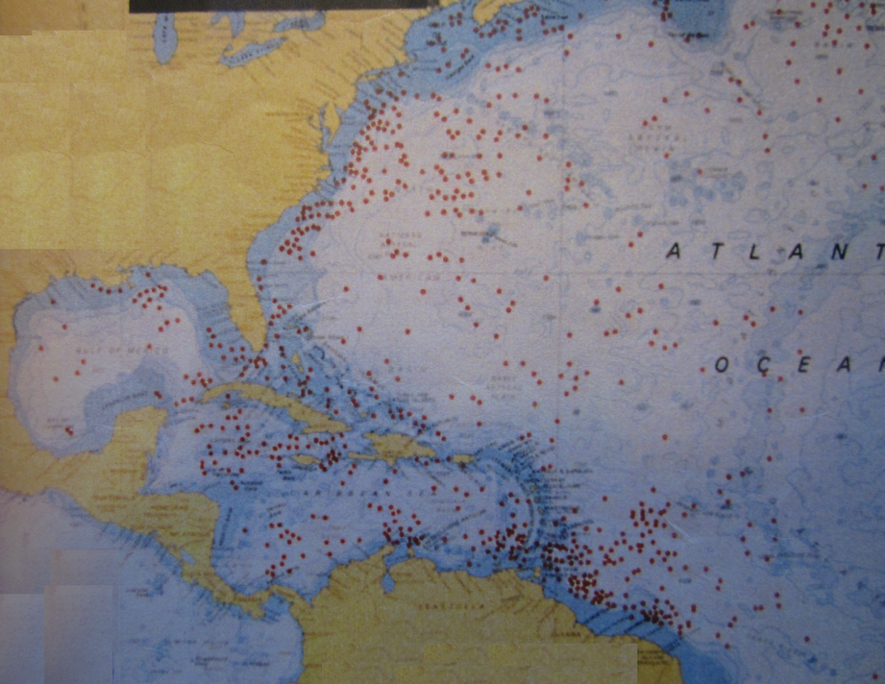
112 German & Italian U-boats attacked 130 Allied ships around the Bahamas from Jan. 1942 to Sept. 1944. 690,928 DWT and 1,239 men were lost….

Slide 3
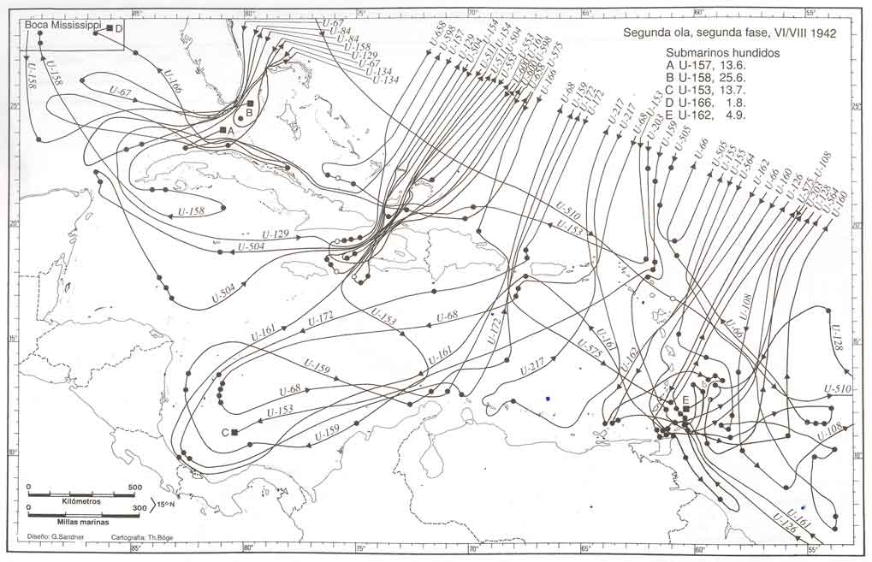
On one day (July 1, 1942) there were 12 U-boats in the million-square-mile area around Bahamas
The Axis objective was to sever the oil supply lines from Venezuela, Curacao/Aruba and Texas to NY, Halifax and ultimately the UK, thus starving the UK out of the war.
The (eventually effective) Allied counter-measures included convoying, carrier-based hunter-killer groups mid-Atlantic, centi-metric radar, the hedge-hog, and signals intelligence (Enigma decryption).

Slide 4
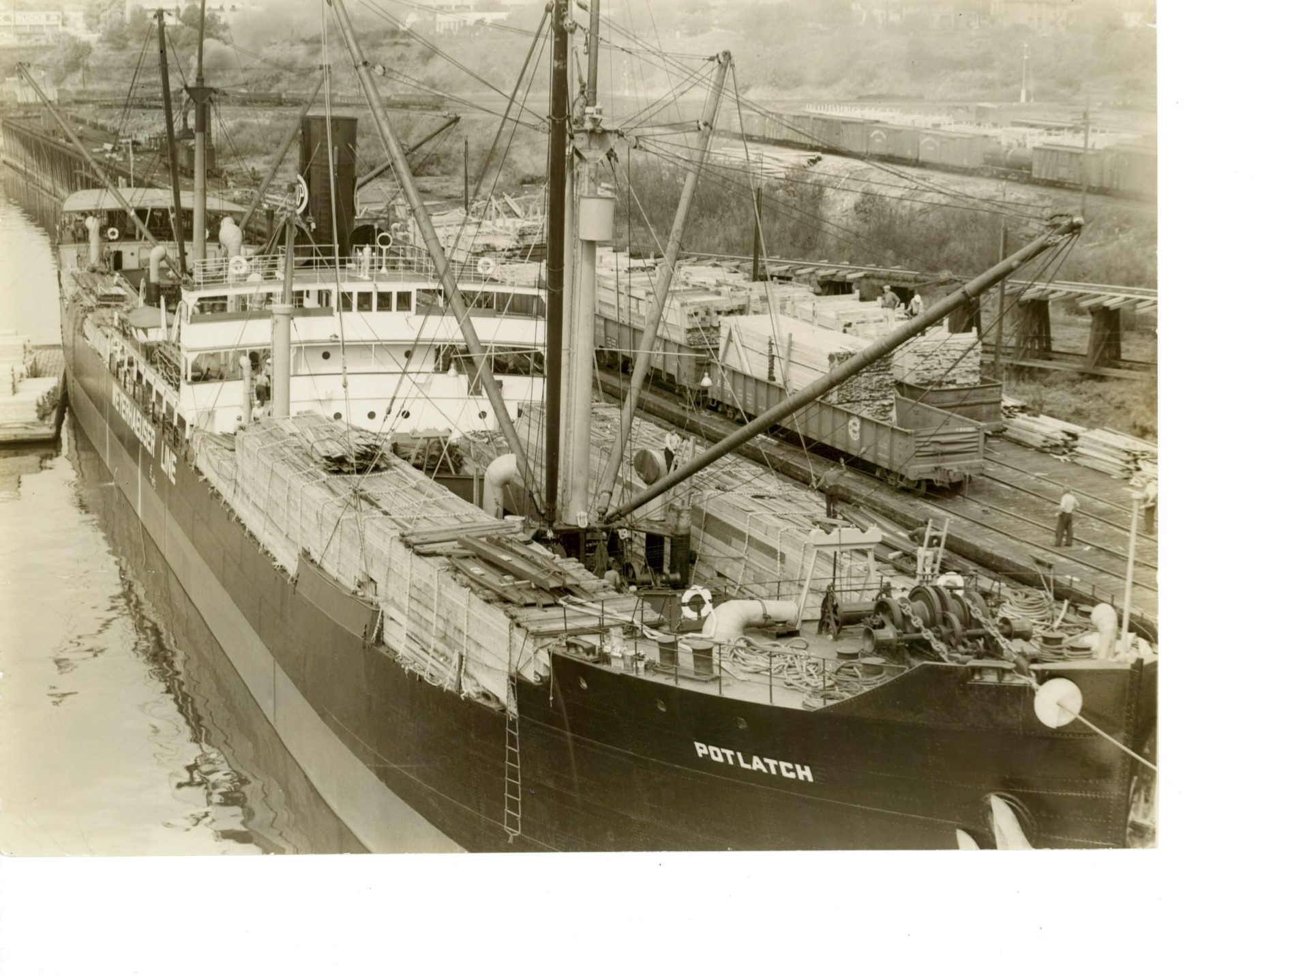
The ship:
Built 1920 by Moore Ship-building of Oakland, owned by Weyerhaeuser SS Co. of Tacoma. 6,085 GRT, 405’ LOA, 53.5’ wide, 32.3’ deep. One 4-inch gun, machine guns. Bound NY – Suez via Cape Town with war supplies.

Slide 5
Last known photo, New York Harbor, 6 June, 1942: Note tank trucks (not tanks) on deck as well as gun wells, crows nest, lifeboats, rafts.

Slide 6
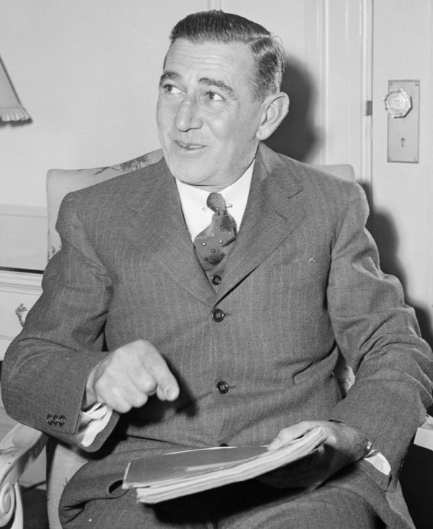
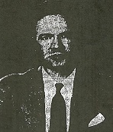
Capt. John “Jack” Joseph Lapoint, Baltimore. His next ship, the “Samuel Gompers” was sunk in the Pacific by the Japanese. Photo taken mid 1943.
Lt. Dorsey Lybrand, head of Armed Guard, later politician, lawyer (Jatho said “it figures” on learning that….).

Slide 7
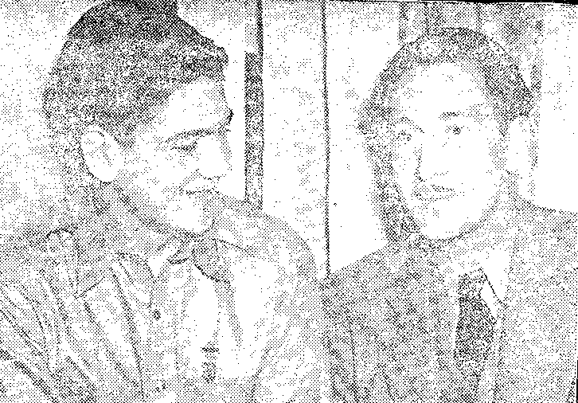
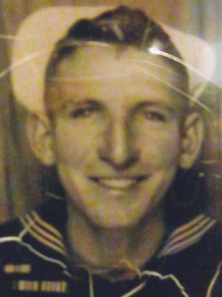
Henry Jensen with USN publicist Earl Schenck
Thomas Marion King of the Carolinas, member of the gun crew
Jake Jatho, 16-year old Naval Armed Guard

Slide 8
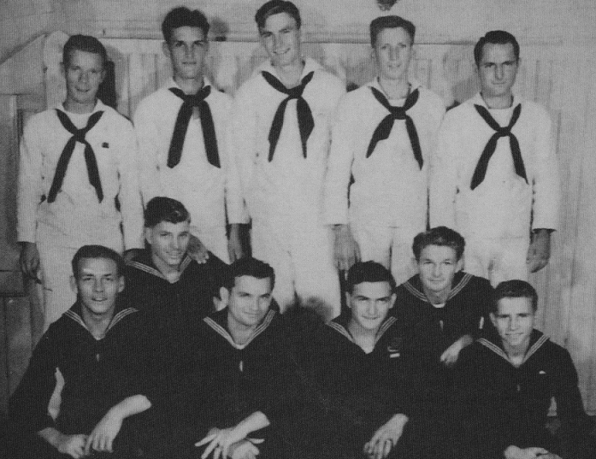
Young recruits: Naval Armed Guard – Jake Jatho back row 4th from left, Dempsey Ruggles front row, bottom right corner. Both were teenagers then and are alive today.

Slide 9
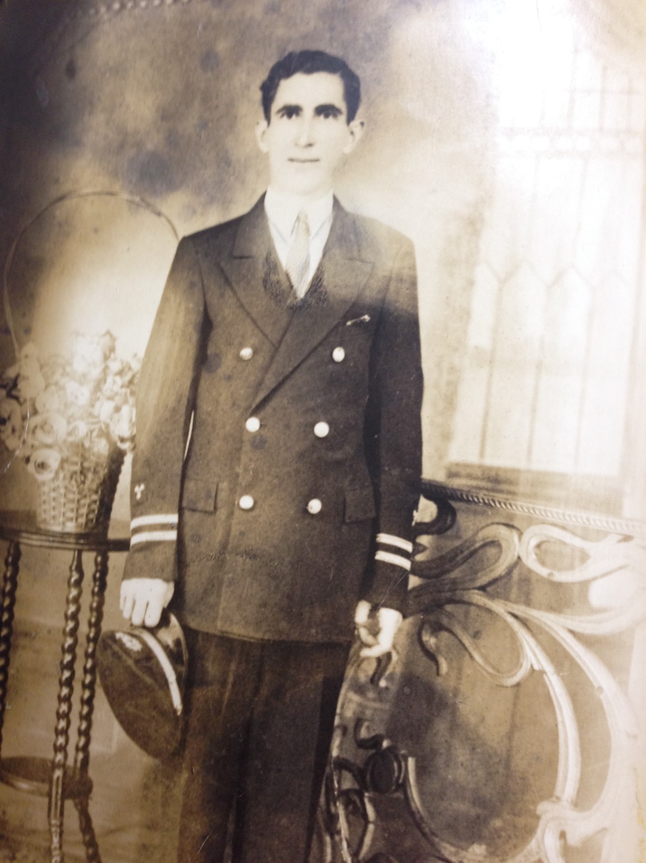
Basilios Palaeologas, Deck Engineer, KIA
Steward David Parson, aged 57, died
in lifeboat, buried in remote Bahamas

Slide 10
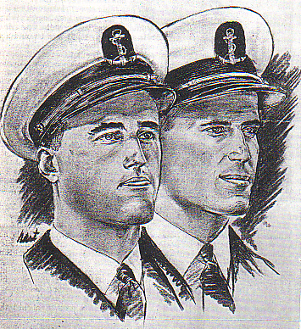
Kings Point Midshipmen-Cadets Nathan Kaplan (left), James Carbotti
Gunner Solomon Goodman of Virginia, later a lawyer

Slide 11
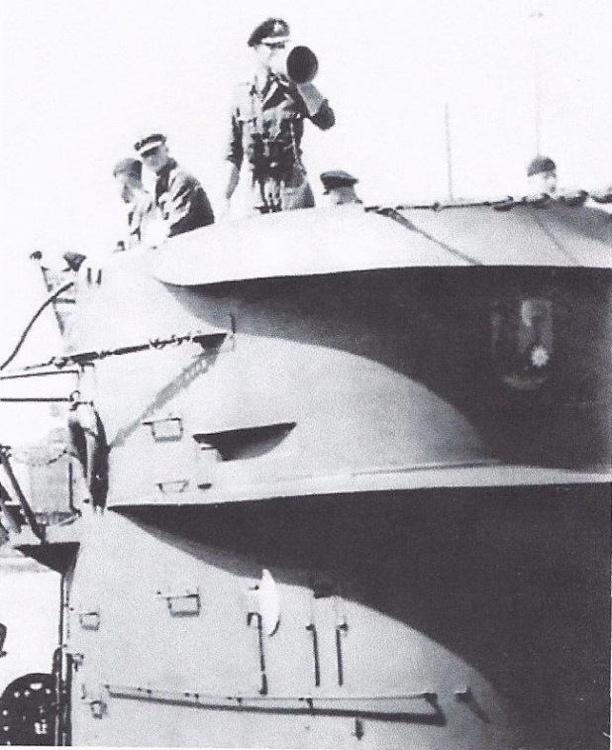
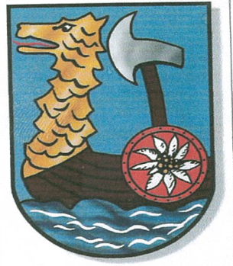
The Germans: U-153 and Wilfried Reichmann
U-Boat Commander Korvettenkapitän Wilfried Reichmann, 36 is in white cap. First Watch Officer Oberleutant zur See Wolfgang Felsch, aged 25, holds the
megaphone. Taken between patrols, probably in Lorient France June 1-6 1942.
Emblem of U-153, U-Axt: Their motto was “be bright, cheerful, and strike them hard.”

Slide 12

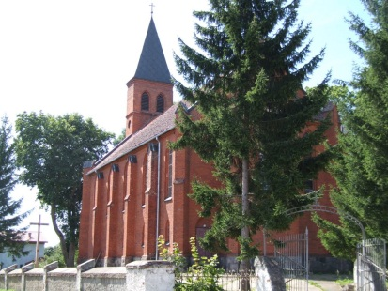
The church in Wittigwalde, Prussia where Reichmann’s father was a vicar.
Sail training vessel Asta of which Reichmann commanded with distinction, in the Baltic Sea pre-war.

Slide 13
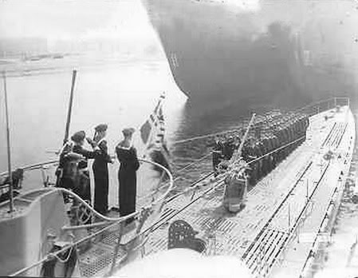
Commissioning ceremony of U-153 in Stettin (now Poland), 19 July 1941. Note deck gun. Reichmann is likely the officer saluting to the left.

Slide 14
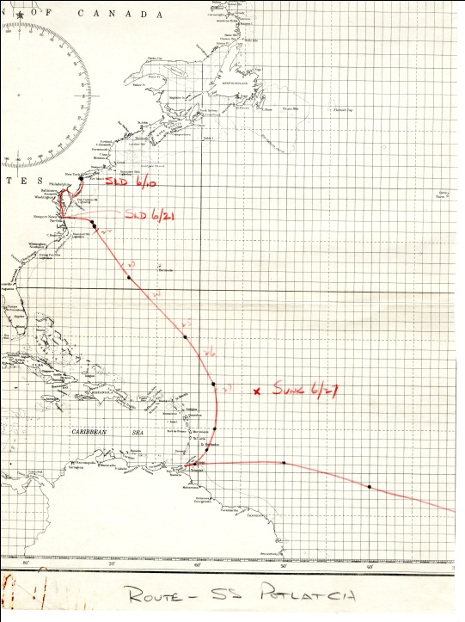
US Navy chart showing deviation of Potlatch from proscribed route, attack and loss on 27 June, 1942. Also shows departure 10 June and convoy from New York to the Virginia Capes.

Slide 15
The attack, June 27th 1942: Abandoning ship with a geyser of oil and water erupting. All sketches from “Liberty” Magazine, June, 1943.

Slide 16
Interrogation by Felsch & Reichmann – Lapoint was incapacitated by injuries.

Slide 17
One 26’ lifeboat, four rafts set out westwards with 49 men….

Slide 18
Shark is brought aboard, bites John “Stinky” Miller’s arm, is lost overboard….

Slide 19
Miller is buried at sea after about three weeks. 48 men left in the lifeboat.

Slide 20
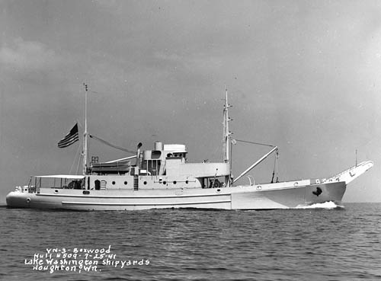
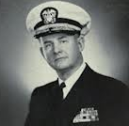
Meanwhile on 13 July 1942 U-153 attacked the USS “Mimosa” (sister ship at left) off Panama. It was sunk with all hands by USS Landsdowne under Commander (later Rear Admiral) William Renwick Smedberg, III.

Slide 21
The 48 Potlatch men land in Great Inagua, SE Bahamas and forage for water by following wild jackasses.
They light a fire, dig a well, gather conchs and whelks and prepare a stew.

Slide 23
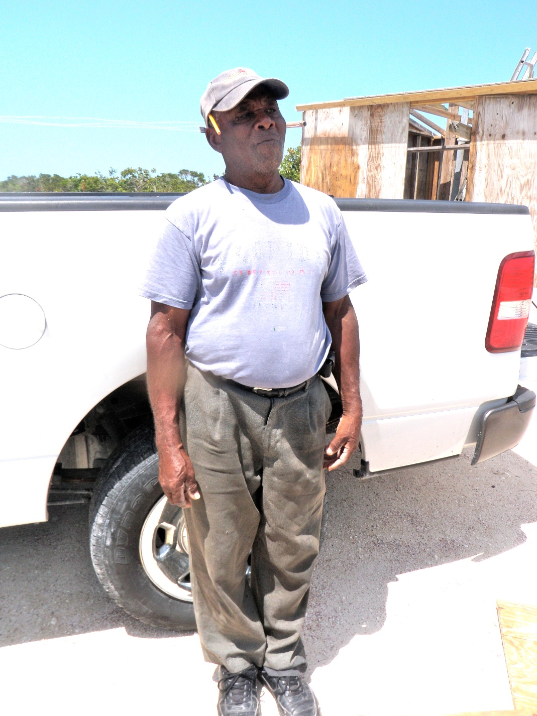
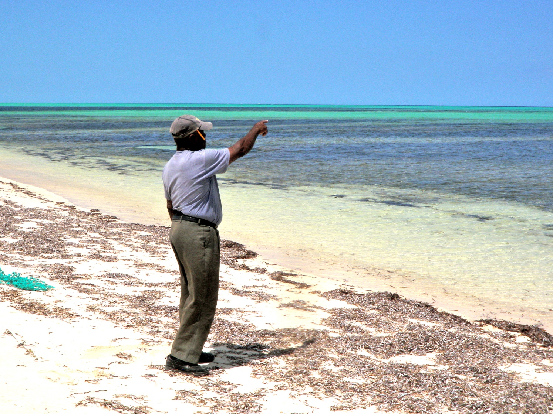
Eye-witnesses to the landing of the Potlatch men, recorded in 2013 by volunteer historians:
Newton Williamson, a little boy at the time points to where the “Potlatch Jr.” landed on 29 July 1942.

Slide 24

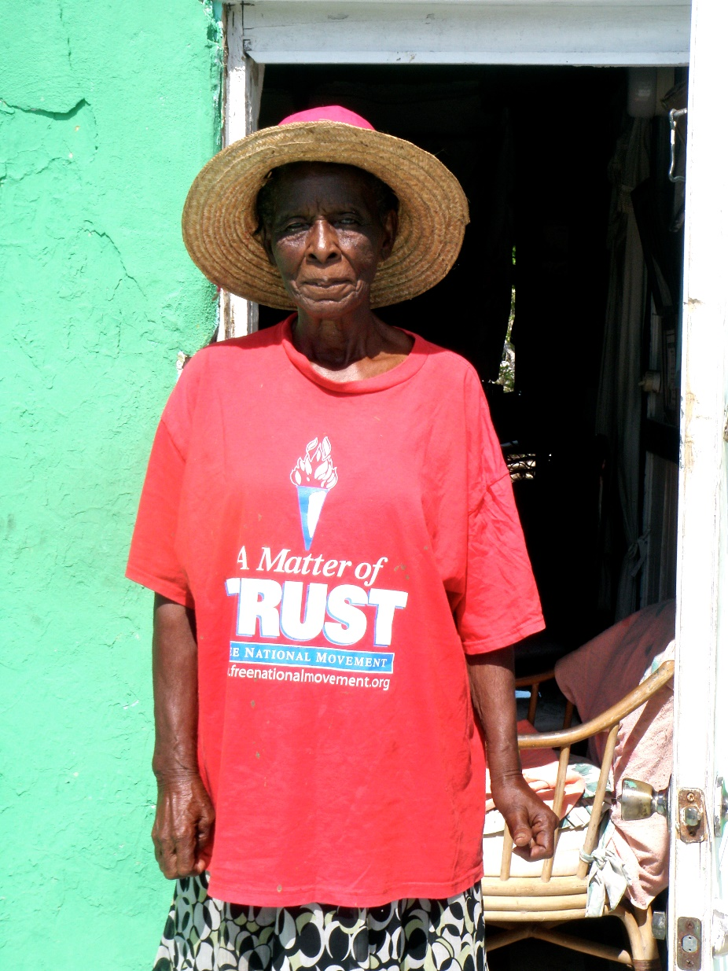
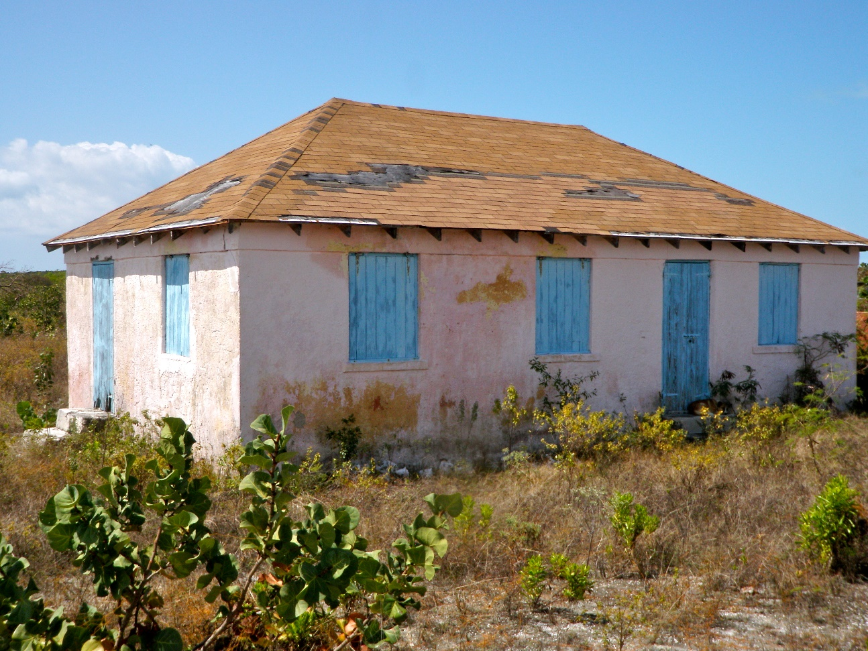
Rev. Remilda Cox, daughter of Rev. Capt. Collie, Acklins:
Recording:
School House in Hard Hill where the 47 survivors rested and were fed.

Slide 25
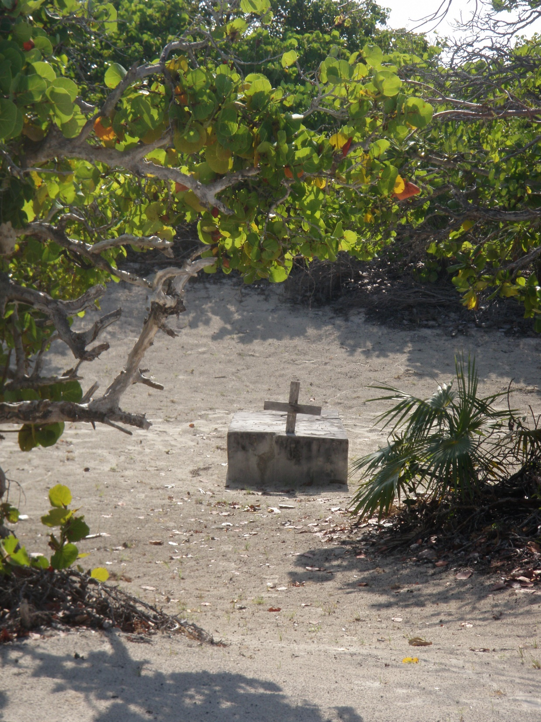
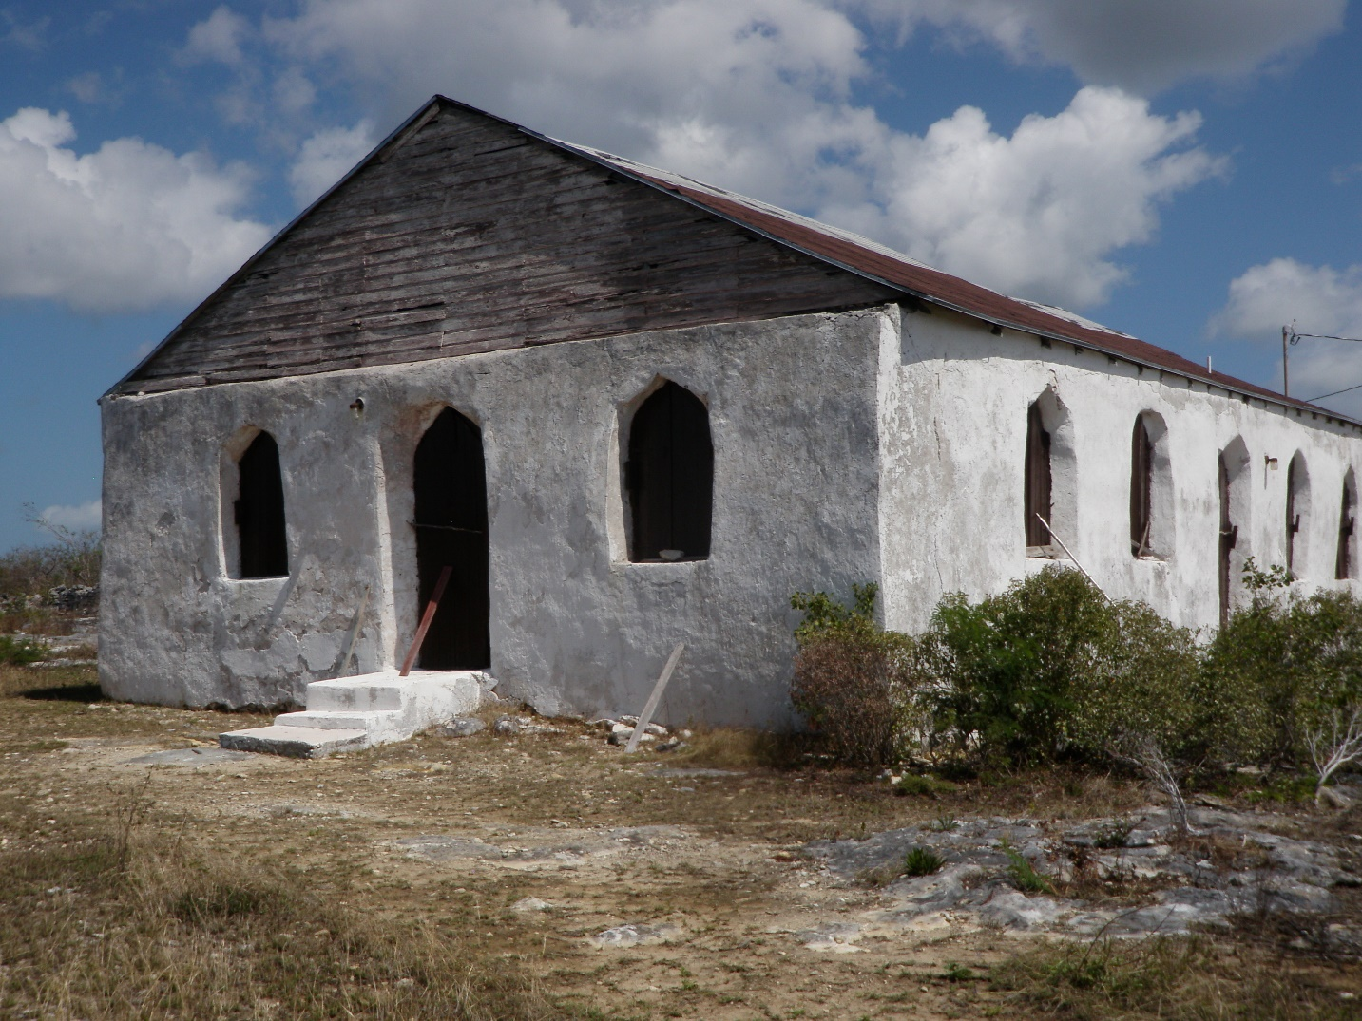
Church where locals sang dirges for David Parson, and the cemetery he was buried in on 30 July, 1942.

Slide 26
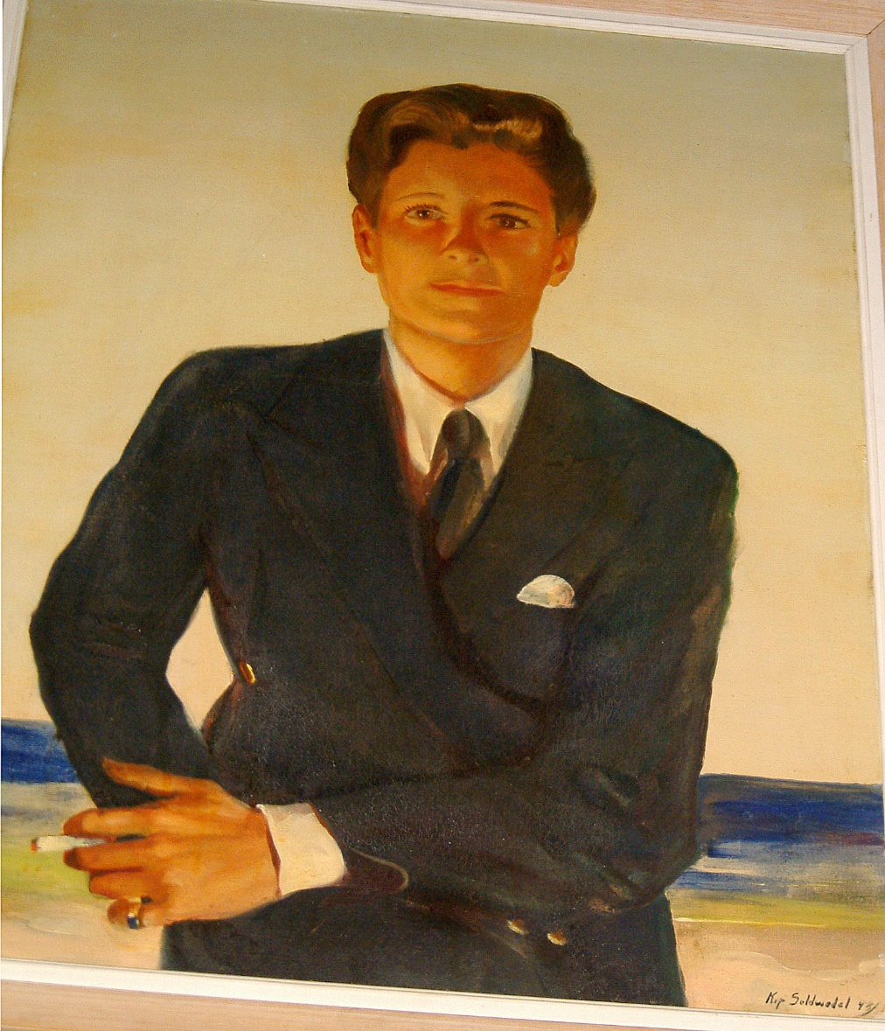
Marion “Betty” Carstairs & her yacht Vergemere IV, named for the Beach Point Club, Mamaroneck.

Slide 27
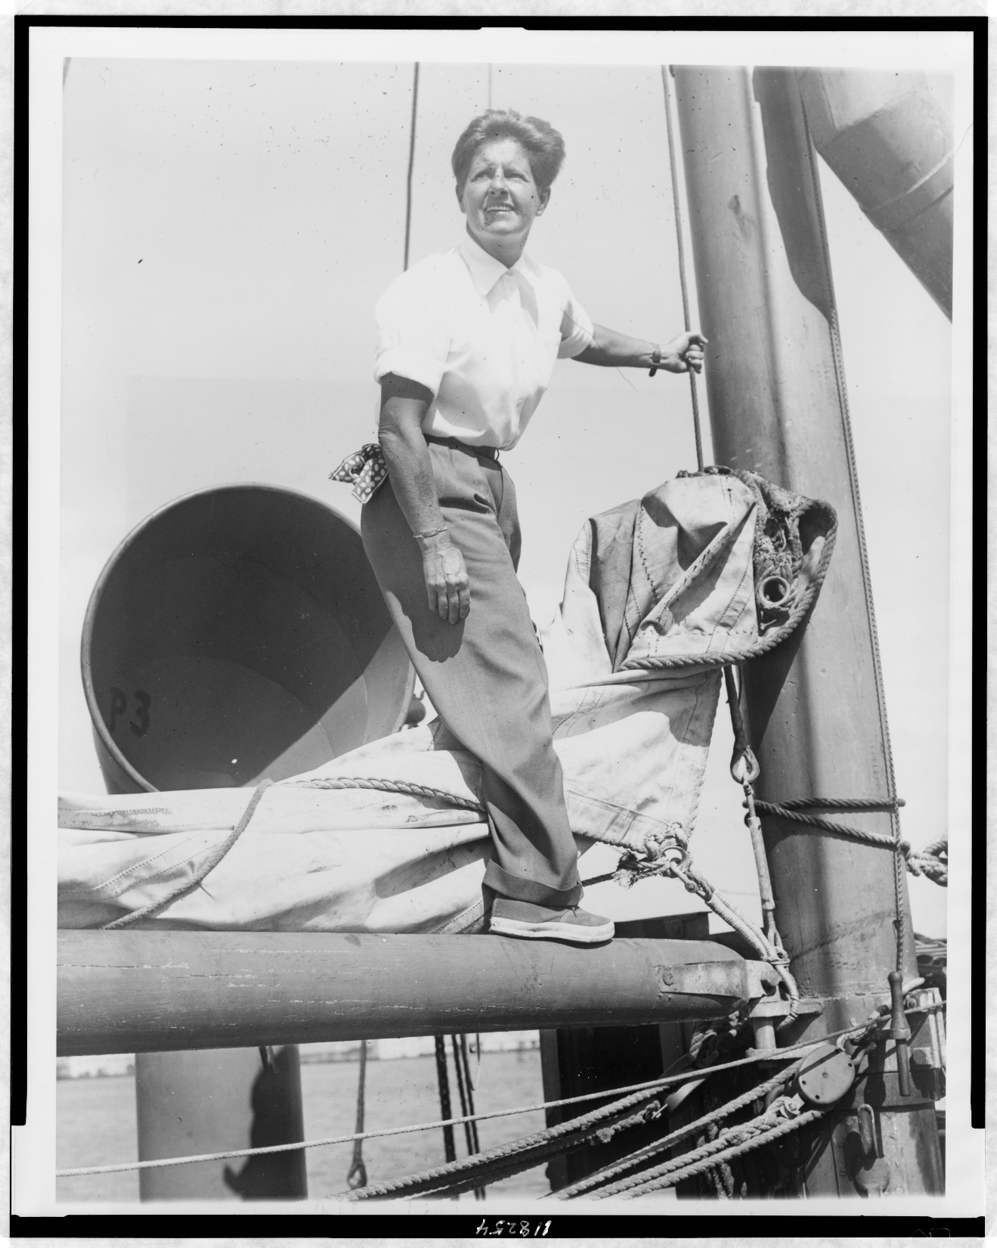
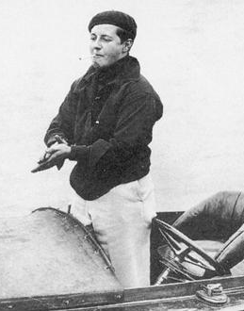
Betty “Joe” Carstairs, power boat racer, heiress, “Queen of Whale Cay.”

Slide 28
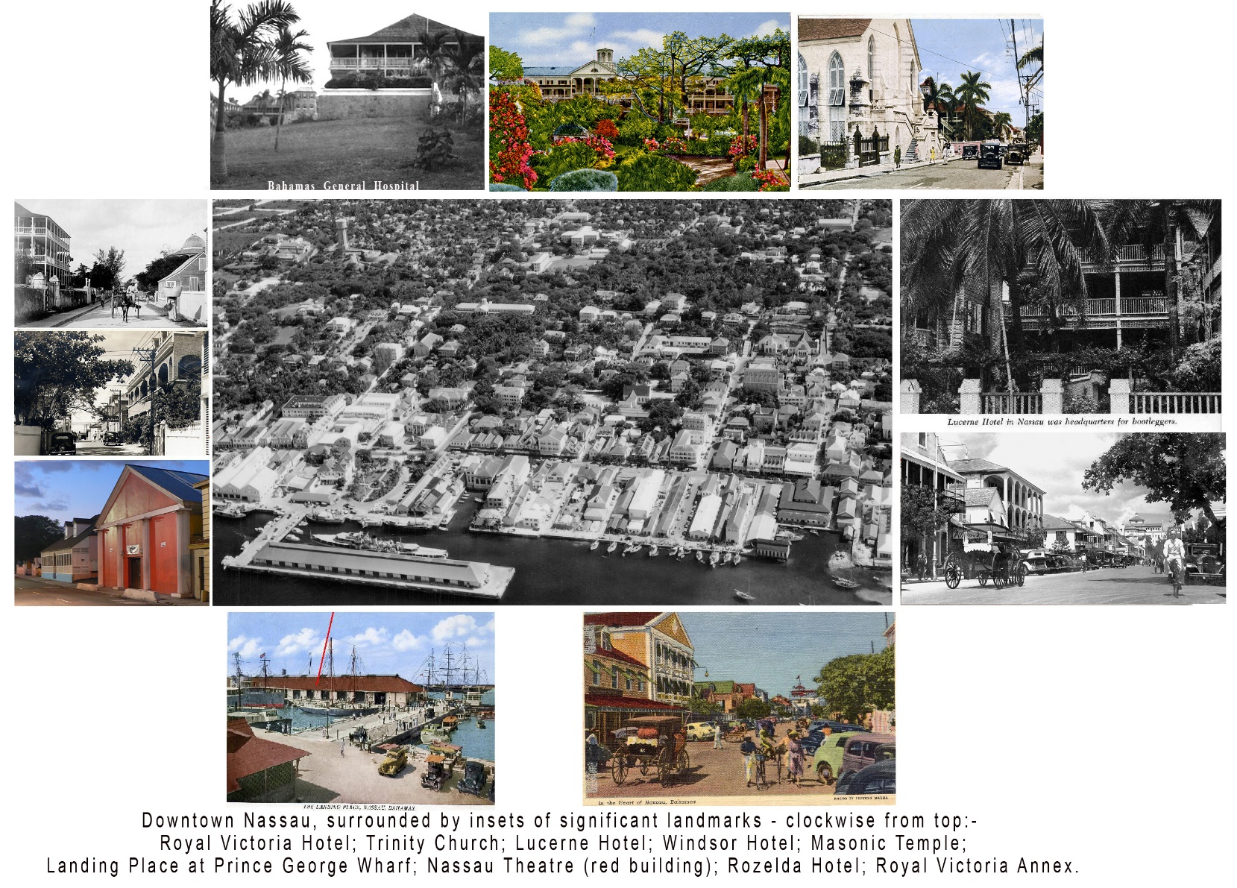
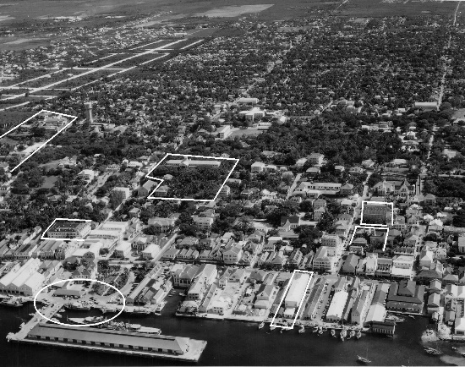
Nassau, Bahamas, a colonial capital, 1942:

Slide 29
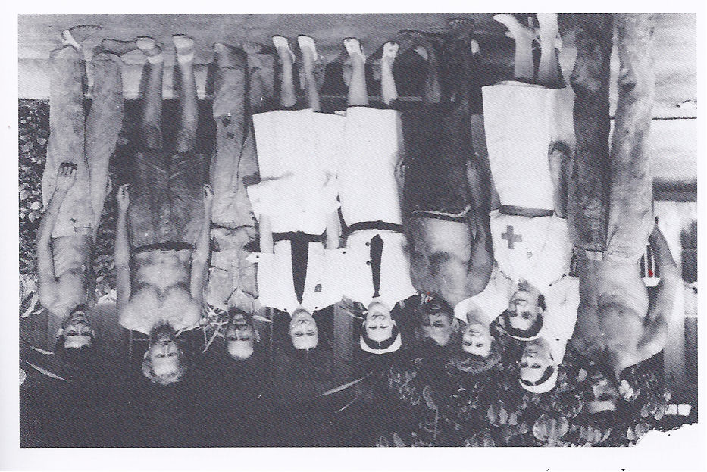
Potlatch survivors with Duchess of Windsor, head of Bahamas Red Cross. L to R: Cadet Kaplan, Lowe, Tiliakos (?), Carstairs, Sorensen (?) Commandant Terese Straton, Roberts, Moe (?), Cadet Carbotti.

Slide 30
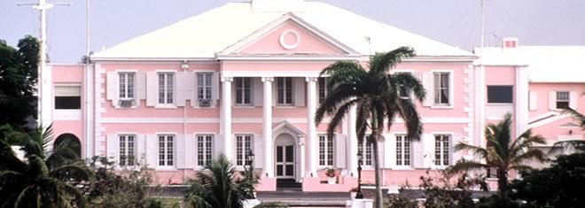
Capt. Lapoint & Lt. Lybrand were invited to Government House in Nassau by HRH the Duke & the Duchess of Windsor – a private car was sent to collect them.

Slide 31
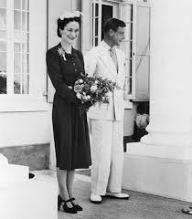
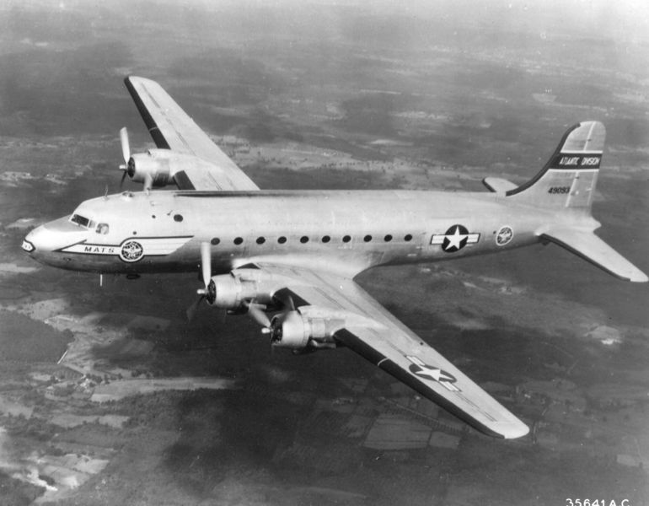
The Duke & Duchess, and a DC-4/C-54 like the one which repatriated Potlatch survivors to USA, August 5th, 1942.

Slide 32
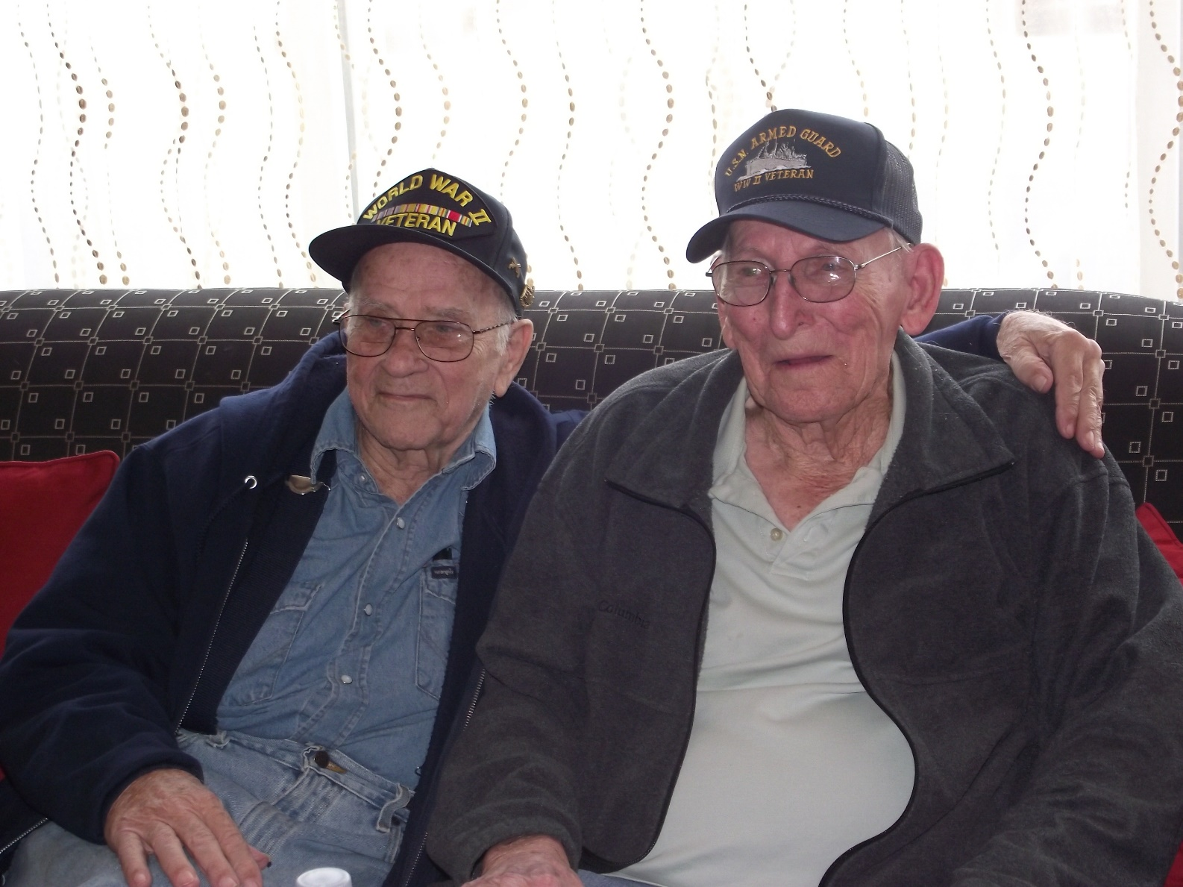
Jake Jatho (right) & Dempsey Ruggles, winter 2013 reunion for the first time in 71 years.

Slide 33
- The End -
  Questions?
  See also
  www.uboatsbahamas.com
  www.Uboatsbahamas.blogspot.com
  www.Uboatsbermuda.blogspot.com
  www.ericwiberg.com

