Slide 1
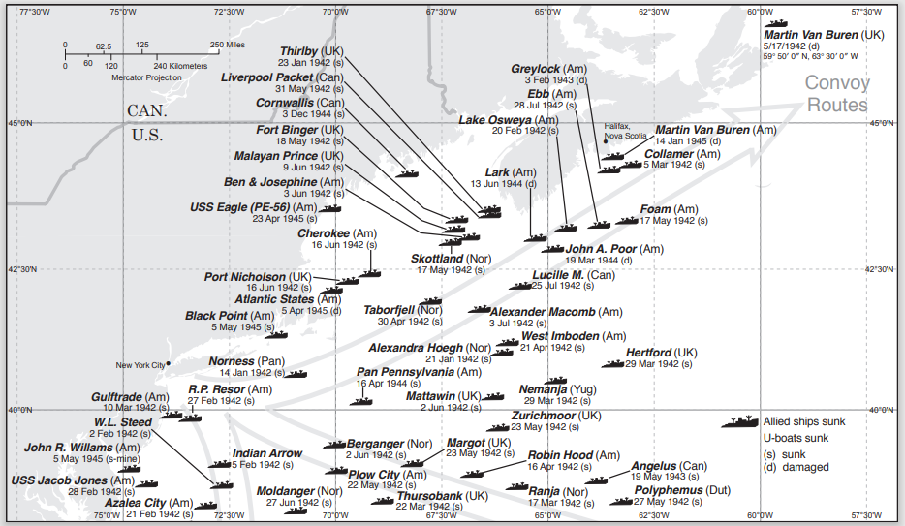
The Busy Little General Greene:
How a Doughty Coast Guard Cutter Pulled 5 boats to Nantucket in World War II
April 29, 2021, 5:30 pm – 6:30 pm Held via Zoom, hosted by NHA
By Eric Wiberg, maritime historian

Slide 2
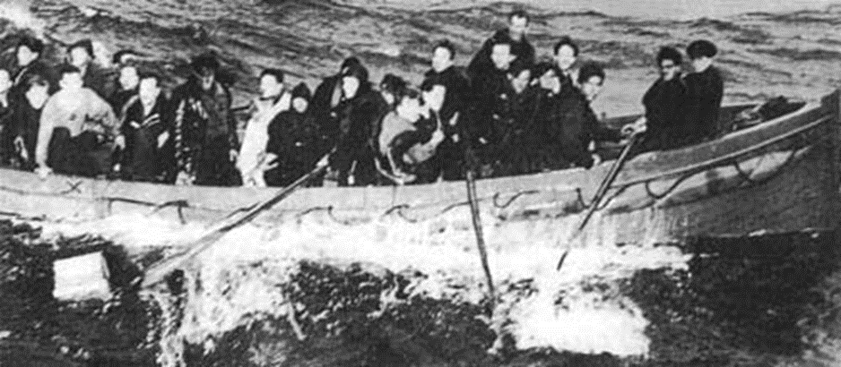
Norland survivors, mixed in with Polyphemus survivors, in a boat about (they are almost home!) to be finally rescued following encounters with four U-boats….. c/o daughter of James Glover, the one with an “X” under his right arm in white shirt back of boat

Slide 3
SUMMARY / OVERVIEW:
4 Allied merchant ships (Peisander, Polyphemus, Norland, Mattawin)
5 lifeboats
16 days, from 24 May – 9 June, 1942
90 men landed from four ships as follows
  61 Peisander 25 May 1942 – 3 boats
  7 Polyphemus 6 June 1942 – 1 boat
  3 Norland 6 June 1942 – 0 boat (shared w/ Polyphemus rescuers)
  19 Mattawin 8 June 1942 – 1 boat
  ====90 men from 4 ships in 5 boats
Nationalities of 90 survivors (all were male, aged from teens to sixties):
  England
  Ireland
  Scotland
  Wales
  China
  Hong Kong
  Singapore
  Netherlands
  USA
  Australia
  Sierra Leone
  Gold Coast
  Liberia
  Nigeria
  Guinea Bissau
  Canada

Slide 4
Breakdown by flag or region:
Under the British umbrella:
  49 from the UK, including
    6 Scotsmen
    3 Welshmen
  7 British West Africans
Not British
  3 US American Field Service volunteers
  23 Chinese nationals (possibly domiciled Hong Kong)
  1 Canadian
  1 Australian
  3 Dutch
  3 Ireland
===Totals: 90 (56 UK, 23 China, 3 US, 1 Can., 1 Aust., 3 Neth., 3 Ire.)
List of Vessels Used to Rescue Allied U-Boat Victims off Nantucket in WWII:
Planes - 4:
1 US Navy airplane for Peisander’s third boat rescued – ex Boston 24 May, 1942
1 other US Navy planes for Peisander location duty May 24 1942
1 US Army Air Force plane for Polyphemus boat June 6 1942
1 plane for Mattawin location 6 June 1942
===4 aircraft (at least) focused/ordered just to these searches
US Coast Guard & Auxiliary or Reserve Vessels – 6, of 5 varieties:
1 USCGC General Greene, WPO 140 – all rescues, all dates
2 USCG Reserve (or Auxiliary) vessels, names unknown, Peisander rescue May 25 1942
1 CGR 37, Madaket (Coast Guard Reserve, of ACOTP, or Asst. Capt. of the Port type)
1 motor lifeboat #3828 (USCG Madaket)
1 Dory No. 5009 (Madaket)
===6 USCG, USCG reserve, and USCG Auxiliary vessels of 5 types

Slide 8
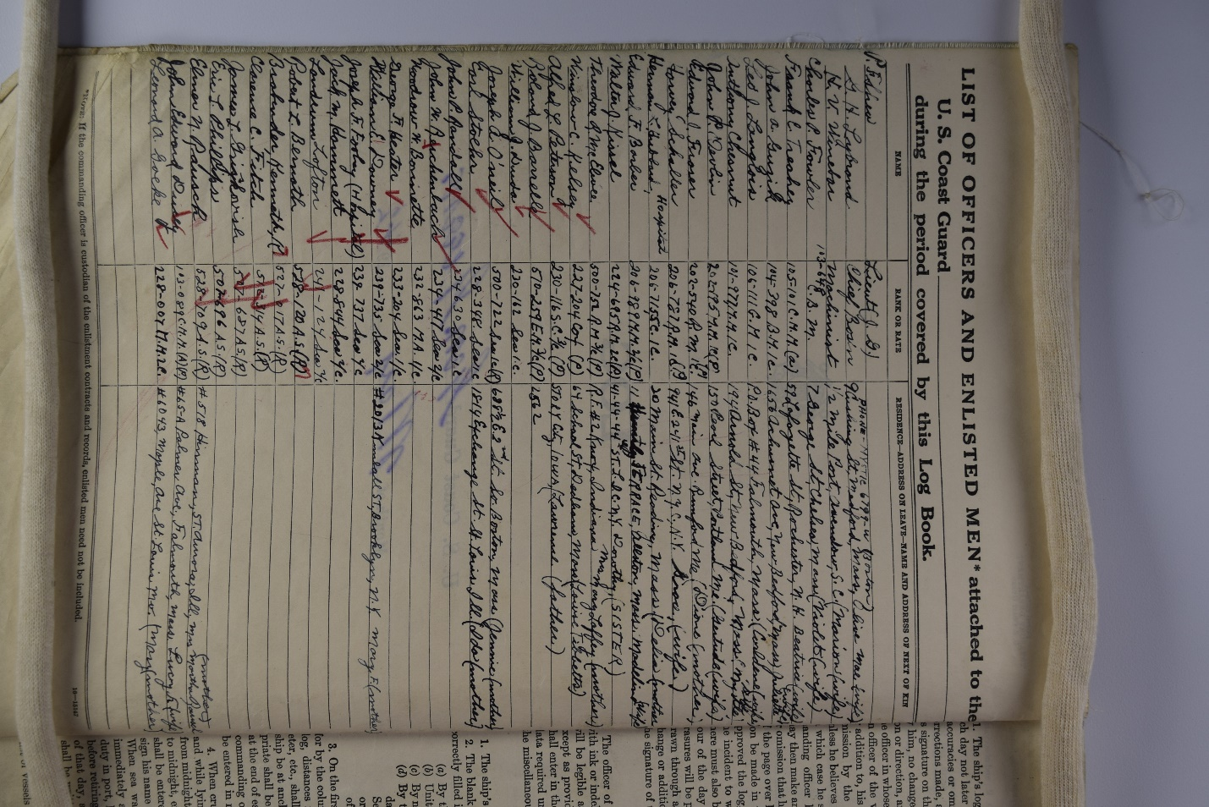
Key Personnel:
MEN ABOARD GENERAL GREENE (covering 4 years):
• Lt. (jg) P. F. Shea, Commander in May & June, 1942 – at all times relevant to this study
• Lt. Arthur B. Gibbs of Nantucket – served on the General Greene in 1942, went on to run the USCG station in Woods Hole, MA, passed on Nantucket, 1978
• Coxswain John Randall – in 1942, The Quarterdeck Log, Vol. 16, No. 2, Association News
• EM3/c Roland Barrelle
• FN2/c Eric ‘Junior’ Philips
• Radioman Cornel Scanlon
• Chief Boatswain C. L. Joran, Commander, oceanographic survey, Newfoundland, May 1941
• Machinist F. T. Lilia, perished aboard her on 20 Sept., 1938 (pre-war, details not known)
• MOMM1 H. T. Webster, perished aboard her on 20 Sept., 1938
• RM3 J. A. Steadman, perished aboard her on 20 Sept., 1938
USCG General Greene crew muster from deck logs

Slide 9
TOTAL HOURS ALLIED SAILORS SPENT ON NANTUCKET IN 1942 Sat 6 – Mon. 8 June, 1942
10 men mix 7 Polyphemus and 3 Norland spent 17 hours on the island:
14 hours on Sat 6 June,
24 hours Sun 7 June,
5.5 hours (to 5.25 am) Mon 8 June =
53.5 hours or Sat, Sun, early Mon; ACTUAL: weekend, Sat Morning-Monday am
1 man, Leonard Doyle or Woyle of Peisander spent several days on ‘Tucket in hospital, teeth
All others spent ZERO time ashore,
except 43 Peisander men, who simply moved fm Madaket- ‘Tucket. 25 May (a few hrs)
7 POLYPHEMUS & 3 NORLAND SURVIVORS BY NAME:
Jan Dykdrenth, 3rd Mate, Dutch Polyphemus
Carol P. Molenaar, 4th Engineer, Dutch (spoke German w/ Uboats) Polyphemus
Johan Henrik Boom, 5th Engineer, Dutch, Polyphemus
Leslie Charles Wilkins, 2nd Wireless Operator, UK, Polyphemus
Ho Moon, Seaman, Canton, Polyphemus
Wong Chun, Seaman, Polyphemus
How Siaow Mow, Shanghai, Polyphemus
William McAllan, 22 Ordinary Seaman, Scotland, Norland
Angus Campbell, 19, Ordinary Seaman, Scotland, Norland
Donald Campbell, 18, Ordinary Seaman, Scotland, Norland

Slide 10
The makeup of the nationalities of the Peisander men were; 20 from China (or Hong Kong), 3 from Ireland, and the balance, or 38, from the UK. All were in the Merchant Navy, with 2 (Brown and Burden) DEMS, or Defensively Equipped Merchant Ships gunners), there were three Welshmen and 2 Scotsmen. as follows:
The makeup of the nationalities of the Peisander men were; 20 from China (or Hong Kong), 3 from Ireland, and the balance, or 38, from the UK. All were in the Merchant Navy, with 2 (Brown and Burden) DEMS, or Defensively Equipped Merchant Ships gunners), there were three Welshmen and 2 Scotsmen. as follows:

Slide 13
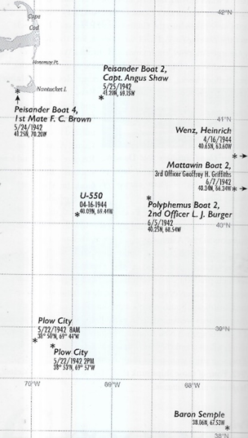
Key events in the rescue of both Allied and Axis sailors off Nantucket in WWII

Slide 14
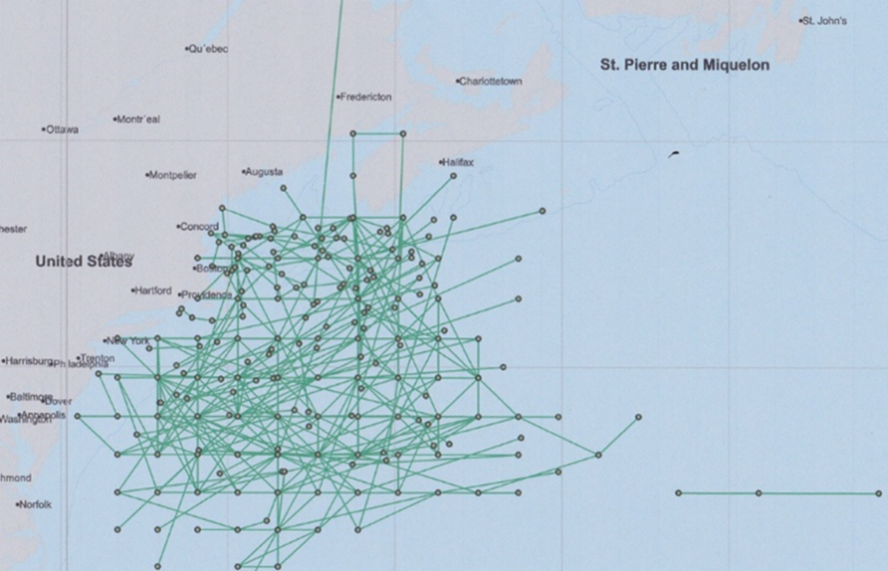
U-boat patrols through New England, by day and U-boat.

Slide 15
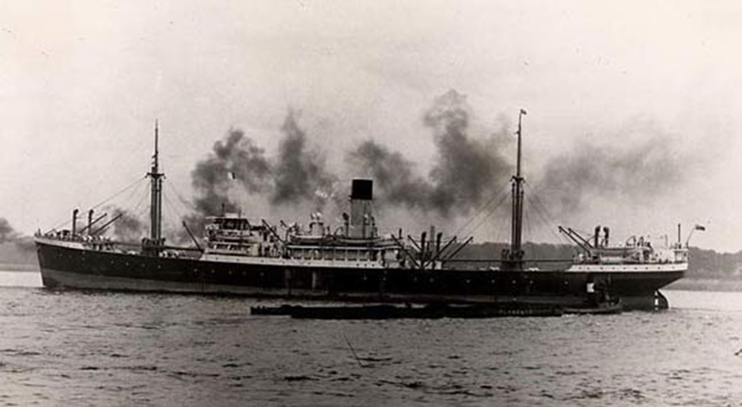
Allied U-boat victim SS Peisander:

Slide 16
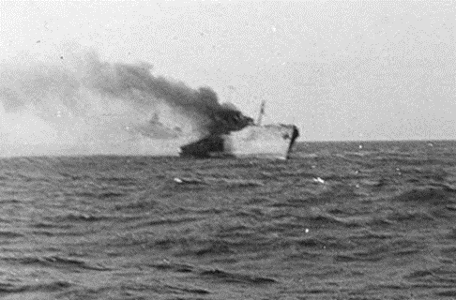
Original U-boat victim off Bermuda, SS Norland under attack:

Slide 17
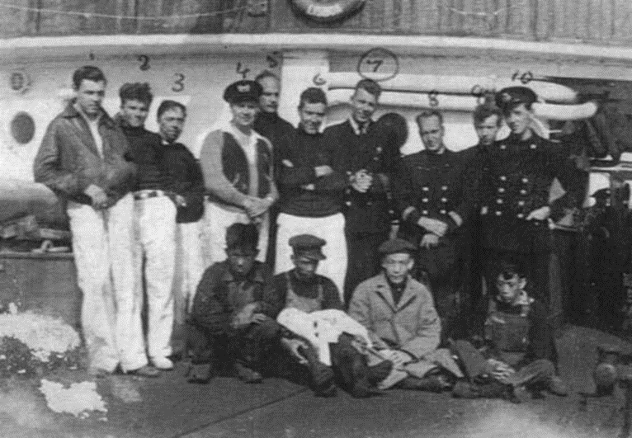
Norland survivors aboard ship, Chinese crew up front:

Slide 18
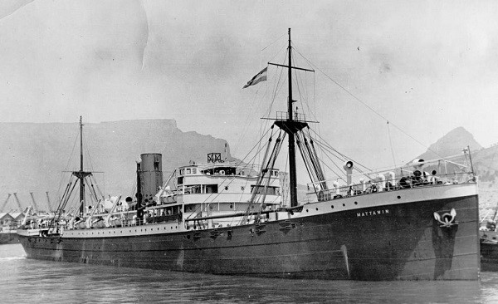
SS Mattawin, British, so named for a river in western Africa where the owners traded:

Slide 19
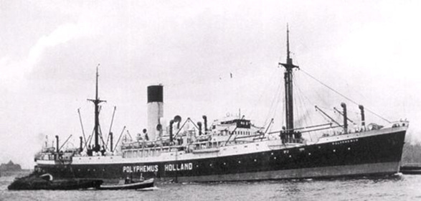
SS Polyphemus, large passenger ship, participant in several rescues, U-boat encounters, and a sinking:

Slide 20
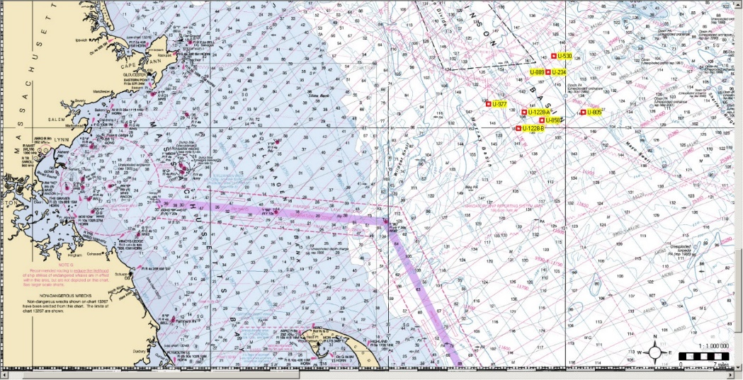
Surrendered U-boats sunk off Provincetown after the war:

Slide 21
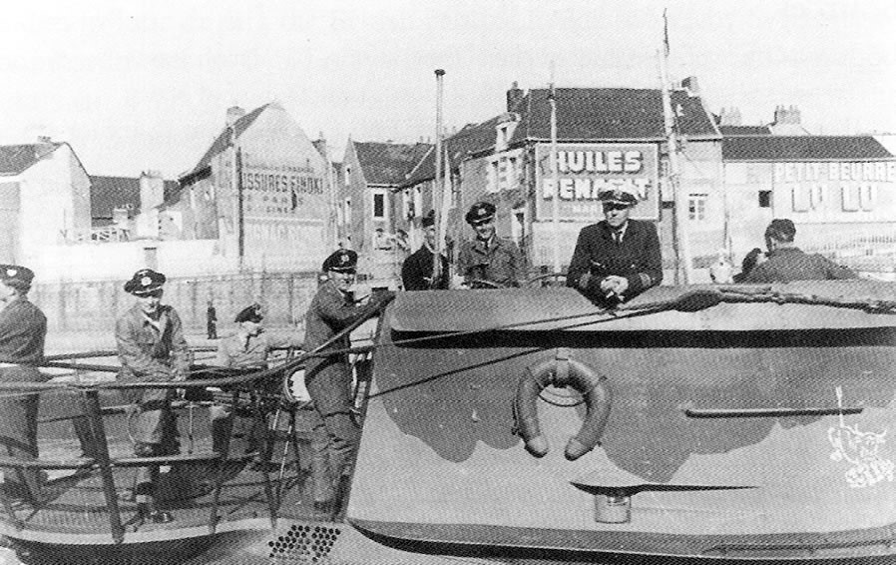
U-boat U-578 under frigate-captain Ernst-August Rehwinkel returns to St. Nazaire France from 3rd patrol on 7 May, 1942. It was lost with all hands later that year, fate unknown. Note the snorting “Bull of Scapa Flow” emblem on conning tower, lower right:

Slide 22
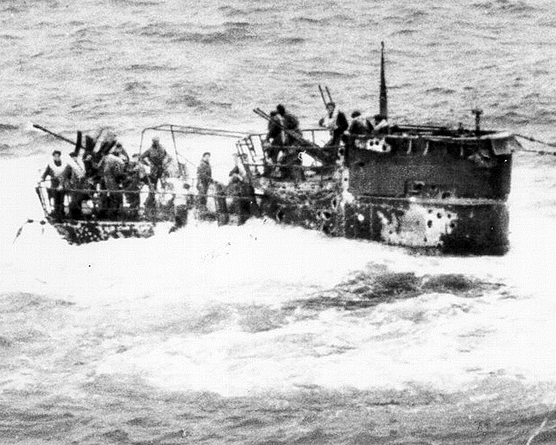
U-550 sunk SW of Nantucket, these men drowned, Pan-Pennsylvania later in war, on 16 April 1944. About 44 men were left alive in the water and this author tracked the remains of nearly a dozen of them and articles, from Staten Island, Long Island, a cemetery in Newport, and a burial at sea off the Cape en route to Canada. An Ivy-League patrol boat skipper based in Newport described finding a “malodorous cadaver.”

Slide 23
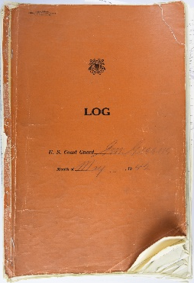
Steamer Peisander, Capt. Shaw from 21 to 25 May 1942 Rescue off Nantucket, as reported to British authorities, as it was a UK-flagged ship. These docs, from the National Archives in UK, tend to be vastly more humanist and narrative than their counterparts from the US NARA….. note references to rum, dog, false teeth, adventure, etc. Here are some samples of original materials:

Slide 24
“General Greene aground on Spring Hill Beach at East Sandwich, Massachusetts, sometime between 4 and 8 March 1960. Bulldozers are creating a trough for use in refloating her at high tide.” (from Wikipedia)

