Slide 1
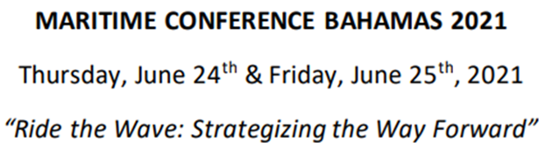
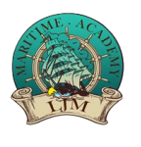

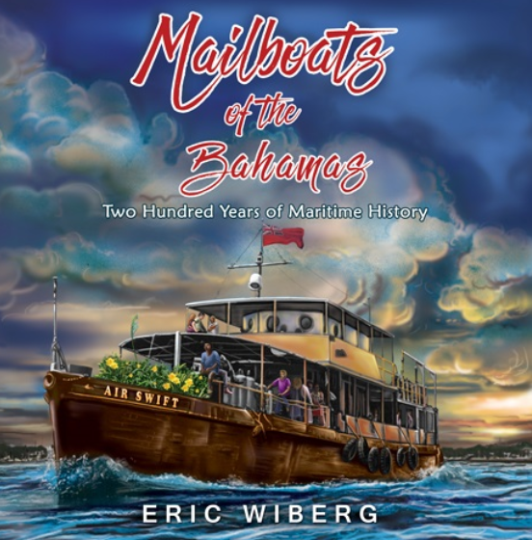

Mailboats of the Bahamas:
An Blue Highway on its Third Century, Since 1804
Capt. Eric Wiberg
Island Books

Slide 2
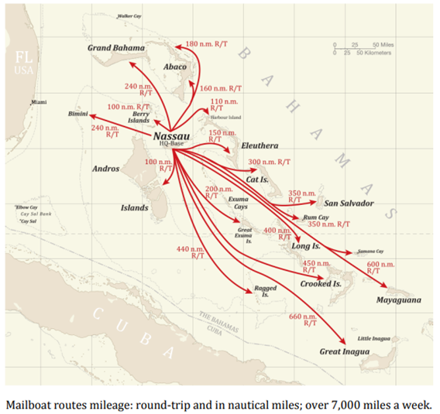

Slide 3
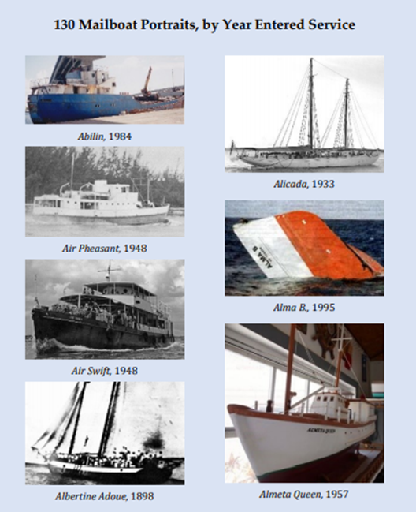
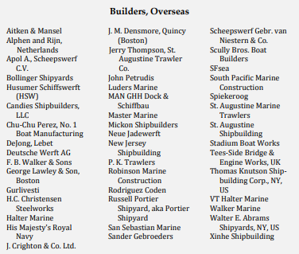

Slide 4
Essential Points:
Definition: Intra-island within Bahamas only, carrying government mail, often with fuel and other subsidies, even if on substitute basis
Not mailboats: no mail, no fixed schedule, or sailing internationally
217 years of service; must accommodate passengers affordably
15 to 20 boats cover 7,000+ nautical miles weekly (incl. substitutes)
340+ mailboats since 1804, sail, power, steam, wood, steel, etc.
15 primary islands, 60+ ports, cargo also at anchor, ramp to shore
One hub: Potter’ Cay, Nassau, NP, capital, 70% of population, 275k
90+ owners since 1804: ownership private, public, co-op, & mixed
Economic advancement for non-white communities outside Nassau
Mailboats are the commercial, community sinews of archipelago.

Slide 5
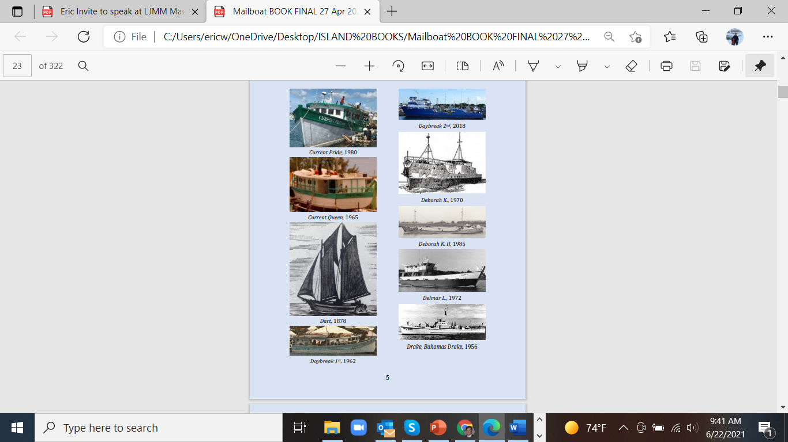
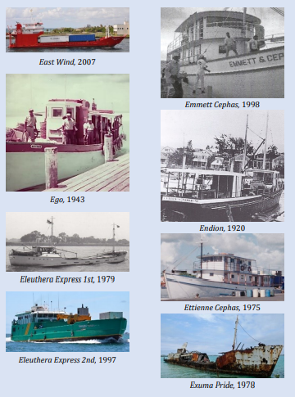
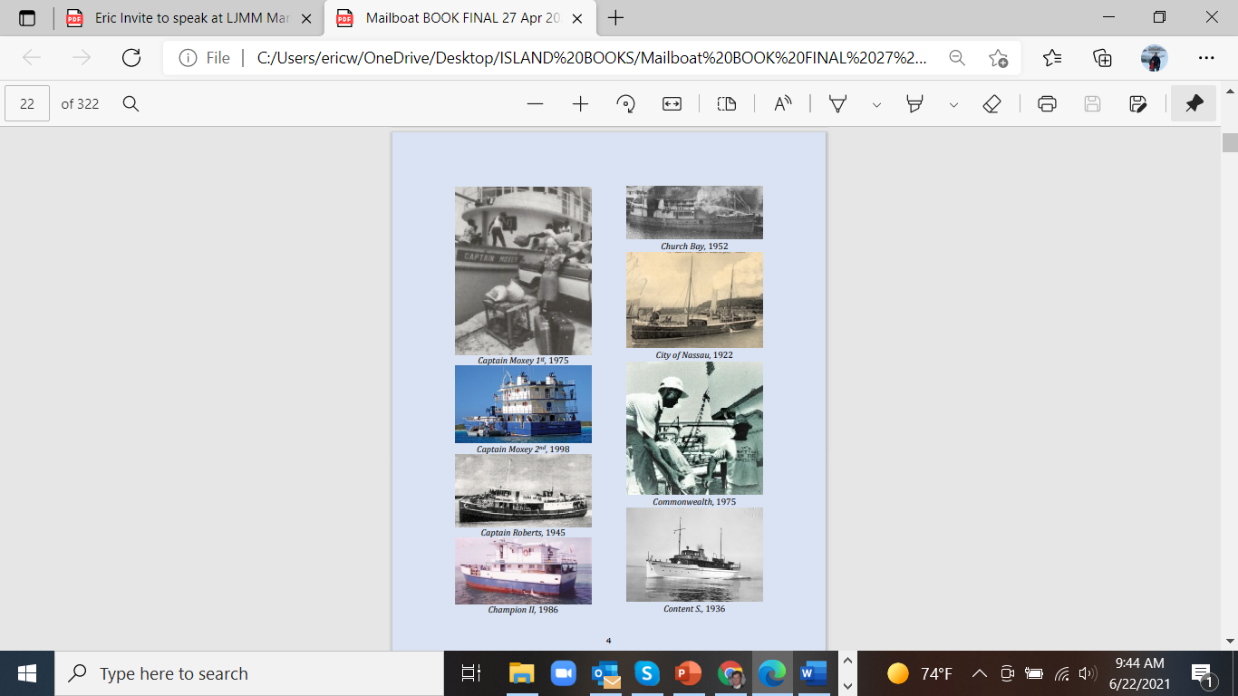

Slide 6
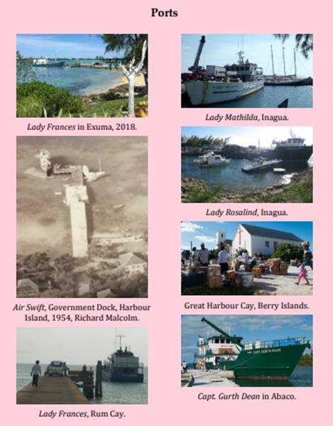
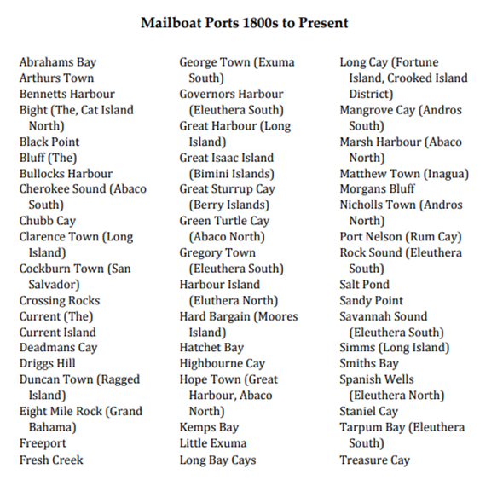

Slide 7
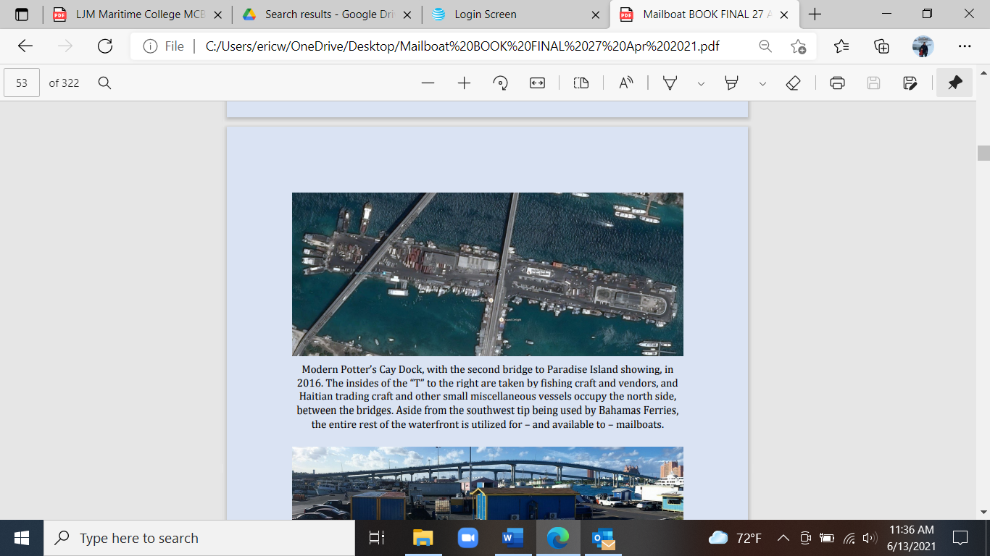
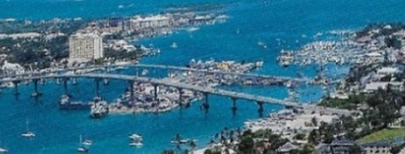

Slide 8
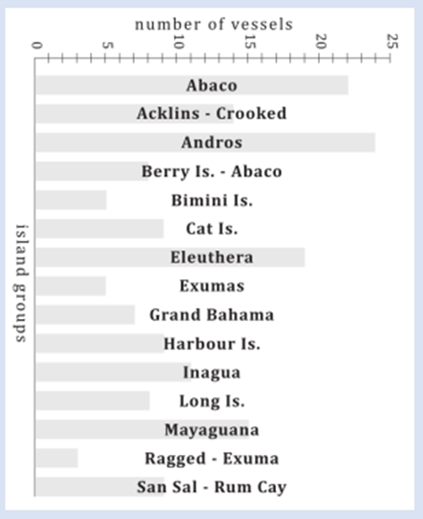
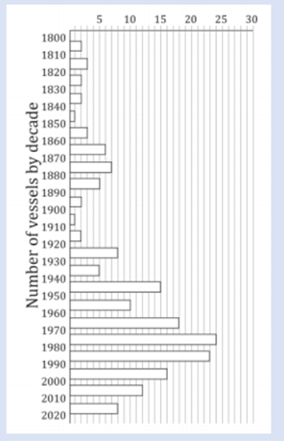

Slide 9
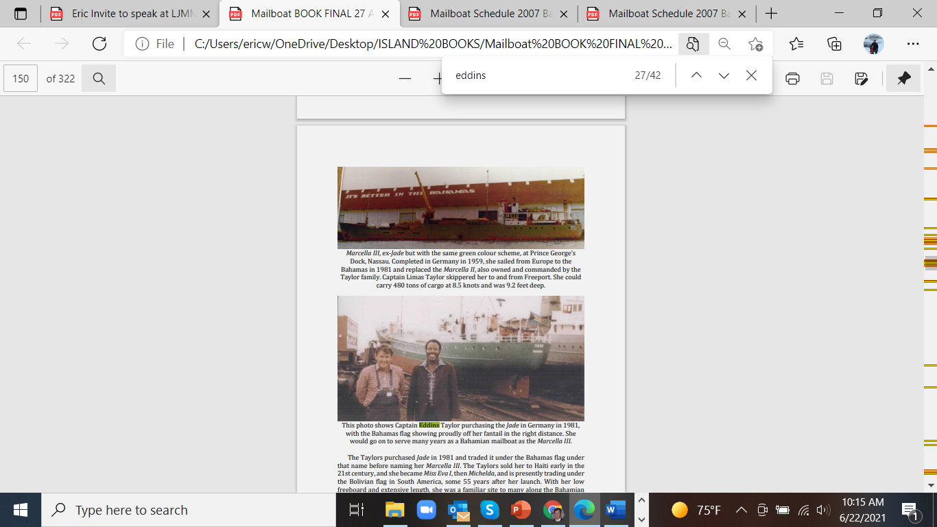

Slide 10
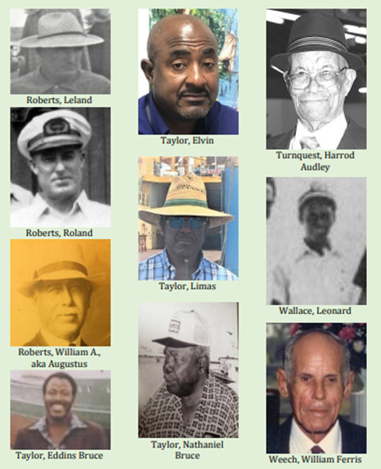
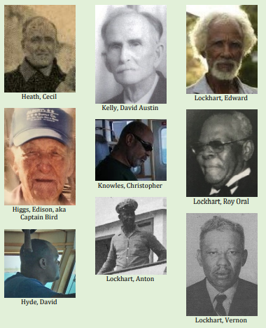

Slide 11
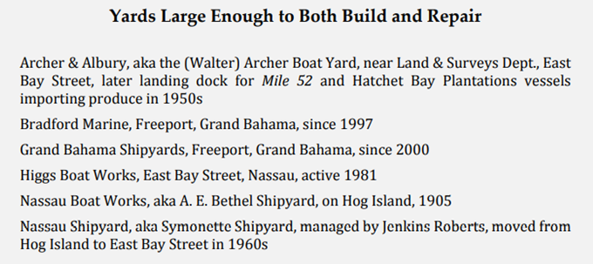
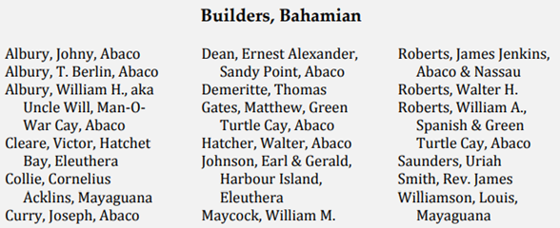

Slide 12
1999 WEEKLY MAILBOAT SCHEDULE, From Dock Master’s office on Potter’s Cay
Bahamas Daybreak III: North Eleuthera, Spanish Wells, Harbour Island, Bluff, 5½ hours., Rock Sound, Davis Harbour, South Eleuthera, seven hours.
Captain Moxey: South Andros, Kemp’s Bay, Long Bay Cays, Bluff, 7½ hours.
Central Andros Express: Fresh Creek, Staniard Creek, Blanket Sound, Bowne Sound, 3½ hours.
Sea Hauler: Cat Island, Bluff, Smith’s Bay, 10 hours.
North Cat Island Special: North Cat Island, Arthur’s Town, Bennet’s Harbour, 14 hours.
Maxine: San Salvador, United Estates, Rum Cay, 18 hours.
Grand Master, Seahauler, Lady Roslyn, Captain Moxey: Exuma, George Town, Mt Thompson, 14h.
Abilin: Long Island, Clarence Town, 18 hours., Spanish Rose: Spanish Wells, 5½ hours.
Champion II: Abaco, Sandy Point, Bullock Harbour, Moore Island, 11 hours.
Lisa J II: North Andros, Nichol’s Town, Mastic Point, Lowe Sound, five hours.
Lady Francis: Exuma Cays, Staniel Cay, Black Point, Farmer’s Cay, Barraterre.
Deborah K: Abaco, Marsh Harbour, Hope Town, Treasure Cay, Green Turtle Cay, Coopers Town, 12h.
Mangrove Cay Express: Mangrove Cay, Lisbon Creek, 5½ hours.
Lady Gloria: Mangrove Cay, Behring Point, Cargill Creek, five hours.
Current Pride: Current Island, Upper and Lower Bogue, Eleuthera, five hours.
Emmette and Cephas: Ragged Island, 21 hours.
Nay Dean: North Long Island, Salt Pond, Deadman’s Cay, Stella Maris, 14 hours.
Marcella III: Grand Bahama, Freeport, High Rock, Eight Mile Rock, West End, 12 hours.
Windward Express: Crooked Island, Acklins, Mayaguana, Inagua.
Eleuthera Express: Rock Sound, five hours. Spanish Wells, Harbour Island, five hours.
Challenger: North Andros., Lady Margo: North Andros., Bimini Mack: Bimini, Cat Cay, 12 hours.

Slide 13
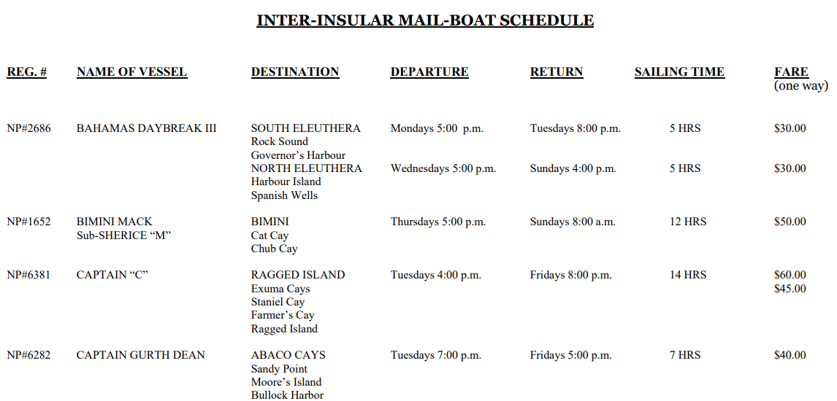
2007 Sample of Weekly Mailboat Schedule

Slide 14
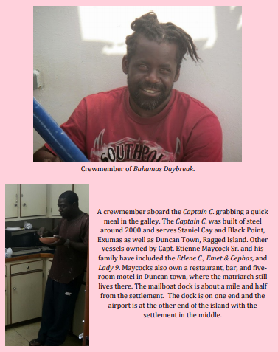
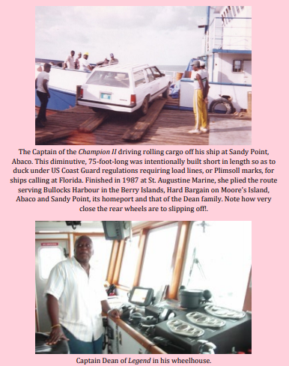

Slide 15
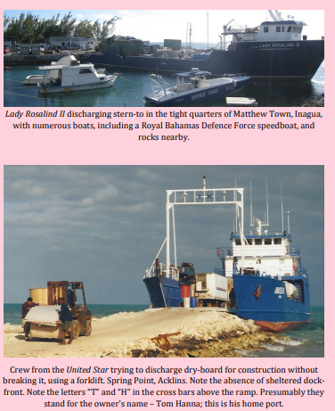
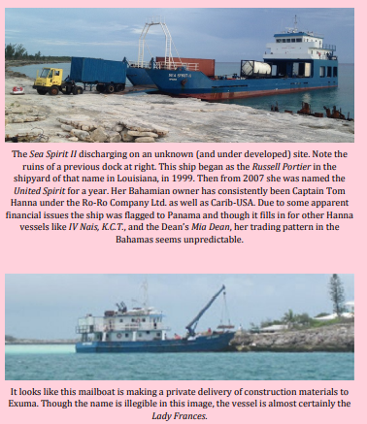

Slide 16
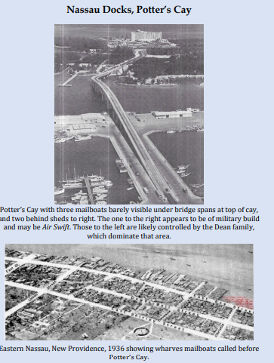
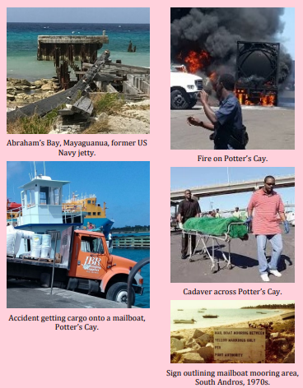

Slide 17
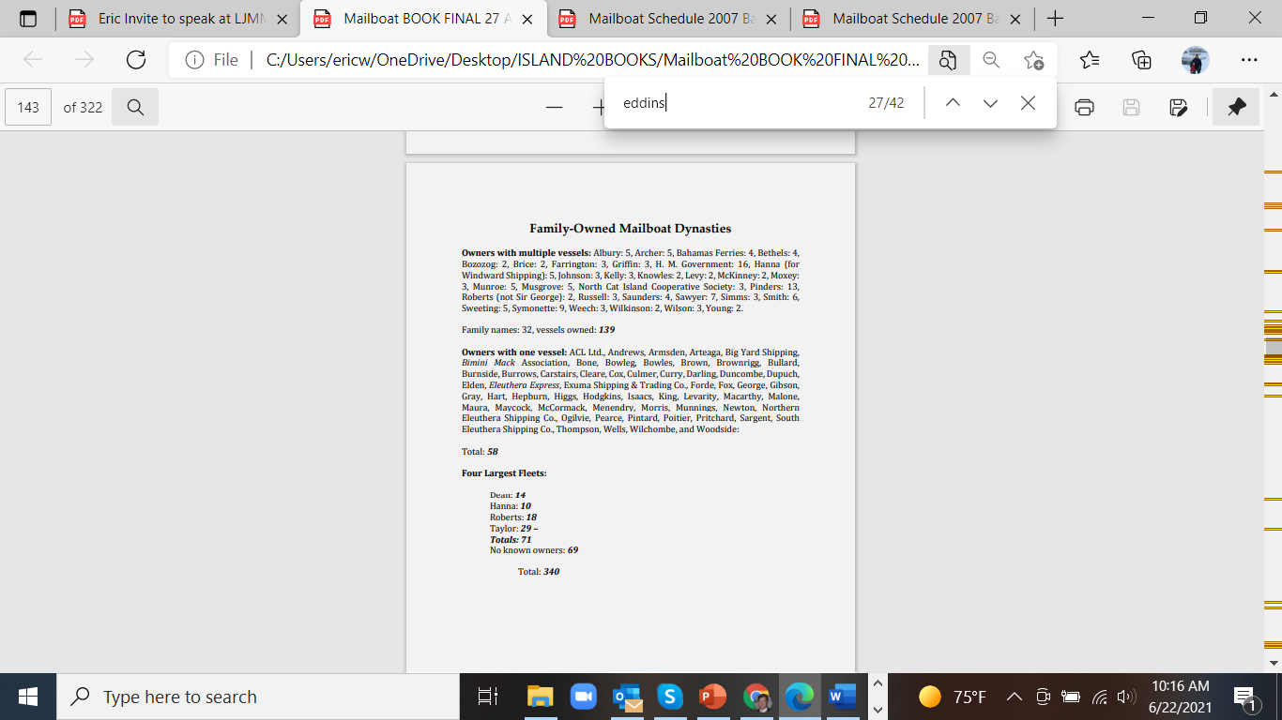
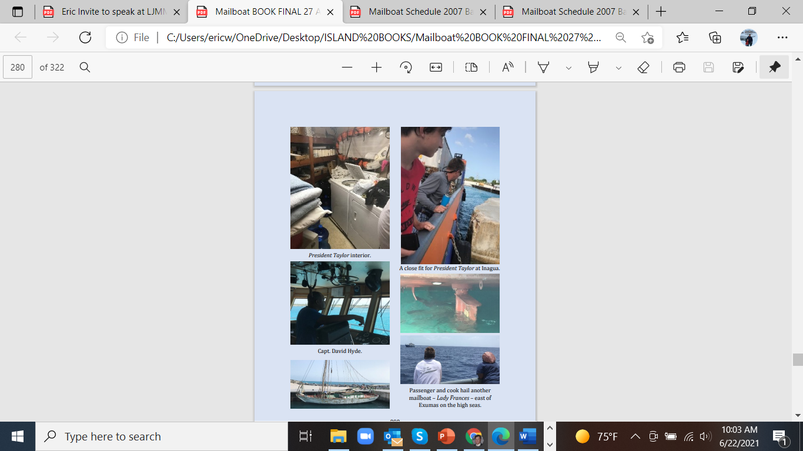

Slide 18
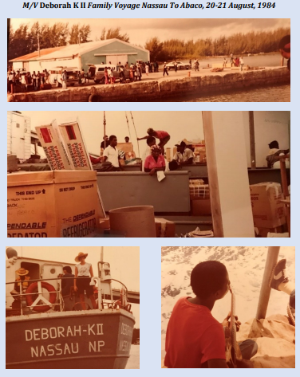


Slide 19
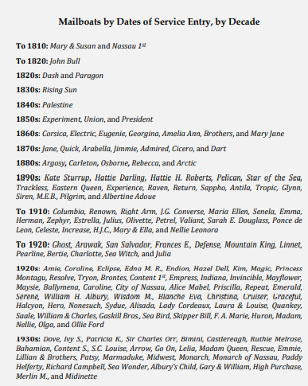
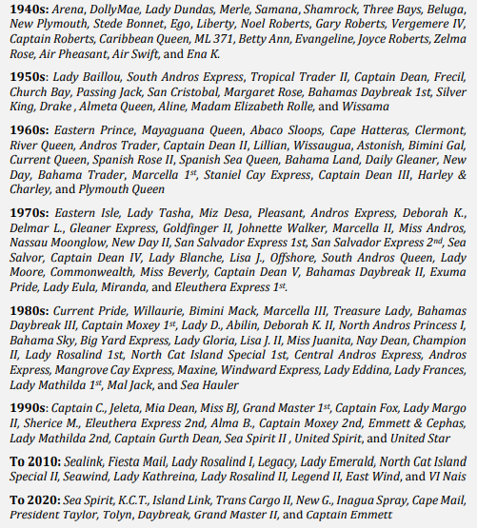

Slide 20
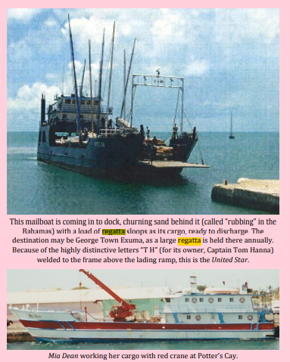
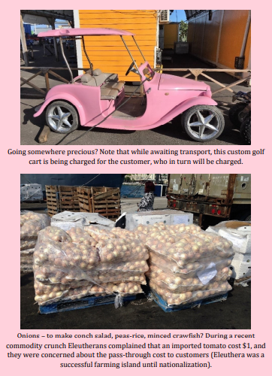
Precious cargo, whether for conch salad or racing around….

Slide 21
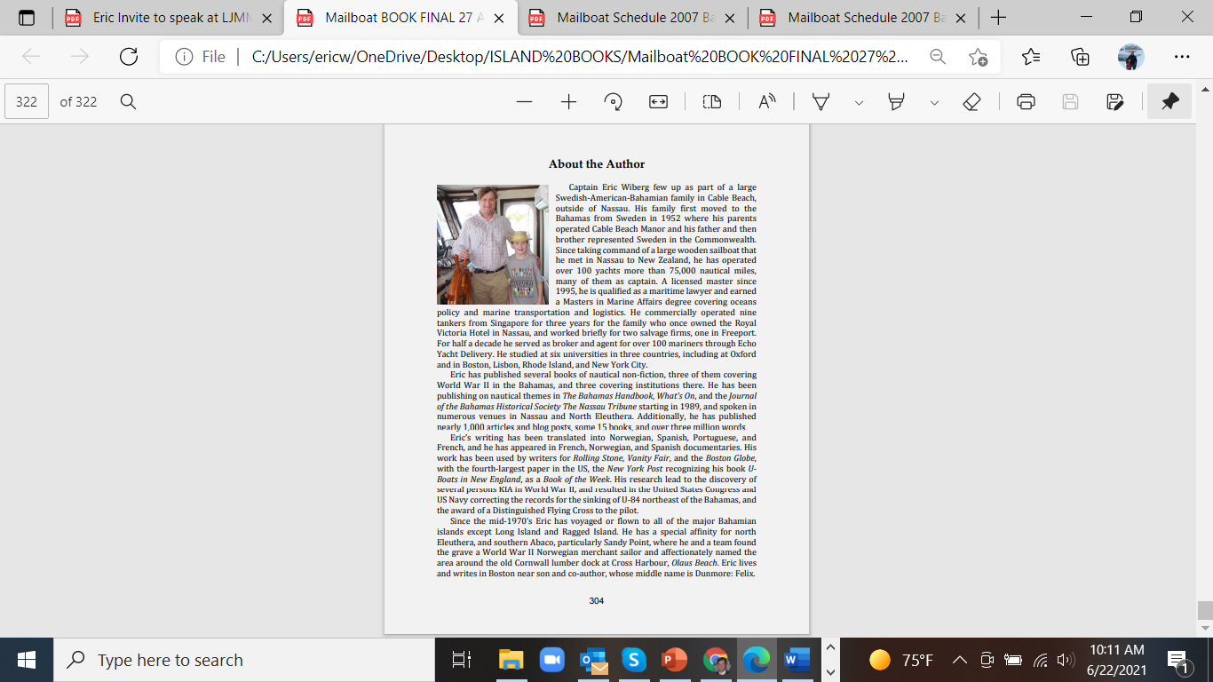

Thank you, and enjoy your next mailboat voyage delivering essential goods to an archipelagic network!

