Slide 1
S/Y “STORNOWAY”’s Construction & Trans-Pacific Voyage
IYRS / MoY Presentation
Tues. 29th March 2011
Capt. Eric T. Wiberg
From the book
Round the World in the Wrong Season (Island Books, 2010)

Slide 2
The offer: Actual fax sent from “Stornoway”’s owners in Panama to me in Nassau, November 1993

Slide 3
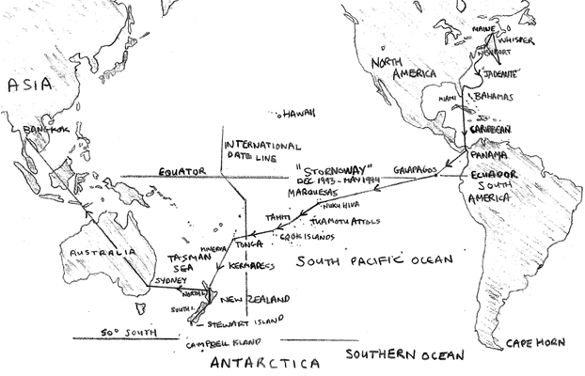
Stornoway’s Trans-Pacific Voyage 1993-94: Panama – Galapagos – Marquesas – Tahiti – Rarotonga (Cook Islands) – Nuku ‘Alofa (Tonga) – Auckland New Zealand

Slide 4
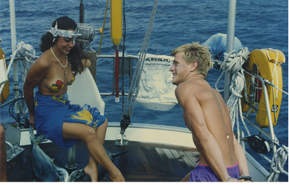
Stornoway crossing the equator
Ceremony approaching Galapagos Christmas Eve 1993

Slide 5
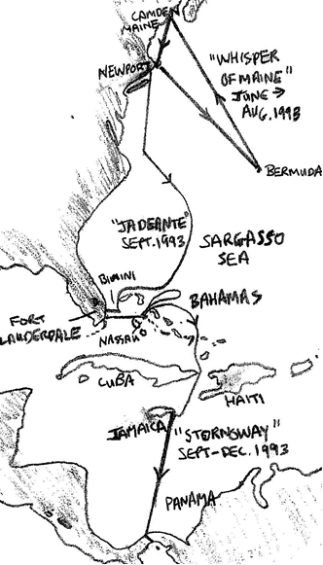
Author voyages summer to fall of 1994 leading to meeting Stornoway in Nassau & joining in Panama

Slide 6
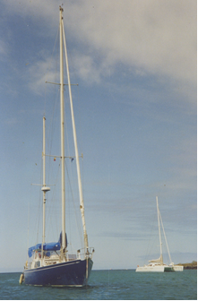
Stornoway and MaiTai anchored, Wreck Bay Galapagos Jan. 1994

Slide 7
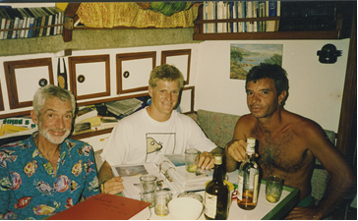
Owner, Chris, Author, Michel aboard Michel’s boat Cow Over the Moon

Slide 8
Baby seal at rookery, Galapagos
(note mother in distance serving as sentry)

Slide 9
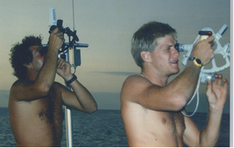
Learning celestial from a Chilean naval officer at Post Office Bay, Galapagos

Slide 10
Underway at last – New crew Trevor at the wheel

Slide 11
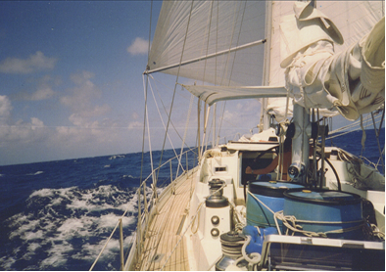
Stornoway where she belongs - at sea in trade winds.
Note barrels with diesel.

Slide 12
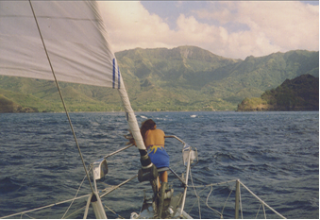
Tina at bow on arrival in Taoihae Bay Marquesas -
Young whaler Herman Melville jumped ship in this same bay

Slide 13
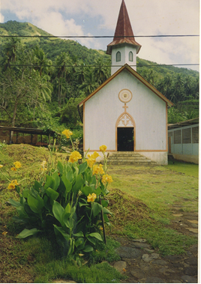
Chapel in Typee Valley, Nuku Hiva, which was nearly deserted

Slide 14
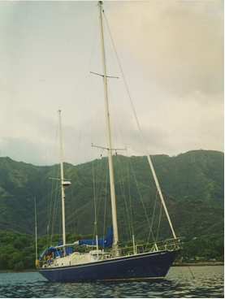
Stornoway in Nuku Hiva, Marquesas Islands after covering 3,250 nautical miles in 17.5 days – note Tina on deck

Slide 15
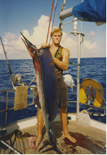
Sailfish landed off the Tuamotu or “Dangerous” islands. 21 steaks

Slide 16
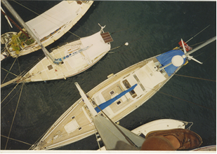
Stornoway in Papeete Harbour, Tahiti from the mast head looking down

Slide 17
Papeete harbor with Moorea in background, as Club Med tall ship clears breakwater - our view for four Friday evenings.

Slide 18
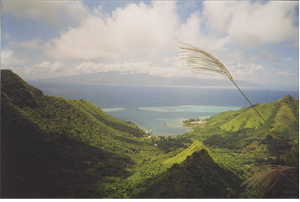
View of Tahiti from ridge above Moorea’s ferry harbor on a hike

Slide 19
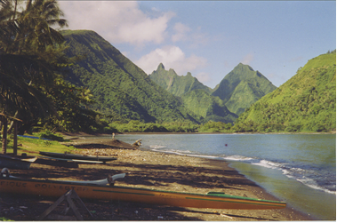
Campsite, Tahiti-Iti / Presque Isle – the view on waking up

Slide 20
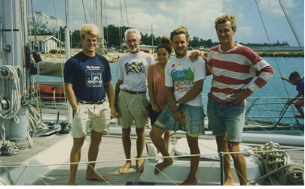
Final crew: Author, Chris, Tina, Trevor, Stefan in Tonga, May
Passports: US, France, NZ, Australia, Italy, Canada, UK, Sweden...

Slide 21
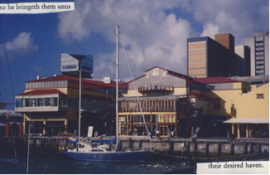
Stornoway at her final berth in Viaduct Quay Auckland.
Note strips of paint missing from starboard side

Slide 22
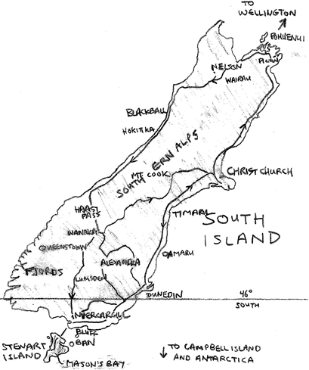
Travels through New Zealand’s South Island
& writing on Stewart Island summer (their winter) 1994

Slide 23
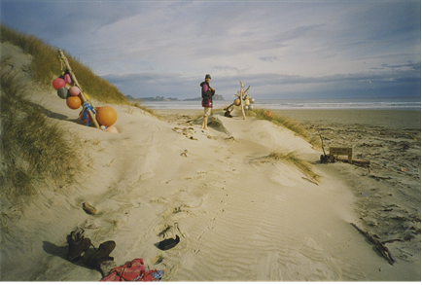
End of the line: Andreas in remote Mason’s Bay, Stewart Island

Slide 24
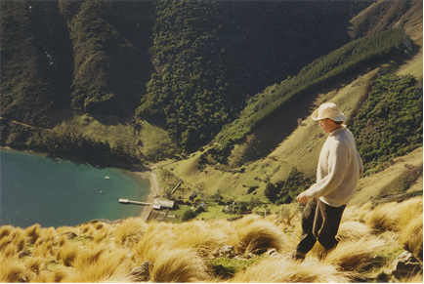
Andy shepherding, Pohuenui Island, Marlborough Sounds, NZ. Farmhouse, shearer’s lodging and export wharf far below

Slide 25
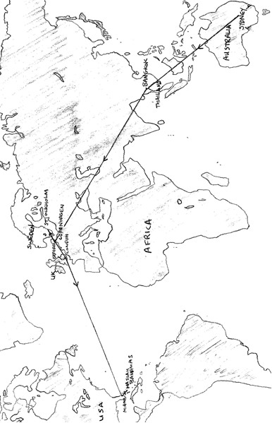
Return journey – NZ-Sydney–Thailand–Sweden–UK–US–Nassau: nowhere near as original as the outward voyage

Slide 26
Broke in Bangkok, Thailand

Slide 27
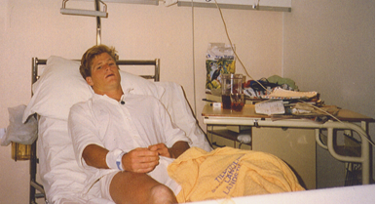
Final slide: hospitalized in Stockholm,
November 1994, 1 year after Panama

Slide 28
Resources: www.wrongseason.net www.islandbooks.biz www.ericwiberg.com
Armchair Sailor / Bluewater Books
Questions?

