Slide 1
Military Aircraft Wrecks, Cape Cod
Museums on the Green
55-65 Palmer Avenue
Falmouth, MA
by Capt. Eric Wiberg, Esq.
East Boston

Slide 2
Overview:
Did you realize that in New England there are so many aircraft wrecks, both military and civilian, that on average there is one every 35 miles of land? That is because historians like Jim Ignasher of New England Aviation History and Larry Webster in Rhode Island have identified close to 2,000 air accidents, from losing a wheel to total destruction or missing in the oceans. In Massachusetts there are at least 375 military and 301 civilian airplane mishaps, with over 150 occurring on Cape Cod or surrounding seas and islands. Falmouth alone has five, Mashpee 2 (one of them recently found by the speaker), and over 40 in Otis Air Force Base or Camp Edwards. This talk will focus on trying to find evidence of the many air wrecks in and near Falmouth, and the need to learn, preserve and share the back-stories of the men and women who fell to earth while flying to keep us safe. Last year Eric spent many months finding a dozen and documenting nearly 200 other WWII aircraft in Bahamas. Now he shares his focus on women pilots, Cold War warriors, and lone fighter pilots who ditched in the cold Atlantic, or into ponds and marshes and road near us.

Slide 3
Cape Cod Military Air Accidents, All Dates
Aquinnah - Vineyard – 2
Atlantic Ocean MA - 35
Barnstable, MA. – June 23, 1945
Bourne, MA. – October 9, 1942
Buzzard's Bay - 2
Camp Edwards – December 22, 1942
Camp Edwards – September 2, 1943
Cape Cod Bay, Off Cape Cod – 10+

Slide 4
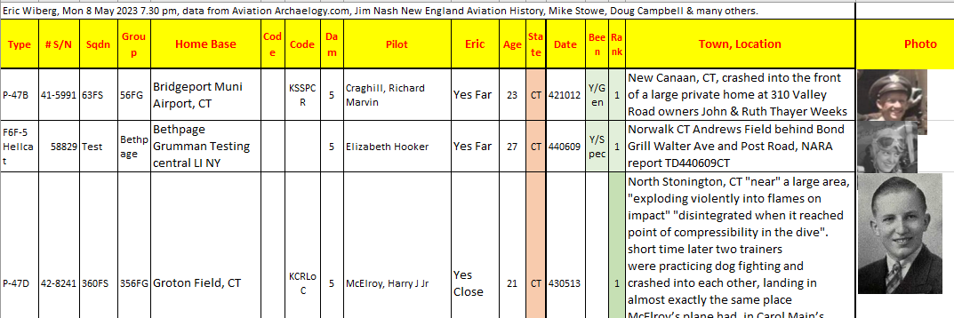
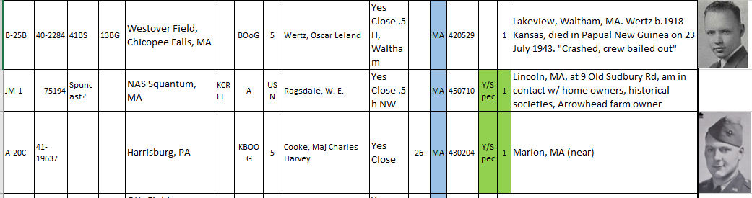
Thanks to Jim Nasher, New England Aviation History

Slide 5
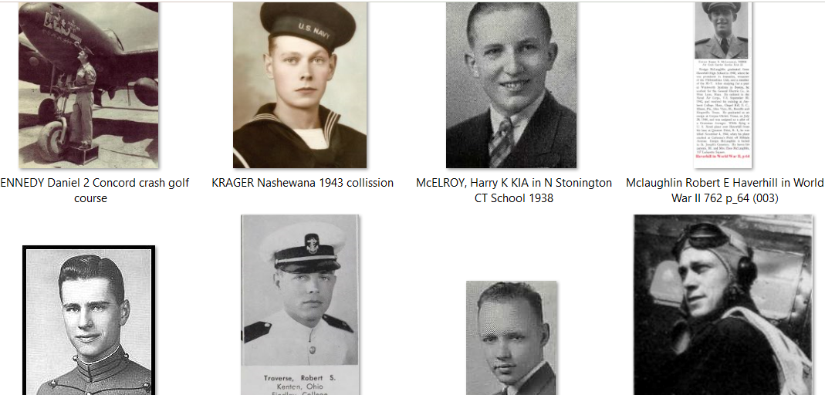
Who Were The Missing?

Slide 6
Cape Cod Beach – May 8, 1942
Cape Cod Canal – October 9, 1942
Chatham - MA 3, 1918-1943
Falmouth, MA. – August 17, 1945
Falmouth, MA. – January 8, 1962
Falmouth, MA. – May 31, 1949
Falmouth, MA. – October 9, 1951
Gosnold, MA. – November 18, 1944
Harwich, MA. – November 24, 1944

Slide 7
Hyannis - 8
Martha's Vineyard - 15
Mashpee, MA. – March 20, 1949
Mashpee, MA. – October 9, 1951
Nantucket - 10
Nashawena Island, MA. – August 27, 1943
No Mans Land Island – September 2, 1949
Off Falmouth, MA. – October 27, 1953
Off Harwich, MA. – May 19, 1946

Slide 8
Otis Air Field - 40+
Provincetown, MA. 2
Truro - 2
Vineyard Haven, MA. – July 31, 1926
Wellfleet, MA. – August 7, 1959
Wellfleet, MA. – July 18, 1943
Woods Hole Harbor – March 3, 1944
Yarmouth, MA. – June 17, 1989

Slide 9

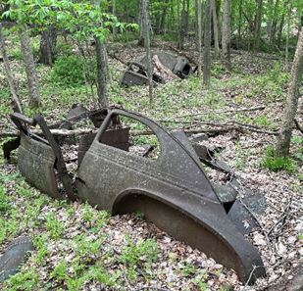


Where and How to Look for Them? Notes:

Slide 10
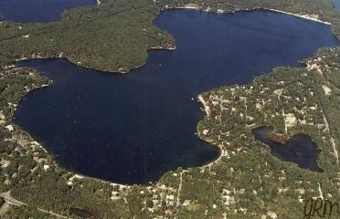
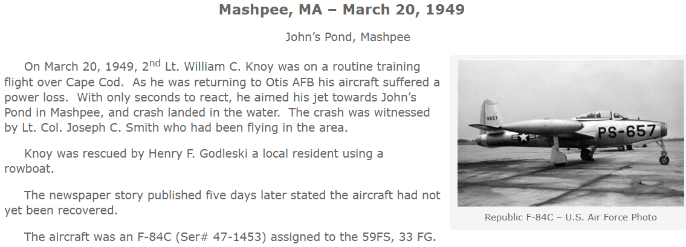
Johns Pond Mashpee Otis AFB, Fall 2023

Slide 11


Slide 12
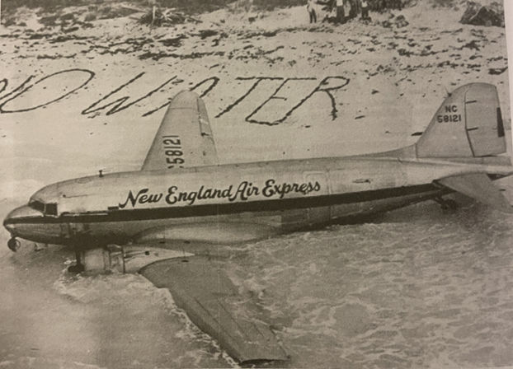
A New England Air Express passenger craft which crashed in the Bahamas, October, 1948.

Slide 13
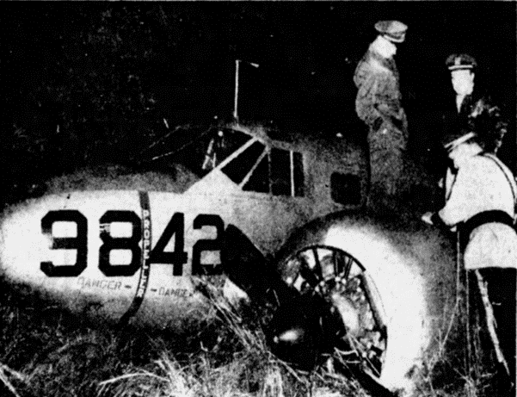
A military aircraft crashed in Canton on approach to Logan, out of fuel, November, 1952.

Slide 14

Marion MA Tragic Bomber Wreck, Tabor, Towers

Slide 15
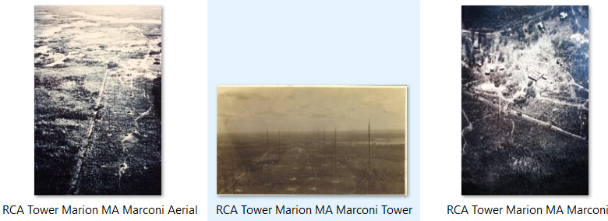
# WHEN WHERE DETAILS
1 5/9/64 North Parsonfield Maine, York Cty skull, bones, shallow grave, dirt road, prob. Not an aviator
2 5/22/75 Burlington, MA, by Merrimack River skeletal in army fatigues, sweater, garison belt, Levi Jeans, not likely a flier, metal necklace w/ Thespian logo, sneakers
3 3/10/77 Atlantic Ocean, Point Judith RI 30 miles off body w bullet in left hip
4 12/23/80 Narragansett, Whale Rock to Narragansett Pier, RI same body parts found 8/18/77 same area
5 9/16/81 Scarborough ME, beach near Rosebrier Motel partial skeletal of right radius (hand?) near hotel Cumberland Cty Maine, on beach at Scarborough ME
6 7/11/82 Brewster, MA, Cape Cod central bones parts, believed male adult died 1978-1980
7 2/5/83 Pine Point Beach, Scarborough, Cumberland Cty, Maine skeletal lower jaw tangled in beach debris at Pine Point Beach, Scarborough ME
8 11/21/83 Potter's Cove, Jamestown RI single specimen found fishermens net
9 8/30/84 Taunton, MA, SW of Boston partial skeletal parts found construction area

Slide 16


Bucolic barn in Cummington, the author found remnants from a crashed fighter plane.

Slide 17
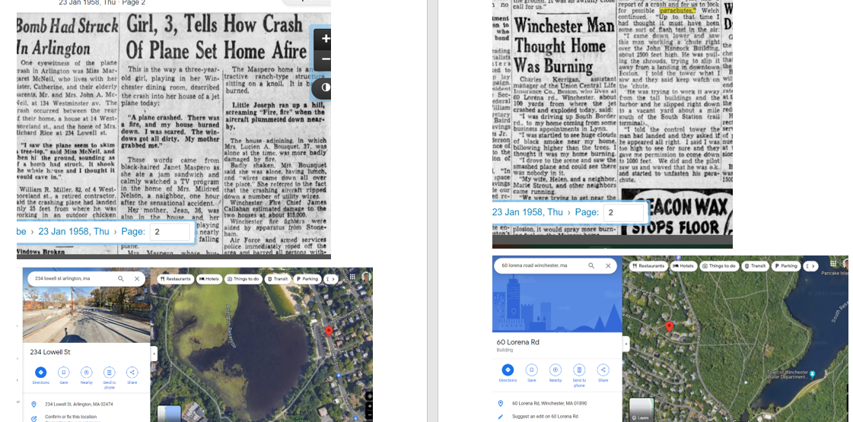
Process, Template: News, Intel, Maps, Photos

Slide 18
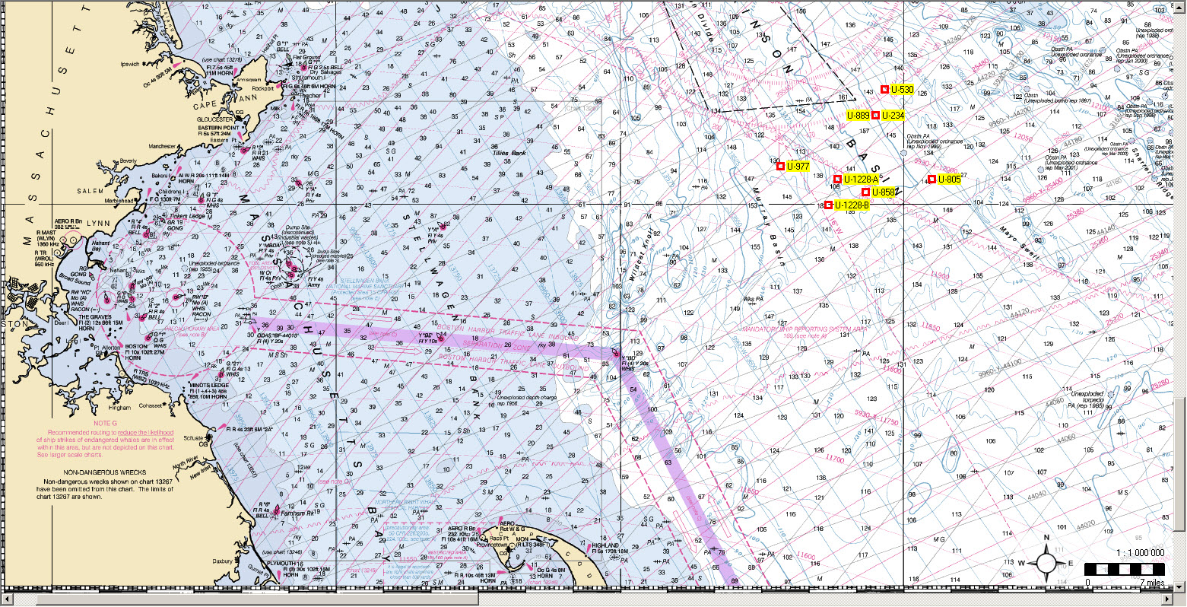
Six U-Boats sunk off Cape Cod MA 1946-1947
These 7 subs were sunk in very deep water, relatively far from shore precisely to deter recreational divers and souvenir hunters from accessing them. A NOAA contact described their location as “recreationally and economically inacessable.” Interesting that when poachers took human remains from U-873 in Newport, immediately the US Navy and their
Erstwhile enemies, the Germans, allied with churches to prevent desecrations and bury them with honors. U-boat and merchant mariners perished at higher per-capita rates than any other service.

Slide 20
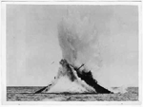
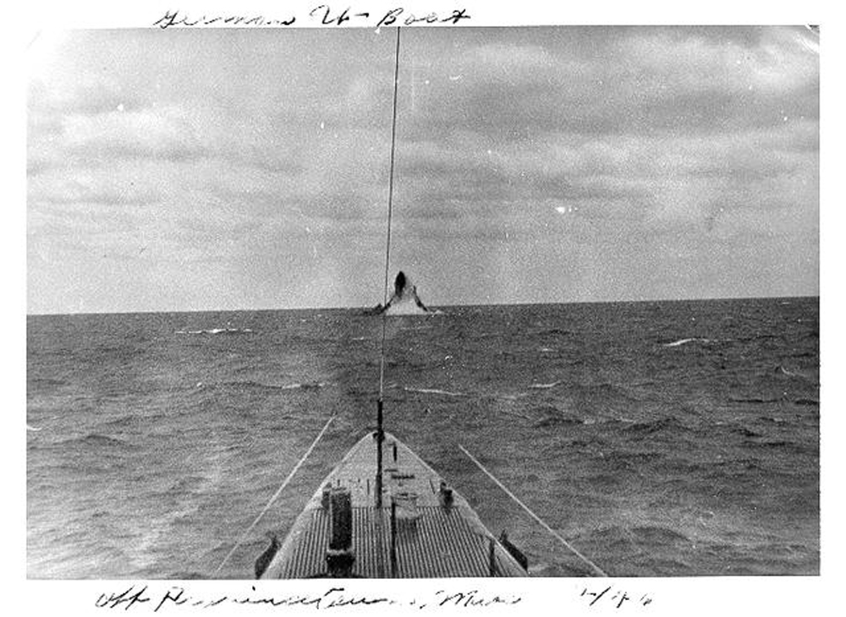
U-977 being sunk by US Navy, Cape Cod 1947
U-1228 being sunk off Cape Cod 1947

