Slide 1
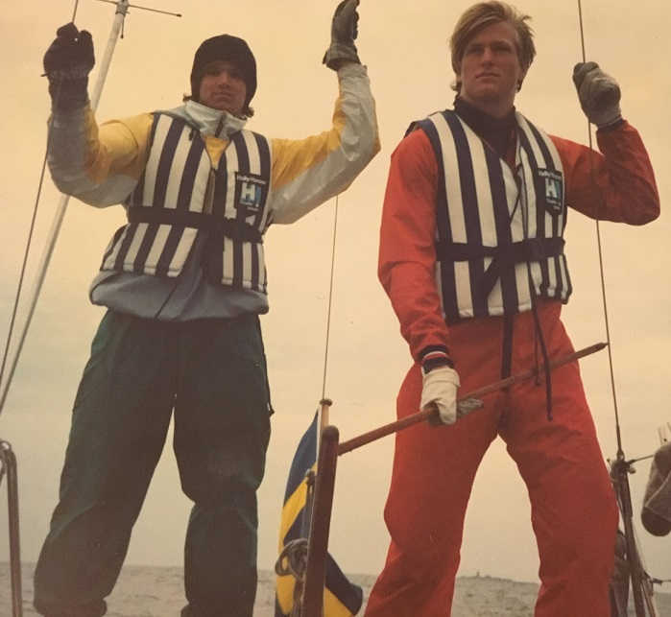
Early Years at Sea - 100 BOATs
AROUND THE WORLD FOUR TIMES!
By: Eric Wiberg – Felix’s Dad!
For: Children of McAllister team-mates
Thursday April 28, 2016

Slide 2
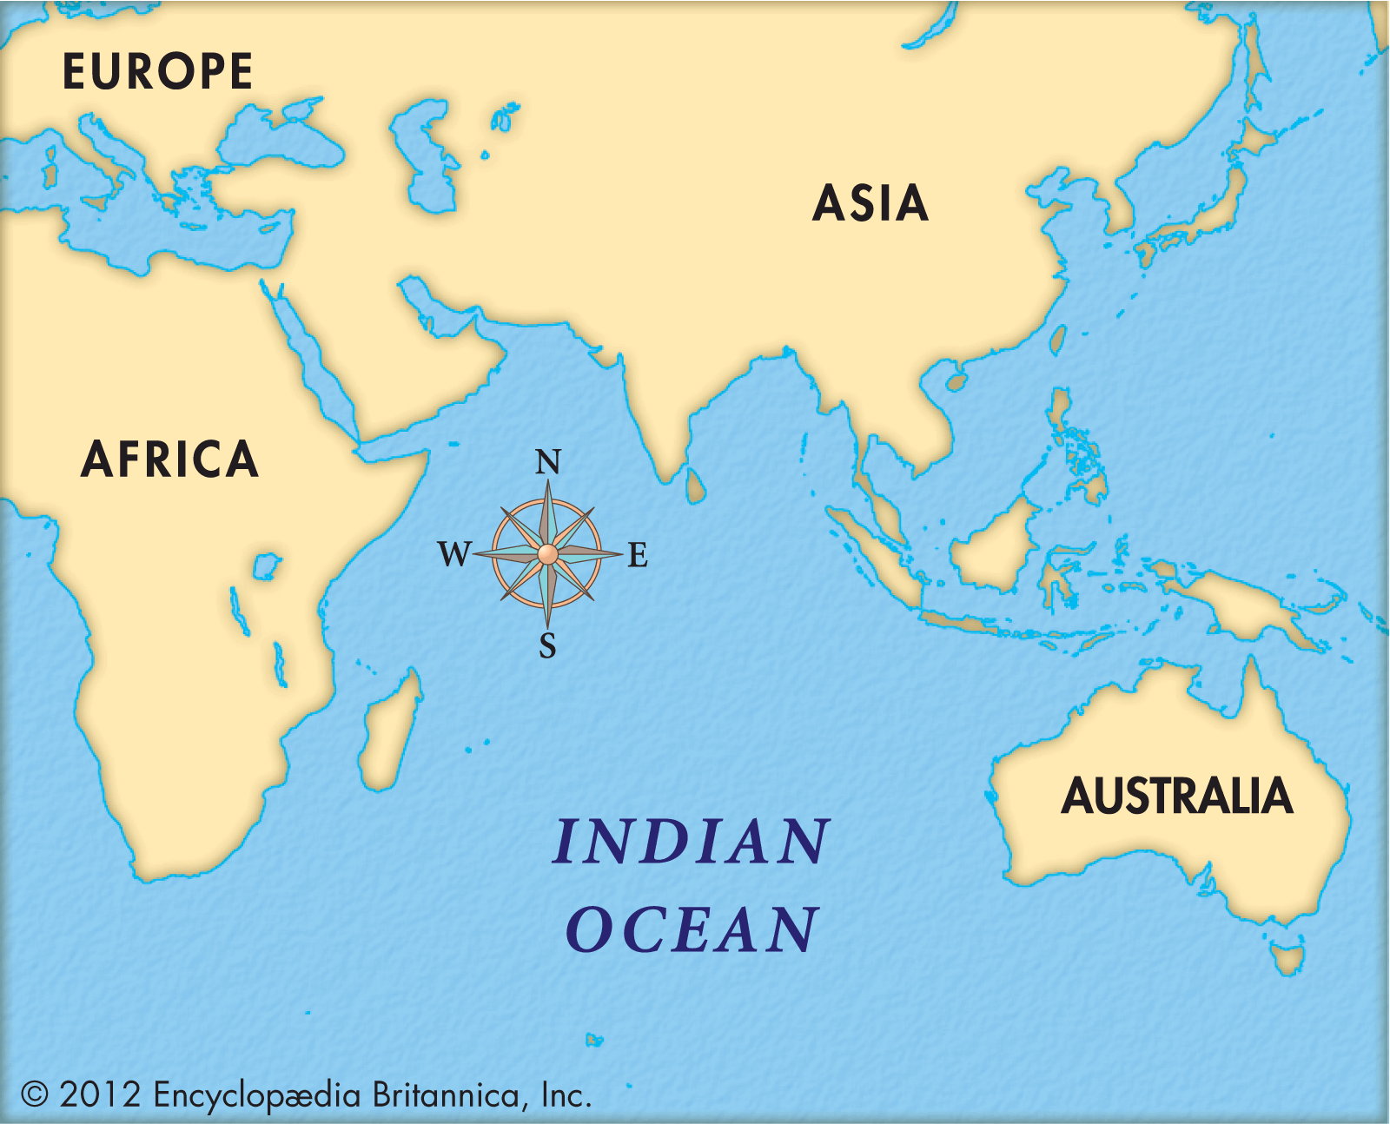
1987 – 2007, ages 16 – 36
100+ vessels from 18’ motor skiffs to 150’ tall ship, tankers, dry cargo. Average was 35’-55’ sailboat.
75,000+ nautical miles; 3 X Earth’s circumference.
4 times round the world (nothing goes up wind like a Boeing 747!). Around the planet by surface except a gap between East India & East Africa.
65 nations and
island groups: 30+ voyages to/from Bermuda, 2.5 Trans-Atlantics, 1 Trans-Pac, several coastwise Canada to Florida.

Slide 3
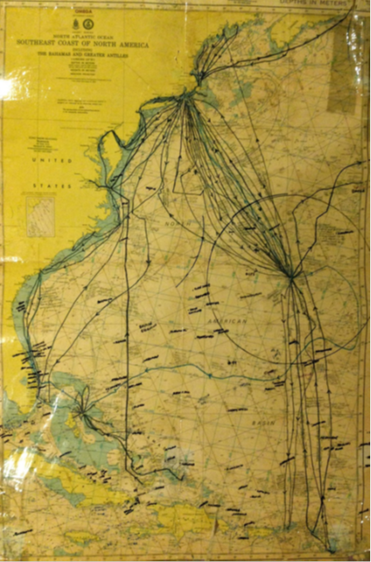
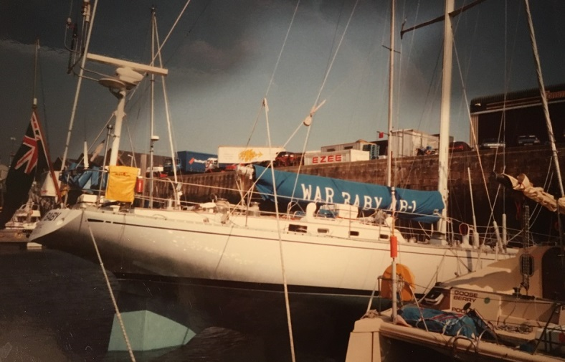
I was able to go to really interesting places,
Islands like Bermuda, the Bahamas, the Caribbean all along the American coast to different towns.
Sometimes we went into port to avoid bad weather, other times
Just because we were tired or out of fuel or food.
During lunch the owner asked the young crew if they noticed the condiments sliding down the table….. Always double-check water depths!

Slide 4
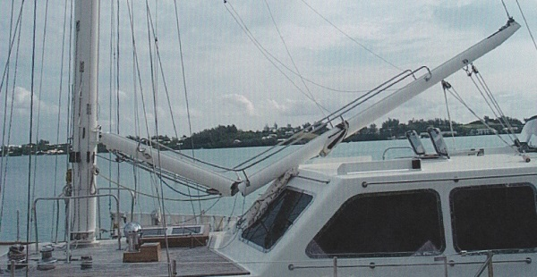
The sea can be very strong: sometimes even stronger than the boats that try to cross them. This broken boom happened to the crew of another yacht en-route from the US to Bermuda.

Slide 5
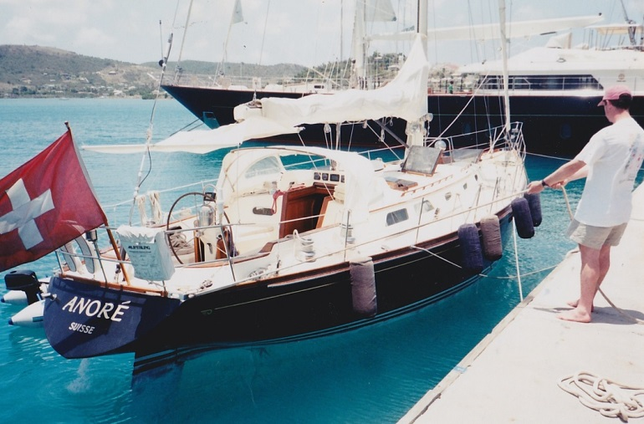
One of my favorite voyages ever: good friends, great food, excellent boat. Good weather except for a lightning storm. Antigua-Bermuda-Newport. The owner was from Switzerland, so was the boat.

Slide 6
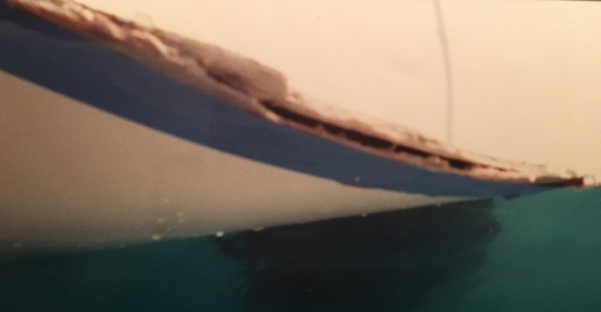
Sometimes little problems become big ones: This innocuous-looking hull damage was caused by a squall slamming a row of yachts berthed stern-to in Bermuda. It required nearly two weeks of repairs there.

Slide 7
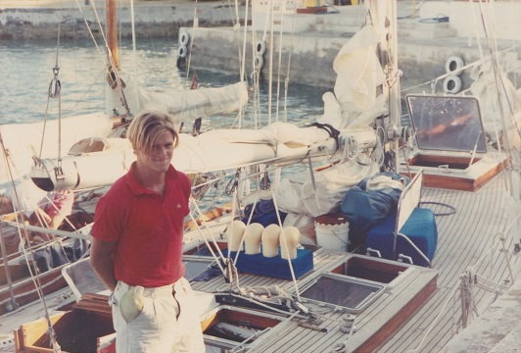
Aboard Chebec in Bermuda, age 20. We rescued the photographer, a marine biologist, when she rode her moped into the harbor! Note: At sea haircuts, toothpaste, even fresh water and fresh food, are not always easy to get.

Slide 8
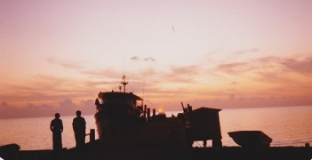
When you work at sea you get to meet really interesting people from all backgrounds. And see nature at its most beautiful. Here is a sunset in Sandy Point, Abaco, Bahamas.

Slide 9
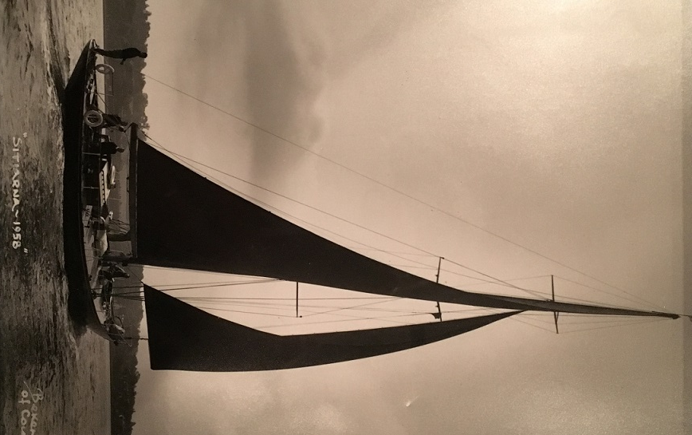
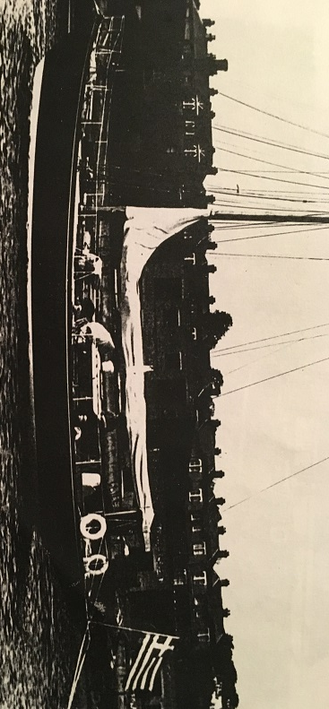
Sailors are very helpful if you get in trouble.
This beautiful yacht sank less than an hour after we left Trinidad. But everything was fine – we had other boats nearby who quickly came to our rescue. No one was hurt.
The Trinidadian Coast Guard sent two boats very quickly.

Slide 10
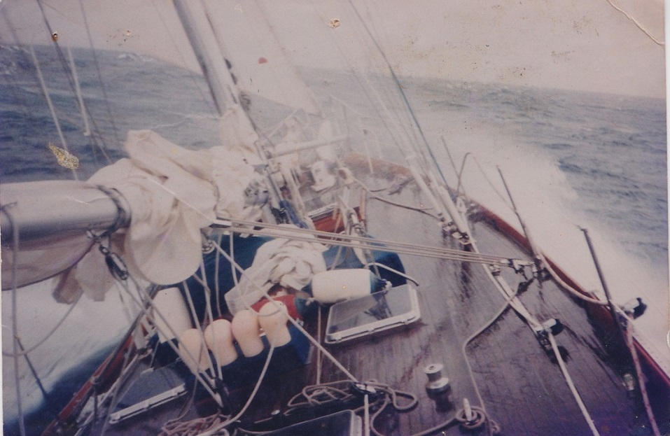
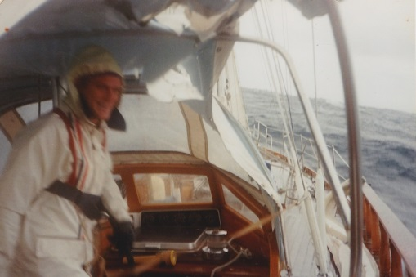
Sometimes there is bad weather, but if you have a good boat and good crew, you can even enjoy it!

Slide 11
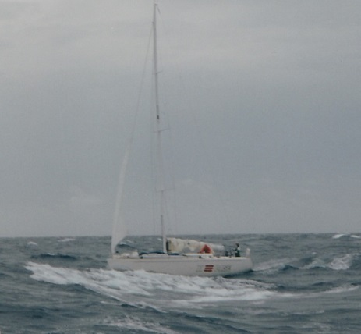
One of the crew on this yacht had his birthday. Soon after this photo was taken we baked them a cake (they didn’t have an oven and we did). Then we simple threw clumps of cake at them, and they ate it off the deck! It was fun.

Slide 12
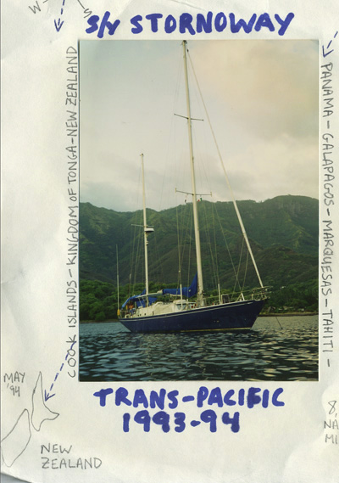
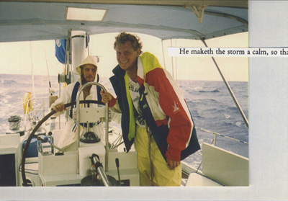
On this voyage the young captain and crew went long distances: across the largest ocean in the world, the Pacific! It was a big strong, boat, and the owner was on board to make sure everything went OK. And we had a great chef as a cook. It took almost half a year to get on New Zealand from Panama, but we had a great time.

Slide 13
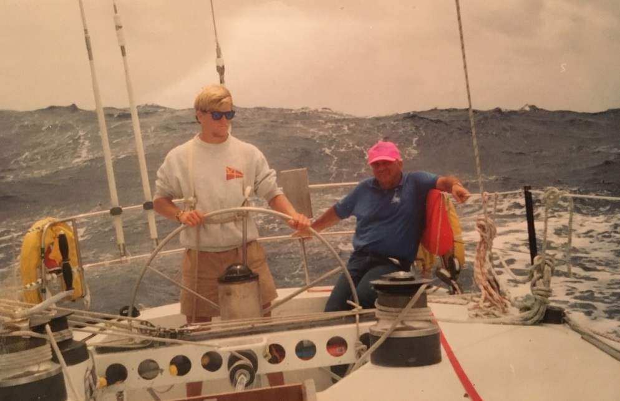
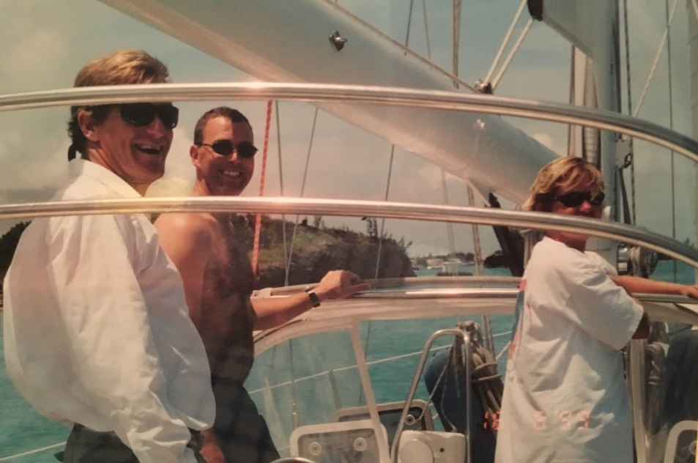
The captain in the pink shirt has lots of experience. That’s me at the wheel, just out of college. His knowledge makes me feel very confident about my job steering, even though there are big seas behind us.
Be safe, having a knowledgeable,
reliable, well-paid, well-fed crew. Then relax and enjoy! Here we are about to enter a very narrow channel in Bermuda. But we are clearly enjoying it! Most boats have women on board as well as men.
She is from South Africa.

Slide 14
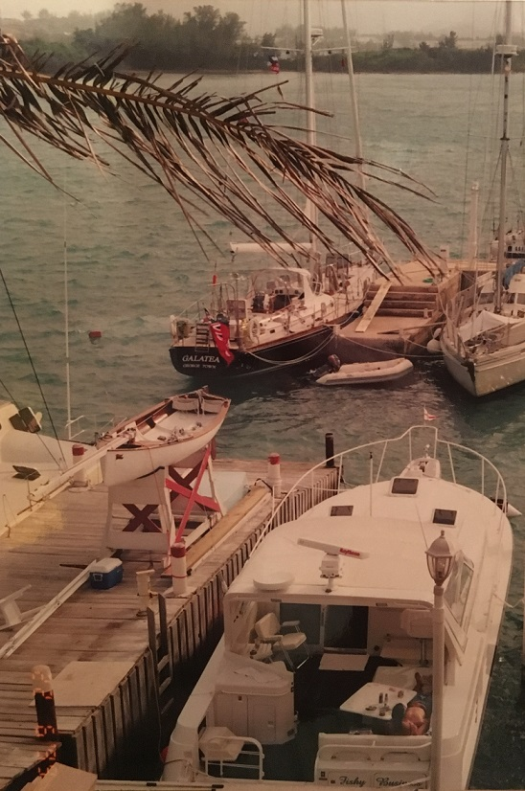
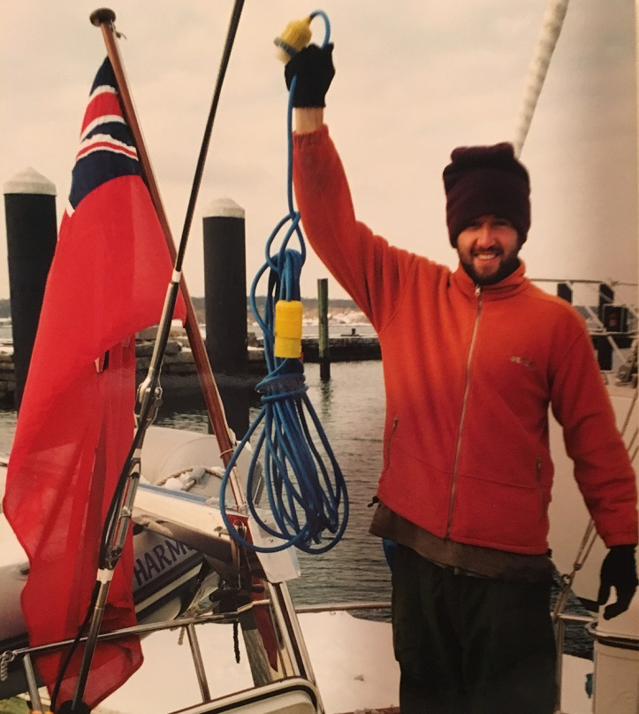
Sometimes It’s Snowy, Others Balmy:
Sailors often have to work in all kinds of conditions, including night-time.
Bermuda in June Yachts in Newport, March. See the snow?

Slide 15
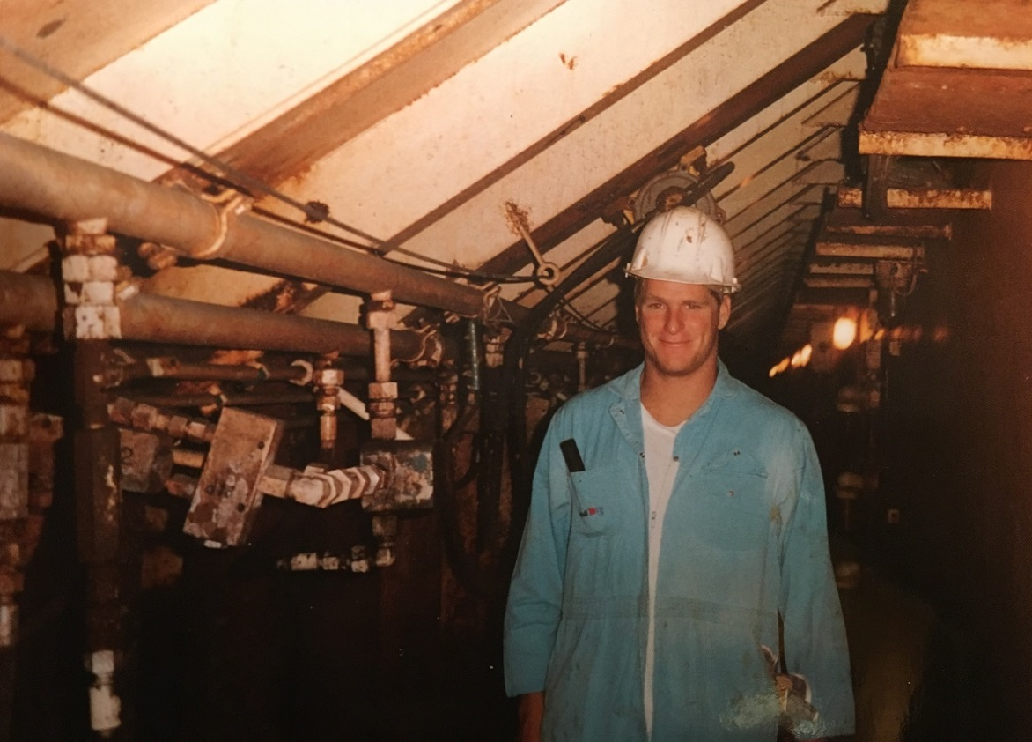
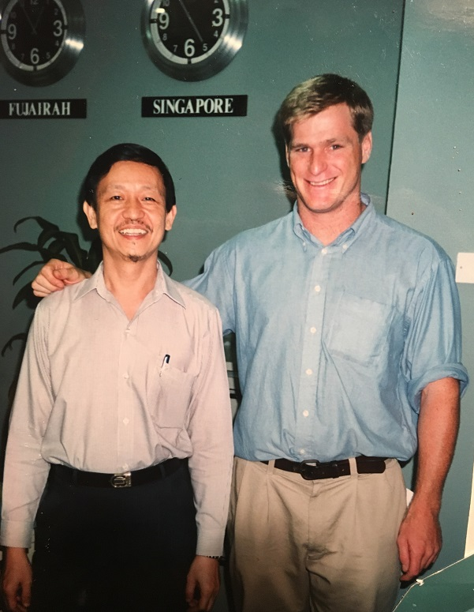
After sailboats I moved to working for big ships in Asia for three years:
A lot of the shipping world was new to me, like huge
steel vessels carrying salt or oil for cars or for cookies.
But I already knew about the sea, navigation, etc. I
made a lot of new friends, including Mr. Arif Lim – to
the right. He converted to his wife’s religion.

Slide 16
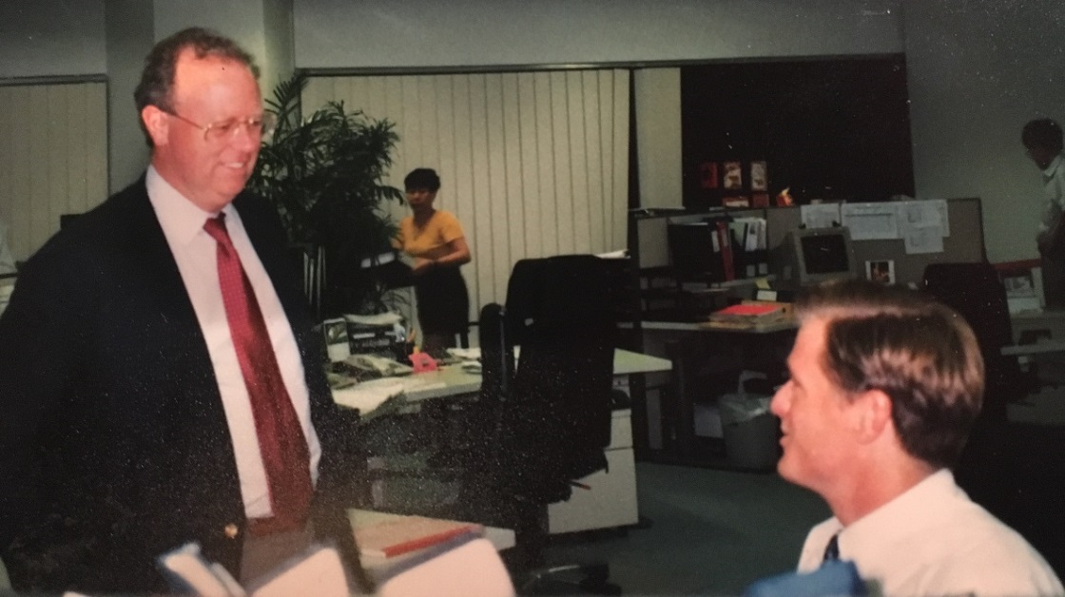
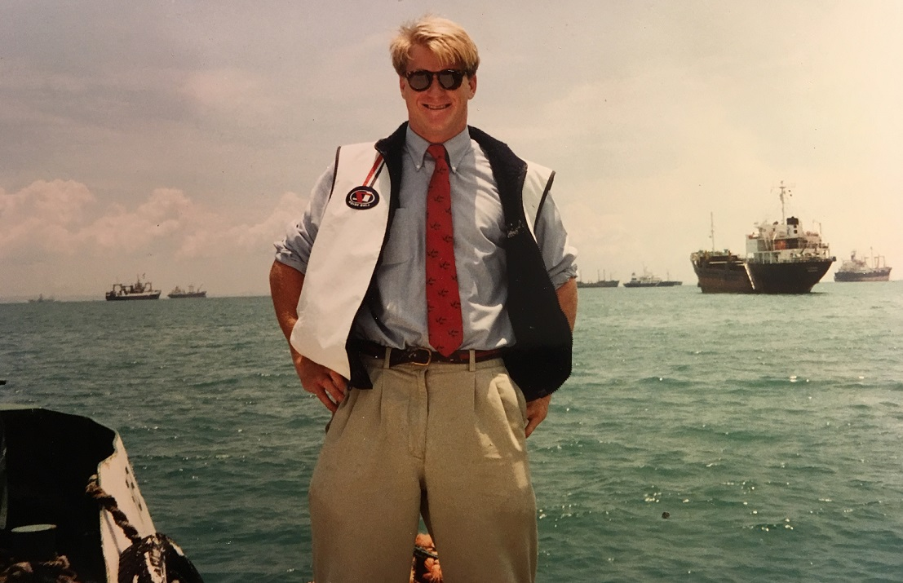
Adapting to a New Environment
The owner of the ships was from Rhode Island, where I had lived and sailed. His wife was from the Bahamas, where I grew up. He was very friendly, and visited Asia. So I felt more comfortable out there.
When you work for the ship owner (instead of for the cargo owner, or the broker, who works between them all), you get special perks, like being able to visit “your” ships any time of day or night! Here I still look like a yacht sailor, though by now I was in shipping!

Slide 17
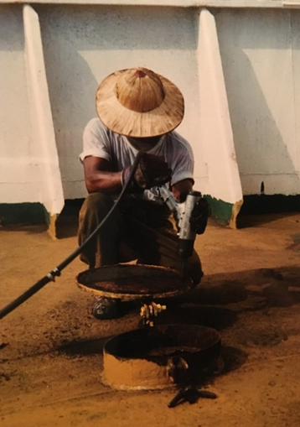
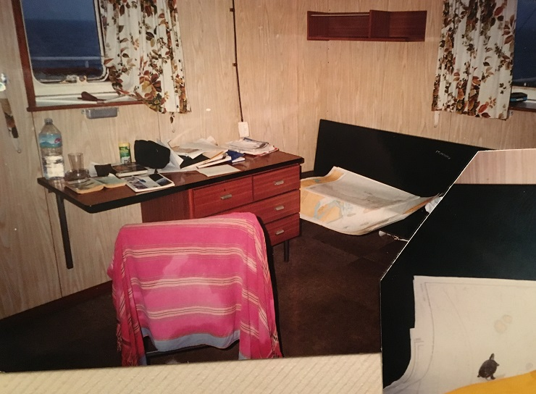
Work on ships can be hard. But you get a nice cabin, great food and good company.
Some times it is difficult to stay in touch with your family, though.
At the lower right corner is one of my two baby turtles, Red and Stripe (red-striped terrapins). I took them along for company. We voyaged from Singapore, the Straits of Malacca, through Andaman & Nicobar Islands to the east coast of India & back.
My little turtle “Red” or his sister “Stripe” exploring cabin!

Slide 18
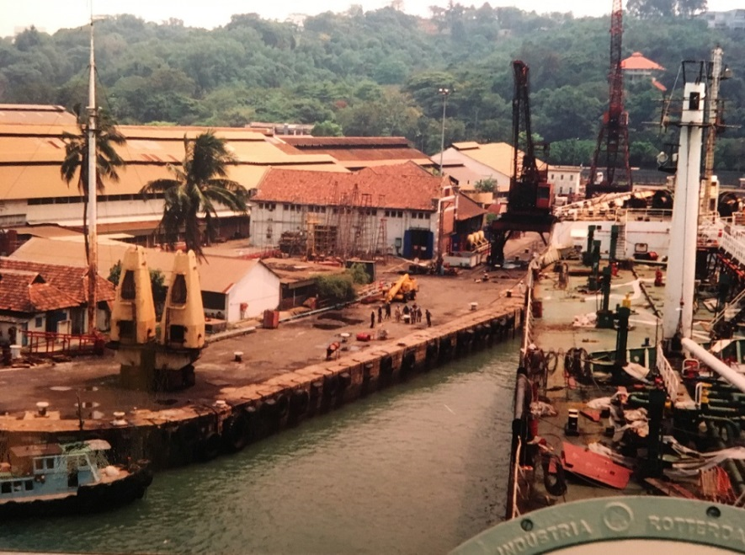
Big ships need to go into shipyards to get worked on and repaired sometimes. It’s like getting a check-up from your doctor, or a new pair of shoes. This is in Singapore. Note the jungle and the palm trees. It was a really beautiful place to live and work three years.

Slide 19
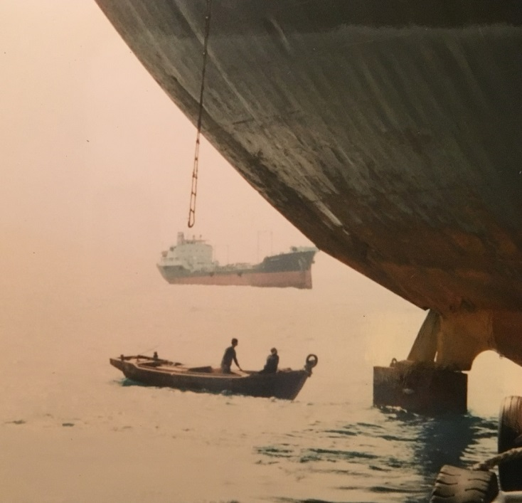
Many different types of boats and ships work hard to keep the big ships running: fueling tankers, garbage boats like this one, tugs, supply boats, crew boats, and so on.

Slide 20
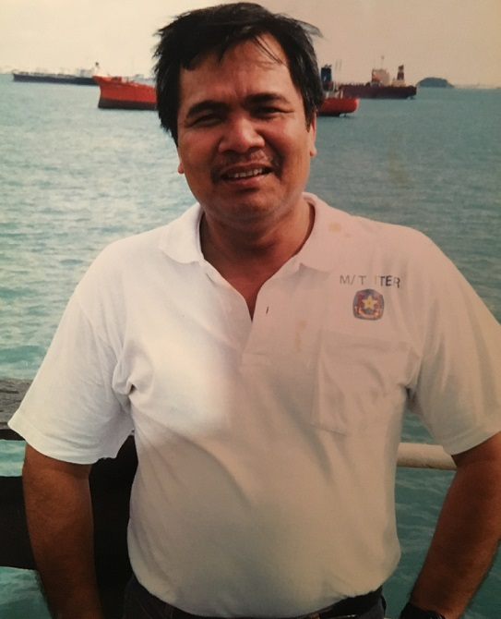
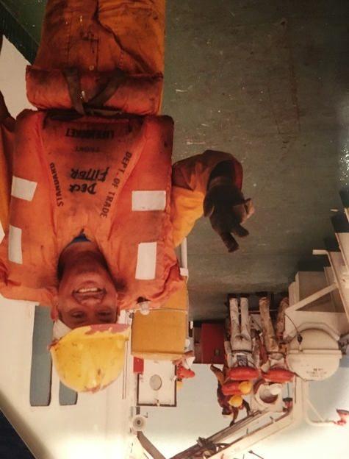
Friendly officers and sailors that I worked with in Singapore, India and beyond in my 20’s. Above is a Captain, to the right is an engine fitter. Both are from the Philippines.

Slide 21
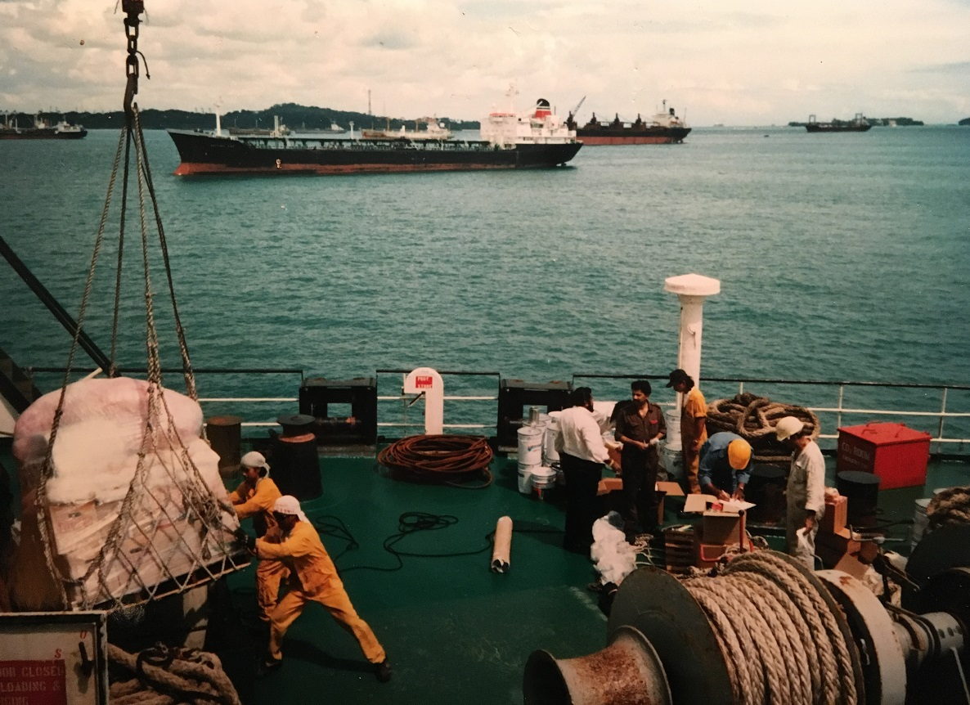
Exciting Global Industry, still! (& safer)
How it works: Global cooperation; folks of many nations and tongues conduct business: owners order the supplies for engine room, ship and galley. Officers sign for it. Crew stow it. Ships of all types lie at anchor ready to deliver or carry cargoes of all descriptions to all corners of the planet. Somehow, the pieces all fit together.

Slide 22
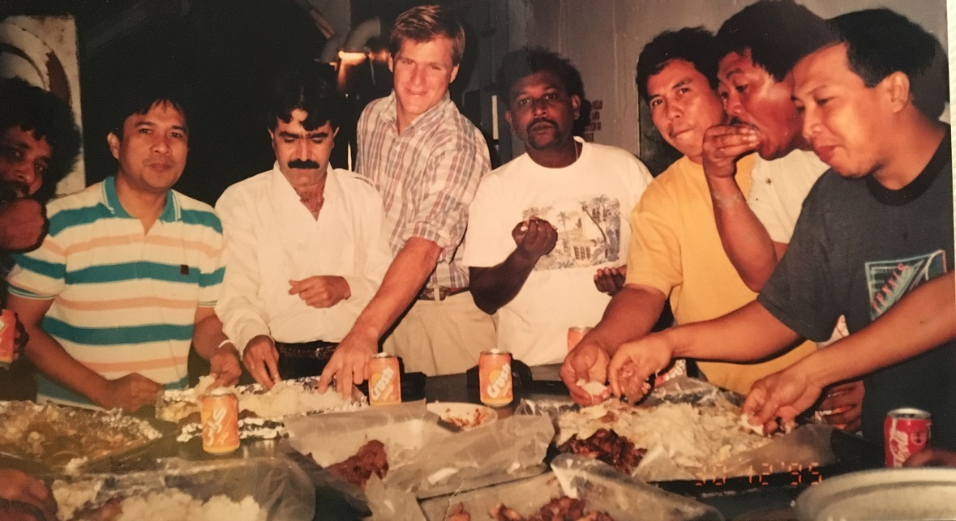
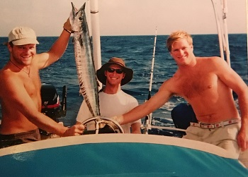
Camaraderie, Fellowship of the Sea
Crossing the Indian Ocean
on the tanker Edmo, 1996. Officers, superintendents, sailors and guests dig in with their hands.
Crossing the Atlantic on S/Y Maruti, 2000: Kiwi engineer, US evangelist, Aussie Skipper, British & Indian owners, going to the Channel Islands, UK. All the way from New York to Europe!

Slide 23
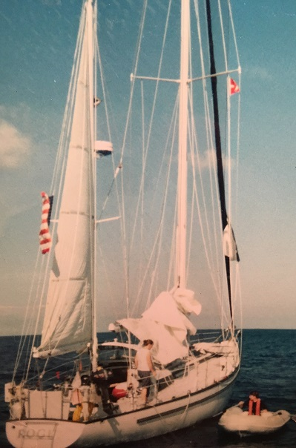
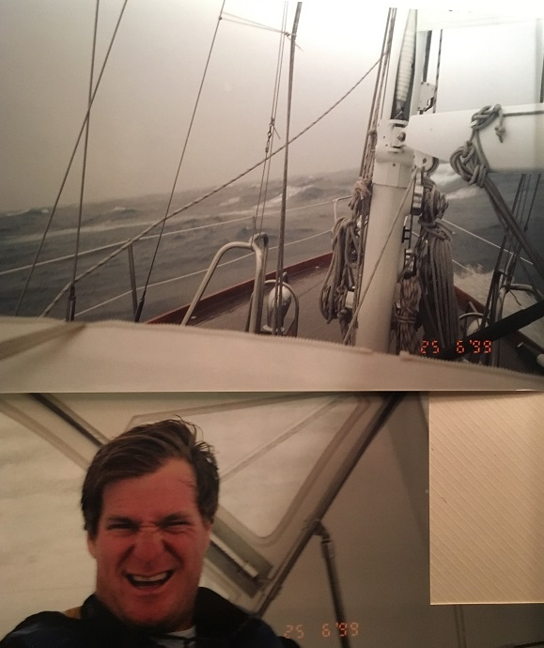
At sea and in port, helping others, being prepared:
180 miles south of Bermuda: Helping another yacht with engine/fuel issues.
Even in a storm (50+ knot winds), if the boat and crew are ready, relax, even enjoy!

Slide 24
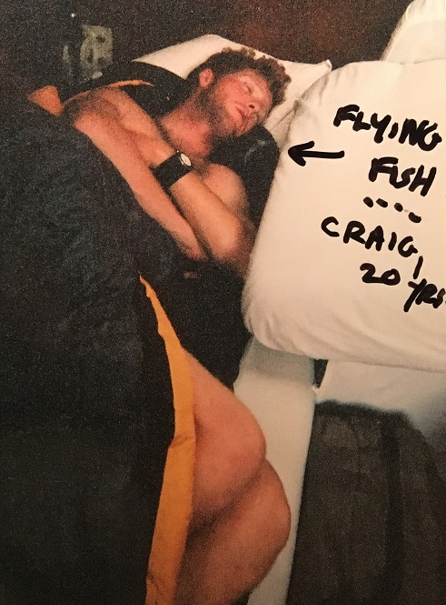
Then, finally, we can sleep!

Slide 25
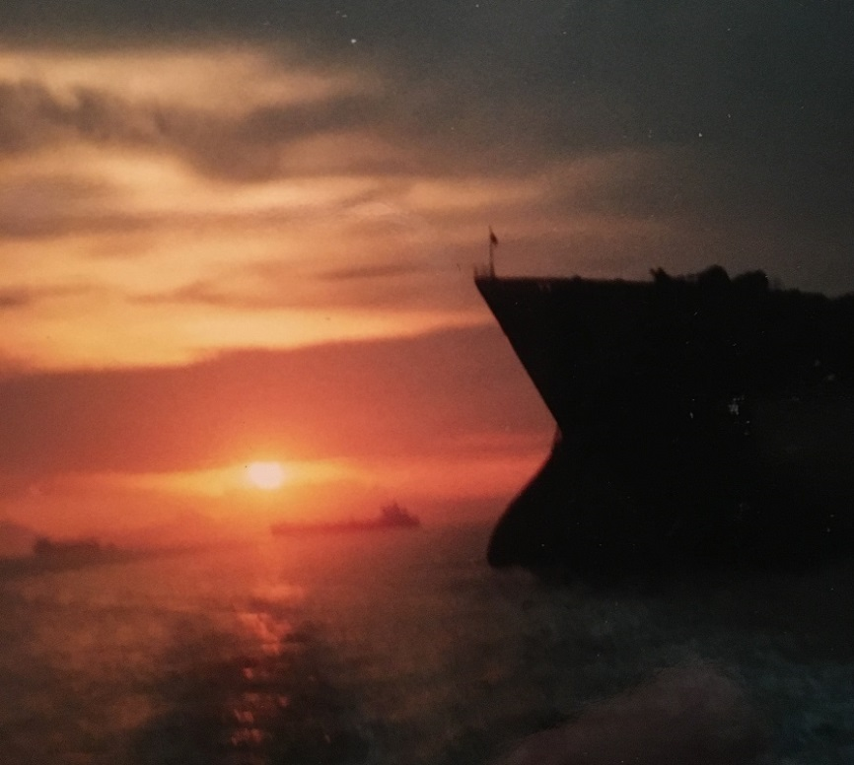
Questions?
THE END
Thank You!

