Slide 1
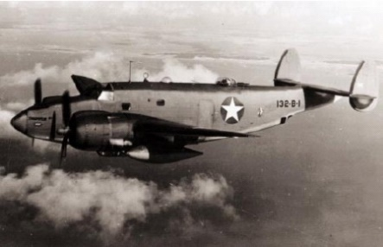
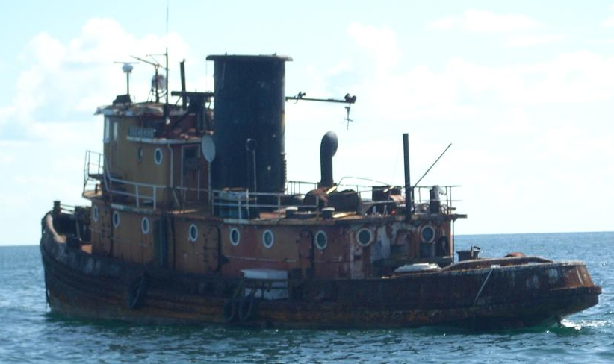
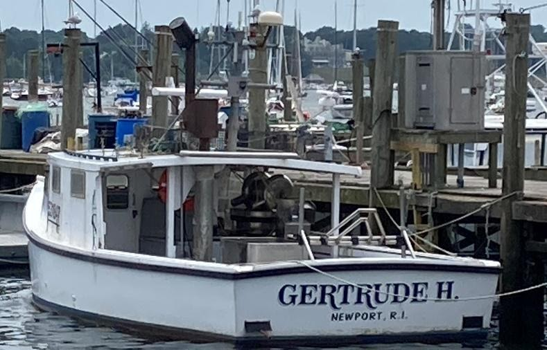
Sub & a Tug, lobster boat, clingstone plane
Capt. Eric Troels Wiberg, Esq.
Bosworth Lecture, Bristol, RI Rogers Library
6.30 pm, Thurs. Apr. 9, 2026

Slide 2
TOPIC ONE: Jamestown’s D-Day Tragedy; Seven Dead at Clingstone, Forensic Mission
Several years ago, when entering the field of aircraft discovery, I was wary of entering the ‘territory’ of Larry Webster, local expert in the Charlestown and Worden Pond area. So, I visited Larry and expert historian Jim Nash (New England Aviation History, a former State Police diver), and learned a great deal. I sought the path of least resistance, the criteria being an undiscovered but historically significant wreck which crashed very near to shore in depths shallow enough for me to snorkel and kayak. The D-Day wreck is said to be 100 yards off shore in Jamestown promised to be a good start, my good friends Cameron Clark and Capt. Steve Connett had local knowledge, I had sailed this area on Tempo and Valentine from the 1980s to the 2000s on and off, and I was confident. I even obtained the help of Hans Hauck, an expert in sub-sea, side-scan SONAR (SonarSub.com), introduced to me by Emily Sweeney of the Boston Globe, who had just helped find Vermont’s longest missing aircraft mystery in Lake Champlain.
Three years later, having been to the sites of nearly 100 aircraft crashes, I’ve only managed to confirm the one, in John’s Pond Mashpee. This is the story of the many efforts to find this plane off Jamestown and honor the men who died. I thank Providence College and URI’s library for this help, well as the Naval War College, NARA, Naval History and Heritage Command, and the US Coast Guard history center, as well as many local individuals who have helped.

Slide 3
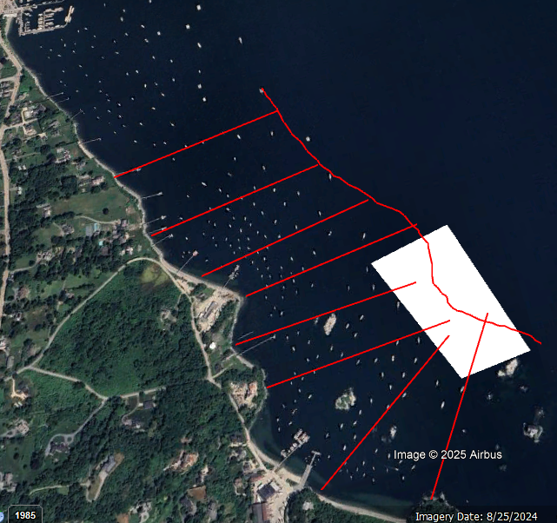

Slide 4
“At 9:34 a.m. on June 6, 1944, a U.S. Navy Pv-1 Ventura (Bu. No. 29917) took off from Quonset Point Naval Air Station with seven men aboard bound for Nantucket, Massachusetts. Six minutes into the flight the plane went down in the water just 200 yards off the shore of Jamestown (a.k.a. Conanicut) Island in an area known locally as “The Dumplings”. (The area is so-called due to the rock formations that protrude from the water.) The fuselage reportedly hit the water between “Big Dumpling” and what was then the Jamestown Ferry Company dock, which is today part of a marina.
There are conflicting accounts of the accident. It was initially reported that the plane suffered some type of explosion while airborne, and possibly a second on impact with the water, and it was further reported that the aircraft was in several pieces on the bottom of the bay. However, the official findings listed in the Navy Investigation Brief, (#44-14865), indicated poor weather conditions as the cause for the accident, with no mention of an explosion.

Slide 5
In the report it was stated in part:, “Opinion from Adm. Report: That the plane crossed over Conanicut Island on a southerly heading and upon entering the vicinity of poor visibility in the Newport Area , either developed engine trouble, causing the pilot to turn and let down to a lower altitude to establish absolute visual contact with the water or ground in case of a forced landing. Upon suddenly finding the island so close ahead he attempted to pull up and turn away in a sharp left turn with an immediate application of full power. The violence of this maneuver or the possible failure of the port engine could have been sufficient to invert the airplane from which recovery at this low altitude was impossible. ”
All aboard the aircraft were killed in the crash.

Slide 6
Pilot: Lieutenant Jack Collins Sullivan, 25, of Dearborn, Michigan. He was survived by his wife Marcia. Aviation Machinist Mate 1st Class Thomas Joseph Kiernan, Jr., 22, of Albany, New York. He was survived by his wife Virginia. Photographer’s Mate 2nd Class Regis Aloysius McKean, 23, of Queens, New York. He was survived by his wife Patricia. Petty Officer McKean was married on March 2, 1944, just three months before the accident. Aviation Ordinance Man 2nd Class Frank Peter Van Oosten, 23, of Malden, Massachusetts. (The only New Englander aboard) He was survived by his wife Hazel. Aviation Machinist Mate 2nd Class Albert Lee Kresie, Jr., 26, of Kansas. Aviation Radioman 2nd Class Francis Gabriel Hricko, 27, of Hastings, Pennsylvania. He was survived by his wife Jane, whom he’d married just two weeks earlier. Doctor John McMorris (Ph. D), 39, of California. He was survived by his wife Helen. Dr. McMorris was a civilian working on an undisclosed project for the military. Dr. McMorris was a pioneer in developing ways to recover formerly unrecoverable fingerprints at police crime scenes. His research, discoveries, and techniques developed in the 1930s are commonly used by police today.
This incident remains the worst aviation accident to occur in the town of Jamestown, Rhode Island.”

Slide 7
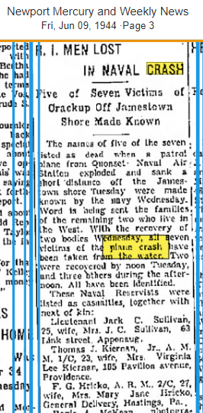
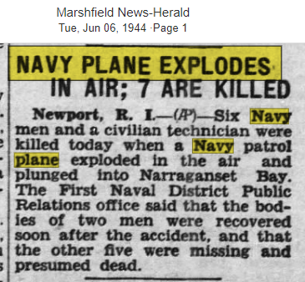
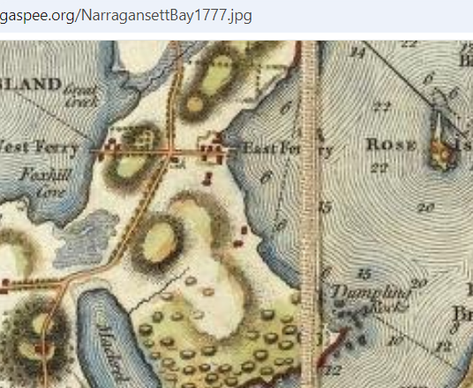
The Jamestown and Newport Ferry Company was chartered in 1873 to establish and maintain a ferry between Jamestown and Newport. The company operated ferries until 1969, when bridge construction made the ferry service obsolete. J.S. Lovering Wharton of Philadelphia designed Clingstone, his new home, with artist William Trost Richards. It was completed in 1905 atop a small rocky island in an island group called “The Dumplings” and replaced Braecleugh which had been demolished when Fort Wetherill was built. The name “Clingstone” was suggested by a remark that “it was a peach of a house.”

Slide 8
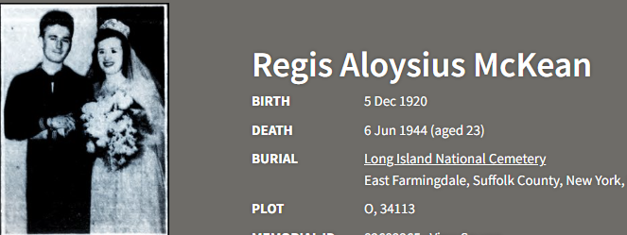
Doctor John McMorris (Ph. D), 39, of California. He was survived by his wife Helen. Dr. McMorris was a civilian working on an undisclosed project for the military. Dr. McMorris was a pioneer in developing ways to recover formerly unrecoverable fingerprints at police crime scenes. His research, discoveries, and techniques developed in the 1930s are commonly used by police today.

Slide 9
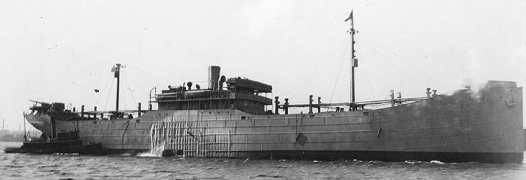
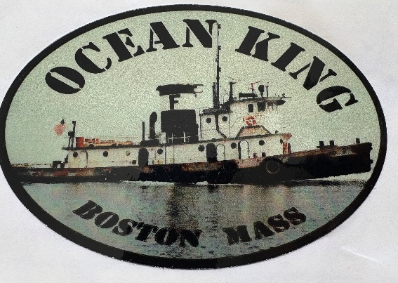
TUGBOAT AND LAST WWII U-BOAT ATTACK

Slide 10
Somewhere in The Bahamas, afloat, aground, or underwater, is a medium-sized tugboat built 80 years ago which was recently confirmed to have hosted the witnesses to the last ever German U-boat attack, in 1945 off Newport, Rhode Island, hours before VE-Day.
Most of the story is clear and well-documented, however her movements in recent decades go cold, starting with oil-prospecting firms in Las Vegas and a waterfront at Arawak Cay cluttered with rusting old tugs. This article is published in the hope that someone on the sand and gravel and oil prospecting business in The Bahamas may come forward.
The tug in question was last known as Carina (2009-2024, in Bahamas), before that Ocean King (the first, in Boston, 2004-2009) and before that the Margaret Sheridan in New York (1951-2003) and originally the Chaplain in New York (1946-1950).

Slide 11
The last living crew to see the last U-boat attack gave this author permission to publish the story with his last breath in 2018. In April of that year a German-American woman named Luise Coley contacted me with a surprising story. Her father-in-law Louis Alfred Coley, Jr. served in the US Merchant Marine from 1942 to 1945. In 1946, the Chaplain (179 tons, 95ft long, 25ft wide), joined the fleet of Sheridan Towing as Margaret Sheridan.
From 1951 to 2004, she sailed under the ownership of Red Star Towing, then Amerada-Hess, in 1977, then Farrell Ocean Services, then McKeil Marine Company, Russell Tripp, and Bay State Towing. Then Constellation Tug Company of Boston renamed her Carina from 2004 to 2009, after which the tug was sold. During her last years in Boston, she was little-used, her last US-owner referred to her as the “old girl”, and Pond Prince.

Slide 12
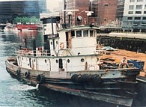
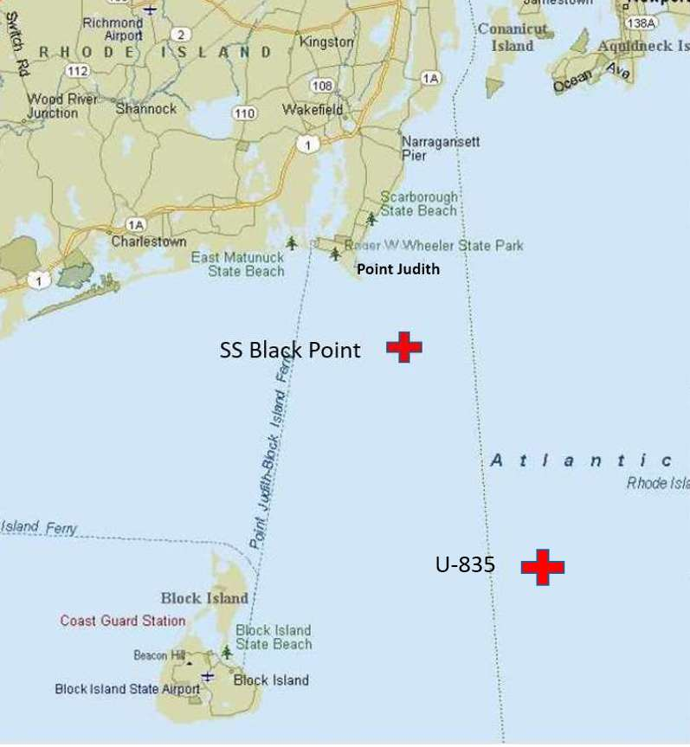
Why does this matter? Because in early May 1945, as the war in Europe was waning to its very last days an American steamer named Black Point set off from Newport News, Virginia for an unescorted voyage to near Boston with 7,595 tons of coal with 45 men under Captain Charles Prior. On the evening of May 5, she was rounding Point Judith Rhode Island roughly four miles from land. There were two other freighters, a tanker, and a tug towing two barges visible to the lookouts. That tug was named Chaplain, and had been launched just weeks before at the Ira S Bushey shipyard in Brooklyn. It was steam-powered, with a Fairbanks-Morse engine of 1,000 horsepower. Her owner was Spentonbush Fuel Transport, and one of her deck-hands was Louis Coley, a 19-year-old waterman whose mother, Catherine Madden, was born and raised on a barge in Boston. Coley said that “the sub was right under, and along their tug, and used it as cover, travelling in their shadow. His crew didn’t realize this until it was too late, and the ship had been hit.” Then Coley watched as “…the Black Point was being circled by the U-boat, and he saw the ship went down.” Being practical men, as soon as the crew of the Chaplain realized they were in the middle of a U-boat battlefield, they got out of the vicinity, which would explain the absence of records about their presence. Perhaps because they fled, Coley was for most of his long life unwilling to share his story. Before allowing me to share his story, he asked if I “was a card-carrying US Merchant Mariner?” When told I am, he said “then it’s alright.” His daughter-in-law said “…it was the most he talked in weeks.” Mr. Coley, waterman all his life, died a few hours after giving me approval.

Slide 13
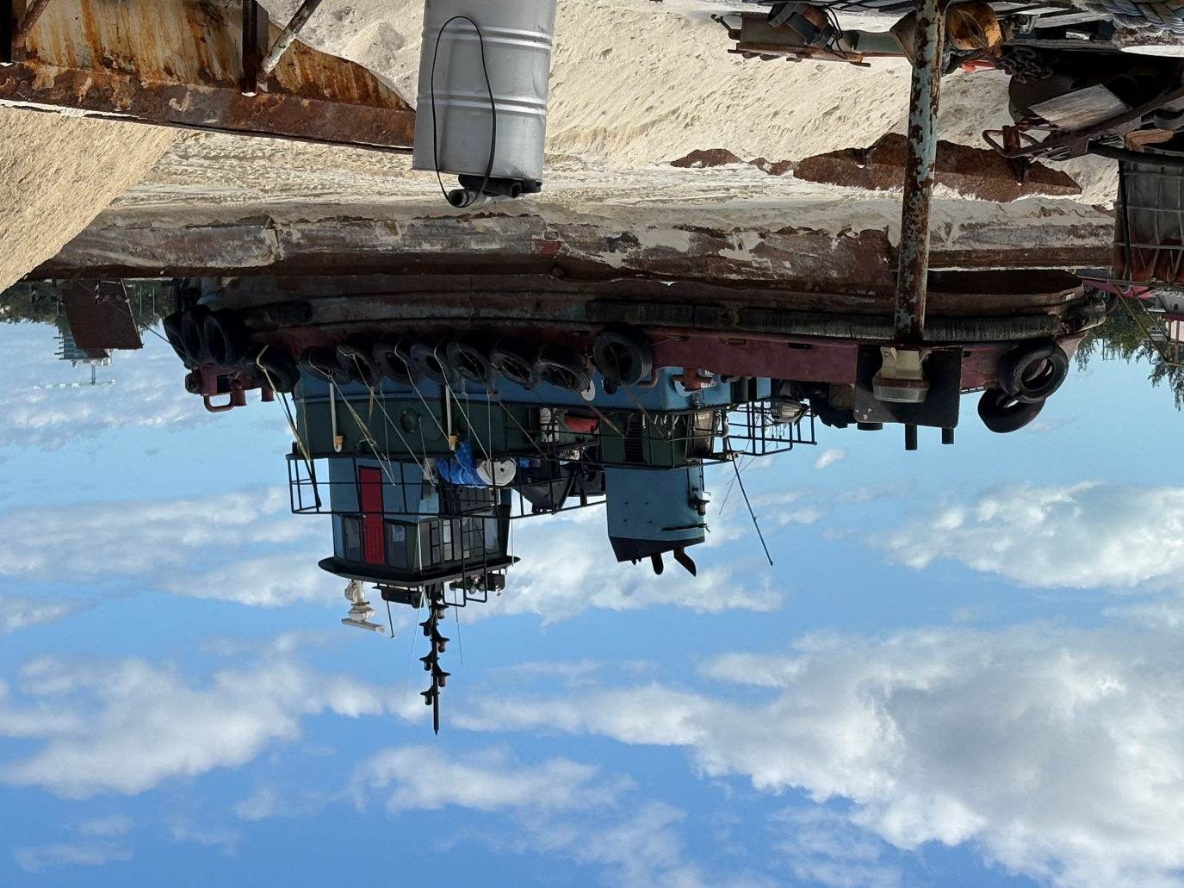
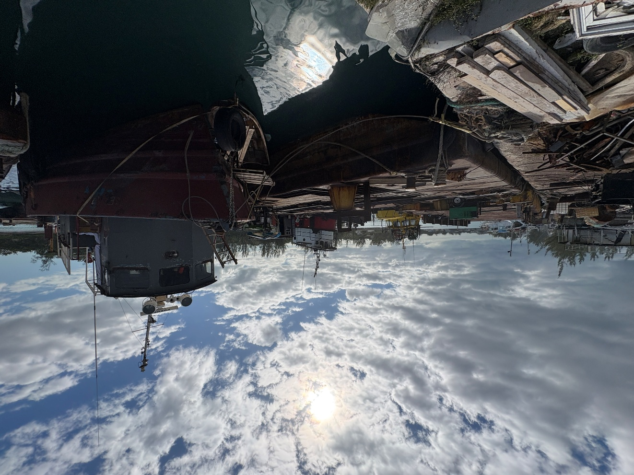
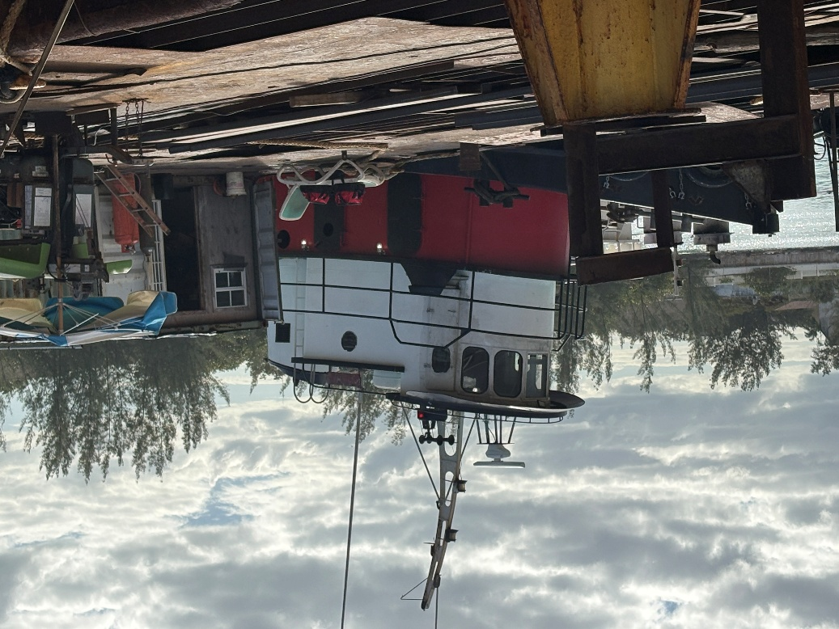
Dozens of visits to maritime junkyards and aggregate docks on Arawak Cay Bahamas and beyond, never finding “the one” always told “it’s there and about to be towed out and sunk!”

Slide 14
Constellation in Boston renamed Ocean King Carina to avoid confusion with another tug of that name and are said to have sold her to a company in the Bahamas in 2005, and as one tug history expert wrote: “that is the last that I have heard about her”.
After much sleuthing and a few fruitless phone calls, her ownership was traced to Liberty Oil & Refining Association, with offices in Las Vegas and West Palm Beach. In August 2024 the government database of vessels globally, Electronic Quality Shipping Information System, or Equasis, lists the “Registered owner” of Ocean King, IMO #5260382, built 1945 since “before 2009” as “LIBERTY EXPLORATION INC” of Las Vegas. This firm contracted with the Bahamian government to prospect for oil off Walker’s Cay in 2005.
Liberty Oil’s principals are Kermitt Waters in Nevada and Carl Thornebrue in Florida. Established in 1979 by Waters, who has owned a law firm in Vegas for 30 years, their initial mandate was to explore for oil in the US, and they ventured into “airborne magnetometers …to locate a massive Jurassic reef …calculated to be 60 X 30 miles and 5,000 feet high.”

Slide 15
With this they “applied to the Bahamas Government and [were] granted a license which contained five blocks ten miles by ten miles each, with the total area of 500 square miles …..to drill three exploratory wells northwest and south of Walker’s Cay… to test for …commercial quantities of hydrocarbons ….[to] ….be converted to production wells”. Sounds convincing – except no exploration even took place.
Liberty Oil claimed to own a jack-up drilling rig Autumn Trader and an offshore supply boat Jim Gibson, and Ocean King Carina is in the paper trail, but aside from a few offhand comments it has not been possible to place this tug in the Bahamas. A characteristic of Liberty’s activities was the conspicuous absence of a tug when they most needed one.
Their 259-foot drill barge Louis J Goulet ran aground at Johnny’s Cay north of Hope Town. When Liberty Oil failed to pull it off the reef – because they could not procure the Ocean King or any tug, Larry Smith wrote that “two [drill permits] are held by Liberty Oil, but were suspended because of the company’s failure to remove a sunken vessel from an Abaco reef”.

Slide 16
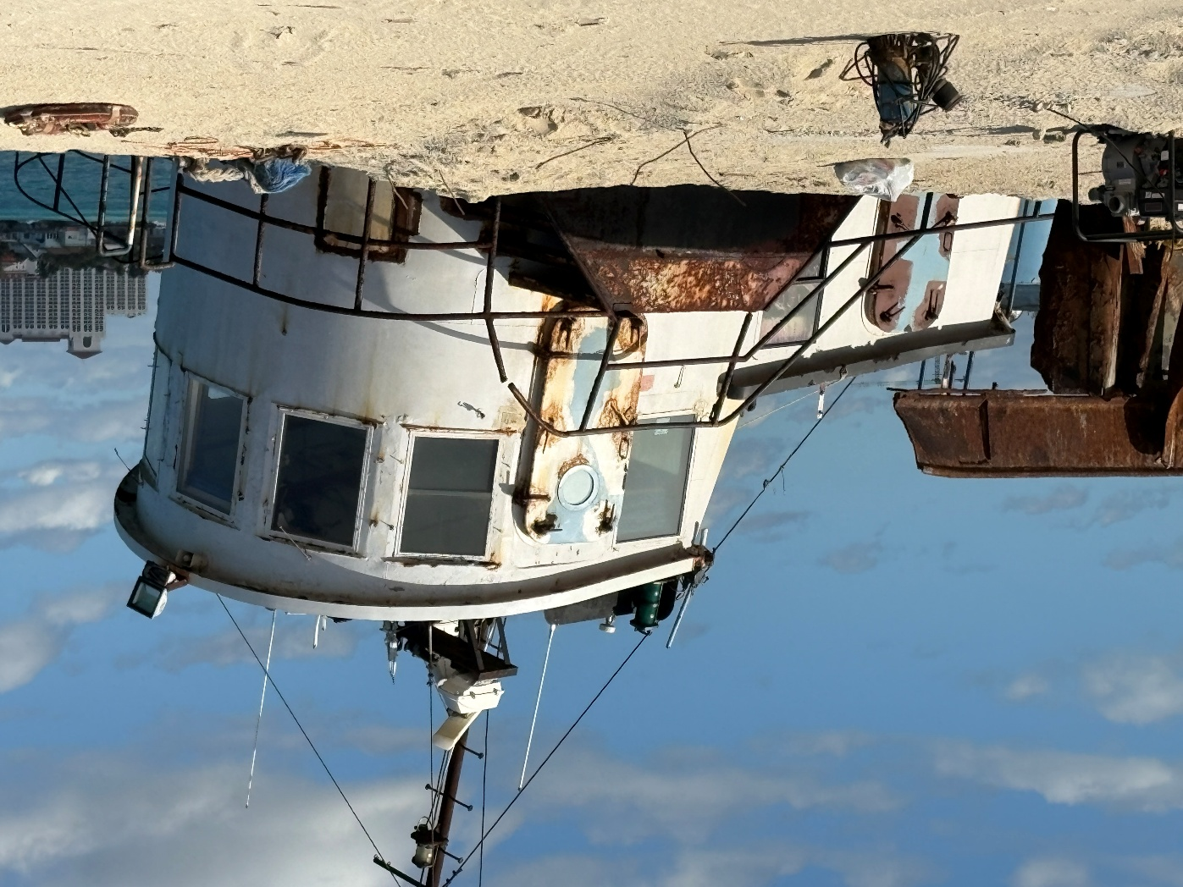
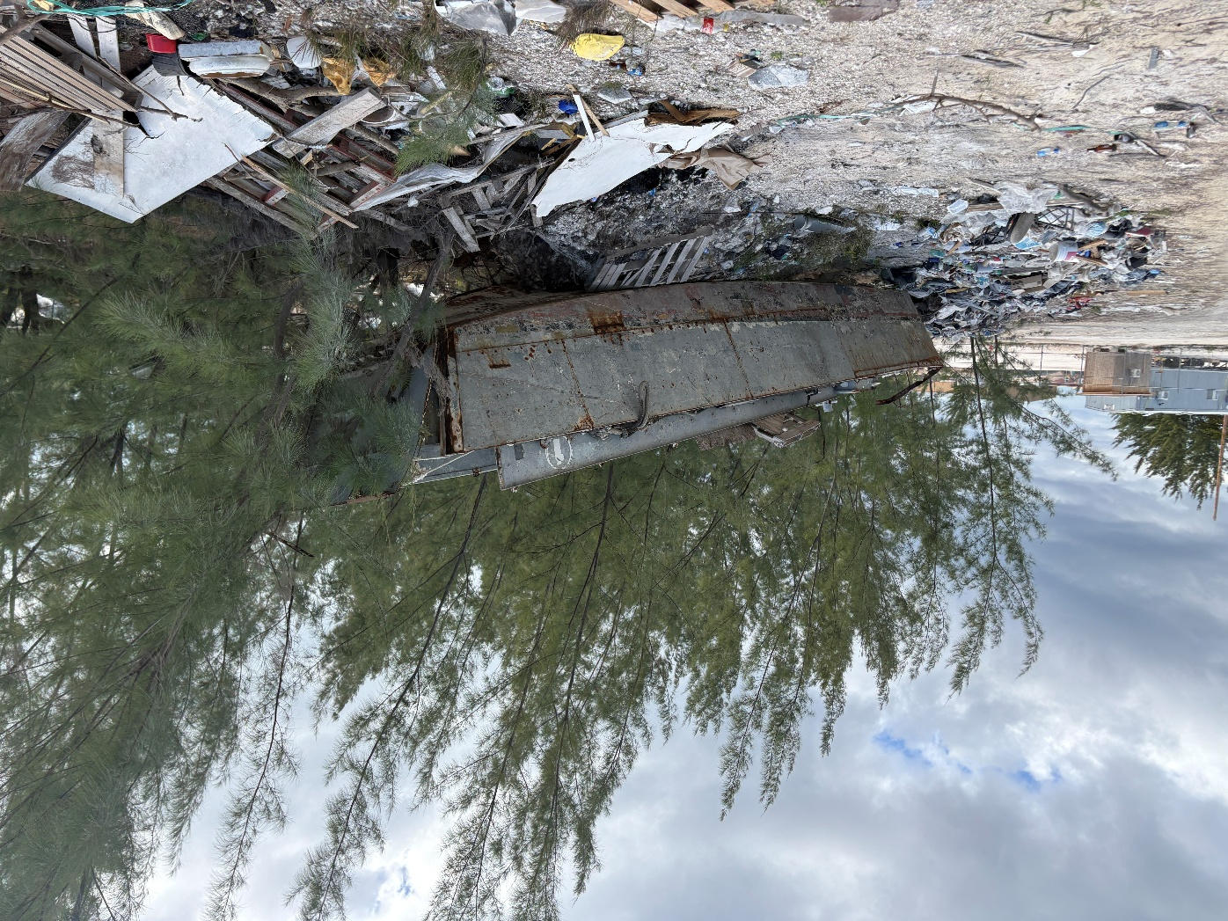
What one finds looking for Carina in Bahamas

Slide 17
In an open letter to Kermitt Waters in the December 1, 2005 Abaconian, Lory Kenyon of Hope Town to have a look. “If you are at all interested in seeing this damage for yourself, I will be happy to take you out to the reef ….I will even provide snorkel gear for you. What size fins do you wear?” she asked. He never took her and presumably went back to the desert to use their NASA-grade toys on a different government. Today their site is down, and their vessels are listed as ‘dead ships.’
If it ever arrived with Liberty Oil, Ocean King aka Carina appears to have never left the Bahamas, and is said to have entered the last stop before the ship knackers: the sand and aggregate business. This theory would find her shuttling barges to and from shallow sand banks to and from Nassau. One prospective owner/operator may be James Edgar Curling, from the seafaring family of Ragged Island, and a firm named Tycoon Management Company on Arawak Cay.

Slide 18
Despite many visits to Arawak Cay and friendly conversations there, nothing has been verified. In 2019, Tycoon is said to have “purchased approximately six tugs and barges for sand dredging operation.” A source said [Carina] “…could easily be one of these, [as] the availability of construction sand has moved further away from Nassau Harbour. After dredging by Rose Island for many years, they moved to Booby Rocks, and now the banks at Finley Cay.”
The present location of Carina, or Ocean King, afloat or asleep, remains a mystery. Probably one day a diver will uncover one of a wreck’s myriad names and post online about it, or this author or someone else, while walking the water front will see one of the monikers of the only surviving ship to see the last attack by a German U-boat in history.
In June of 2025 Captain Tim Farrell, former owner of Carina, sat with me on a blustery day at the bar of the Jeffries Point Yacht Club in East Boston and told me a bit of the history of the tug in Boston, then shared this sticker.

Slide 19
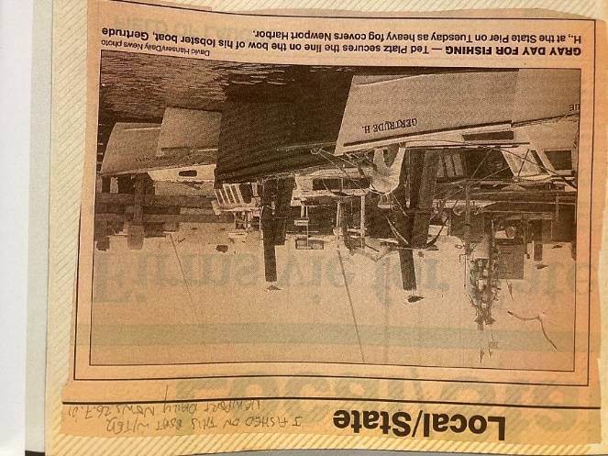
TOPIC THREE: The Story of the Getrude H.

Slide 20
TulipTree Publishers, Colorado
•Single yacht captain, early 30’s killing time mid-summer in Newport RI, early 2000’s
•Call from another (lobster) captain, asking him to bail out ex-girlfriend, yacht in Aruba
•Project fails, waste of time, costing some money for yacht skipper
•August, Ted the lobster skipper, offers me, the yacht skipper, a big cash job 1 day fishing
•Long day 4.30 am – midnight, uneventful, usual oddball crew, sandwiches, loud rock
•On way into port I criticize the boat’s Gertrude H’s name, Ted tells me to quiet & listen
•c.1954 Fall storm from Nantucket to Newport, Margaret M. fled for shelter, ETA midnight on wide Second Beach

Slide 21
•Washing ashore, height of storm, suddenly 2 bright lights motor noises: Gertrude, rescue!
•Emotions of captain and mate at connecting tractor to boat, saving boat, she resourceful
•Denouement: I admit that what makes the story special is wishing his mother was Gertrude H. after years of abuse in boarding school, on the same beach 30 years later
•Gertrude H. can be seen any day at the Fish Pier in downtown Newport, Goat Isl. Bridge
I was a yacht captain in my early 30’s in Rhode Island when a stranger called; said he’d heard I was the man for a job in the Dutch Antilles. I’d just returned to Newport from half a decade in the Asia-Pacific. My main gig was helping people who owned sailboats but didn’t have a lot of experience or time. They would pay me on short notice to do anything from shift the boat across a harbor or from one to another, to sailing large boats thousands of miles. Ironically, summer was my quietest time. Most owners are so determined to just enjoy their boat without interference that they refused to call for help in July and August. So I was idle.

Slide 22
Ted Platz is a commercial fisherman out of Newport, RI. Ted arrived in New England in the spring of 1985 for what was supposed to be a one year fishing adventure before getting a real post college job. He bought a 20' skiff in 1986 and began fishing on that between trips offshore lobstering. He started running a 38' lobster boat for the Sakonnet Lobster Company in 1991. He bought his first boat, Gertrude H., in 1994. He presently owns three 40' fishing boats that primarily fish for monkfish, skate, and dogfish. His company, Ocean Harvest, Inc., also owns two refrigeration trucks which allows them to move all of their product to processors and local end users. He has been actively involved in fisheries management in New England for over 10 years. Currently he serves on the monkfish and skate Advisory Panels. Ted's boats have been actively involved in the monkfish research set aside program (cooperative research) every year since the inception of the program some ten years ago.

Slide 23
In 2021, after kayaking to Sakonnet Light, I stopped in at the local lobsterman’s shack and struck of a conversation with the lobsterman. He said he recalled the Gertrude H. well as a good lobster boat well known and regarded in the area for many decades.
As a footnote, when I had worked for Oldport Marine of Newport for over half a decade, often in the shoulder seasons while in grad school at Bristol, I was entrusted to solo skipper their launches to places like Block Island and the Vineyard. You can imagine the surprise of local lobstermen and recreational fishermen when they saw a small boat with ads for water taxi services painted on the side in the open sea off Sakonnet Point, where Gertrude H. went down!

Slide 24
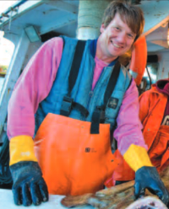

Slide 25
T H A N K Y O U ! !
Thanks to Jim Ignasher, New England Aviation History, Brian Blank, Mike Hudner, William Skelly, Liam McCarthy, Tom Earlie, Hannah Swett, Prof. Rob Dermody, Prof. Jonathan Gutoff, The de Ramel Foundation, Cameron Burrage Clark, many others.
In memory of Larry Webster, finder of aircraft.
Leads welcome at eric@ericwiberg.com

