Slide 1
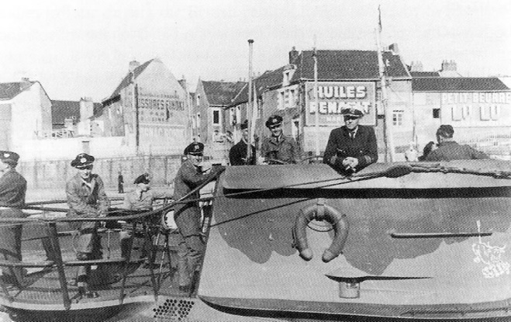
U-BOATS IN NEW ENGLAND
by Capt. Eric Wiberg for the Boston Propeller Club
National Maritime Day Presentation, May 25, 2022
11:30 AM -2:30 PM , The Exchange, Boston Fish Pier

Slide 2
Overview:
73 German U-boat patrols for over 600+ patrol days
35 Allied ships sunk or damaged for over 182,000 GRT
428 Allied sailors killed, 1,152 survived, 545 landed in New England
3 German U-boats sunk off New England: RI, Nantucket, Nova Scotia
4 U-boats surrendered in Portsmouth Navy Yard, Kittery, Maine
7 U-boats destroyed by US Submarines post-war off Cape Cod
3 German officers or sailors buried in New England: MA and Newport
3 groups of German saboteurs landed: Maine, Long Island, St. John NB
1 US Navy vessel (USS Eagle) sunk by U-boat, Portland Maine
1 patrol to lay mines off Boston Harbor MA - unsuccessful

Slide 3
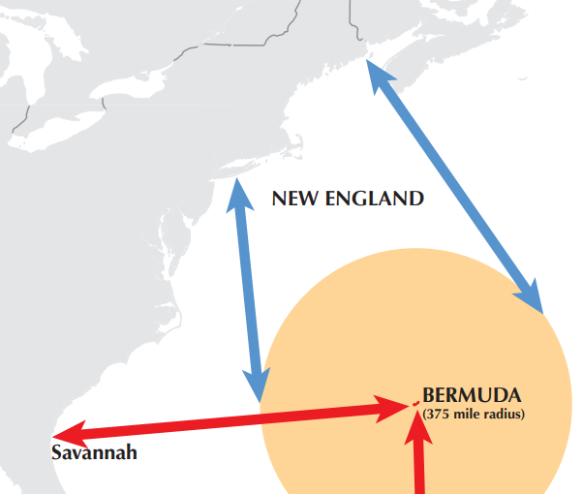

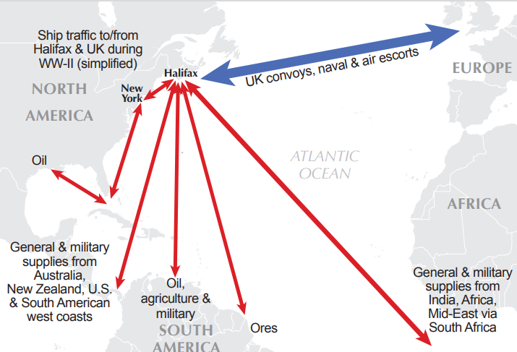

Slide 4
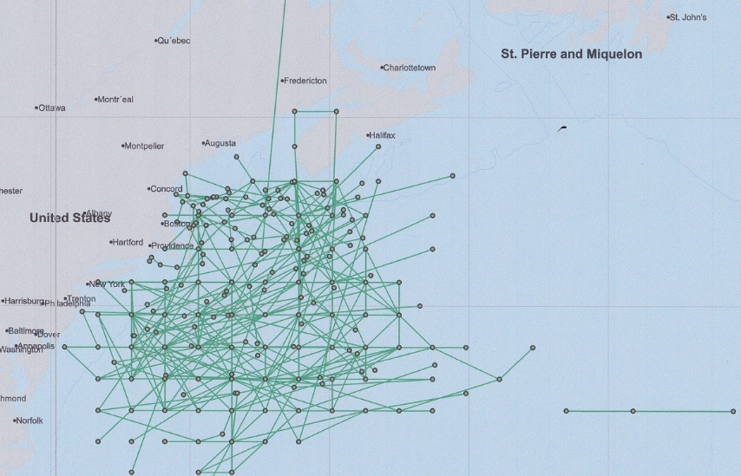
Extent of Battle Field – U-Boat Patrols off New England

Slide 5
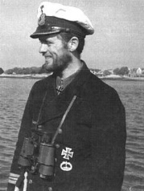

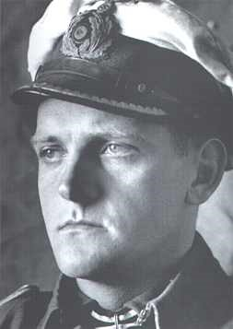
Hardegen in U-123 was first to arrive, Topp an ace
Reinhard Hardegen was the
First of Operation Paukenschlag
to arrive in Jan. 1942. He is
still alive today.
One of the U-boats was en-route to Japan with diagrams for German airplane fighters, as well as material and scientists for an atom bomb.
Another sub had a spy with US$70,000 destined for North America, but it was sunk and he was captured. Two U-boats went to Argentina in 1945.
Erich Topp was one of the greatest U-boat aces of WWII.

Slide 6
NAME | DATE | U-BOAT | CARGO | TYPE | LEFT | DESTINATION | FLAG | TONS | ON | KIA | LIVED | ARR NE | WHERE
Norness | 1/14/1942 | U-123 | 12,222 tons Admiralty fuel oil | Motor tanker | New York | Halifax | Panama | 9,577 | 41 | 2 | 39 | 39 | Newport
Alexandra Hoegh | 1/21/1942 | U-130 | 12,000 tons crude oil | Motor tanker | Caripito, Venezuala | Halifax | Norway | 8,248 | 28 | 0 | 28 |  | Shelbourne NS
Thirlby | 1/23/1942 | U-109 | 7,600 tons maize | Steam ship | New York | Halifax | UK | 4,887 | 45 | 3 | 42 |  | Halifax
Ranja | 3/17/1942 | U-71 | Petroleum | Motor tanker | Houston | Halifax | Norway | 6,355 | 34 | 34 | 0
Thursobank | 3/22/1942 | U-373 | 7,839 tons general cargo | Motor ship | New York | Cape Town | UK | 5,575 | 56 | 30 | 26 |  | Halifax
Hertford | 3/29/1942 | U-571 | 12,013 ton general cargo (meat) | Steam ship | Sydney, Aust. | Halifax | UK | 10,923 | 62 | 4 | 58 |  | Liverpool & Halifax
Nemanja | 4/8/1942 | U-84 | 7,207 tons sugar | Steam ship | San Pedro de Macoris, DR | Halifax | Yugoslavia | 5,226 | 47 | 13 | 34 |  | Halifax
West Imboden | 4/21/1942 | U-752 | 7,357 tons general cargo | Steam ship | Durban | Boston | US | 5,751 | 35 | 0 | 35 | 35 | Portland ME
Taborfjell | 4/30/1942 | U-576 | 2,200 tons sugar in 16,200 sacks, 70 tons chrome ore | Steam ship | New York | Montreal | Norway | 1,339 | 20 | 17 | 3 |  | St. John
Skottland | 5/17/1942 | U-588 | Lumber | Steam ship | New York | Sydney, NS | Norway | 2,117 | 24 | 1 | 23 | 23 | Boston
Fort Qu'Appelle | 5/17/1942 | U-135 | 9,200 tons general cargo, 500 tons acetone | Steam ship | Kingston, Jamaica | Halifax | UK | 7,127 | 47 | 13 | 34 |  | Shelbourne NS

Slide 7
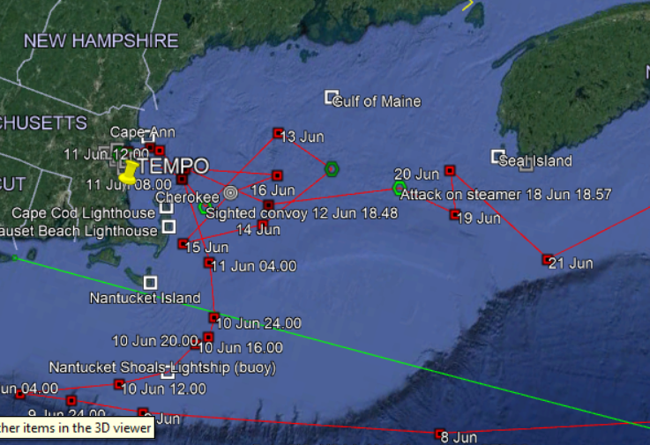
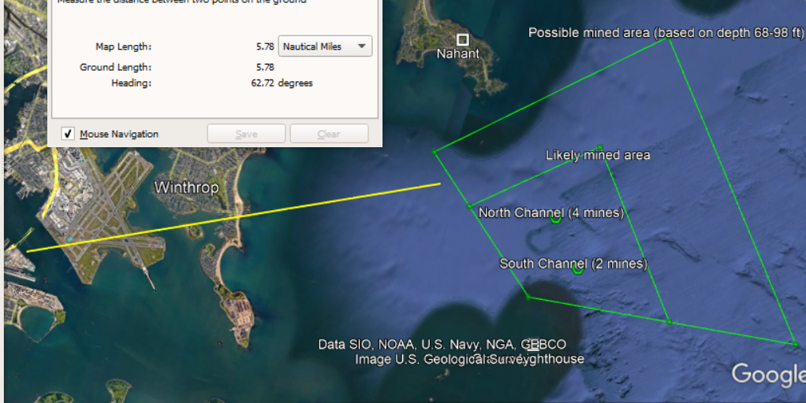
5 miles from where we sit today, a German attack submarine laid six mines off Winthrop, Nahant, and Grave’s Ledge. On the night of the 12th of June U-87 under Joachim Berger laid six TMC-type mines between 04:55 am and 07:10 am German time, off Boston Harbor. The Germans literally brought the war to Boston’s doorstep. One mine was found.

Slide 8
ONE PATROL: U-87 under Joachim Berger proceeded along the outside of Cape Cod Canal and on the 11th rounded Provincetown to port. During the night of the 12th of June the sub laid six TMC-type mines between 04:55 am and 07:10 am German time, off Boston Harbor. They are not known to have sunk any ships or been discovered, rendering their effectiveness as a weapon of fear and damage useless. On the 13th of June Berger headed east and out of Massachusetts Bay to a point roughly 50 miles off Cape Cod. There, on the 16th, the Germans encountered southbound Convoy XB 25 en route to Boston from Halifax. U-87 managed to pick off two vessels from the protected convoy without being sunk herself. Her victims were the Port Nicholson and the Cherokee.
Port Nicholson was a British steamer of 8,402 tons en route from Avonmouth England to Wellington New Zealand via Panama with 5,600 tons of military stores and auto parts. She was attacked during a gale by two torpedoes which struck home. Two crew were killed by the 1st torpedo. Captain Harold Charles Jeffrey and 84 men including gunners were taken off the stricken ship by HMCS Nanaimo (K 101). At dawn the Port Nicholson was still afloat so Captain Jeffrey, two ship’s officers and three ratings from the Canadian corvette re-boarded her. The ship however went down by the stern quickly – too quickly for the men in the lifeboat, who were overturned and sucked into a vortex. Only two men of the six who boarded her survived and were taken with the others to Boston by the corvette.
SS Cherokee was a 5,986-ton passenger steam ship with 169 persons on board. She was en route with sand for ballast between Halifax and Boston when two torpedoes from U-87 struck her. In the space of six minutes the ship was hit, lifted partially out of the water, turned to run, hit again, and sank by the bow. The boats could not be launched due to high running seas but seven rafts were cut loose. The steamer Norlago rescued 44 survivors and took them to Provincetown, Massachusetts. Another 39 were taken to Boston by USCGC Escanaba (WPG 77). Altogether 86 persons perished during the gale-tossed attack. Captain Twiggs E. Brown survived (Uboat.net). Among the survivors were two officers in the Soviet Navy who were passengers. One can only imagine the trauma which would have ensued had the rescue ships hit the mines Berger had laid.

Slide 9
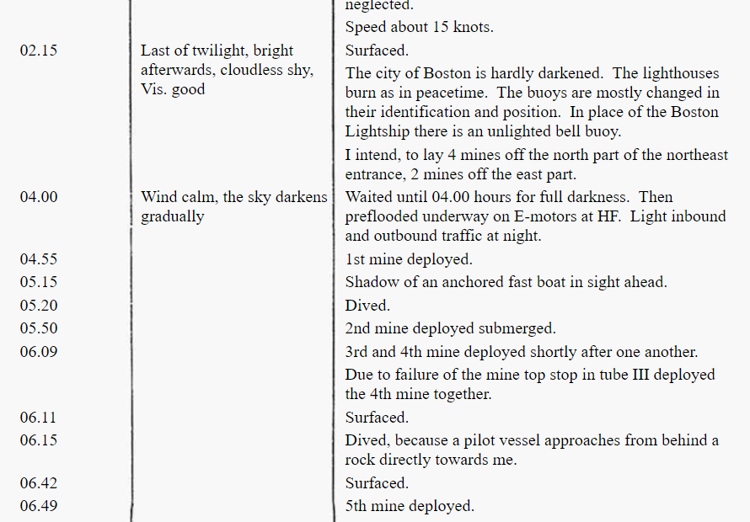
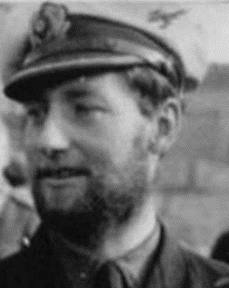
Actual surviving log book entry, Boston mine-field
Source: Capt Jerry Mason, USN Ret, https://uboatarchive.net/U-87/KTB87-3.htm

Slide 10
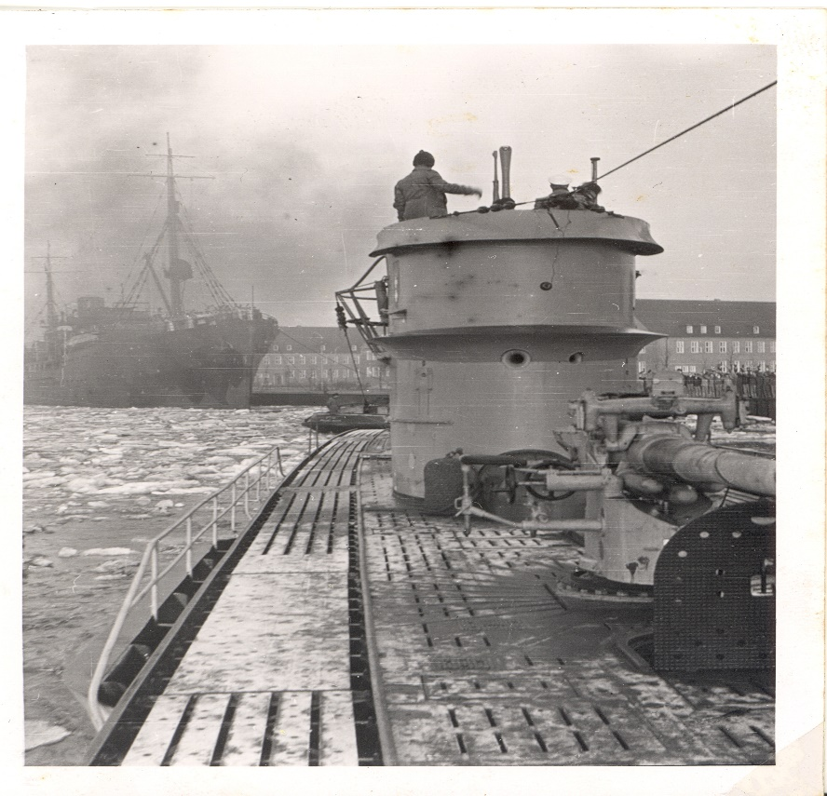
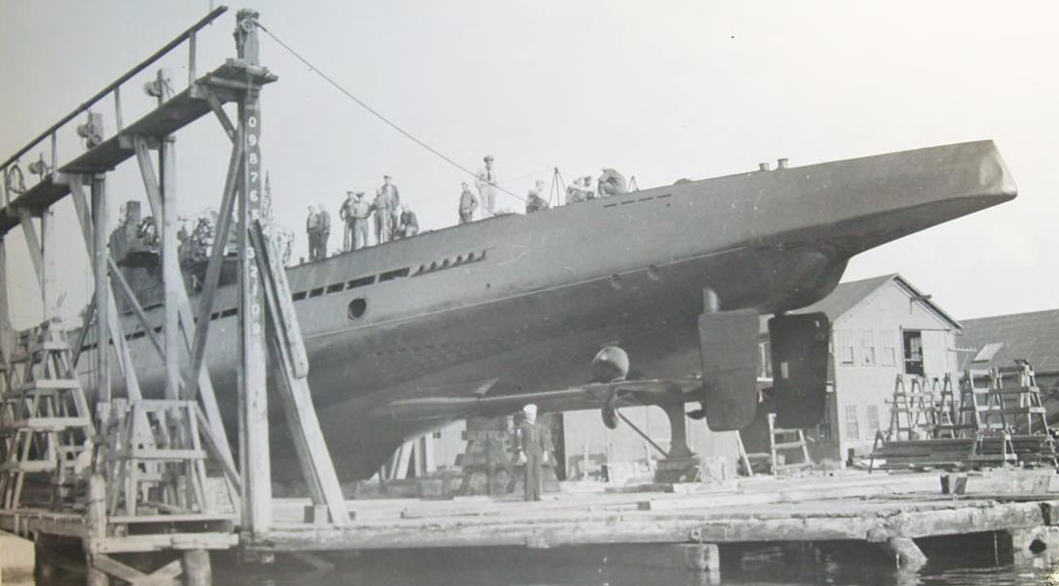
German U-Boats, Personnel
A Type-VII U-boat had Diesel and electric motors, could fire torpedoes from 4 tubes forward and 2 tubes aft, had about 55-55 men, just two toilets which often backfired, and both heavy deck guns, lighter ones, which fought aircraft. They could lay mines (and did at most US ports, Boston to Panama), they could detect ships underwater but mostly relied on binoculars, were 220 feet long, 20 feet wide, 30 feet high, yet could not stay underwater more than 12-20 hours as men and machines needed air.

Slide 11
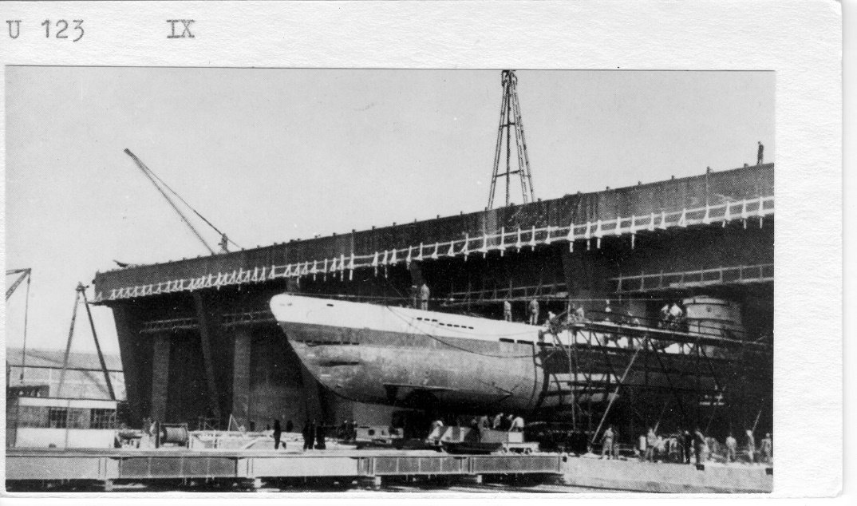
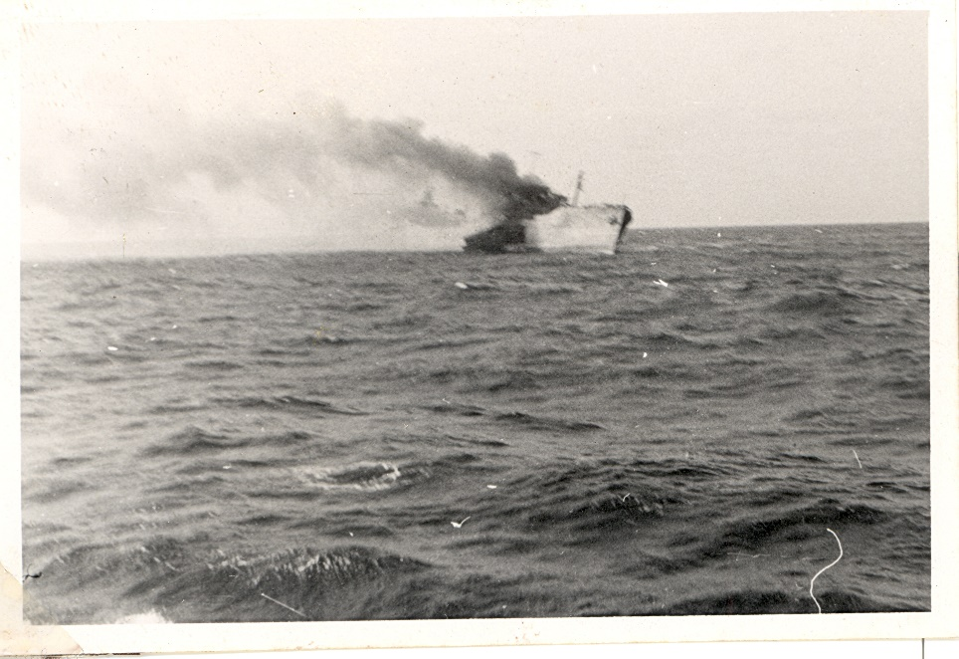
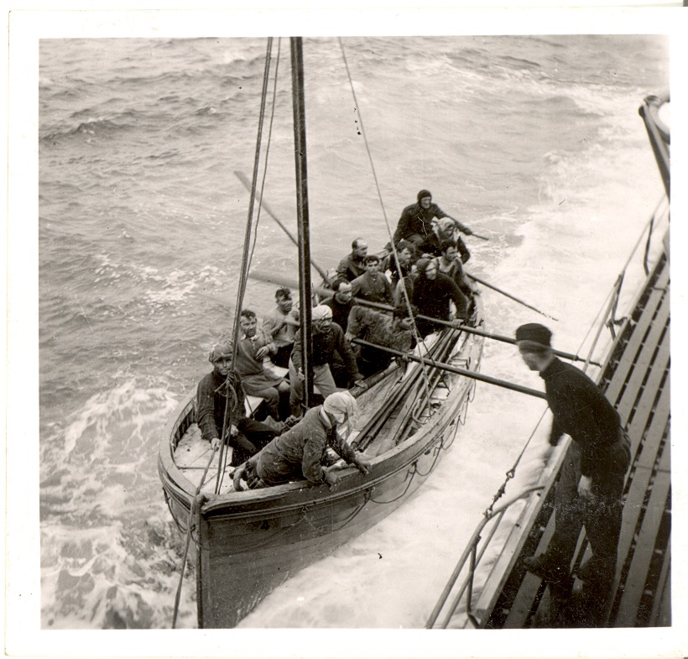
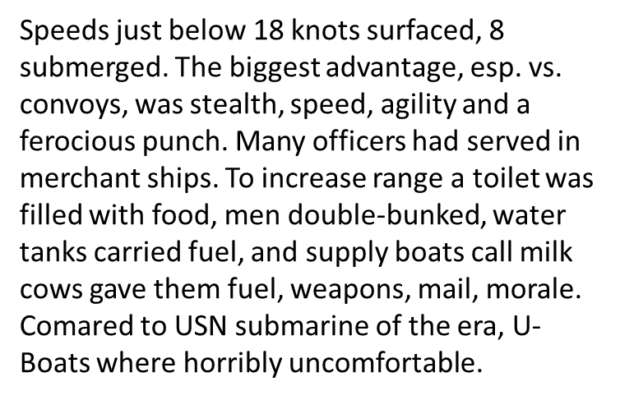
SS Norland being sunk E of Bermuda
All the men in the British boat recently sunk by another U-boat, were never heard from or seen again.

Slide 12
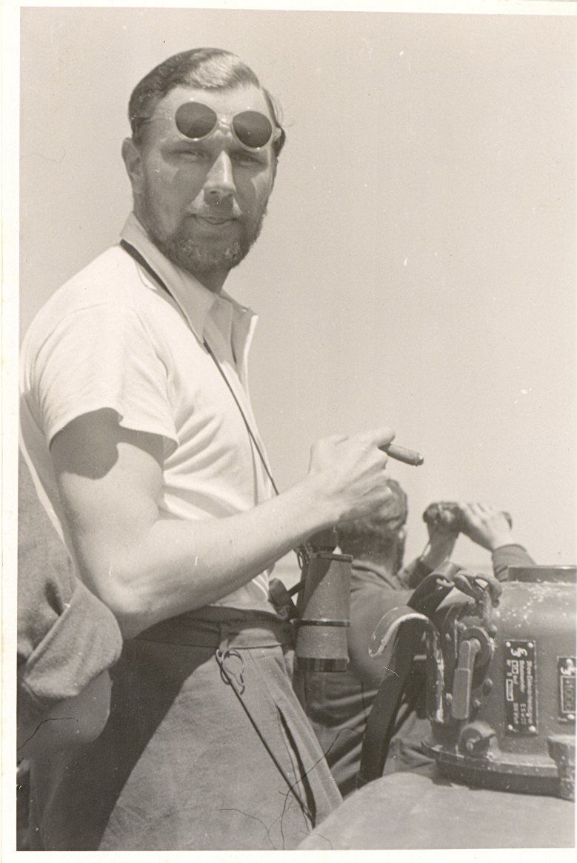
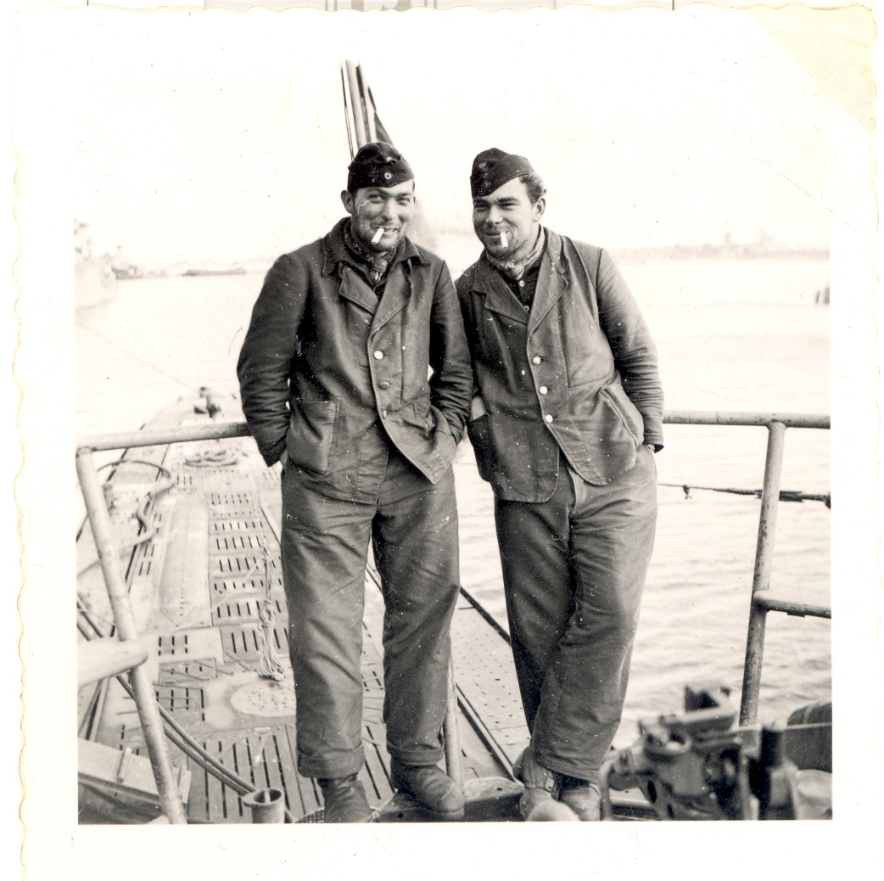
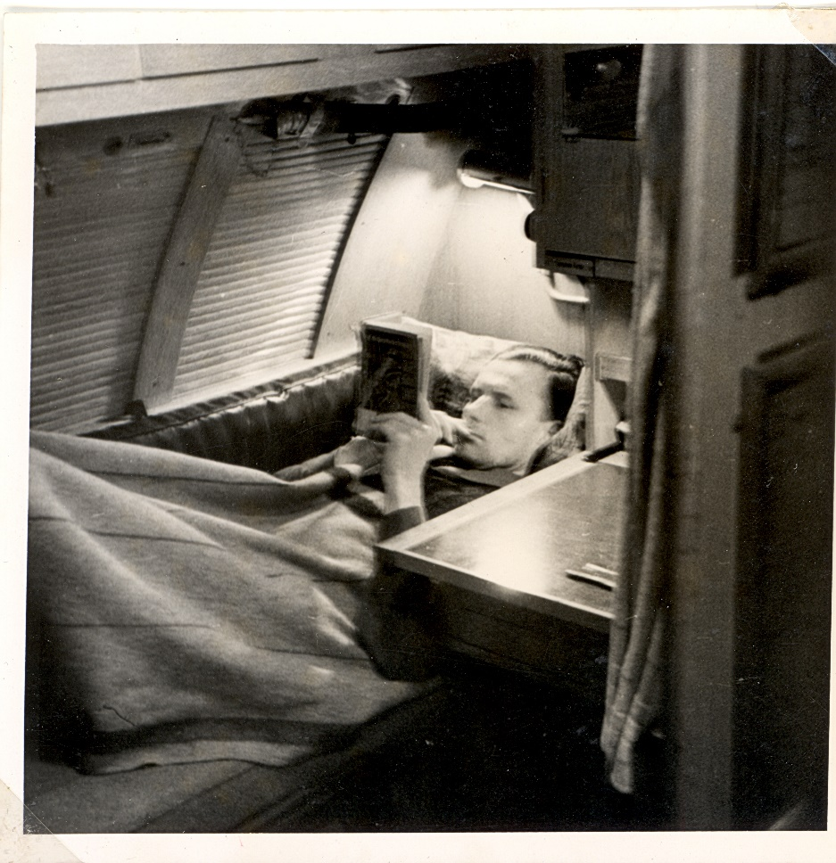
Private photos by a U-Boat crewman, technically not allowed….

Slide 13
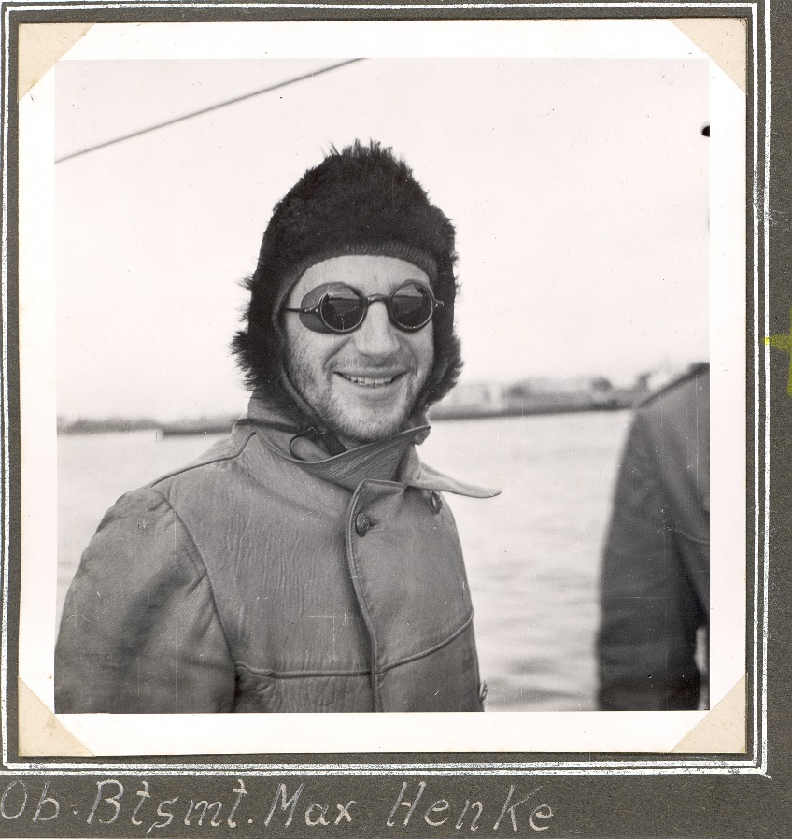
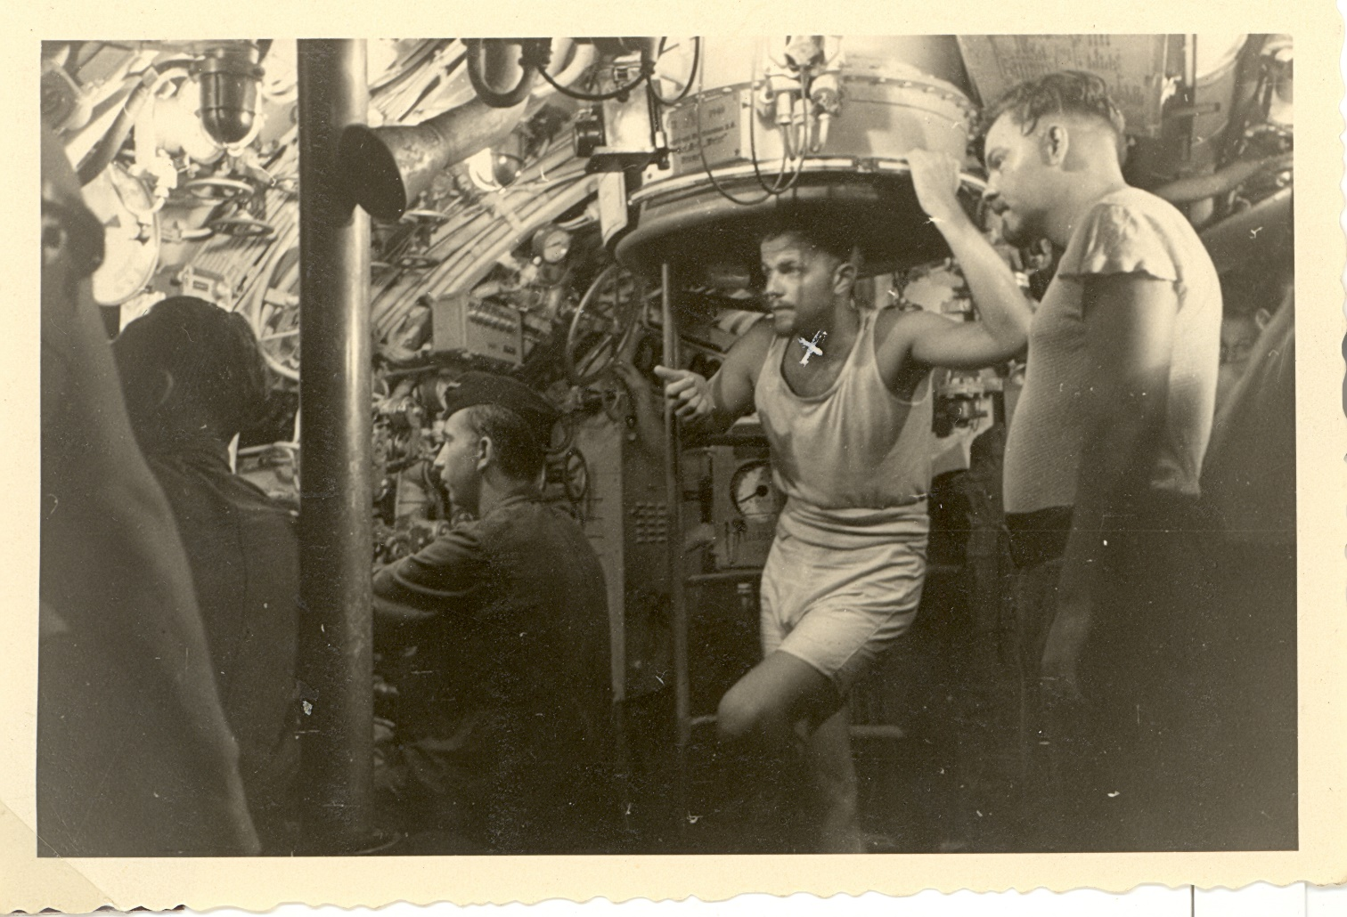
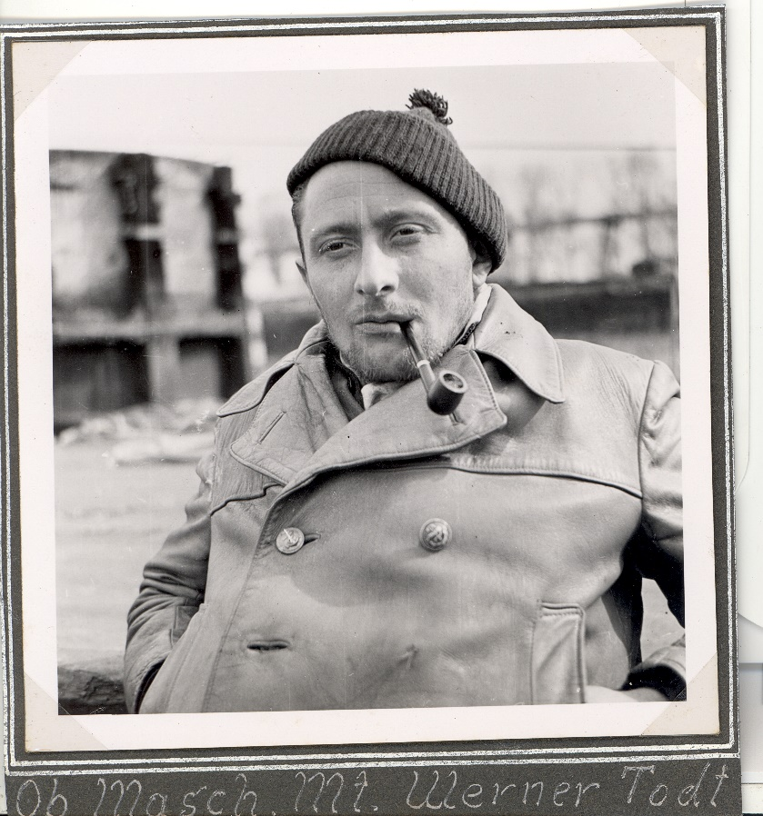

Slide 14
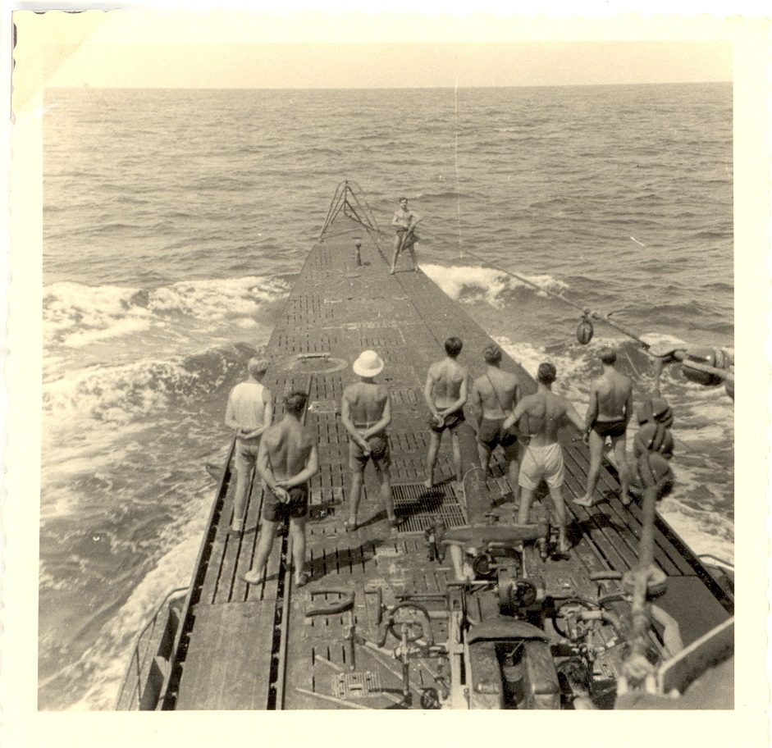
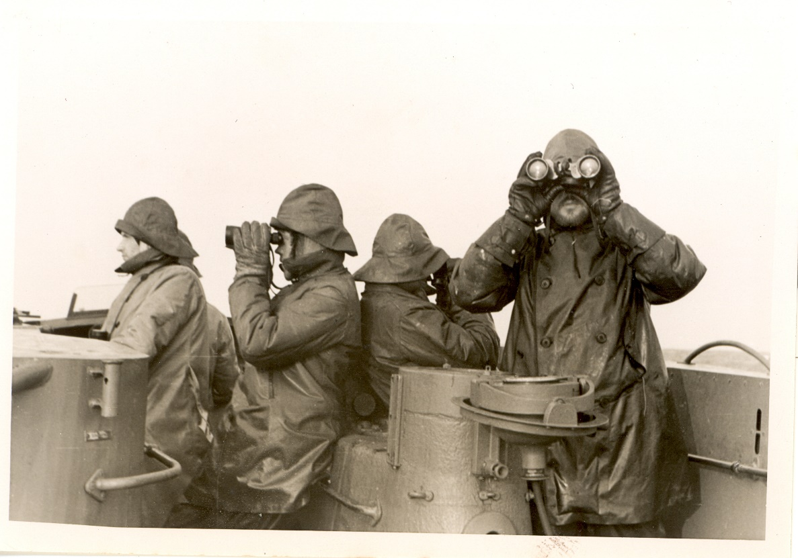
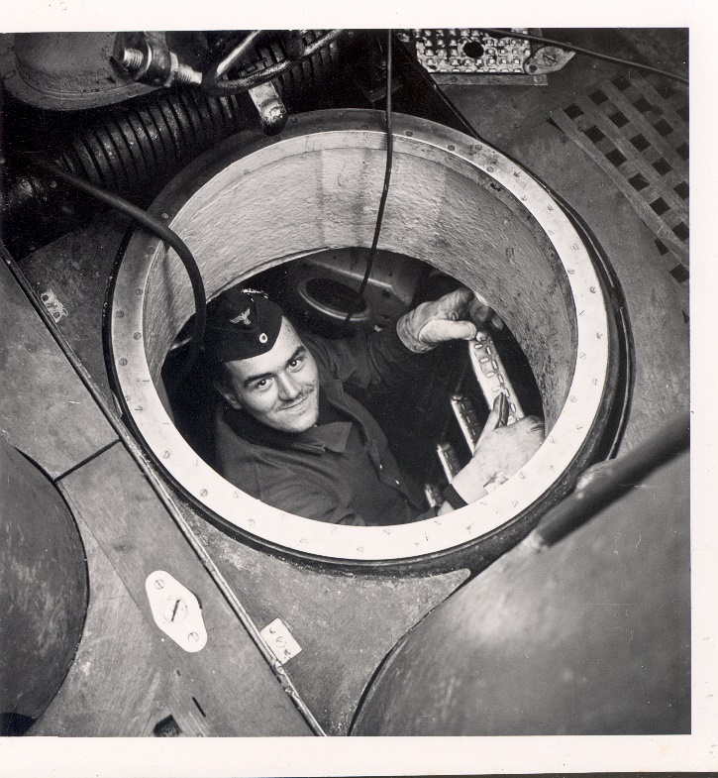
`
The propaganda about “loose lips sinks ship” was not accurate; U-boats used a conning tower of wet and cold or sunburnt teenagers to detect their prey, as well as radio and sonar. Many rumors of fifth columns and blaming civilians were created or tolerated by a government fully aware of its failure to protect its own coastline. “See something say nothing” was the rule of the day, and German broadcasts had more information on sinkings than those by the US government and media. “Sighted sub sank same” was made up by an ad agency while the “Battle of Washington” raged. Then U-boats left.

Slide 15
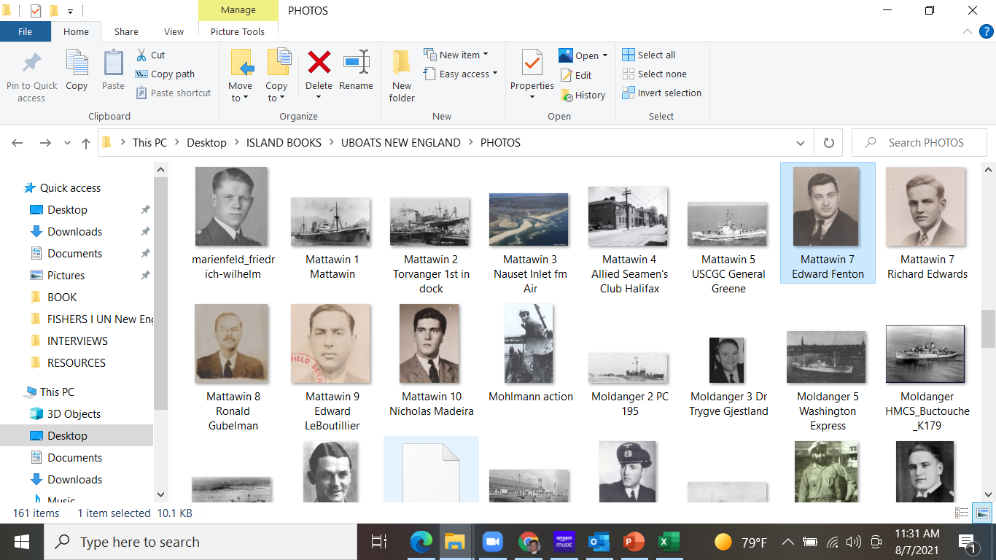
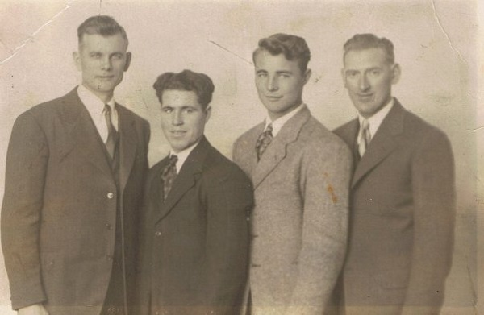
Ivy, Prep School Volunteers Hit by U-boats
AFS or American Field Service volunteers
Canadian survivors of SS Cornwallis – the rest froze; the captain the lights on at night to help local lobster boats. A U-boat saw their lights and sank the ship killing all but these men.

Slide 16
Fort Binger | 5/18/1942 | U-588 | Ballast | Steam ship | Belfast | New York | UK | 5,671 | 61 | 1 | 60 |  | Yarmouth NS
Norland | 5/20/1942 | U-108 | Ballast | Motor tanker | Glasgow | Corpus Christi | Norway | 8,134 | 48 | 0 | 48 | 14 | New Bedford & Nantucket
Plow City | 5/22/1942 | U-588 | 4,971 tons bauxite ore | Steam ship | Trinidad | New York | US | 3,282 | 31 | 1 | 30 | 30 | New London
Margot | 5/23/1942 | U-588 | 5,500 tons general cargo, military stores incl. aircraft parts, tanks, explosives | Steam ship | New York | Cape Town, Egypt via Trinidad | UK | 4,545 | 45 | 1 | 44 |  | New York
Zurichmoor | 5/23/1942 | U-432 | Ballast | Steam ship | Halifax | St. Thomas, USVI | UK | 4,455 | 45 | 45 | 0
Polyphemus | 5/25/1942 | U-578 | 5,936 tons of wheat, 790 tons wool | Motor ship | Sydney, Aust. | Halifax | Dutch | 6,269 | 80 | 15 | 65 | 18 | New Bedford & Nantucket
Liverpool Packet | 5/31/1942 | U-432 | 1,945 tons US Govt. stores | Steam ship | New York | Halifax | Canada | 1,188 | 21 | 2 | 19 |  | Seal I., Cape Sable
Mattawin | 6/2/1942 | U-553 | 7,000 tons military stores | Motor ship | New York | Cape Town | UK | 6,919 | 71 | 0 | 71 | 34 | Cape Cod, MA
Berganger | 6/2/1942 | U-578 | General cargo incl. 48,000 bags coffee, 1,000 bales linters, 1,138 liters sunflower seeds, hides | Motor ship | Santos, Brazil | Boston | Norway | 6,826 | 47 | 4 | 13 | 43 | New Bedford
Ben & Josephine | 6/3/1942 | U-432 | Fish | Fishing vessel | Gloucester | Sea Island, NS | US | 102 | 8 | 0 | 8 | 8 | Mount Desert, ME
Malayan Prince | 6/9/1942 | U-432 | General cargo | Motor ship | New York | Halifax | UK | 8,593 | 40 | 0 | 40 |  | (slightly damaged)

Slide 17
Lark | 6/13/1942 | U-107 | 50 tons fish | Fishing vessel | Le Havre Banks, NS | Boston | US | 148 | 27 | 0 | 27 | 27 | Boston
Port Nicholson | 6/16/1942 | U-87 | 1,600 auto parts, 4,000 tons military stores | Steam ship | Halifax | New York | UK | 8,402 | 91 | 6 | 85 | 85 | Boston
Cherokee | 6/16/1942 | U-87 | Ballast - 350 tons sand | Steam passenger ship | Halifax | Boston | US | 5,896 | 169 | 86 | 83 | 83 | Provincetown & Boston
Moldanger | 6/27/1942 | U-404 | 8,700 tons general cargo, incl. salted hides, tallow, wool, veg. oil | Motor ship | Buenos Aires | New York | Norway | 6,827 | 44 | 14 | 30 |  | Cape May, NJ
Alexander Macomb | 7/3/1942 | U-215 | 9,000 tons military cargo, tanks planse, explosives | Steam ship | New York | Woods Hole MA | US | 7,191 | 66 | 10 | 56 | 31 | Woods Hole MA
Lucille M. | 7/25/1942 | U-89 | Fish | Fishing vessel | Yarmouth | Fishing grounds | Canada | 54 | 11 | 0 | 11 |  | Shelbourne, NS
Angelus | 5/19/1943 | U-161 | Molasses | Schooner | Barbados | Halifax | Canada | 255 | 10 | 8 | 2 | 2 | Portland ME
Pan Pennsylvania | 4/16/1944 | U-550 | 140,000 bbls 80 octane gasoline, aircraft on deck | Turbine tanker | New York | Barry, Wales | US | 11,017 | 81 | 25 | 56 |  | Londonberry, Ireland
Cornwallis | 12/3/1944 | U-1230 | bagged sugar, molasses in barrels | Steam ship | Sandwich, MA | St. John, NB | Canada | 5,458 | 48 | 43 | 5 | 5 | Rockland, ME
Atlantic States | 4/5/1945 | U-879 | Ballast | Turbine tanker | Boston | Las Piedras, Venezuela | US | 8,537 | 57 | 0 | 57 | 52 | Boston
USS Eagle (PE-56) | 4/23/1945 | U-853 | N/A | Patrol craft | Patrol | Patrol | US | 625 | 62 | 49 | 13 | 13 | Maine, TBN
Black Point | 5/5/1945 | U-853 | 7,759 tons coal | Steam ship | Newport News, VA | Weymouth, MA | US | 5,353 | 46 | 12 | 34 | 34 | Point Judith & Newport

Slide 18
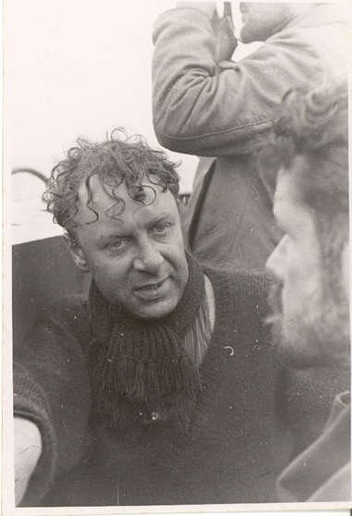
New England Ports Survivors Landed In:
MAINE:
Portland, Rockland, Mount Desert Island
MASSACHUSETTS:
New Bedford, Nantucket, Boston, Woods Hole, Provincetown & “Cape Cod” – probably Provincetown ultimately
RHODE ISLAND:
Point Judith, Newport (both Allied sailors & German U-boat survivors)
CONNECTICUT:
New London (site of US Navy submarine base)
This captain was never seen after this photos was taken North Atlantic winter

Slide 19
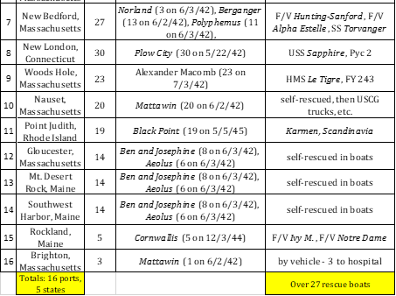
Where Survivors Landed in New England

Slide 20
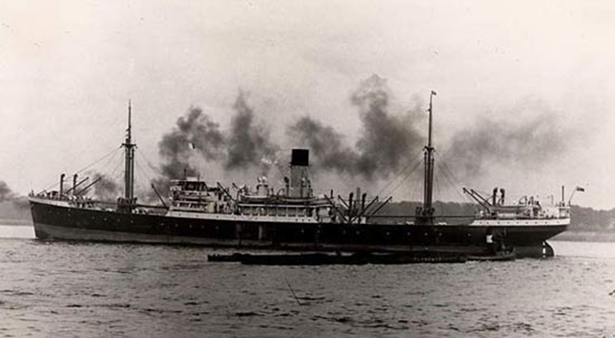
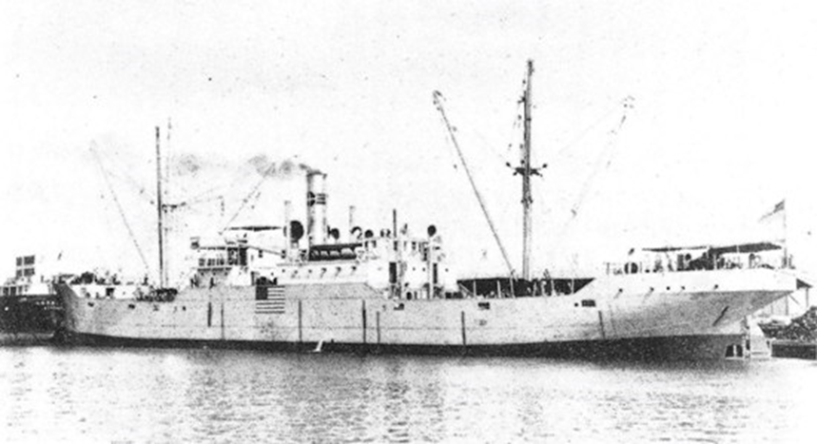
SS Peisander, whose men survived and were rescued by the USCGC General Greene off Nantucket
SS Plow City, whose captain fled the SS Peisander lifeboat, thinking it was a U-boat ploy, only to be itself sunk by a U-boat hours later

Slide 21
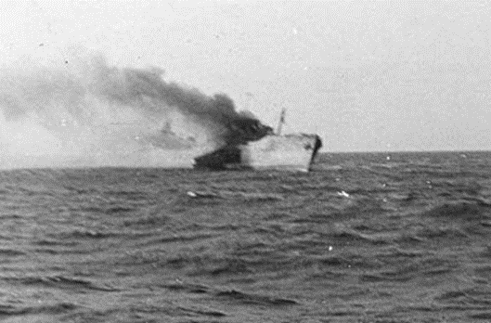
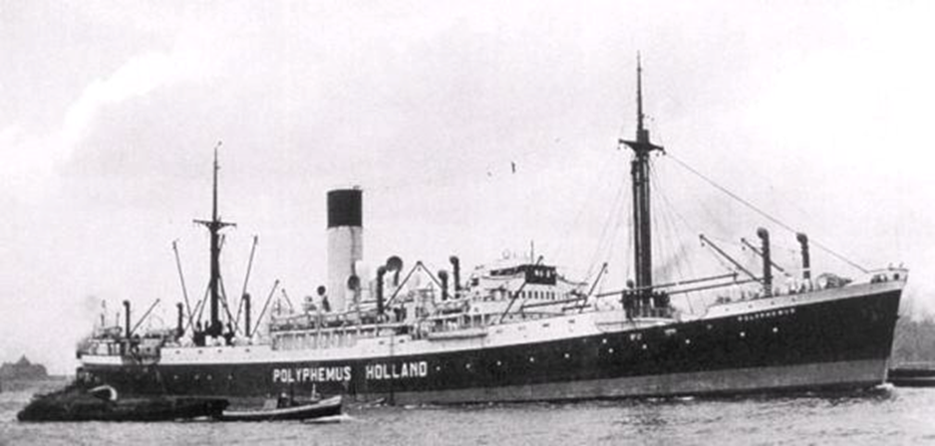
M/T Norland’s extraordinary survival voyages
The Polyphemus which rescued Norland survivors only to be itself sunk the following day
M/T Norland under fire by U-108 in a rare action photo

Slide 22
Norland summary of survivor’s voyages:
The surviving men from both the Polyphemus (51 men) and the Norland (14) then boarded five lifeboats, which together were sighted by three (3) submarines (U-566/Borchert, U-593/Kelbling, and an unidentified boat) and rescued by six (6) vessels. The six vessels which rescued the Norland survivors after they were rescued by the Polyphemus were:
D/S Maria Amelia (to New York),
Torvanger (to the F/V Alpha and Estelle),
the F/V Alpha and Estelle (to New Bedford Massachusetts),
the F/V Hunting-Sanford (to New Bedford),
the D/S Mirandella (to New York), and
the USCGC General Greene (WPC 140) (to Nantucket).

Slide 23
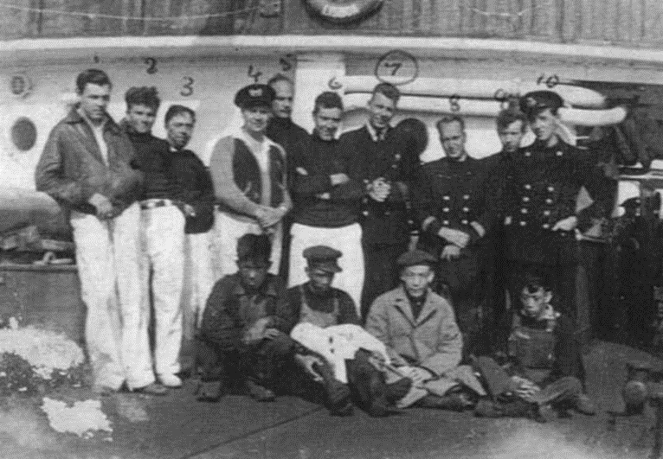
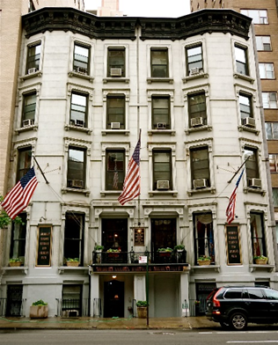
Boat 1: 2 SS Norland men – rescued by the F/V Hunting-Sanford, landed New Bedford.
Boat 2: 3 SS Norland men – rescued by USCGC General Greene, landed Nantucket.
Boat 3: 2 SS Norland men – rescued by F/F Mirandella, landed New York.
Boat 4: 4 SS Norland men – rescued by F/V Maria Amelia, landed New York.
Boat 5: 3 Norland men, including Second Officer Bjelde navigating (total 14 men) – rescued bySS Torvanger, then transferred to F/V Alpha and Estelle, landed New Bedford.
The Soldiers, Sailors,
Marines, Coast Guard
and Airmen’s Club, since
1919, Lexington Avenue,
New York, NY

Slide 24
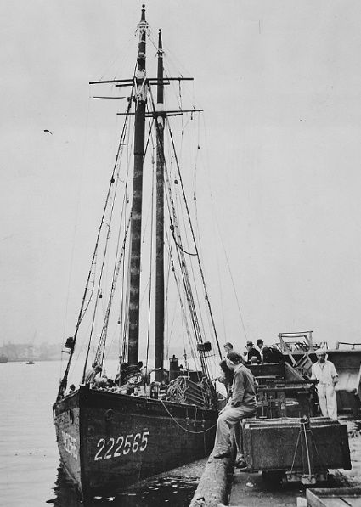
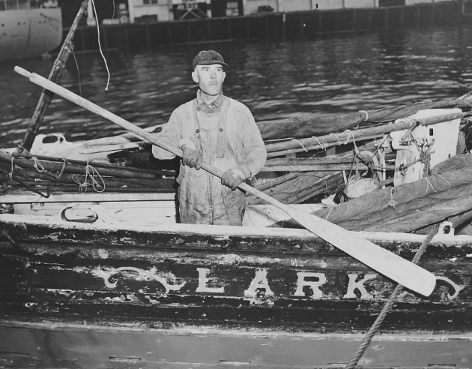
F/V Lark, shelled by sub, made it back to Boston

Slide 25
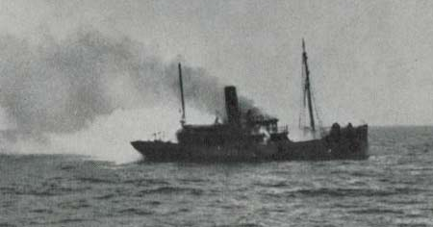
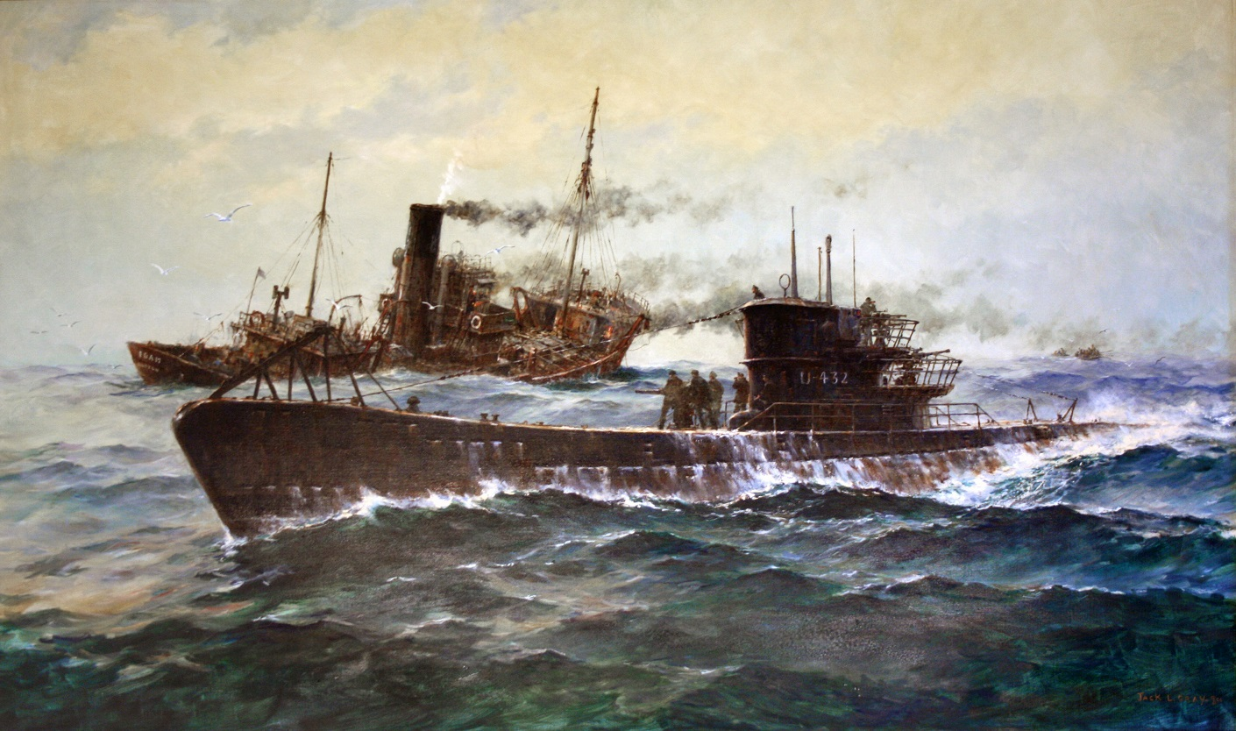
F/V Foam sunk by U-432 off Nova Scotia 1942
Interesting back story; the Foam was thought to have been once a McAllister Towing salvage boat, but was in fact owned by a prominent Irish-American fishing family in Boston. Originally a French WWI armed trawler Jemmapes, 1921 sold as Blue Point, 1928 renamed Princeton ”Ivy League” enforcement fleet, then 1938 to General Seafoods Co, Boston. The McAllister boat ended up used to run weapons to revolutionaries in Central America, grounded, and burned out – it’s still there…

Slide 26
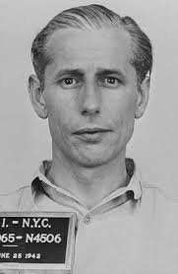
Operation Pastorius
John Dasch, 39, leader of the 4-man team landed at Amagansett Long Island on June 12, 1942 thanks to U-202 under Lindner. He had over $84,000 cash in USD. Five days later Dasch went from NY to DC to surrender. All 7 spies were arrested. Five were electrocuted after military tribunal on 8 August. Dasch and Burger were spared and returned to Germany in 1948.

Slide 27
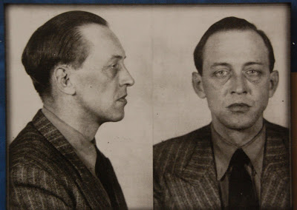
Operation Grete, Landing New Brunswick, Canada
Marius Alfred Langbein, a spy who landed at St. Martin’s village, near St. John New Brunswick in the Bay of Fundy by U-213 under von Varendorff on the 14th of May, 1942. His job was to monitor convoys from Halifax and relay it to Germans. Instead he buried the radio, hitched and took the train to Montreal, was arrested in a brothel, released, and lived as Alfred Haskins, touring night clubs and brothels until the end of 1944, burning through $7,000. Then he ran out of funds and surrendered. He was deported back to German after the war and returned to his wife, for whom the operation was named.

Slide 28
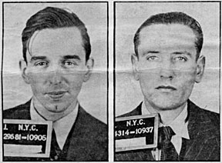
Operation Magpie
William C. Colepaugh of Niantic, CT and educated at MIT (left), and Erich Gimpel were landed at Hancock Point, Frenchman’s Bay, near Bar Harbor Maine by U-1230 under Hilbig on Nov. 27, 1944. They had US$60,000 cash and diamonds and evaded capture on snowy roads and trains to reach New York City. Colepaugh, who had taken a Swedish freighter to Germany to enroll with the Abewehr and was trained by SS Major Otto Skorzeny, spent on lavish living for a month then got cold feet. He confessed to a school friend and turned himself – and Gimpel – into the FBI the day after Christmas. Though sentenced to death, FDR died before they were executed, so the sentence was commuted, and they served sentences in jail. Colepaugh went on to a quiet life in Pennsylvania and Florida, earning accolades as a Rotarian in PA.

Slide 29
ARTICLE: The Boston Navy Yard during World War II Boston National Historical Park
Part I: Short of War In 1932, the Department of the Navy designated the Boston (Charlestown) Navy Yard to be the building site for destroyers. Two years later, the USS McDonough (DD-351) slid down the ways, marking the first major ship launching at the yard in over a decade. The launch of McDonough ushered in the most productive period of ship construction in the history of the Navy Yard. By September 1, 1939, when Nazi Germany invaded Poland, the Boston Navy Yard had completed and commissioned six new destroyers. Furthermore, several other destroyers and auxiliary vessels were in various stages of construction across the facility. Though Germany's invasion of Poland sparked war in Europe, the United States remained neutral.
Shortly after the beginning of hostilities in Europe, the U.S. Navy organized a neutrality patrol utilizing several of the new vessels built in Boston. This patrol monitored the activities of warships of belligerent nations within 300 miles of the coasts of North and South America as well as in the Caribbean Sea. Beginning in 1940, the Navy and Coast Guard began providing escorts for merchant convoys bringing provisions, fuel, and military supplies to Great Britain in this neutral zone. The work of these escorts in the oftentimes rough waters of the North Atlantic was punishing, and the Boston Navy Yard had to focus on the constant maintenance and repair of these ships.

Slide 30
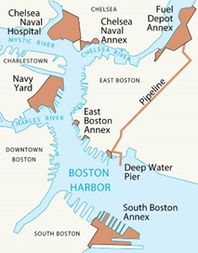
During World War II the Boston Naval Shipyard complex encompassed nearly every corner of Boston's Inner Harbor. Due south of this map were even more private shipyard facilities constructing new warships, such as Bethlehem Steel in Hingham and Fore River in Quincy and Braintree. NPS Map
By the summer of 1941, the Boston Navy Yard was a hive of activity; the yard’s labor force had increased from 3,875 in January 1939 to 18,272 in order to meet the increased demand for new ship construction. By then, it had become standard practice to lay the keels of two to four vessels and proceed with their construction at an even pace, with launchings occurring as soon as the hulls were completed. In September, the keels of the first Fletcher Class destroyers to be built at Boston Navy Yard were laid down. The Fletcher Class was considerably larger and more complex in construction than the destroyers previously built at the yard.
In regards to the physical plant of 1941, storage facilities and several new administrative and shop buildings, including a five-story electrical shop, were under construction in Charlestown while ship repair and conversion facilities were expanded at the South Boston Naval Annex (acquired shortly after World War I). Along the waterfront, piers were added, rebuilt, or extended, and the capacity for shipbuilding was dramatically increased with the construction of Shipways 2 and 3 (the latter now referred to as Dry Dock 5). Additional ship repair facilities were acquired by the Navy in Chelsea and East Boston. A Fuel Depot Annex was constructed alongside Chelsea Creek in East Boston and connected by pipeline to a fuel pier extending out into Boston Harbor.

Slide 31
In January 1942, the Boston Navy Yard was selected as the building site for a new class of warship, the Destroyer Escort (DE). Boston was a logical choice, since the yard had specialized in building destroyers (DD) for a decade. Slightly smaller than the Fletcher-Class Destroyers then under construction in Charlestown, these escorts required far less time to construct at roughly half the cost. They were designed to protect merchant ship convoys and to destroy enemy submarines with an array of armaments. Some were built to serve in the Royal Navy as part of the Lend-Lease Agreement, but many would be retained by the United States Navy and see service in both the Atlantic and Pacific Theatres.”
Between September 8, 1939 when a limited national emergency was declared and the wars end in 1945, the Boston Navy Yard launched 303 vessels and commissioned another 120 ships that were constructed at private yards.
Ship construction and repair at Boston Navy Yard peaked in 1943, with the workforce reaching an all-time high of 50,128 employees, including a large number of women and minorities. Throughout the year, the Yard led the nation in construction of destroyer escorts, breaking numerous launching records in the process.

Slide 32
Ten U-boats sunk off New England: 3 during WWII
Sub # | Date Sunk | Sunk by what Allied vsl | Region Sunk | Lat / Long Sunk | Date POW | How Surrendered
U-215 | 3-Jul-42 | HMS Le Tigre | East of Boston | 41°48'N / 66°38'W | KIA | never surrendered
U-550 | 16-Apr-44 | USS Gandy, USS Joyce, USS Peterson | 70 nm SE of Nantucket | 40°09'N / 69°44'W | KIA | surrendered in battle
U-853 | 6-May-45 | USS Atherton, USS Moberly | Block Island Sound | 41°13'N / 71°27'W | KIA | never surrendered
U-1228 | 5-Feb-46 | USS Sirago SS 485 | 37 nm NE of Provincetown MA, in Gulf of Maine (see U-234), 600' of water | 42°32′N / 69°37′W (Niestle says 42°30'N / 69°38'W) | 17-May-45 | surrendered Portsmouth NH
U-805 | 8-Feb-46 | USS Sirago SS 485 | off Cape Cod | 42°32'N / 69°27'W | 15-May-45 | surrendered Portsmouth NH

Slide 33
U-977 | 13-Nov-46 | USS Atule SS 403 | off Cape Cod | 42°33'N / 69°43'W | 17-Aug-45 | surrendered Argentina, motored to Boston 13 Nov. 1945
U-530 | 28-Nov-47 | USS Toro SS 422 | 40 nm NE of Cape Cod | 42°39'N / 69°32'W | 10-Jul-45 | was taken to Argentina in 1945, towed to Boston MA
U-234 | 19-Nov-47 | USS Greenfish SS 351 | 40 nm NE Provincetown MA, in Gulf of Maine (see U-1228, U-889, same position), 600' of water | 42°37'N / 69°33'W | 19-May-45 | surrendered Portsmouth NH 19 May 1945
U-889 | 20-Nov-47 | USS Flying Fish SS 229 | off Cape Cod - same position as U-234 | 42°37'N / 69°33'W | 13-May-45 | surrendered Shelburne NS, transferred to NH 10 Jan. 1946
U-858 | 21-Nov-47 | USS Sirago SS 485 | c. 40 nm off Cape Cod | 42°31'N / 69°34'W | 14-May-45 | surrendered Lewes Delaware

Slide 34
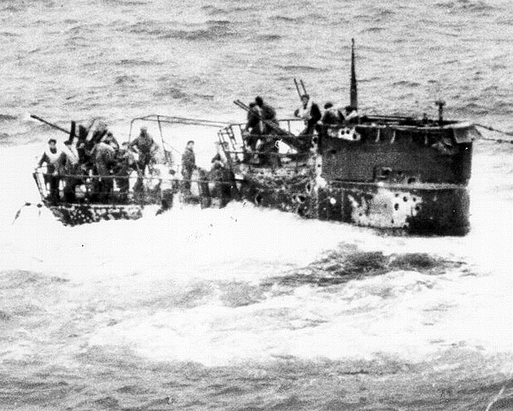
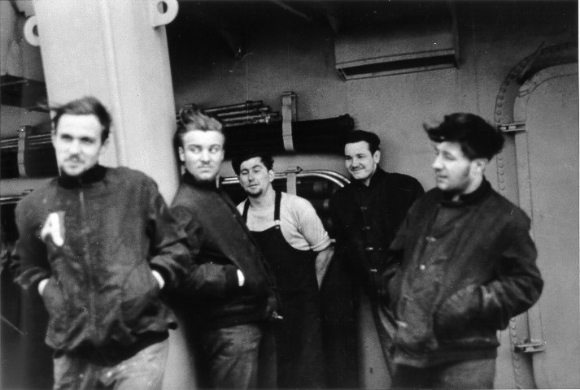
U-550 sunk off Nantucket, survivors taken

Slide 35
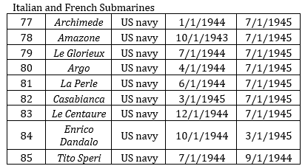
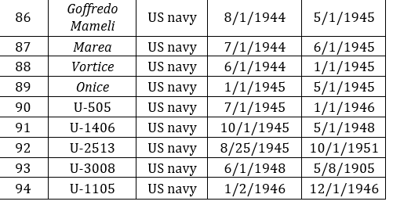
Axis Submarines Surrendered to USN, Used
Most were based and repaired in nearby New London, CT, yet Italians had to be protected from the French, due to strong antipathy between the two navies. So many were repaired in Portsmouth NH.

Slide 36
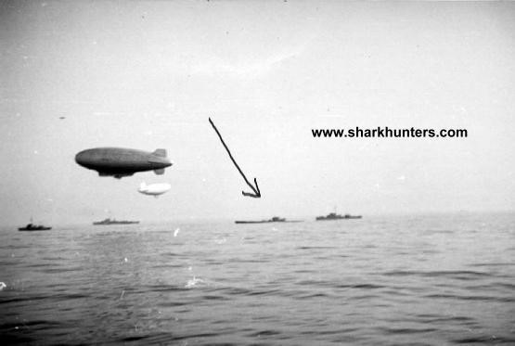
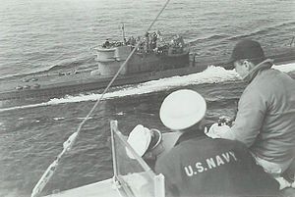
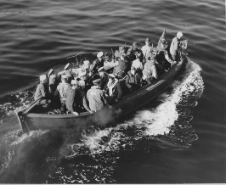
U-boats surrendering at sea

Slide 37


U-boats surrendered in Portsmouth, NH 1945

Slide 38


Steinhoff surrender & suicide, Boston jail

Slide 39


Boston jail, now a modern hotel on the Charles River near the Zakim Bridge
Steinhoff’s grave at Fort Devens, MA, along with over a dozen Axis POW dead. The Boston Marathon bomber has been imprisoned there.

Slide 40


U-Boat, Axis Sailors Buried in Newport, & LI, NY
“According to 1944 interment records …in Farmingdale [NY], the remains of four Turner sailors were buried in individual graves within a year of the disaster.” That is the same national cemetery that Siegfried Zube and Wilhelm Flade, German sailors abandoned alive by the US Navy after U-550 was sunk in April 1944 and buried in May the same year. There are “thirty-seven German and fifty-four Italian foreign nationals. Thirty-six of the Italian PoWs are interred in one group grave as unknowns; these men were [on] Benjamin Contee during an aerial torpedo strike on 16 August 1943.” Furthermore, “there are thirty-nine group burials in Long Island National Cemetery containing the remains of 112 soldiers,” as well as five French wartime sailors.

Slide 41

Burial Locations of U-Boat Sailors, NY, MA, RI

Slide 42

Six U-Boats sunk off Cape Cod MA 1946-1947
These 7 subs were sunk in very deep water, relatively far from shore precisely to deter recreational divers and souvenir hunters from accessing them. A NOAA contact described their location as “recreationally and economically inacessable.” Interesting that when poachers took human remains from U-873 in Newport, immediately the US Navy and their
Erstwhile enemies, the Germans, allied with churches to prevent desecrations and bury them with honors. U-boat and merchant mariners perished at higher per-capita rates than any other service.

Slide 44


U-977 being sunk by US Navy, Cape Cod 1947
U-1228 being sunk off Cape Cod 1947

Slide 45

Video of U-858 and U-805 surrendering in NH

Slide 46

U-977 and U-530 in Rio de Janeiro, Brazil Sept. 1945, they surrendered in Argentina, were brought to New London. Married sailors were given option to be dropped off at Canaries, where they swam. Torpedoes retained, schnorkel used.
Thank you!
Ericwiberg.com

