Slide 1
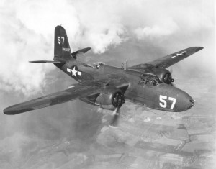

Plane down in marion! Fatal Havoc crash 1943
Capt. Eric Troels Wiberg, Esq.
Retired Professionals Group, Bitter Sweet Farm
Westport MA, 12 pm, Weds. May 13, 2026

Slide 2
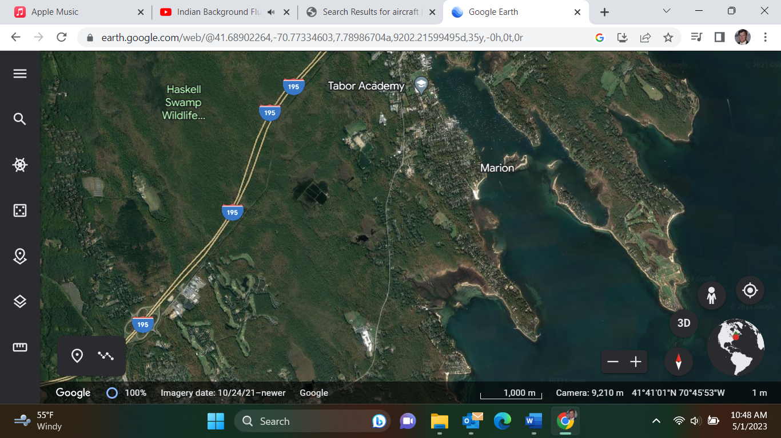
USAAF Havoc Air Crash, Marion MA
On Feb. 4, 1943: 3 KIA, 1 MIA, 1 Survivor
by Eric Wiberg
OVERVIEW: 80 years ago, at 3pm on a winter Thursday, florist John Allanach on Front Street in Marion, Massachusetts, heard and saw a bomber aircraft zig-zagging down to earth from 14,000 feet towards the field he owned. The final move of the out-of-control aircraft was to veer towards the RCA (aka Marconi) radio tower “forest” which kept stations in Norway, ships and planes attuned. There, the A-20C Havoc medium bomber, from which 3 of the 4 crew jettisoned by parachute (only the pilot survived), smashed into a rock formation, ejecting and crushing the observer, a major from the US 3rd Army. Nearly four months later the gunner, a local lad, was pulled from frigid Buzzards Bay waters. The final crew’s remains were never found, only his parachute was. None of them were buried on-site.

Slide 3
LANE: Douglas A-20C Havoc, U.S. Army Air Force, U A-20C Havoc, Serial No. 41-19637
DATE: Thursday, February 4, 1943, from morning to late night
CAUSE: PLE – plane’s limit of endurance for fuel / ran out of gas
CREW:
BAILEY: Major Arnold J. Bailey; pilot, Knob Noster, Missouri, to age 72 (1918-1991)
COOKE: Major Charles H. Cooke, observer from 3rd Armored Division – age 26, from
Washington DC, buried in Arlington National Cemetery
REPOSA: Sergeant Albert D. Reposa; gunner, age 26, buried St. Patricks, Hyannis, MA
ROBINSON: Sergeant Donald T. Robinson; Radio Operator (bio-data not known yet)
UNITS: 3rd Air Force (3 men) & 3rd Armored Division, observer Cooke
WHERE IN PLANE: Bailey at controls in cockpit, Cooke in the nose (bombardier’s position),
Reposa midships at guns, and Robinson in bow, behind cockpit
TOOK OFF FROM: Cumberland Air Base in Harrisburg, Pennsylvania
DESTINATION: Lebanon area, Pennsylvania
DIVERTED TOWARDS: first back to Harrison, PA, then to Baltimore MD (never locked in)
DIVERTED AGAIN: To “New England”
CRASHED: beneath an RCA/Marconi radio tower, Aucoot Cove or Atlantis St., Marion MA.
“The wreckage was finally located in a wooded area on the grounds of the RCA wireless station in the coastal town of Marion, Massachusetts.”
FATES:
SURVIVOR 1 (BAILEY) LANDED: Pilot Bailey landed at Mayflower Ridge, Wareham River, Wareham, MA. “Hiked though the woods w parachute to Wareham Country Club, then he obtained a ride to Camp Edwards.”
PERISHED 1 (COOKE): Major Charles H. Cooke’s “body was recovered at crash site”
PERISHED 2 (REPOSA): “….presumed that both men had landed in the frigid water and drowned. Sgt. Reposa’s body was later recovered in May, 1943 on the shore of Wareham.”
PERISHED 3 (ROBINSON): “A parachute belonging to one of the men was found offshore in the water and it was presumed that both men had landed in the frigid water and drowned.”
STATUS OF KIA: 1 survived, 1 found in Marion, 1 in water of Wareham, 1 lost at sea

Slide 4
At Harrisburg he attempted two unsuccessful instrument landings before setting a southern course towards Baltimore, Maryland, flying between layers of clouds as he did so. Upon arriving at Baltimore, he found conditions to be the same as they were at Harrisburg, and set a northeast course towards New England. However, the weather continued to grow worse, and as the plane neared the New England coast it encountered heavy rain.
As the aircraft passed over eastern Rhode Island the pilot noted that the fuel was low. He then took the plane to 13,000 feet and gave the order to bail out.
Major Bailey landed safely in a wooded area at Mayflower Ridge, near the Wareham River, in the town of Wareham, Massachusetts. He then hiked thought the woods carrying his parachute until he came to the Wareham Country Club where he obtained a ride to Camp Edwards.
Nobody had seen or heard the plane come down, therefore the location of where it crashed was not immediately known. Initial reports indicated the plane had gone down in the water somewhere between Swansea, Massachusetts, and Bristol, Rhode Island. Later reports indicated the plane had gone down in Buzzard’s Bay, Massachusetts. The wreckage was finally located in a wooded area on the grounds of the RCA wireless station in the coastal town of Marion, Massachusetts.
Major Cooke’s body was recovered at the crash site, but Sergeants Robinson and Repoza were missing, and after a five-day search had not been found. A parachute belonging to one of the men was found offshore in the water and it was presumed that both men had landed in the frigid water and drowned.
Sgt. Reposa’s body was later recovered in May of 1943 on the shore of Wareham.

Slide 5
“On February 4, 1943, a U. S. Army, Douglas A-20C Havoc, (Ser. No. 41-19637), left Cumberland Air Base in Harrisburg, Pennsylvania, with four men aboard. The purpose of the flight was to take part in a joint-training exercise with members of the 3rd Armored Division in the vicinity of the town of Lebanon, about twenty-five miles to the east. Once over the Lebanon area, the crew was to remain airborne and establish radio contact with armored division forces on the ground. When the exercise was over, the aircraft was scheduled to return to Harrisburg.
The aircrew consisted of the pilot, Major Arnold J. Bailey; the gunner, Sergeant Albert D. Reposa; and the radio operator, Sergeant Donald T. Robinson; all assigned to the 3rd Air Force. Also aboard was Major Charles H. Cooke of the 3rd Armored Division who was acting as an observer, and occupied the bombardier’s position in the nose of the aircraft.
As the aircraft flew towards Lebanon it encountered poor forward visibility due to low cloudy conditions, and at the time the pilot didn’t have a current instrument flight certification. Therefore, he climbed and executed a 180 degree turn and began heading back towards Harrisburg. While making their way back to Harrisburg the pilot once again saw the ground, but the overcast continued to close in so he climbed to nearly 4,000 feet to get above it.

Slide 6
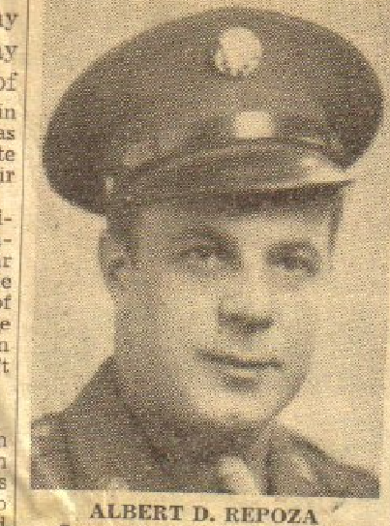
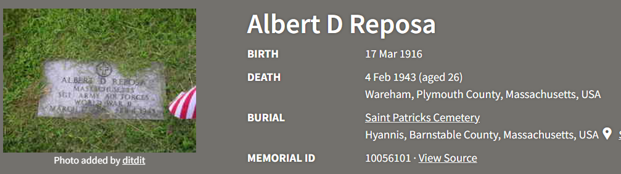
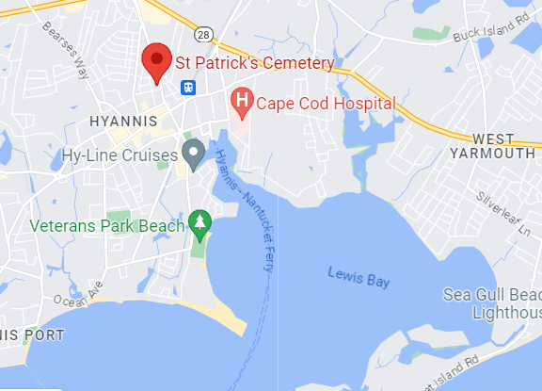
REPOSA:
Grave inscription: SGT Army Air Forces World War II
Family Members
Parents Manuel Duarte Reposa 1892–1926 Mary Julia Medeiros Reposa 1894–1971
Siblings Mary Sylvia Reposa Evans 1911–1960
Helen Lois Reposa Wiseman 1925–2005
Children Robert Albert Reposa 1935–1996

Slide 7
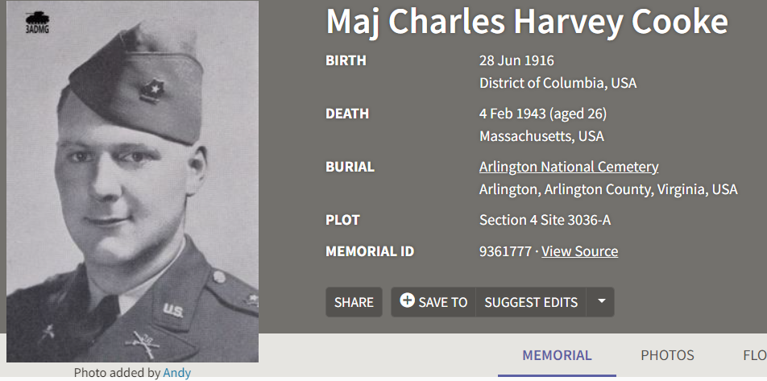
Source: www.findagrave.com/memorial/9361777/charles-harvey-cooke
MAJ US Army, 36th Armored Infantry, 3rd Armored Div He graduated from McKinley Tech High School, Washington, DC and University of MD, College Park, MD. He received his Army commission in February 1941. He died in a plane crash over Massachusetts on a flight that originated from Harrisburg, PA. He was predeceased by an infant brother, Robert Fisher Cooke. He was survived by his parents, Charles Henry Cooke and Bertha Gertrude Wright Cooke; his brother, John H Cooke; sister, Viola H Cooke; and his wife, Dorothy Millar Cooke. Interment on February 10, 1943.
Parents Charles Henry Cooke 1893–1955 Bertha Gertrude Wright Cooke 1894–1982
Siblings Robert Fisher Cooke 1921–1921

Slide 8
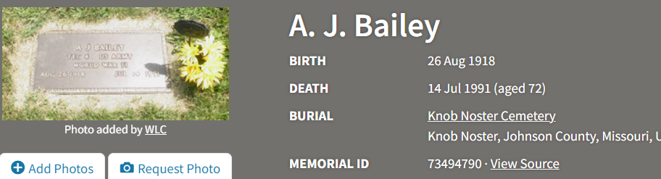
ROBINSON: Donald T. Robinson, Sergeant, Radio Operator – no matches found; however, his body was not recovered and so date of death and other details including even actual proof of death would be complicated “missing.”
BAILEY: Major Arnold J. Bailey; the only survivor, this may be him (USAF veteran same initials) but may not be.
Inscription: TCE 4 US ARMY WORLD WAR II
Family Members
Spouse Ruth E. Bailey 1919–1994
Children Patricia Ann Bailey 1940–1941

Slide 9

The Story of the Getrude H.

Slide 10
TulipTree Publishers, Colorado
•Single yacht captain, early 30’s killing time mid-summer in Newport RI, early 2000’s
•Call from another (lobster) captain, asking him to bail out ex-girlfriend, yacht in Aruba
•Project fails, waste of time, costing some money for yacht skipper
•August, Ted the lobster skipper, offers me, the yacht skipper, a big cash job 1 day fishing
•Long day 4.30 am – midnight, uneventful, usual oddball crew, sandwiches, loud rock
•On way into port I criticize the boat’s Gertrude H’s name, Ted tells me to quiet & listen
•c.1954 Fall storm from Nantucket to Newport, Margaret M. fled for shelter, ETA midnight on wide Second Beach

Slide 11
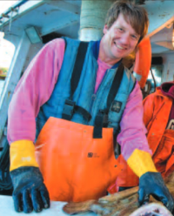

Slide 12
T H A N K Y O U ! !
Thanks to Jim Ignasher, New England Aviation History, Brian Blank, Mike Hudner, The de Ramel Foundation, Cameron Burrage Clark & others.
In memory of Larry Webster, finder of aircraft.
Books on Amazon & www.ericwiberg.com
Leads welcome at eric@ericwiberg.com

